Slide 1
Week 4: Fluid dynamics principles
Tally’s book, chapter 7

Slide 2
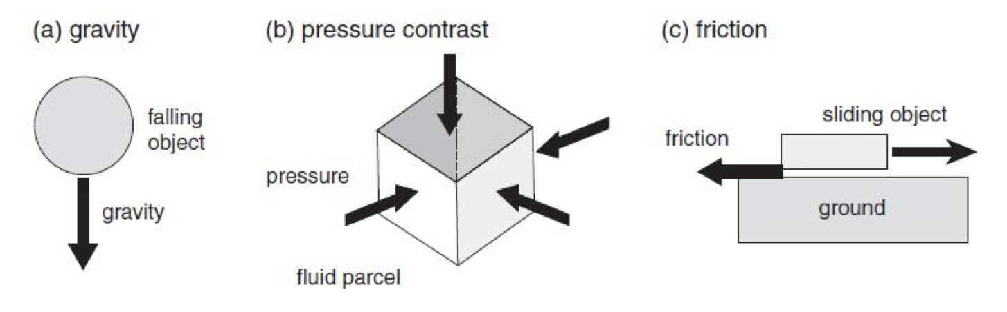
Balance of forces
Three types of forces we consider here:
And the effect of the rotation of the Earth
Centrifugal force
Coriolis force

Slide 3
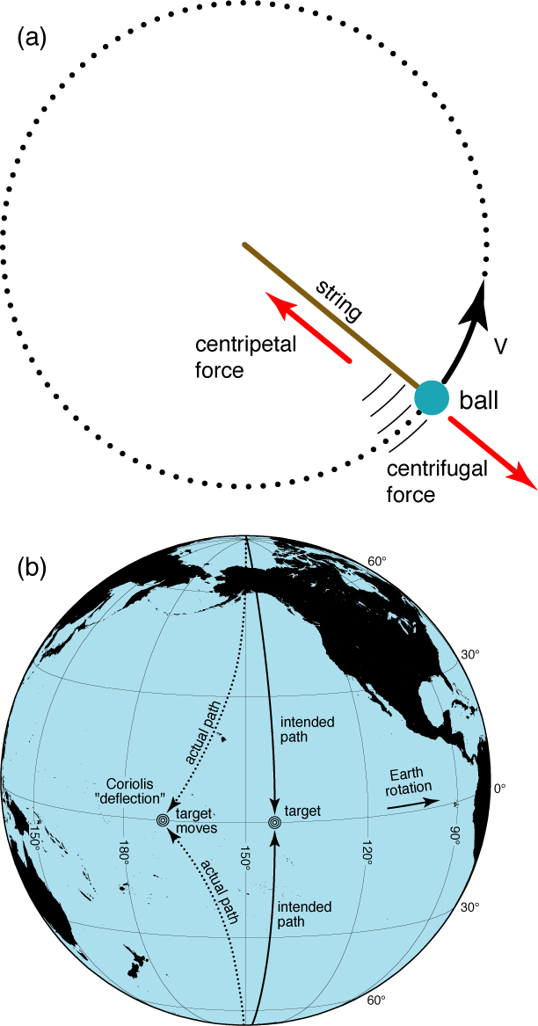
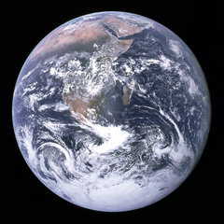
Rotating coordinates
Rotation vector that expresses direction of rotation and how fast it is rotating:
  vector pointing in direction of thumb using right-hand rule, curling fingers in direction of rotation
R
= angle/second ~ 10⁻⁴ (s⁻¹)

Slide 4
Frame of reference: mathematical expression
Inertial frame of reference (non-rotating) : subscript “in”
  Velocity in inertial frame: u_{in}
Rotating frame of reference : subscript “rot”
  Velocity in rotating frame: u_{in} = u_{rot} + (effect of rotation)

Slide 5
Parcel acceleration in the rotating frame
Apply the formula twice
Two forces
  Coriolis force depends on parcel velocity
  Centrifugal force depends on parcel position

Slide 6
Equation of motion in the rotating frame
Expression of the Centrifugal term
    where
    Radially outward (+r₀) w.r.t. the axis of rotation
    Φ_{ce} is called centrifugal potential

Slide 7
Local Cartesian coordinate
Local Cartesian (x,y,z), ignoring sphericity
West-east (“zonal”) = x – direction
  positive eastwards
South-north (“meridional”) = y-direction
  positive northwards
Down-up (“vertical”) = z-direction
  positive upwards
Notes:
Add diagram

Slide 8
Effective gravity
Can we combine gravitational and centrifugal force?
Both of them are characterized by potentials (Φ), thus can be combined together
Combined gravitational and centrifugal potential

Slide 9
Rotation vector in local Cartesian coordinate
The rotation vector projects onto meridional (y, north-south) and vertical (z) directions
Vertical coordinate is defined in the direction of effective gravity
Notes:
Stop

Slide 10
Coriolis force
In local Cartesian coordinate, the Coriolis force depends on the horizontal speed (u,v) and the Coriolis parameter (f=2Ωsinθ).

Slide 11
Equation of motion in local Cartesian coordinate
In x-, y-, z- components

Slide 12
Equation of motion in local Cartesian coordinate
Coriolis force

Slide 13
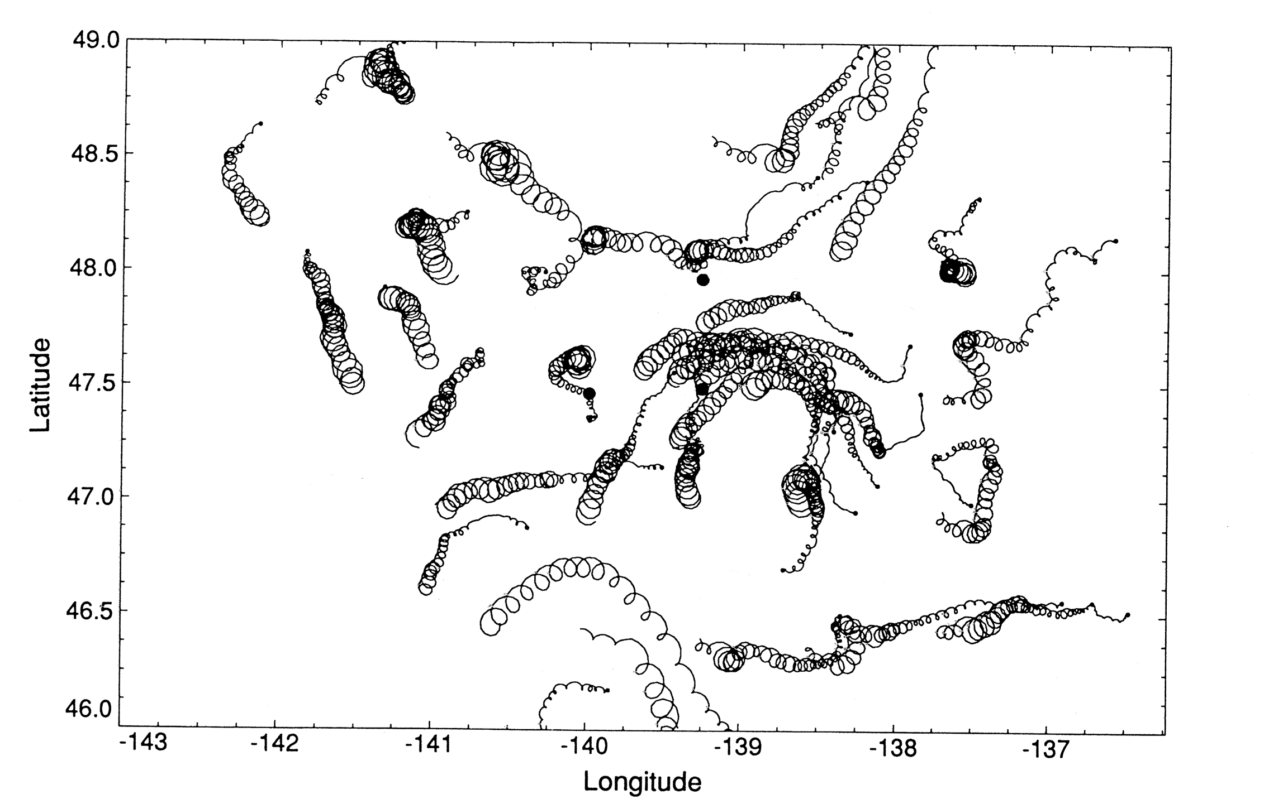
Coriolis in action in the ocean: Observations of Inertial Currents
D’Asaro et al. (1995)
DPO Fig. 7.4
Surface drifters in the Gulf of Alaska during and after a storm.
Note the corkscrews - drifters start off with clockwise motion, which gets weaker as the motion is damped (friction)

Slide 14
Inertial oscillation
Balance between local acceleration and Coriolis force
Solving this equation results in oscillatory solution with the Coriolis frequency ➔ Inertial oscillation

Slide 15
Equation of motion in local Cartesian coordinate
Pressure gradient force

Slide 16
Equation of motion in local Cartesian coordinate
Effective gravity (gravity + centrifugal force)

Slide 17
Equation of motion in local Cartesian coordinate
Hydrostatic balance (gravity = pressure force)

Slide 18
Primitive equation
Equation of motion: 3 coupled partial differential equations for (u,v,w) with 5 unknows (u, v, w, P, ρ)
  More equations are needed to determine the solution
Conservation of mass (continuity equation)
Equation of state ρ = ρ(S,T,P)
  Density depends on salinity and temperature
  Conservation of heat (pot. Temperature)
  Conservation of salinity
Total of 6 coupled non-linear PDEs and the equation of state: very difficult to solve and understand, so we attempt to derive simplified equations for approximate solutions

Slide 19
Geostrophic balance
Geostrophic balance : Coriolis and Pressure gradient
X (east-west)
Y (north-south)
Z (vertical)

Slide 20
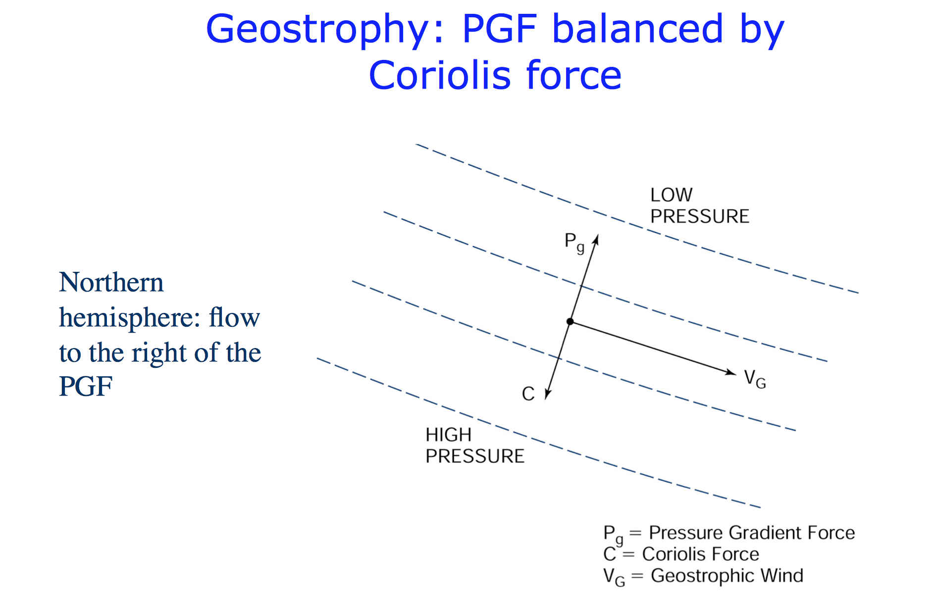

Slide 21
What controls the pressure gradient force?
Hydrostatic pressure

Slide 22
What controls the pressure gradient force?
Hydrostatic pressure
Sea surface height can change in x and y

Slide 23
What controls the pressure gradient force?
Hydrostatic pressure
Sea surface height can change in x and y
Density can change in x and y (and z)

Slide 24
Observing the ocean’s geostrophic current
What we want: current speed and direction
Required observation: pressure gradient
  Before 1990s, it was impossible to determine the spatial distribution of sea surface height accurate enough for the geostrophic calculation
  Density (T, S, P) measurements were available and used to estimate geostrophic currents
  Satellite altimeter (since 1990s) can determine sea level height with an accuracy within a few cm

Slide 25
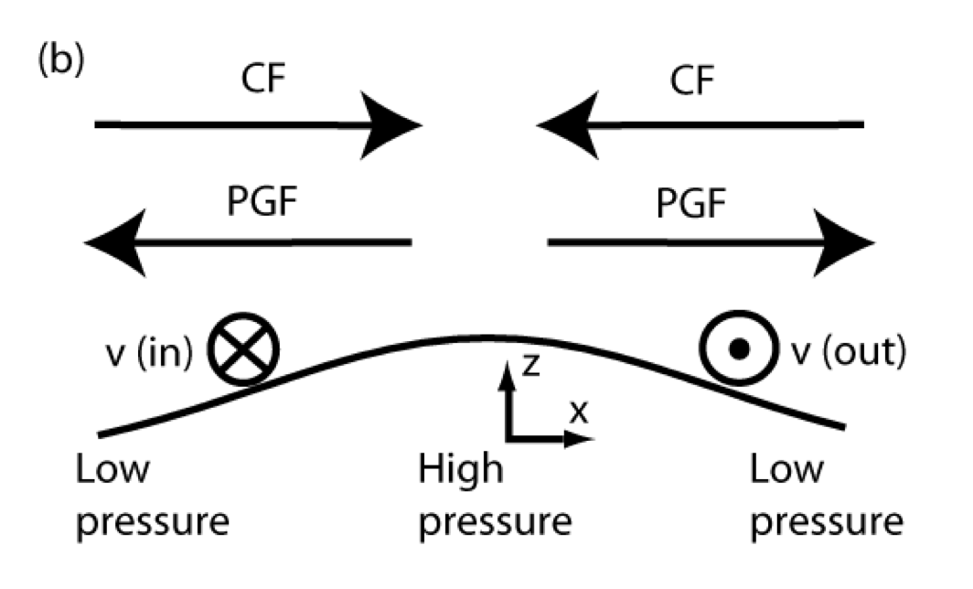
Pressure gradient due to SSH gradient
ps : a constant surface atmospheric pressure (Nm⁻²)
η: sea surface height or SSH (m)

Slide 26
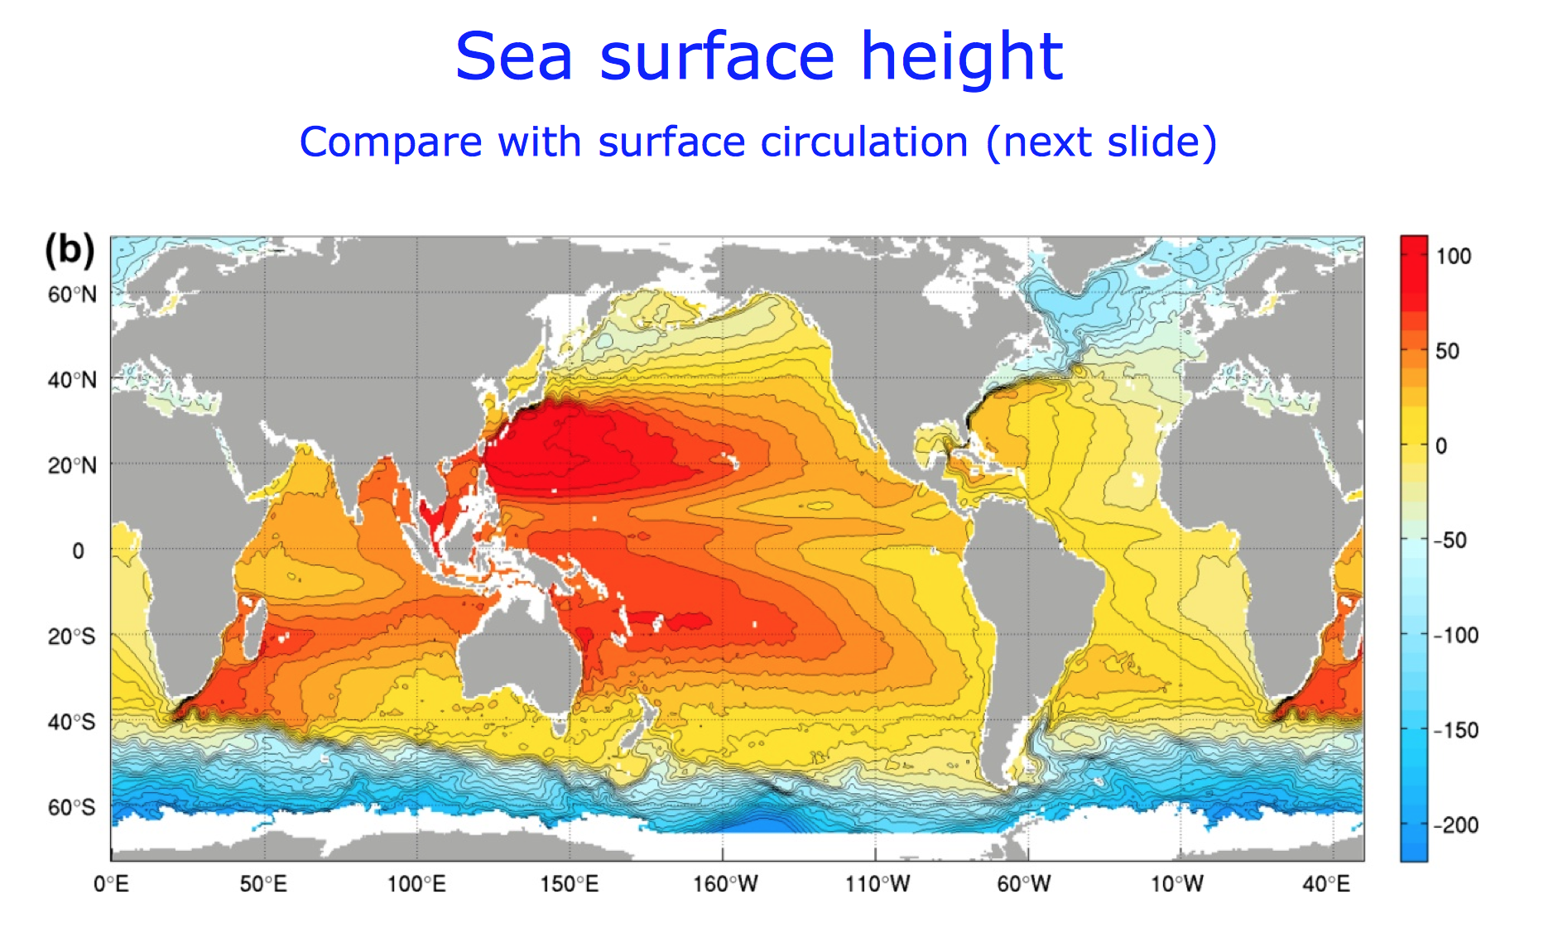

Slide 27
Notes:
Ended here Tuesday

Slide 28
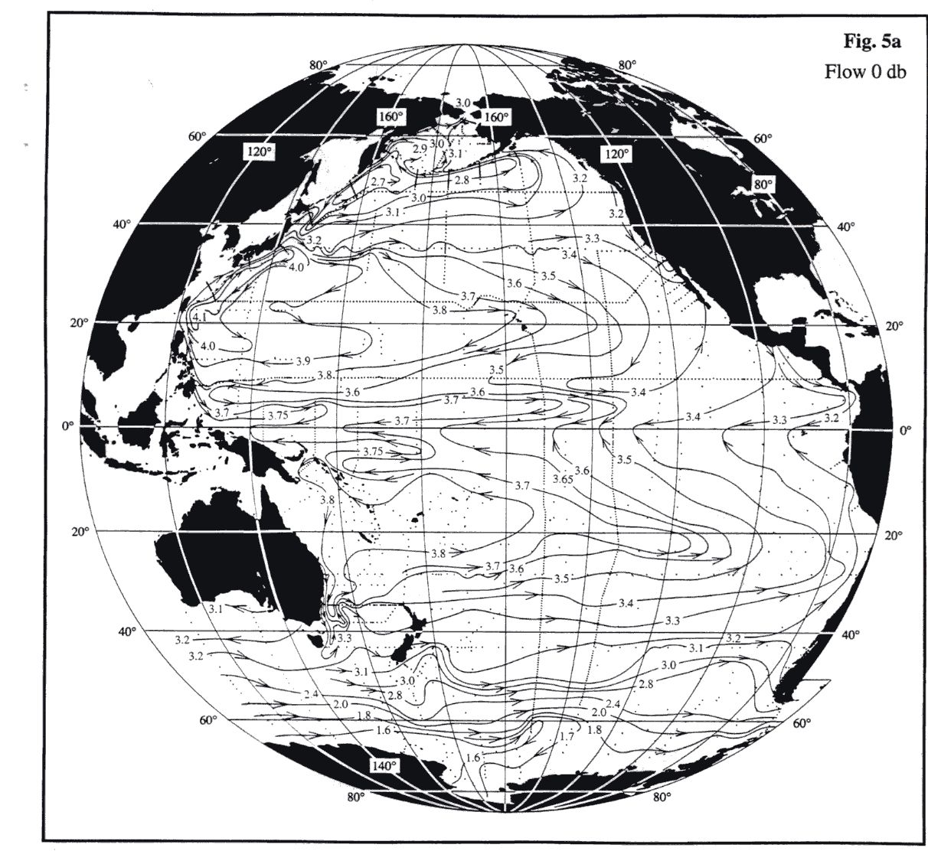
Example from ocean of geostrophic flow
Surface height/pressure and surface geostrophic circulation
Circulation is counterclockwise around the Low (cyclonic) and clockwise around the High (anticyclonic).
(northern hemisphere)
Southern Hem:
Cyclonic is clockwise, etc..
Reid, 1997
LOW
LOW
HIGH
LOW
LOW
HIGH
LOW
LOW

Slide 29
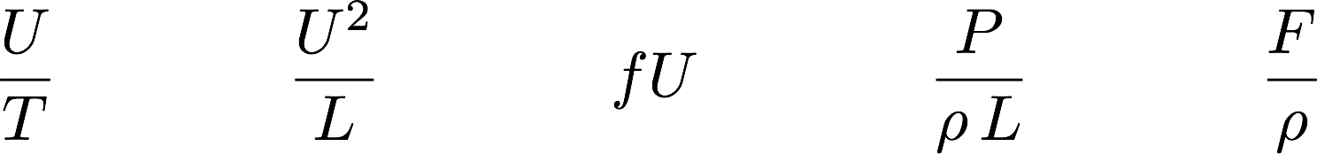
Geostrophic approximation
Under what condition can we assume geostrophic balance?
The equation of motion: estimate the magnitude of each term
U: velocity scale, T: time scale, L: length scale, ρ: density scale, P: pressure scale, F: friction scale

Slide 30
Geostrophic approximation
Estimate the magnitude of each term
Non-dimensionalize : normalize every term by fU

Slide 31
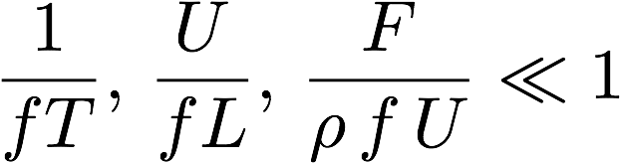
Geostrophic approximation
Estimate the magnitude of each term
Non-dimensionalize : normalize every term by fU
Geostrophic approximation assumes slow, large-scale circulation and weak friction

Slide 32
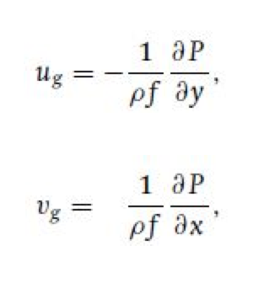
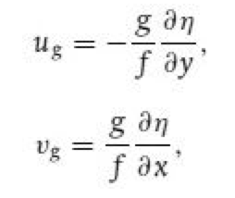
Expression of geostrophic flow using SSH
Given the spatial pattern of SSH field, we can calculate the geostrophic flow in the ocean

Slide 33
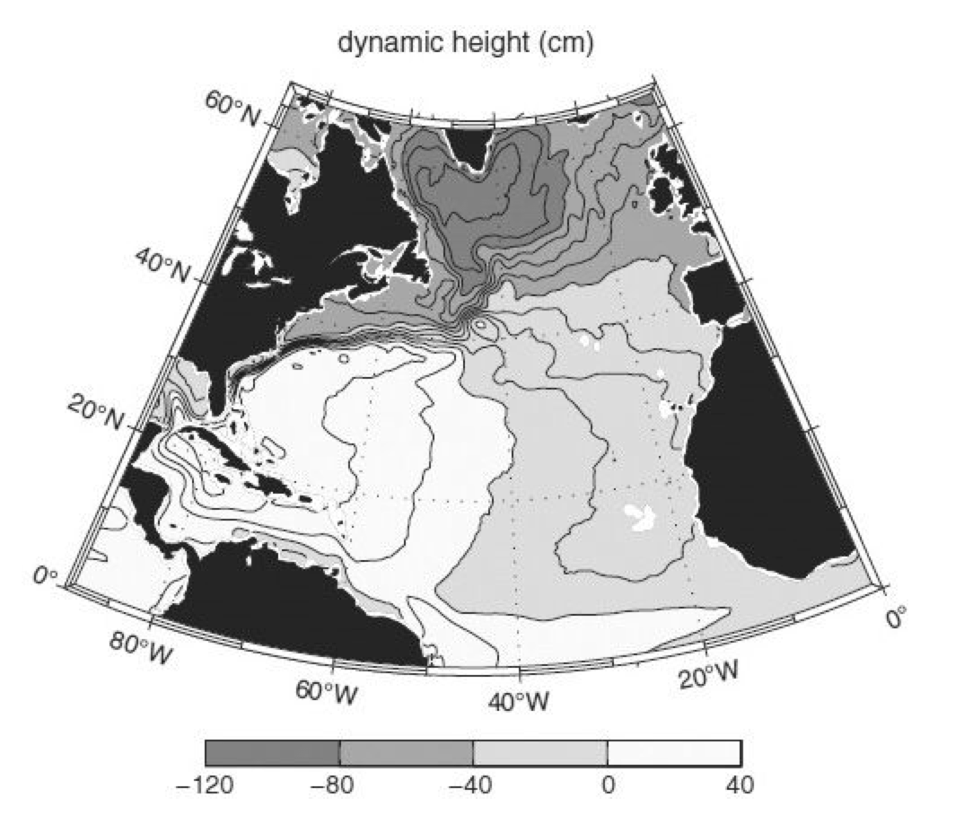
Satellite SSH in the North Atlantic

Slide 34
Calculating geostrophic current
What is the direction and speed of the geostrophic current with this SSH gradient at 30N (consider Gulf Stream) ?

Slide 35
Calculating geostrophic current
What is the direction and speed of the geostrophic current with this SSH gradient at 30N?

Slide 36
Calculating geostrophic current
What is the direction and speed of the geostrophic current with this SSH gradient at 30N?

Slide 37
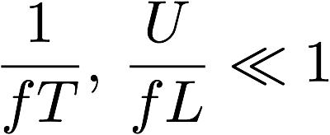
Rossby number
Conditions for geostrophic balance
Rossby number:
From the Gulf Stream example:
U = 0.7 (m/s)
f = 0.7 x 10⁻⁴ (1/s)
L = 200km = 2 x 10⁵ (m)

Slide 38
Cyclonic and anti-cyclonic
Cyclonic = Rotating in the direction of the planetary rotation
(CCW in the NH and CW in the SH)
Anti-Cyclonic = Opposite of cyclonic
Then, geostrophic flow around low pressure is cyclonic in both northern and southern hemispheres.
Geostrophic flow around low pressure = Cyclonic
Geostrophic flow around high pressure = Anti-Cyclonic

Slide 39
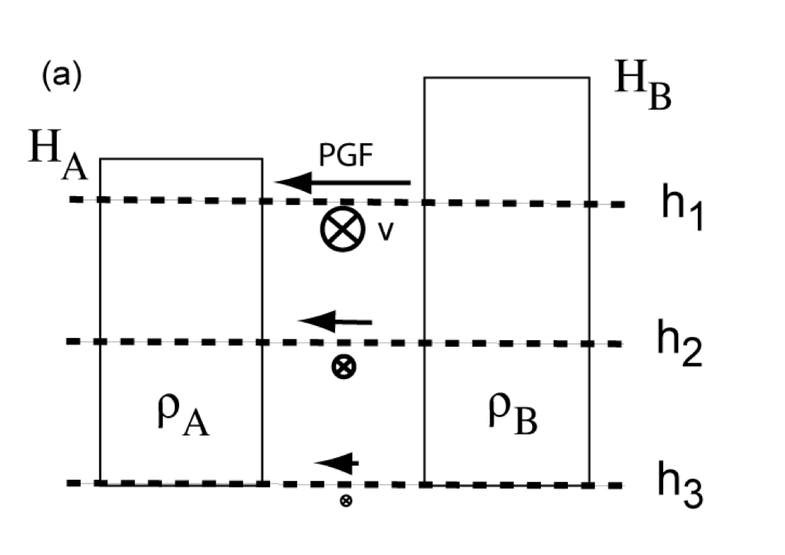
Density and pressure gradient
Water column with two different densities
ρ_{A} > ρ_{B}
At the surface the less dense water has higher sea surface height → Steric sea level
The pressure gradient gets smaller with depth

Slide 40
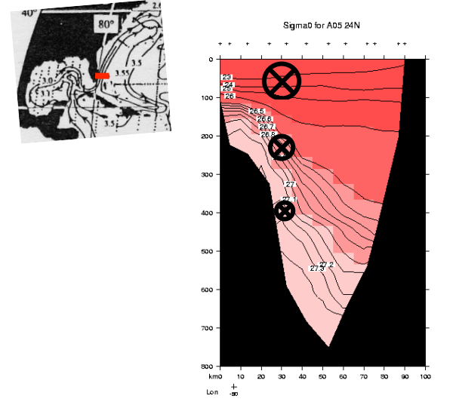
Observed density profile across the Florida Strait

Slide 41
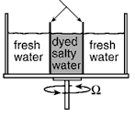
A tank experiment
Objective: illustrate the flow under a density gradient and rapid rotation
Initially, metal container separates dyed salty (dense) water from the surrounding freshwater (less dense)
After the tank is in solid body rotation, the container is removed.
What will happen?

Slide 42
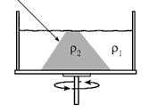
Evolution of circulation and isopycnal tilt
Gravity pull down the dense water downward
  Convergence at the top, divergence at the bottom
Coriolis effect defects the horizontal motion, the circulation starts to spin around the dense water

Slide 43
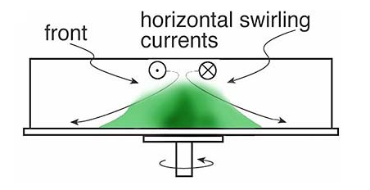
Isopycnal tilt and geostrophic circulation
“Thermal wind balance” = Coriolis force balancing the buoyancy force acting on the tilted isopycnal surface

Slide 44
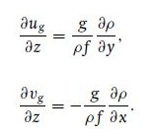
Thermal wind balance
Assume geostrophy in horizontal, and hydrostatic balance in vertical
Eliminate pressure
If we measure ρ(x,y,z) and the value of u and v at a given depth, we can calculate the geostrophic velocity

Slide 45
Thermal wind balance and geostrophic currents
The PGF is calculated as the difference of pressure between two stations at a given depth (relative to the geoid).
If the velocity is known at a given depth, then the PGF at that depth is also known (from geostrophy).
b) From the measured density profiles at the two stations, we can calculate how the velocity change with depth.
c) Using the known velocity from (a), which we call the reference velocity, and knowing how velocity changes with depth from (b), we can compute velocity at every depth.
c-alt) If a reference velocity is NOT available, assume deep water is not moving, approximating the reference velocity to be 0 (at arbitrarily set depth in the abyss = level of no motion).
Notes:
Got to here 11/7

Slide 46
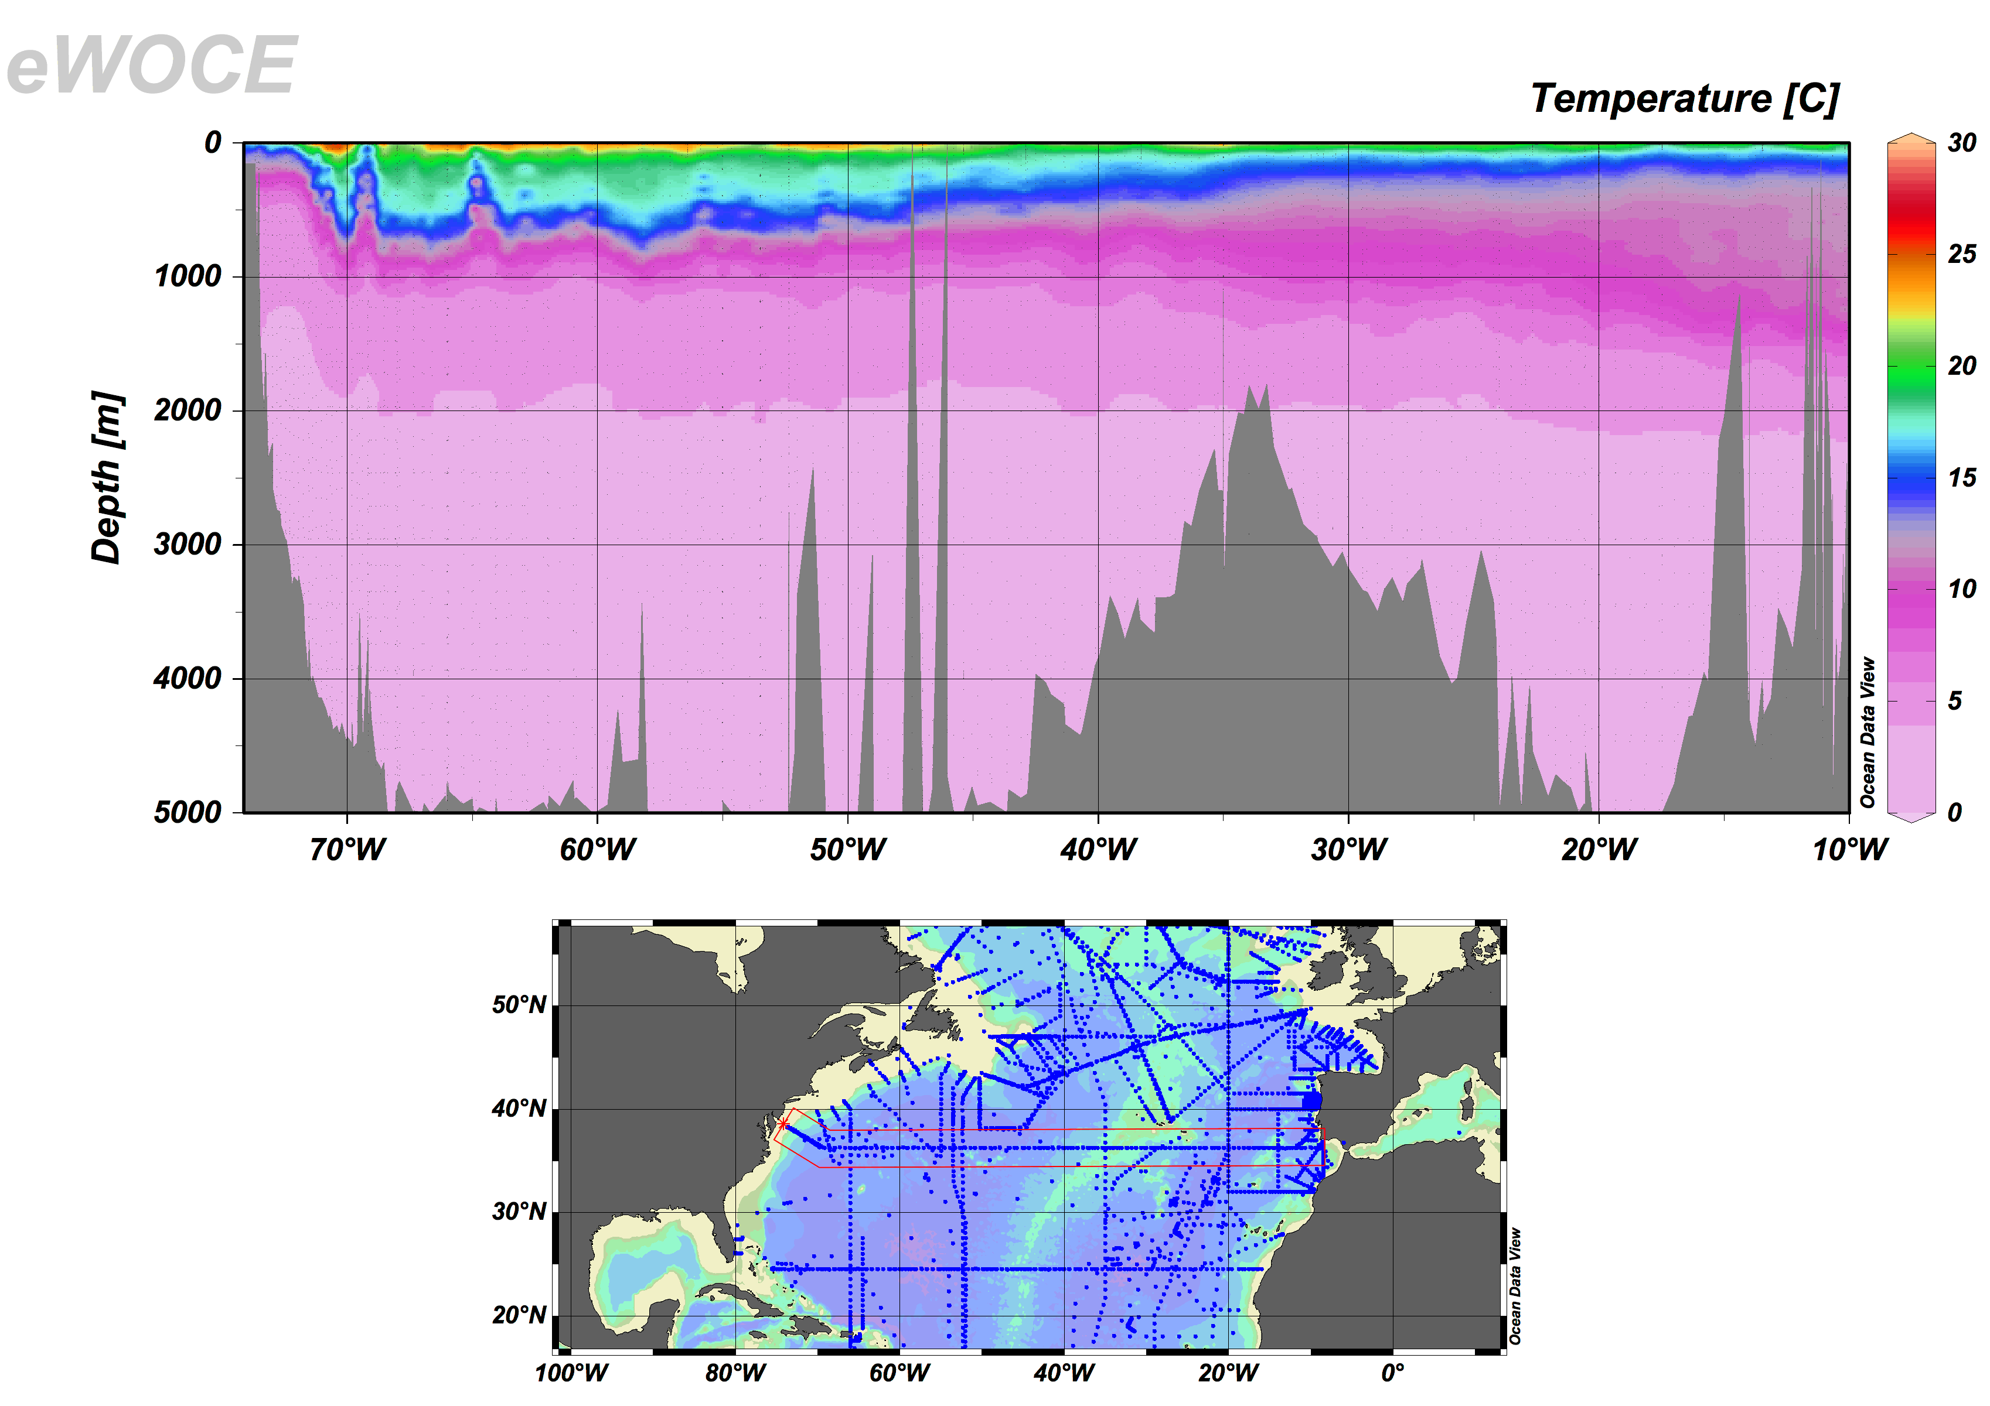
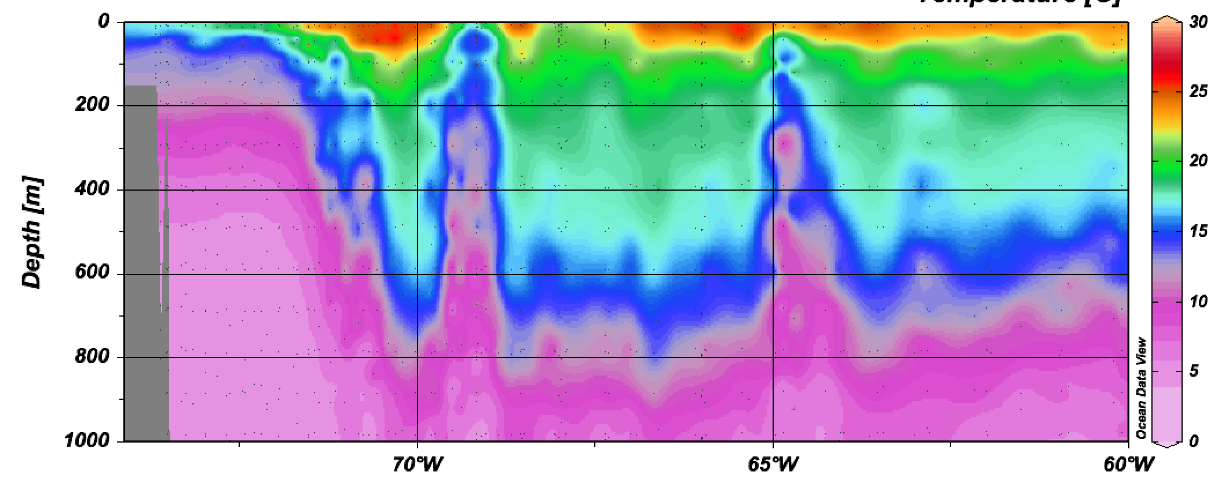
Observed isopycnal tilt in the Gulf Stream

Slide 47
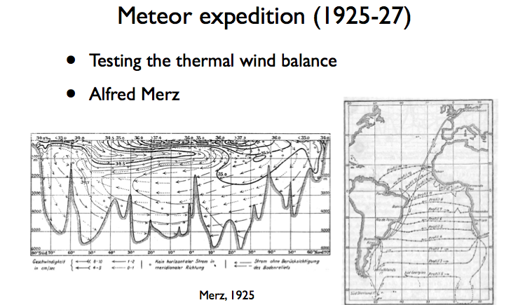

Slide 48
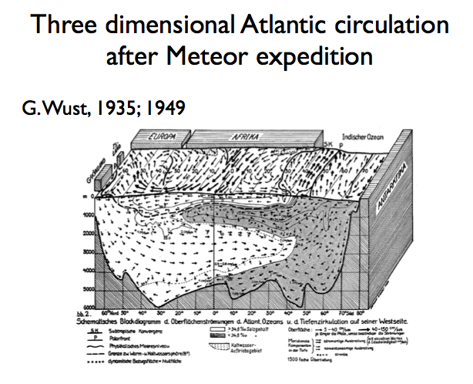

Slide 49
Summary: week 4
Geostrophic balance
  Balance between Coriolis force and Pressure Gradient Force
  Assume: frictionless and small Rossby number (slow speed, large-scale)
  YOU WANT: Horizontal current speed and direction
  YOU NEED: Horizontal pressure gradient at constant depth
  AVAILABLE MEASUREMENT:
    Density (T and S)
    Satellite SSH (after 1992)

Slide 50
Summary: week 4
Geostrophic balance
  Cyclonic circulation (CCW in NH) around the low pressure
  Anticyclonic circulation (CW in NH) around the high pressure
  Ocean heat content → Steric sea level
    SSH is higher for the warmer water column → Anti-cyclonic flow in subtropics
    SSH is lower for the colder water column → Cyclonic flow in subpolar region

Slide 51
Summary: week 4
Estimating large-scale ocean currents
  AVAILABLE MEASUREMENT:
    Density (T and S)
  Thermal wind balance + level of no motion
    Assume that the deep ocean is motionless (u=v=0 in the deep ocean, say z=2,000m), vertically integrate the thermal wind (∂u/∂z and ∂v/∂z) vertically.
  Thermal wind balance + level of known motion (preferred)
    Obtain velocity at one depth from independent measurement, and then vertically integrate the thermal wind from the known velocity.

