Slide 1
Week 2 : Large-scale ocean properties
Tally’s book chapter 4

Slide 2
Review: salinity
What’s the definition of salinity?
  Mass of salt (g) dissolved in a unit mass of seawater (kg).
What are the experimental methods to measure salinity?
  Temperature and Conductivity (as in CTD instrument)
What’s the meaning of the law of equal proportions?
  Concentrations of dissolved constituents vary in equal proportion to salinity.

Slide 3
Review question: temperature/pressure
What’s the difference between temperature and potential temperature?
  Potential temperature (θ) accounts for the compressibility of the seawater, and it measures the temperature of water if it were adiabatically raised to the surface.
What are names of the three major regions in the (vertical) water column?
  Mixed layer, thermocline, and deep ocean

Slide 4
Term project
Due Sept. 13th (Thu): Topic, objectives and questions
Example1: Atlantic meridional overturning circulation
  Objective: This term paper will summarize the recent progress and current knowledge gaps in our understanding about the Atlantic Meridional Overturning Circulation (AMOC).
  Scientific questions: What is AMOC? Why is it important? How do we measure the magnitude of AMOC? What are the recent changes in AMOC? What do we know about its past change from paleoclimate proxies? What are the climate model projections of AMOC in this and coming centuries?
Example 2: Topic: Sea level rise
  Objective: This project will summarize the current status of knowledge about the sea level change?
  Questions: What earth processes control the sea level? Why is it important? What are the timescales associated with different mechanisms? What are the effects of climate warming on the sea level? What are the relative importance between the melting polar ice caps and thermal expansion?
Email Daoxun (sdxmonkey@gatech.edu): the topic, objective(s) and questions that define the goals of your term paper.
What’s next: draft an outline with bibliography

Slide 5
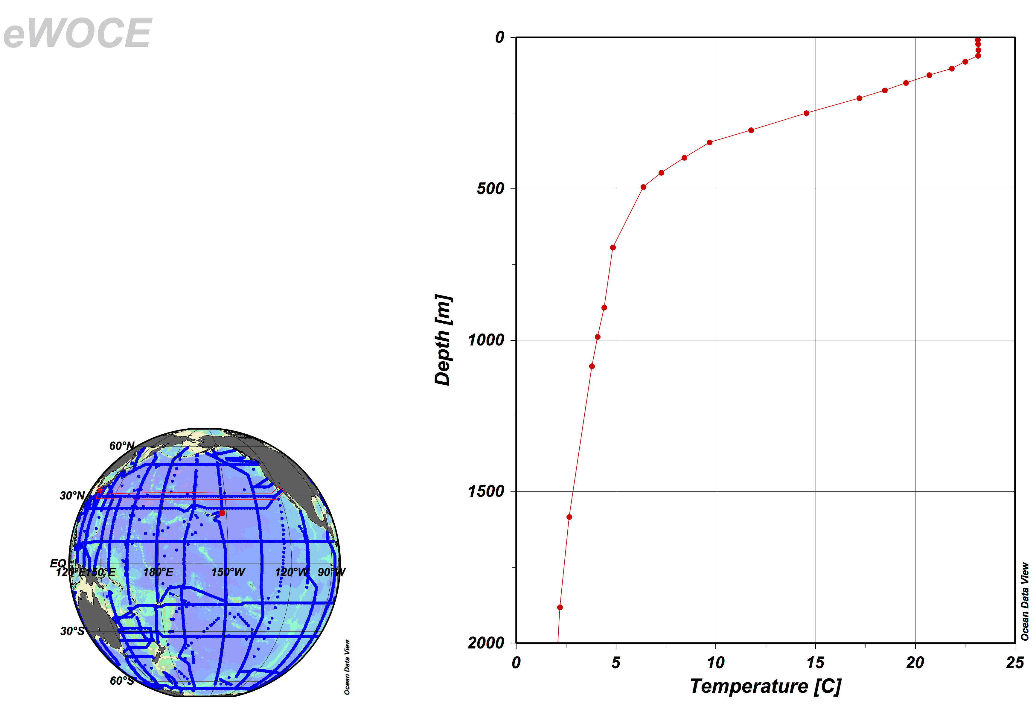
Three zones
Mixed layer
Thermocline
Deep ocean

Slide 6
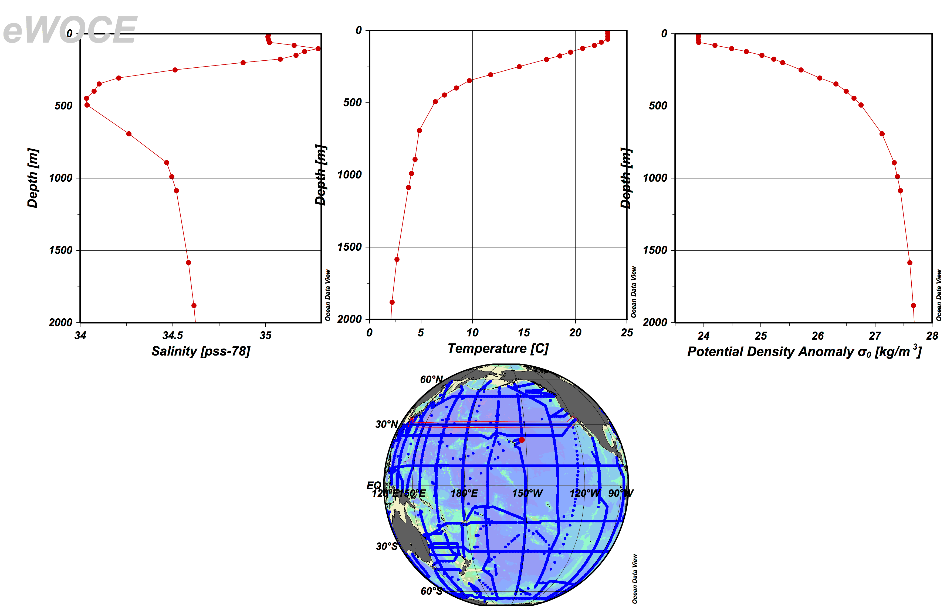
Halocline, Thermocline, Pycnocline

Slide 7
Potential density
  Adiabatic compression has 2 effects on density:
  Changes temperature (increases it)
  Mechanically compresses so that molecules are closer together (density increases)
  We are usually NOT interested in this purely compressional effect on density. We wish to trace water as it moves into the ocean. Assuming its movement is adiabatic (no sources of density, no mixing), then it follows surfaces that we should be able to define. This is actually very subtle because density depends on both temperature and salinity.

Slide 8
Potential density
  Sigma-t: This outdated (DO NOT USE THIS) density parameter is based on temperature and a pressure of 0 dbar
  σ_{t} = σ(S, T, 0)
  Potential density: reference the density σ (S, T, p) to a specific pressure, such as at the sea surface, or at 1000 dbar, or 4000 dbar, etc.
  σ_{θ} = σ₀ = σ(S, θ, 0)
  σ₁ = σ(S, θ₁, 1000)
  …..
  σ₄ = σ(S, θ₄, 4000)

Slide 9
How to calculate potential density
  Potential density: reference the density σ (S, T, p) to a specific pressure, such as at the sea surface, or at 1000 dbar, or 4000 dbar, etc.
  First compute the potential temperature AT THE CHOSEN REFERENCE PRESSURE
  Second compute density using that potential temperature and the observed salinity at that reference pressure.
  σ_{θ} = σ₀ = σ(S, θ, 0)
  σ₁ = σ(S, θ₁, 1000)
  …..
  σ₄ = σ(S, θ₄, 4000)

Slide 10
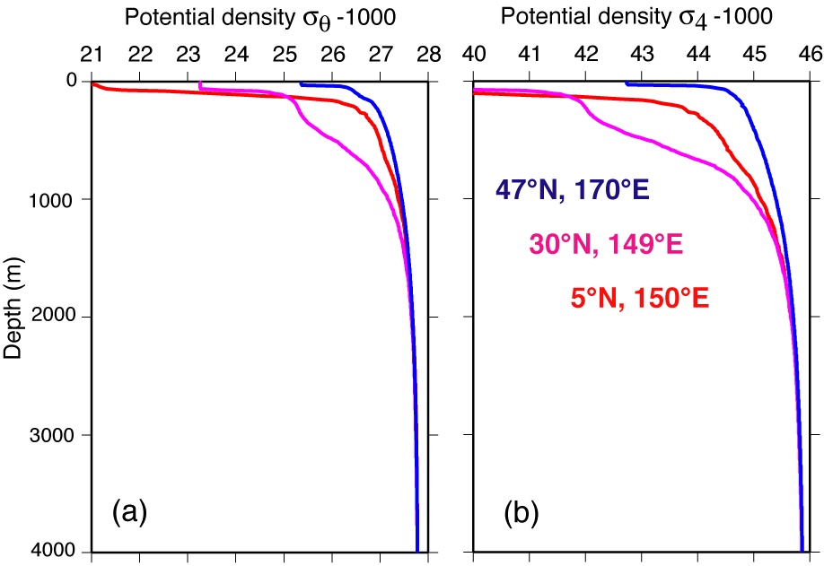
Potential density profiles (σ_{θ} & σ₄)
DPO Figure 4.17

Slide 11
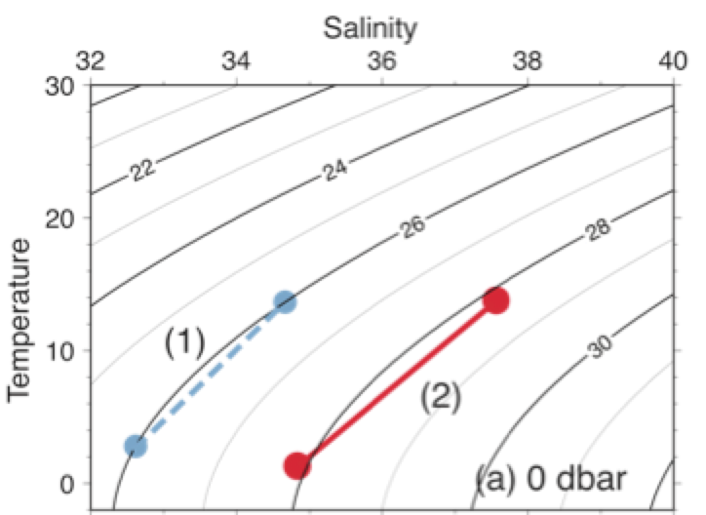
The T-S diagram
Plot salinity on x-axis and (potential) temperature on the y-axis.
The line of constant density forms a contour line.
Assume you have two water mass with distinct (T,S) properties and you mix the two types of waters. The product of mixing is expected stay on the straight line in the T-S diagram.
→ Conservative tracer

Slide 12
Conservative or non-conservative?
Non-conservative properties are not conserved following the circulation in the interior (subsurface) ocean
  Nutrients, oxygen, carbon (biological sources/sinks)
  Temperature
  Density
Conservative properties
  Salinity
  Potential temperature
  Potential density

Slide 13
An important nonlinearity for the EOS
Cold water is more compressible than warm water (thermobaricity)
At cold temperature, density is more sensitive to salinity variation.
Density contour in T-S space has curvature. (see next slide). This curvature becomes flatter at higher pressure.

Slide 14
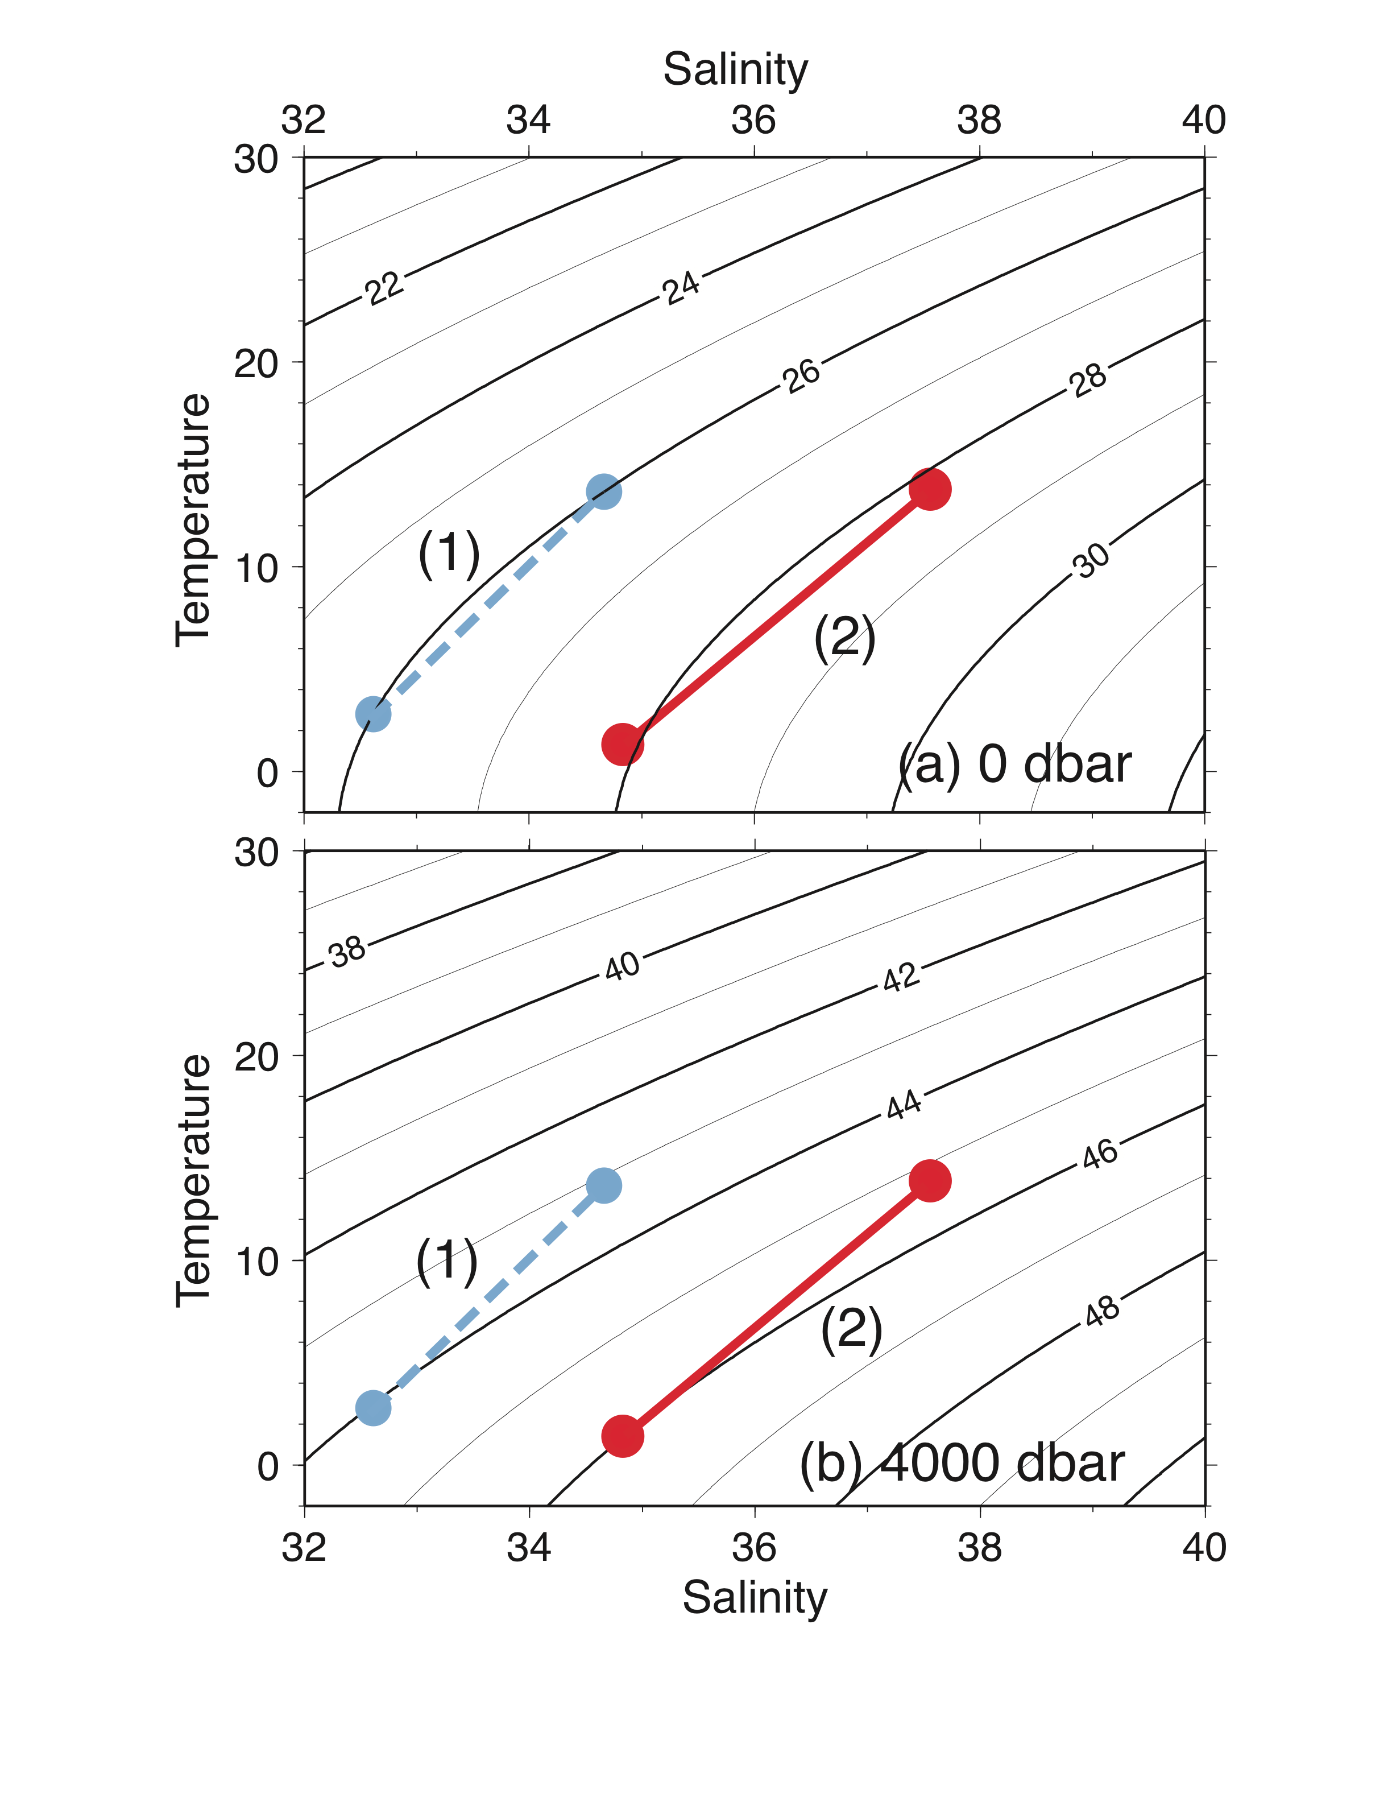
Potential density relative to 0 dbar and 4000 dbar
Cabbeling: Mixture of 2 different (compensating T,S) waters with the same density can lead to a different density
Thermobaricity: The density contours are flatter at 4000dbar. The combination of (S,T) having equal density at surface (0 dbar) will have different density at depth.
DPO Figure 3.5

Slide 15
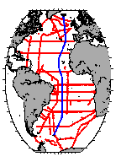
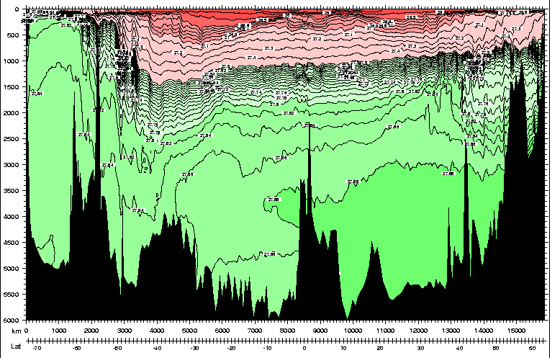
Atlantic section of potential density referenced to 0 dbar (σ_{θ} )
Note deep potential density inversion - need to use deeper reference pressures to show vertical stability

Slide 16
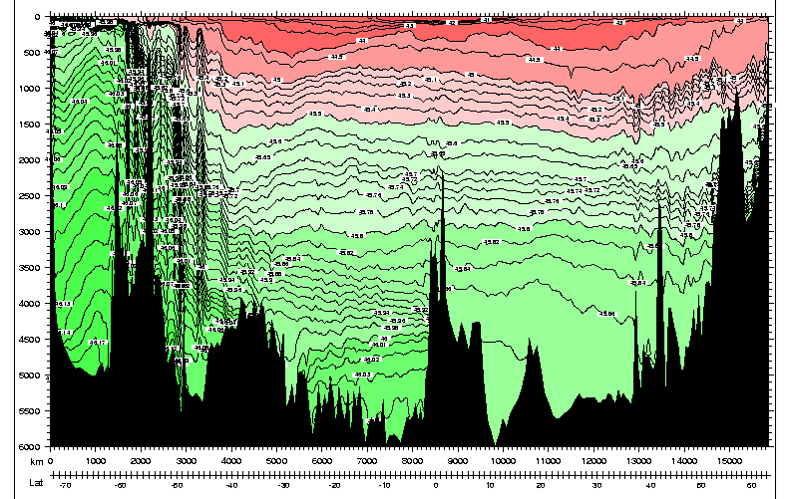
Atlantic section of potential density referenced to 4000 dbar: σ₄
Potential density σ_{θ} inversion vanishes with use of deeper reference (σ₄ ): in fact, extremely stable!!
Notes:
Do the experiment with salt water stratification

Slide 17
Neutral density γ^{n}
To follow a water parcel as it travels down and up through the ocean:
Must change reference pressure as it changes its depth, in practical terms every 1000 dbar
Neutral density provides a continuous representation of this changing reference pressure. (Jackett and McDougall, 1997)
Isopycnal = Surfaces of constant potential density (σ_{θ}, σ₁, σ₂, …)
Isoneutral = Surfaces of constant neutral density (γ_{n})

Slide 18
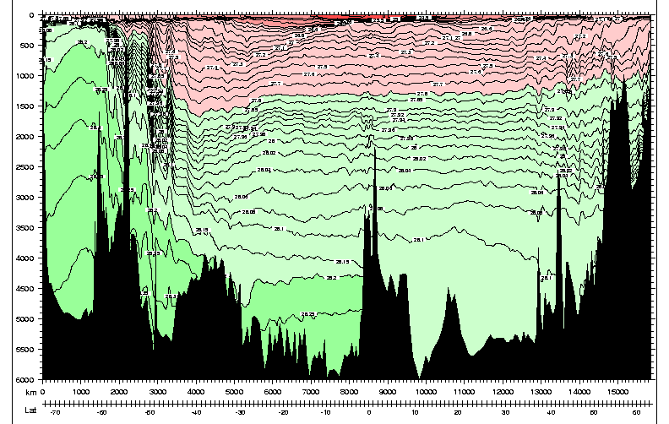
Atlantic section of “neutral density”: γ^{n}

Slide 19
Isopycnal analysis: track water parcels through the ocean
Seawater move mostly adiabatically (isentropically). Mixing with parcels of the same density is much easier than with parcels of different density because of ocean stratification
Use isopycnal (surface of constant potential density) surfaces to evaluate the transport of tracer properties (S, chemical tracers…)

Slide 20
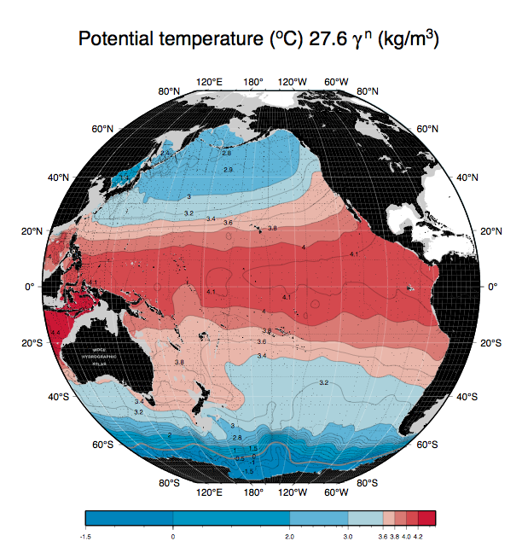
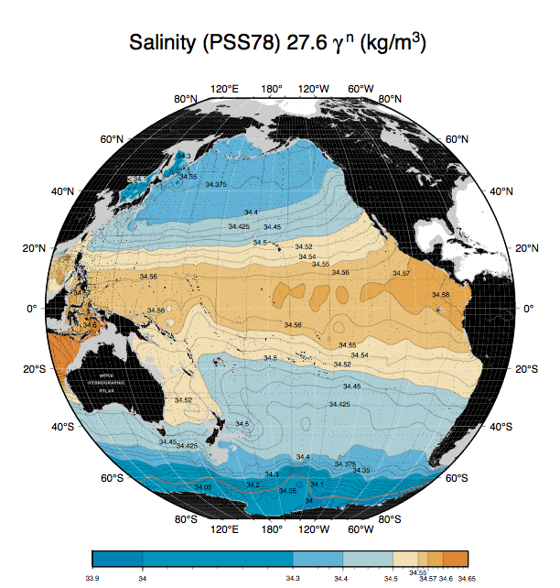
Deep isopycnal surface in the Pacific Ocean
Potential temp. Salinity
WHP Pacific Atlas (Talley, 2007)

Slide 21
Ocean stratification and water masses
Ocean is stratified → potential density increases with depth.
The potential density can become a vertical coordinate. The advantage of using density coordinate is that the sea water tends to mix with waters that have the same density. The oceans can be viewed as stratified layers of density surfaces that has distinct physical and chemical properties, often originating from different formation regions → such body of waters are called “water mass(es)”.

Slide 22
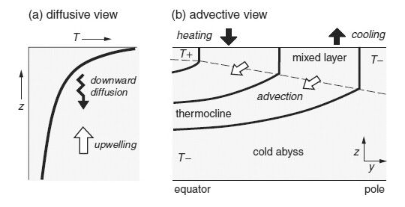
What controls the stratification?

Slide 23
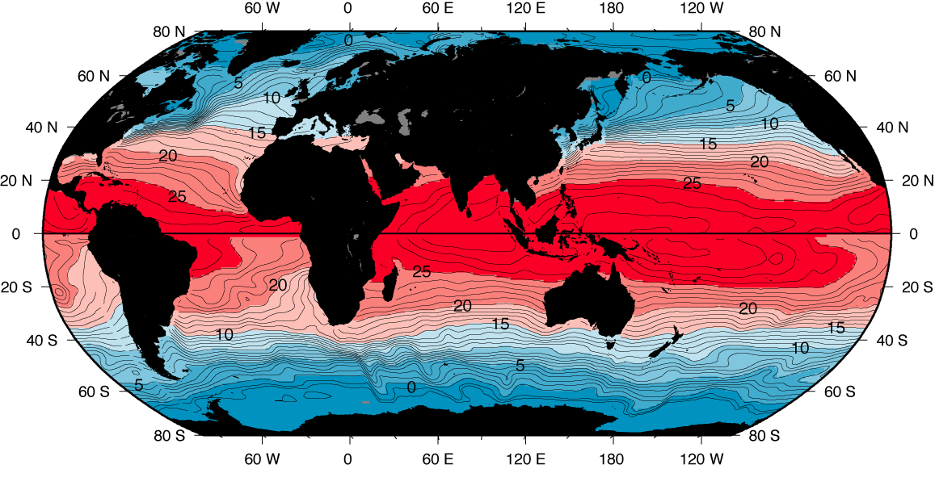
Surface temperature: note where the 4°C isotherm occurs (most ocean volume is colder than this)
DPO Figure 4.1: Winter data from Levitus and Boyer (1994)

Slide 24
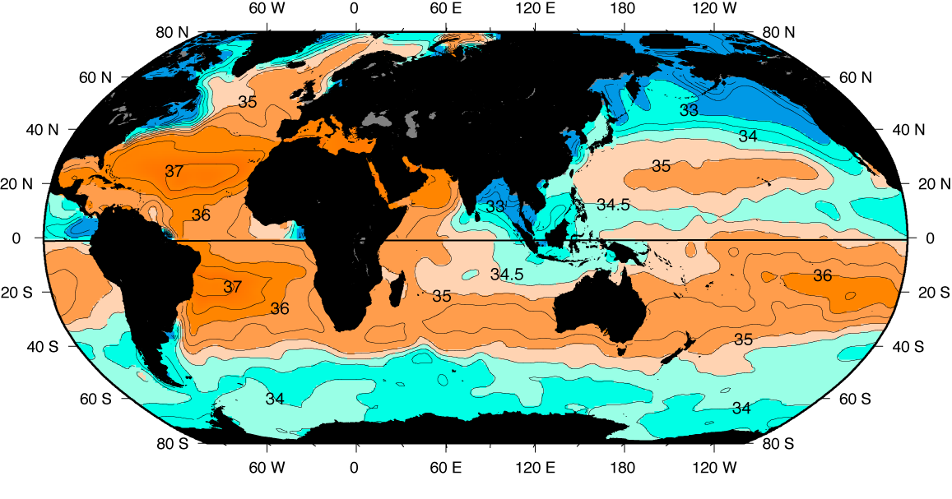
Surface salinity
Surface salinity (psu) in winter (January, February, and March north of the equator; July, August, and September south of the equator) based on averaged (climatological) data from Levitus et al. (1994b).
DPO Fig. 4.15

Slide 25
Surface density (winter)
Surface density σ_{θ} (kg m^{–3}) in winter (January, February, and March north of the equator; July,
August, and September south of the equator) based on averaged (climatological) data from Levitus
and Boyer (1994) and Levitus et al. (1994b).
DPO Figure 4.19

Slide 26
Review question
How much pressure increase do you expect for a 1m depth increase?
What controls the density of the seawater?
What is the temperature of the densest water with S=0 and S=35 at the surface pressure?

Slide 27
Review questions
What happens to the melting point of ice under high pressure?
What causes the ”brine rejection”?
What are the impacts of brine rejection on the deep circulation?

Slide 28
Measuring seaice thickness from space
Summertime Arctic seaice has been declining, documented by the satellite imagery since late 1970s
But, knowing the seaice extent is not enough to determine the mass balance.
Thickness change is crucial for the calculation of total ice loss.
Before 2000s, some observations exist from the Navy’s submarine data.
After 2003, satellite radar altimetry provides seaice thickness estimates (ERS-1, ICEsat, CryoSat-2)

Slide 29
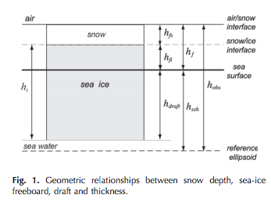
Measuring seaice thickness from space
Kwok (2010) J. Glaciology
Radar altimeter can measure the height of the sea surface, and freeboard ice height. Isostatic calculation will give the total thickness of the seaice.
A major source of uncertainty is the thickness of the snow layer on top of the seaice.

Slide 30
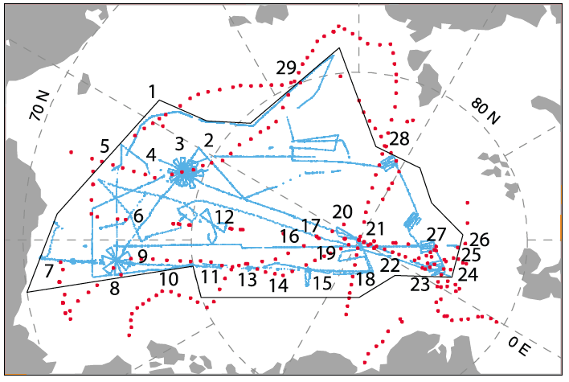
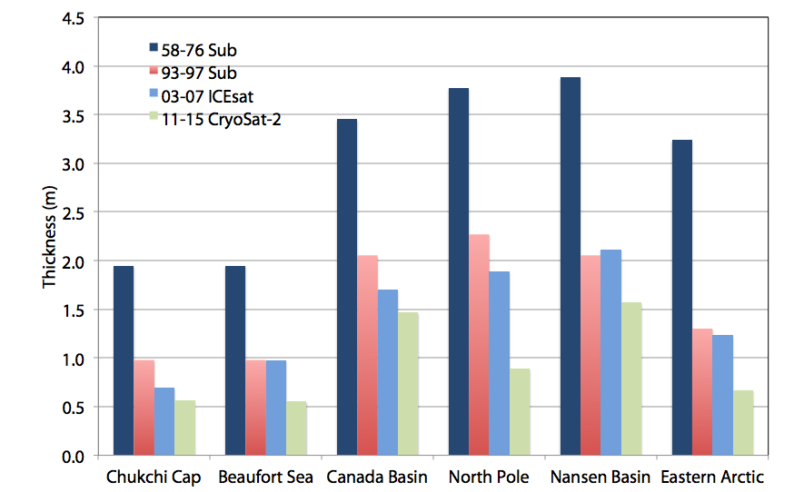
Thinning of Arctic seaice
Chukchi
Nansen
Eastern Arctic
September
Beaufort
Canada Basin
North Pole
R. Kwok, 2017
Notes:
This is a sampling of the changes in H in five regions
This is a combination of sub data from the late fifites to lat nineties an different period to ICEsat in the 2000s and CS-2 isince 2011
The sub is from ULS data from US Navy submaries, and the satellite derived ice thickness is from altimetry
This is September data at the end of summer, so near the thinnest part of the seasonal cycle
Thickness is M\more than 2 to 3.5 m in the early sub cruises
Thinning almost everywhere of a meter to 1.5 m , 1.5 m is about my hight loss of more than 50% of the ice thickness since the late fities

Slide 31
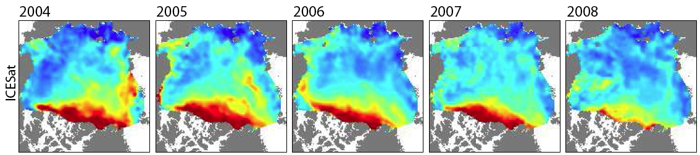
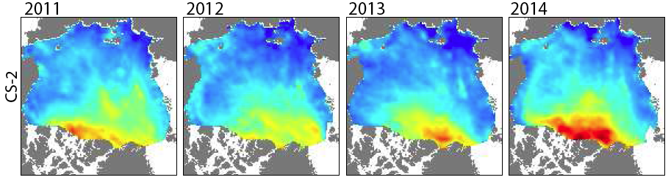

Decline of Arctic sea ice volume
End-of-winter
ICESat
CryoSat-2
Volume (km³)
Winter
Summer
Kwok and Cunningham (2015)
Notes:
From satellite mapping of ice thickness we capture the spatil distribution of ice thickness as well as
Total ice volume inside the arctic basin
Heat and freshwater storage
Spatial distribution of ice thickness, thicker north of the Greenland coast and thins across the Arctic to Alaska and Siberia
Note the thicker ice north of it’s due to regional climate and convergence of the ice cover
The thickest ice in the Arctic is produced here
This is a very short record of ice thickness but studies suggest having large scale thickness observations are crucial for improving forecasts
2014 was a very unusual year becaue of cooler summer and covergence of the ie cover

Slide 32
Review questions
What is the Thermodynamic Equation Of State (TEOS) of seawater?
What is the meaning of nonlinearity in the equation of state?

Slide 33
Review questions
Imagine density contours in the T-S diagram. What are the effects of nonlinearity?
Cold water is more compressible than warm water. What is the term used to explain this effect?
What are the 3 major regions of the water column based on its temperature profile?

Slide 34
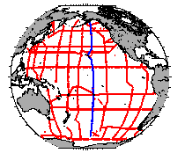
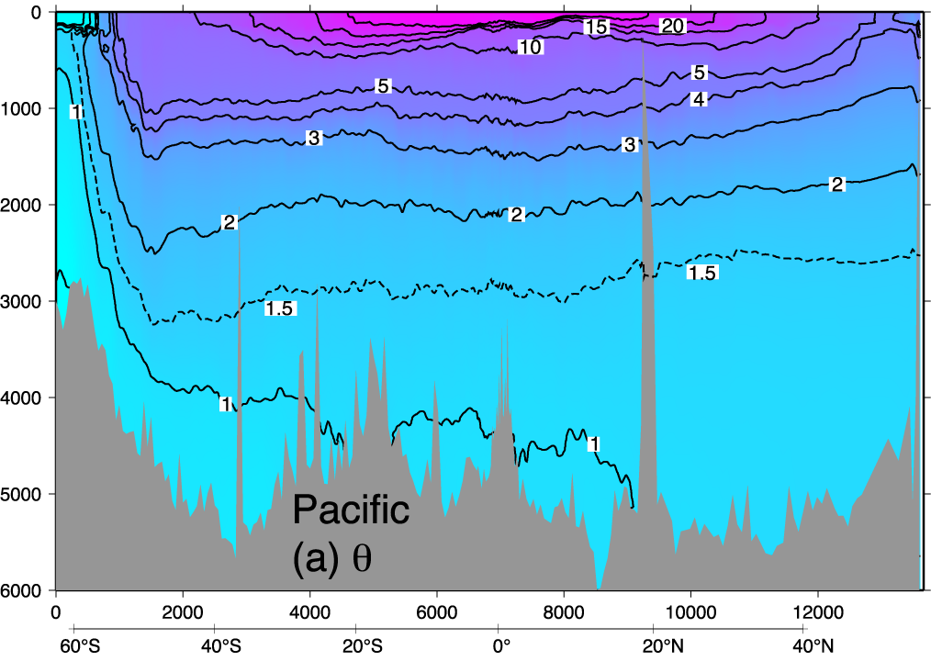
Pacific potential temperature section
thermocline
DPO Fig. 4.12a

Slide 35
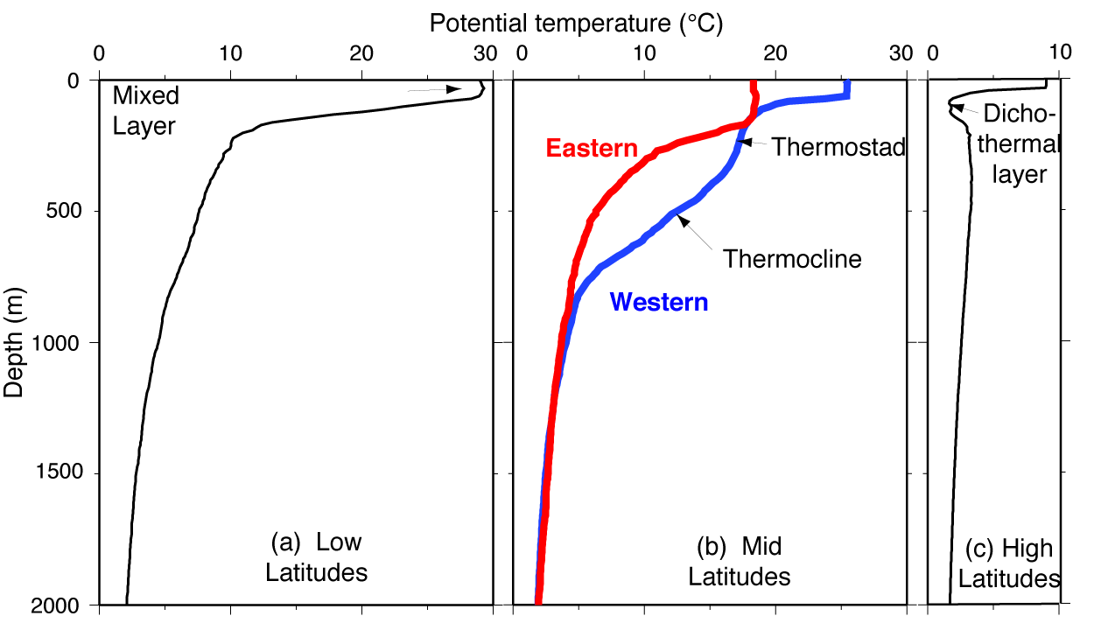
1. Definitions: vertical structures (temperature)
Mixed layer
Thermocline
Thermostad
Dichothermal
layer (T minimum)
Typical North Pacific profiles
DPO Figure 4.2

Slide 36
Pacific potential temperature section
Mixed layer Thermostad Thermocline
thermocline
Dichothermal layer (T minimum)
DPO Fig. 4.12a

Slide 37
Water masses
Water mass: “body of water with a common formation history”. Names are capitalized.
A water mass has
an identifiable property (usually an extremum of some sort)
an identifiable formation process
Water type: point on a temperature-salinity diagram (this can include additional properties such as nutrients)
Source water type: water type at the source of water mass

Slide 38
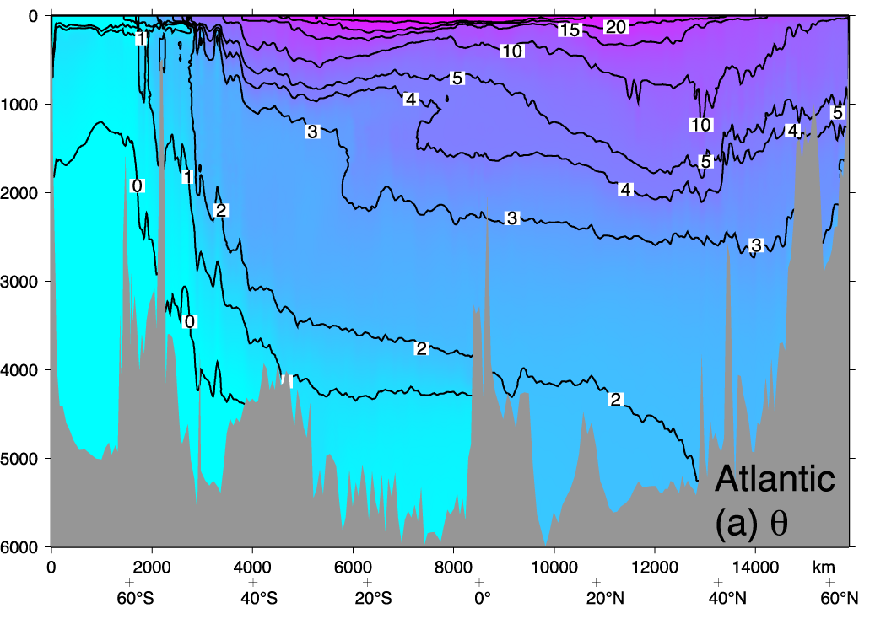
Atlantic vertical section: overall vertical structure
Upper
Intermediate
Deep
4. Abyssal
DPO Fig. 4.11

Slide 39
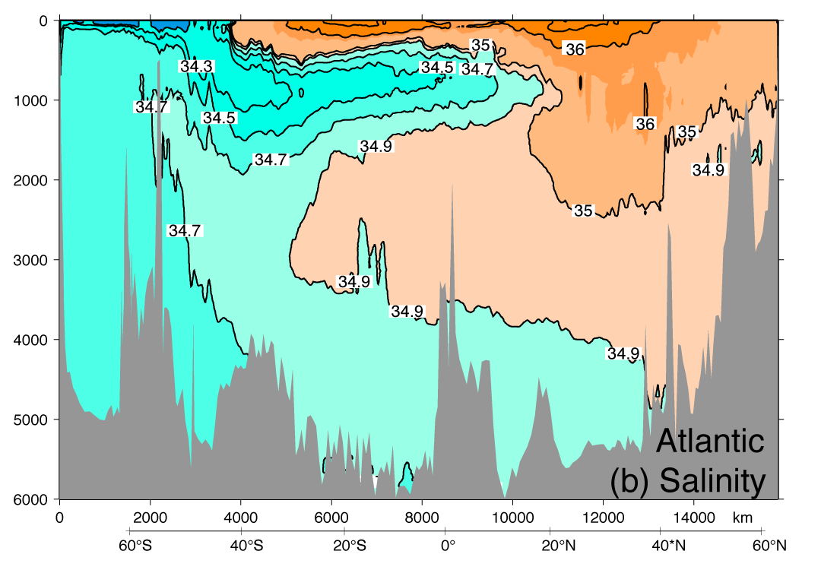
Atlantic vertical section: overall vertical structure
Upper
Intermediate
Deep
4. Abyssal
DPO Fig. 4.11

Slide 40
Upper ocean
Characterization: Surface mixed layer down through the main pycnocline.
Location: In the tropics and subtropics and into the subpolar regions (bounded by the Antarctic Circumpolar Current to the south, and the northern marginal seas to the north)
Formation mechanisms: late winter mixed layer properties are “subducted” into the ocean interior (slide down slightly inclined isopycnals from the mixed layer). “Central Water”
Mixed layer properties are set by air-sea fluxes, and depth by wind stirring or buoyancy-driven convection

Slide 41
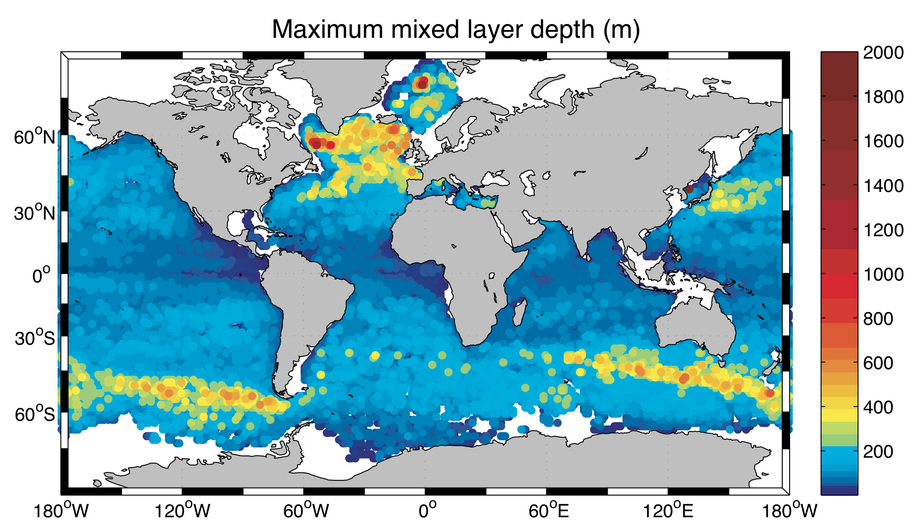
Mixed layer depth
Typically 20 to 200 m (late winter)
Thicker (> 500) in some special locations, notably in
(1) band in the Southern Ocean and (2) northern North Atlantic
Using delta T = 0.2°C
DPO Fig. 4.4c from Holte et al al.

Slide 42
What drives the turbulence in the mixed layer?
Heat loss and convection (buoyancy effect)
Atmospheric wind (mechanical effect)

Slide 43
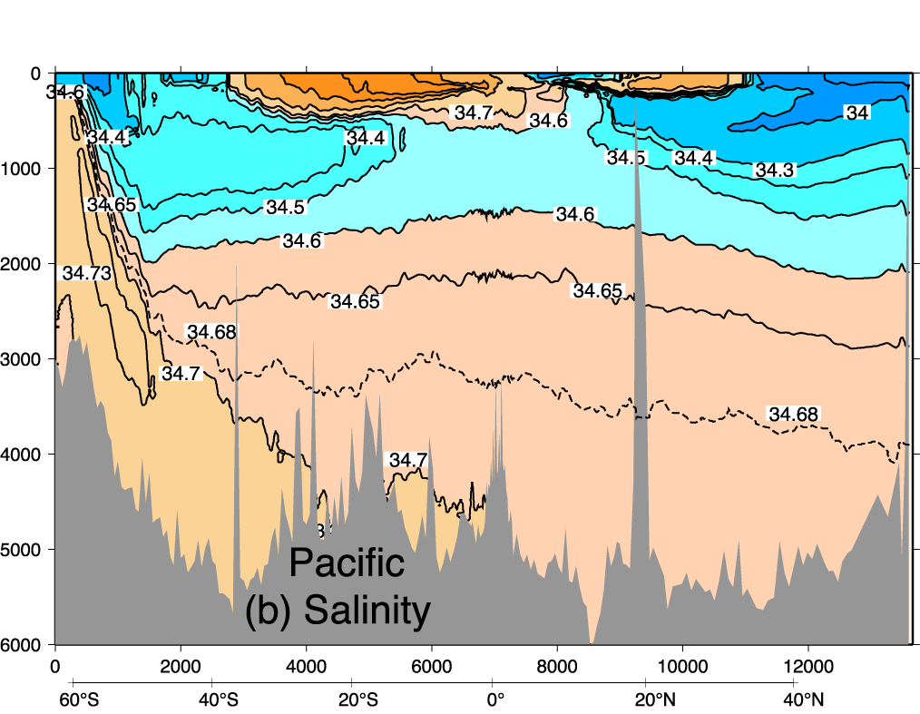
Pacific salinity vertical section
Salinity maximum layers
Salinity minimum layers - intermediate waters (Antarctic and North Pacific I.W.)
DPO Fig. 4.12b

Slide 44
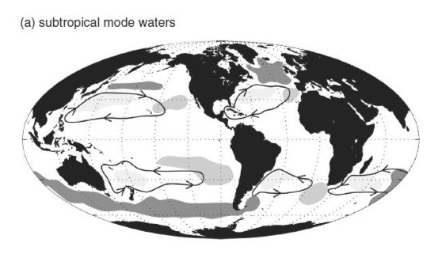
Subtropical Mode Waters (STMW)
“The 18-degree Water” in the North Atlantic
Major thermocline water mass
  Exists in all major basins forming ”pycnostad”
  Subtropical origin, relatively high S and T
  Depth range: 200 – 600m

Slide 45
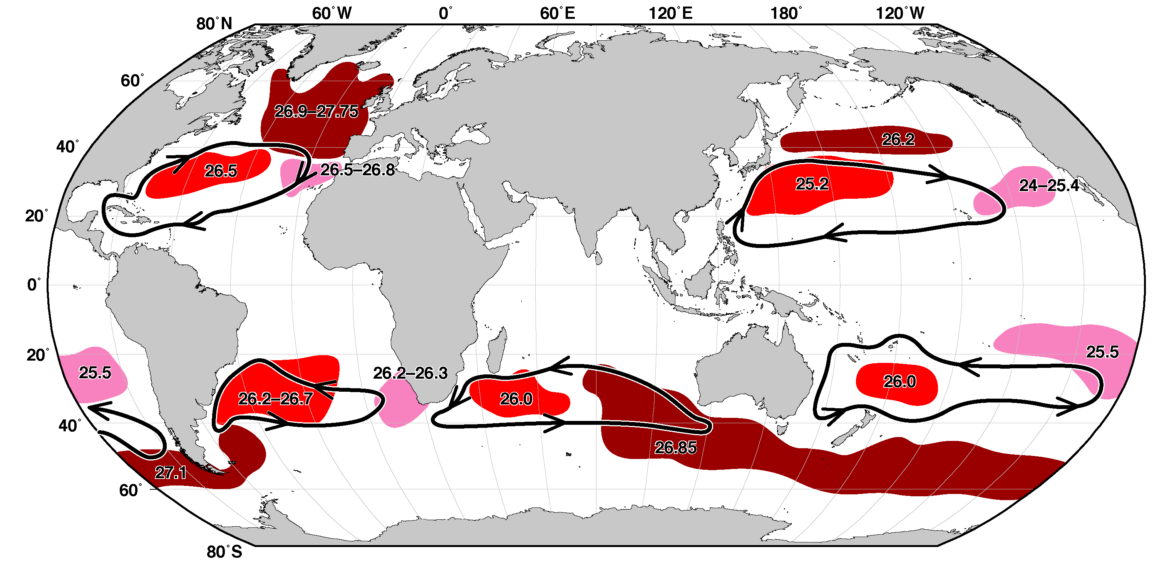
Global Mode Waters
Location of especially strong, permanent thermostads/pycnostads - derived from thick winter mixed layers that then spread into the interior along isopycnals (subduct)
Gulf Stream’s Eighteen Degree Water (Subtropical Mode Water of the North Atlantic) from previous slide
Hanawa and Talley (2001); DPO 14.12

Slide 46
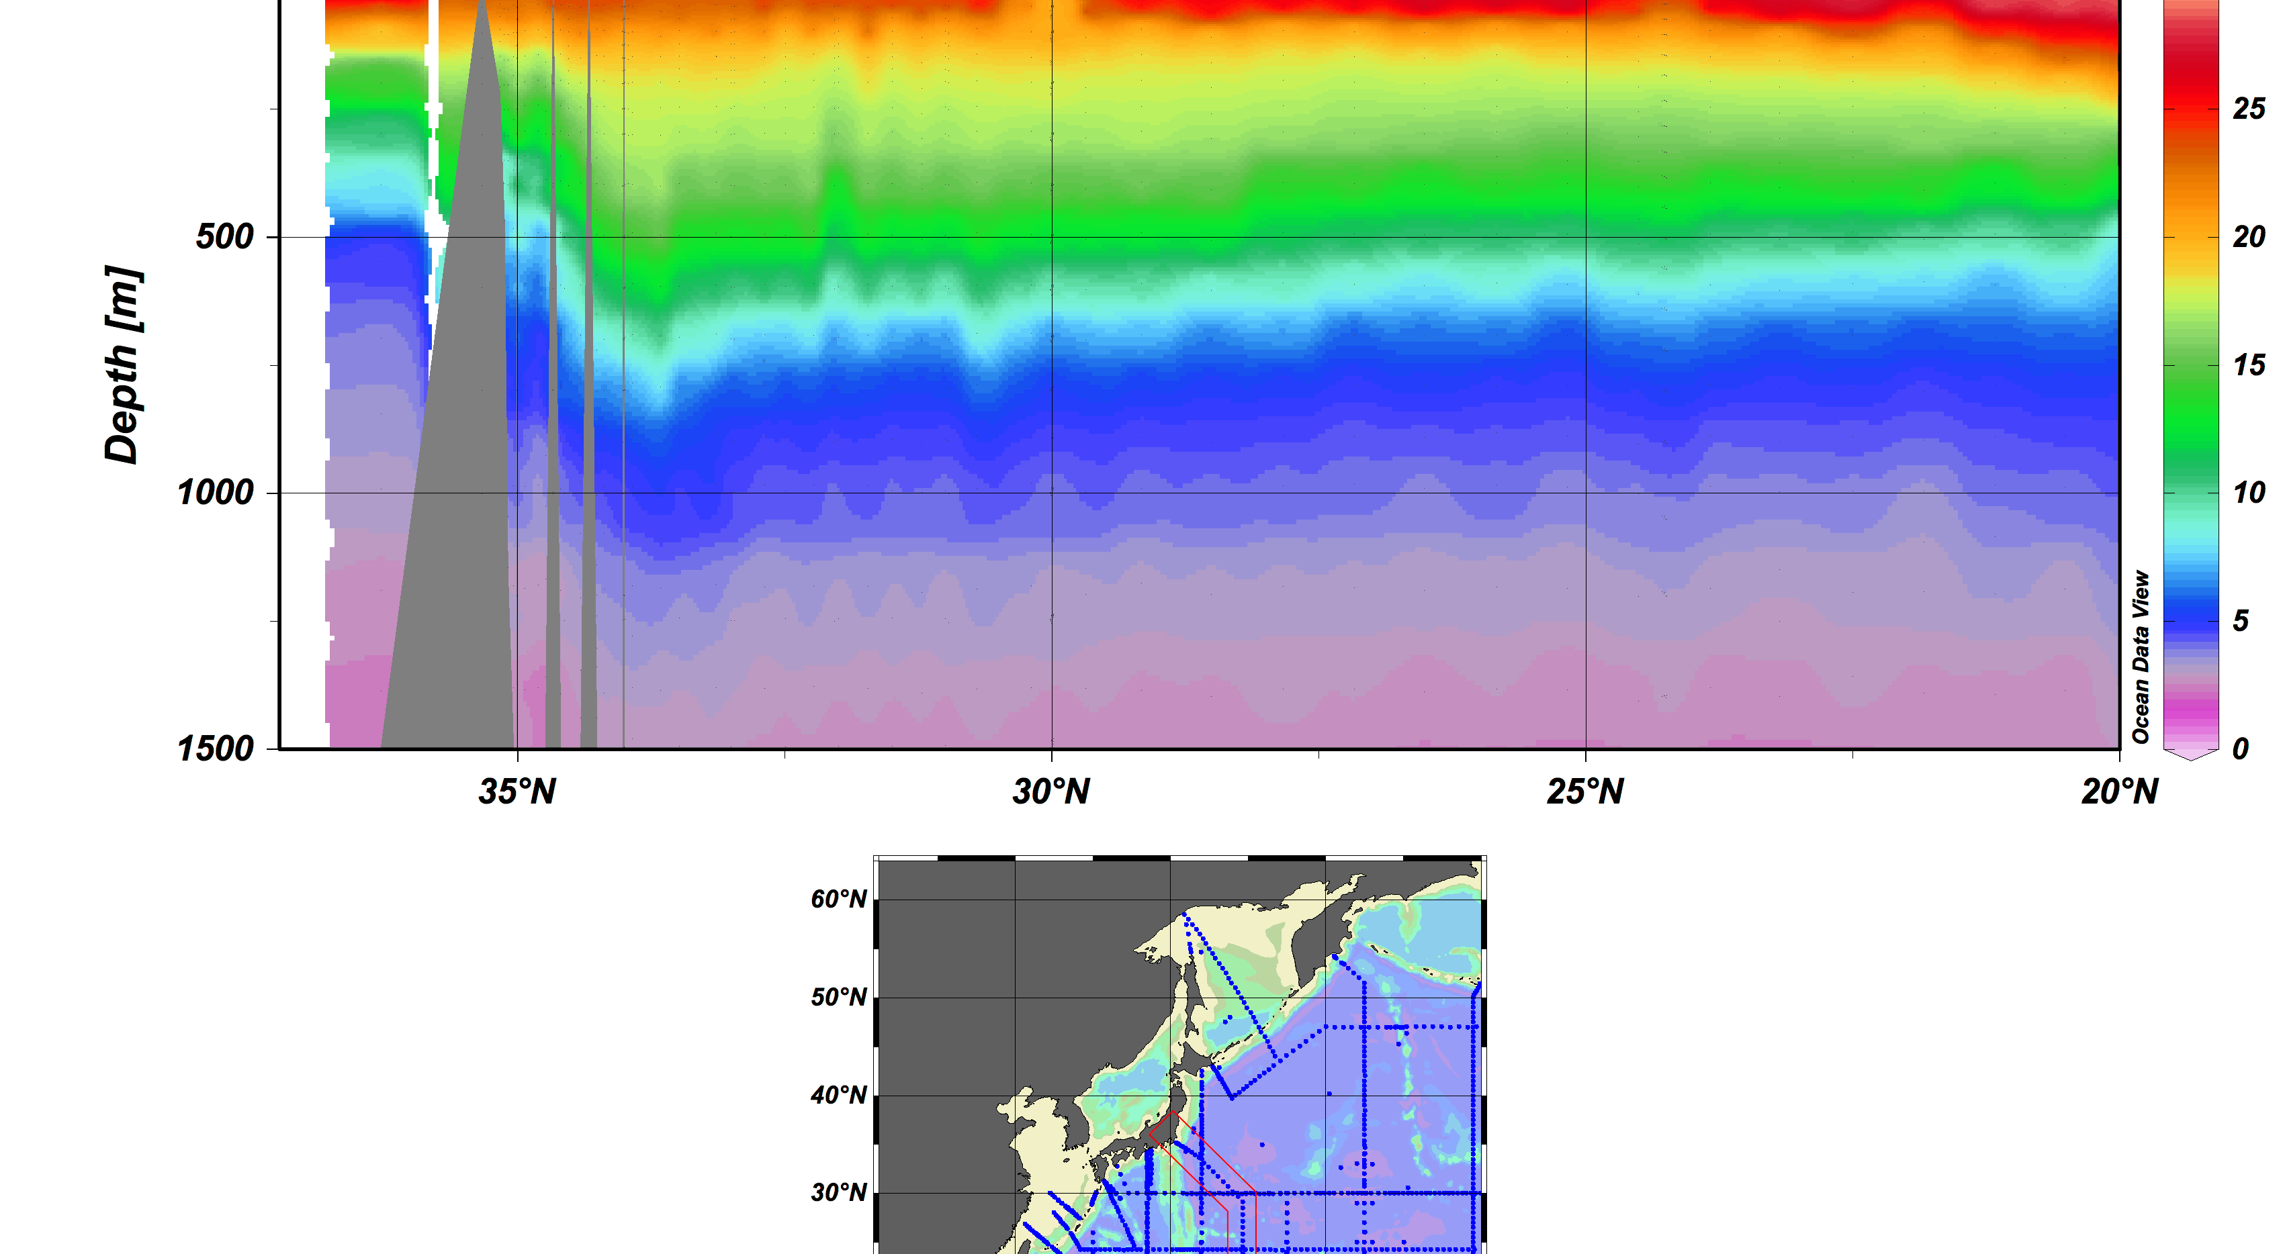
An example: Kuroshio

Slide 47
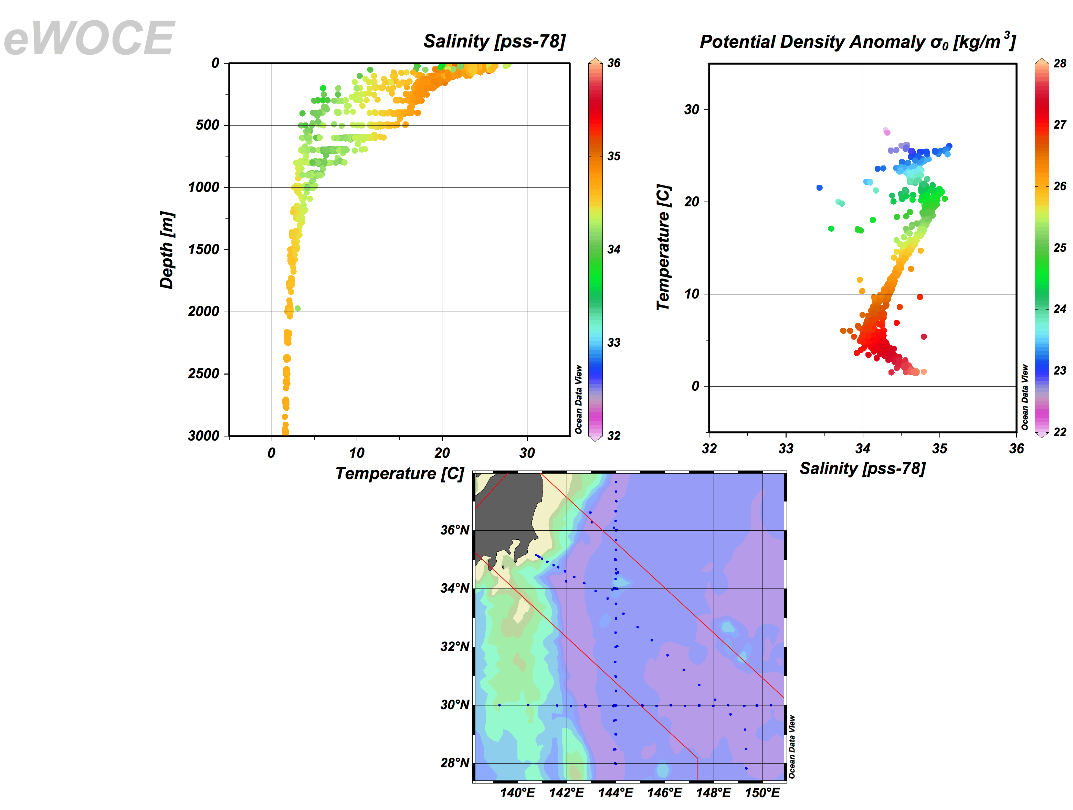
Mode Water in the North Pacific
Mode water
Intermediate water
Deep Water

Slide 48
What regulates the mode water formation?
Winter-time cooling
Heat flux components: Q [W/m²]
  Q_{SW}: Short-wave radiation
  Q_{LW}: Long-wave radiation
  Q_{SH}: Sensible heat flux
  Q_{LH}: Latent heat flux

Slide 49
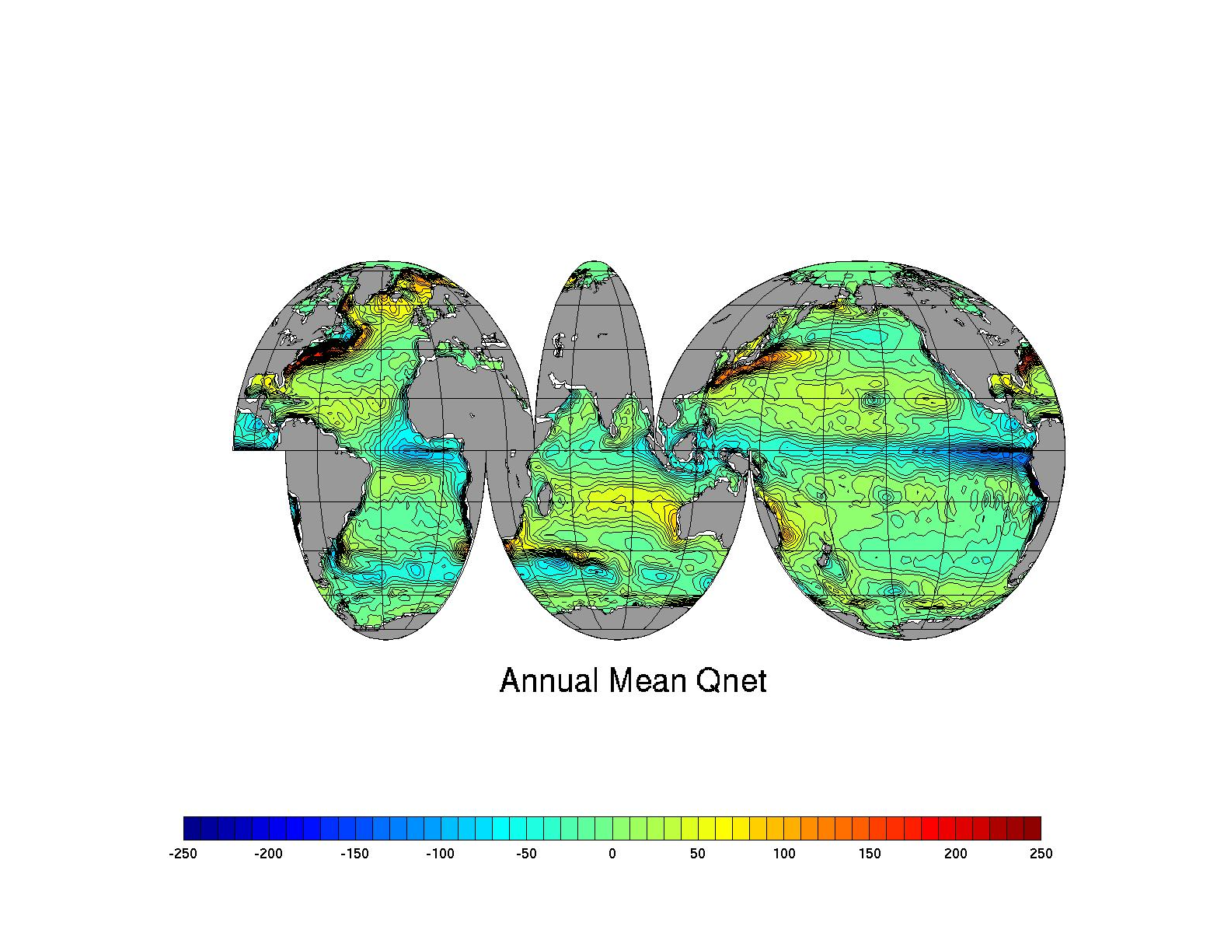
Net air-to-sea heat flux
Sum of the four components
  NCEP Reanalysis climatology 1968-1996
  Upward positive (positive into the atmosphere)

Slide 50
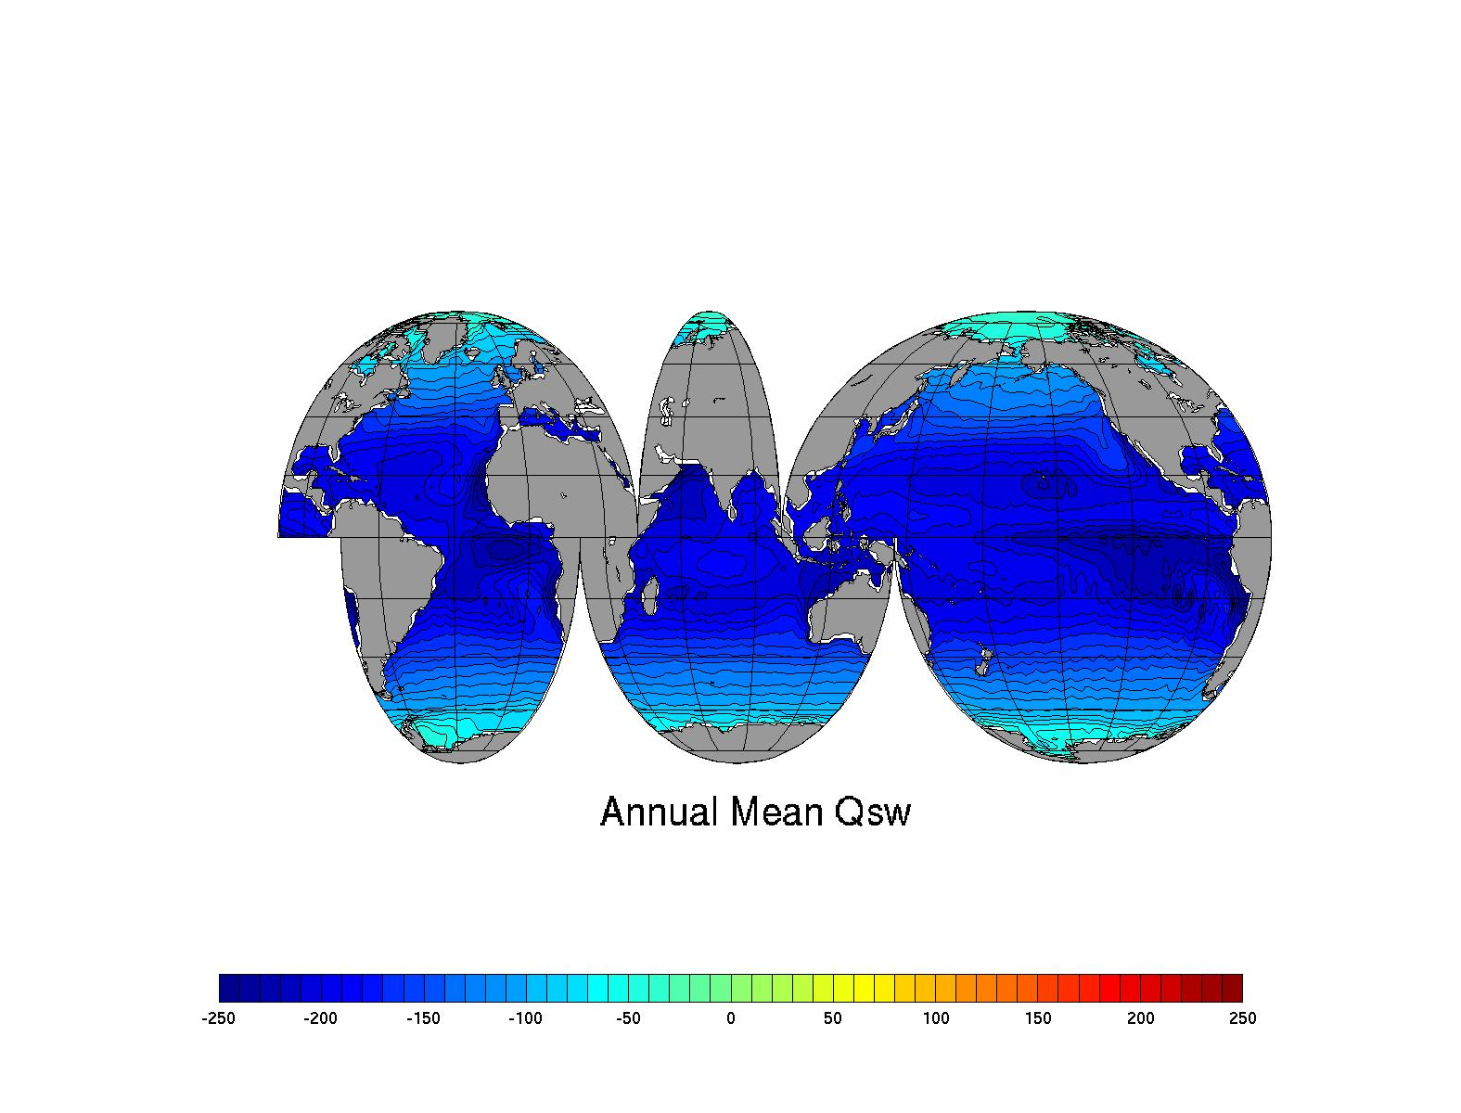
Shortwave radiation
NCEP-Reanalysis
  Climatology 1968-1996
  Upward positive (positive into the atmosphere)

Slide 51
Factors controlling SW radiation
Latitude
Cloudines (albedo)

Slide 52
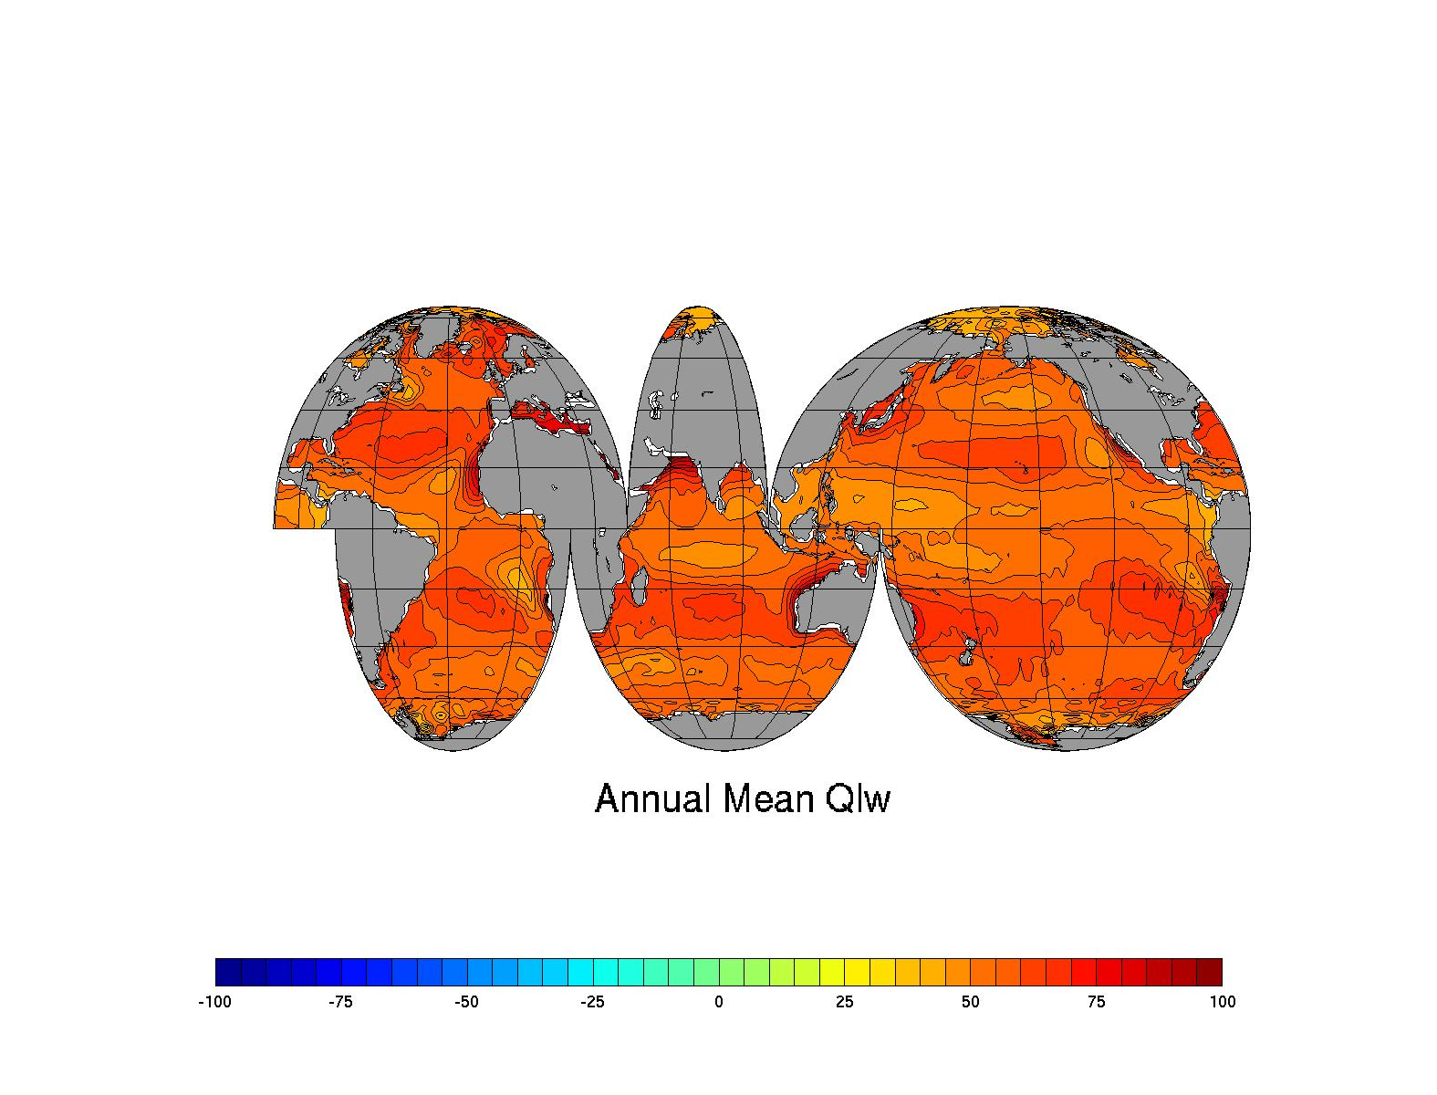
Longwave radiation
NCEP-Reanalysis
  Climatology 1968-1996
  Upward positive (positive into the atmosphere)

Slide 53
Longwave radiation
SST, cloud and water vapor

Slide 54
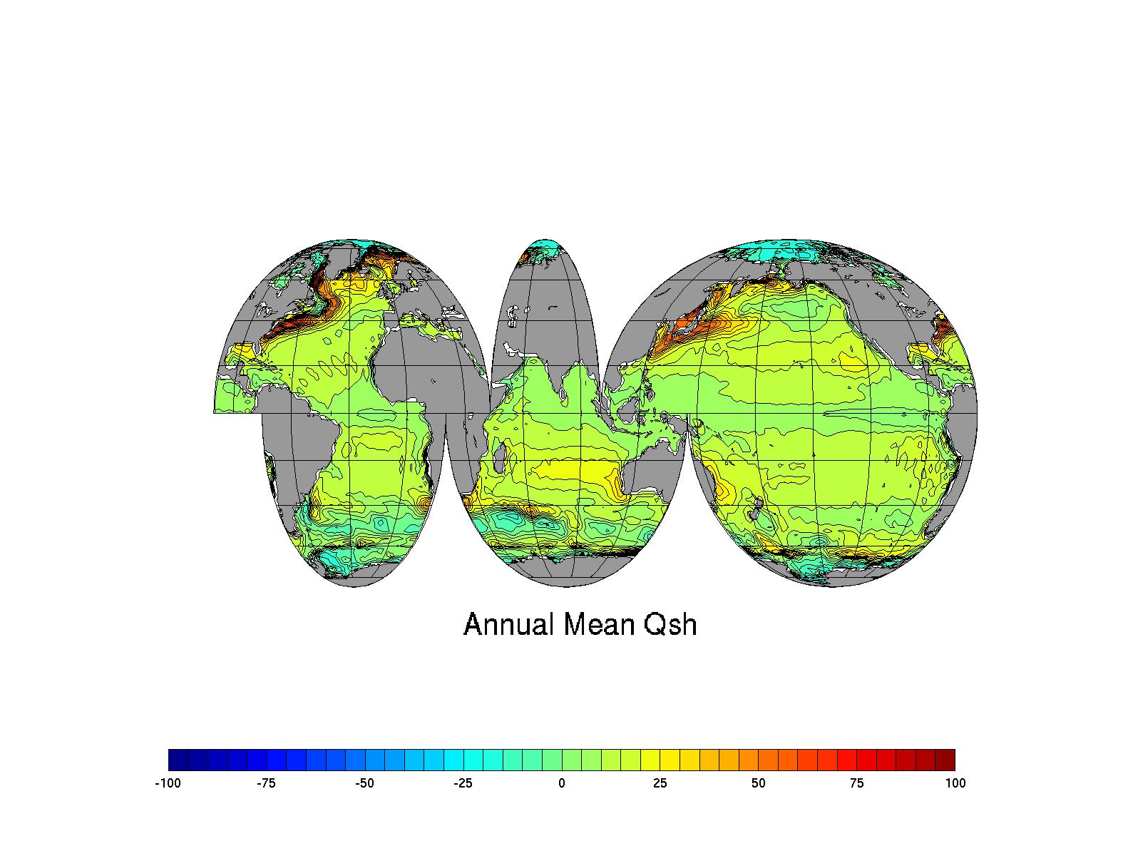
Sensible heat flux
NCEP-Reanalysis
  Climatology 1968-1996
  Upward positive (positive into the atmosphere)

Slide 55
Sensible heat flux
Surface wind speed and air-sea temperature difference
Notes:
Ch = 0.83e-3 for stable condition
Ch = 1.10e-3 for unstable condition

Slide 56
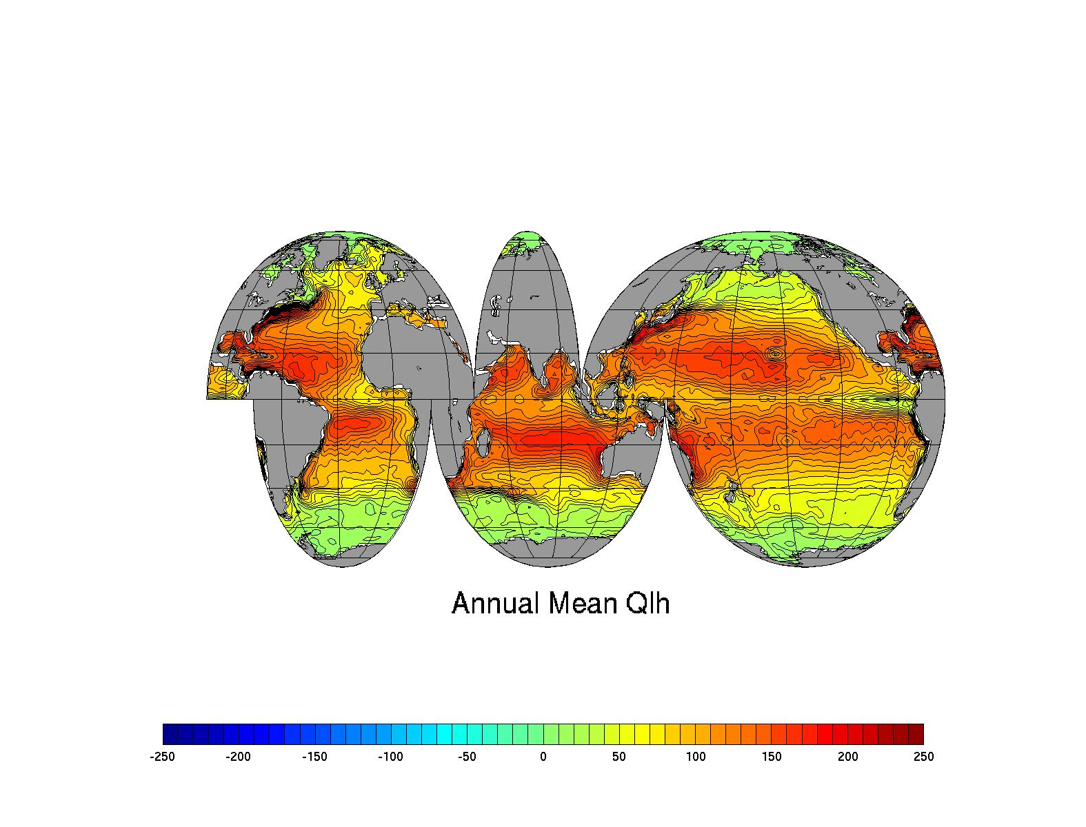
Latent heat flux
NCEP-Reanalysis
  Climatology 1968-1996
  Upward positive (positive into the atmosphere)

Slide 57
Latent heat flux
Rate of evaporation

Slide 58
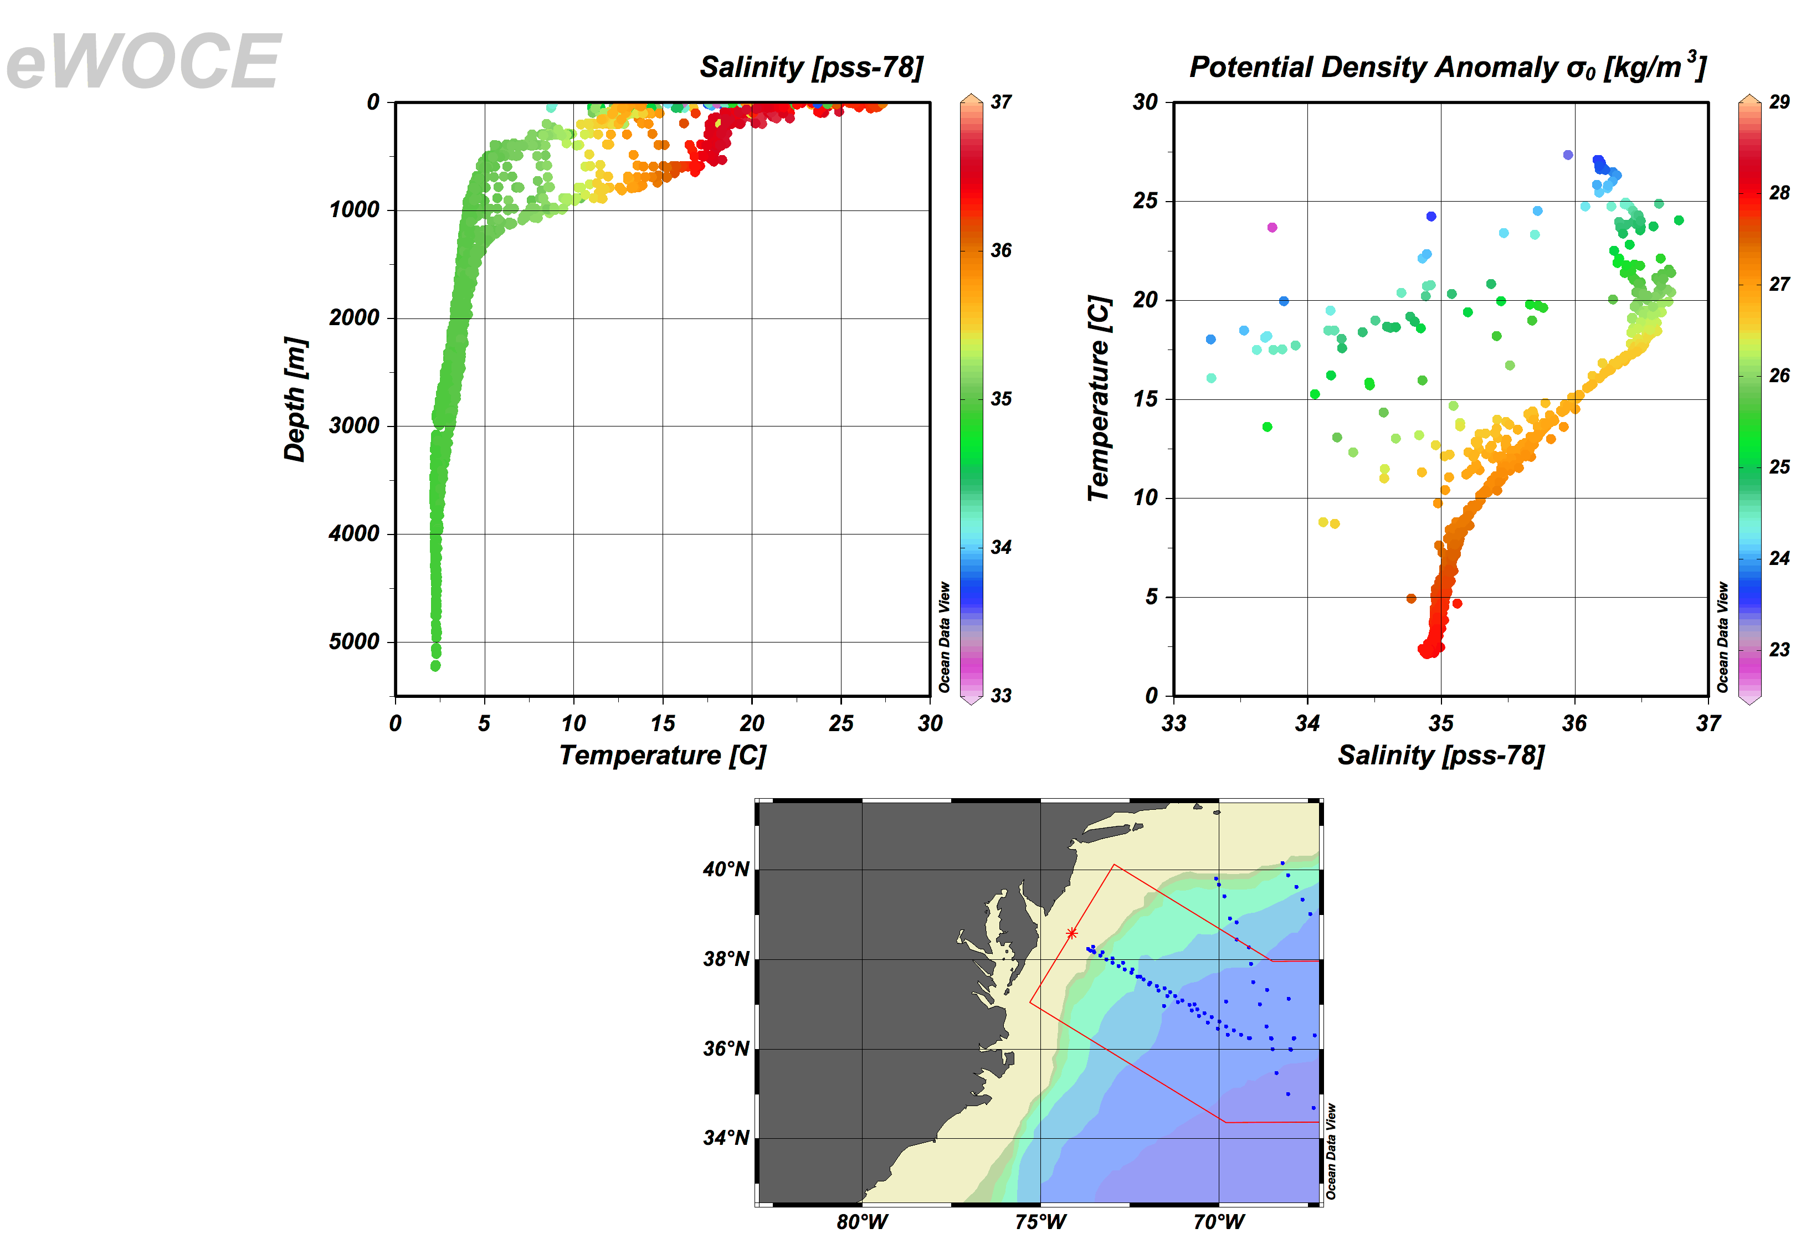
TS structure of the Gulf Stream
Mode Water
Deep Water

Slide 59
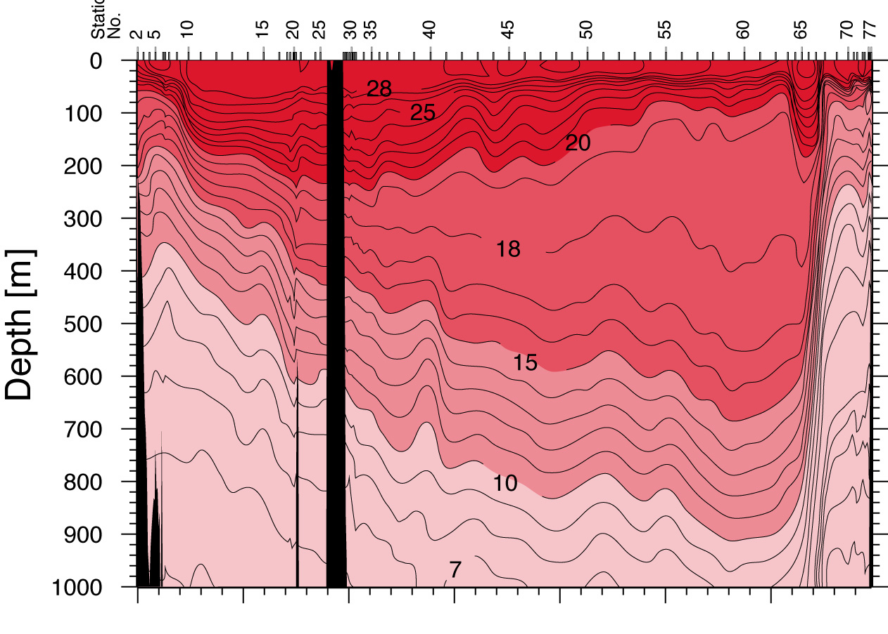
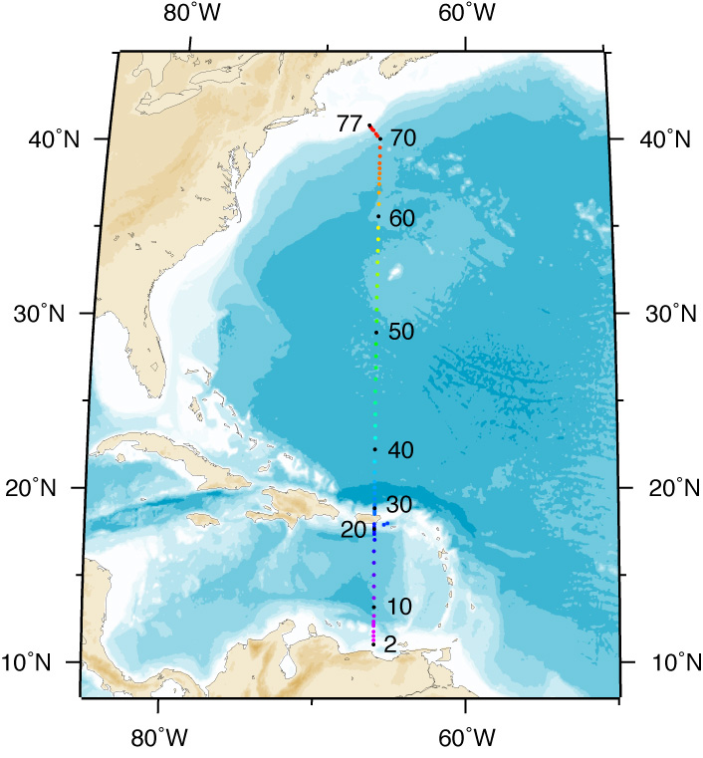
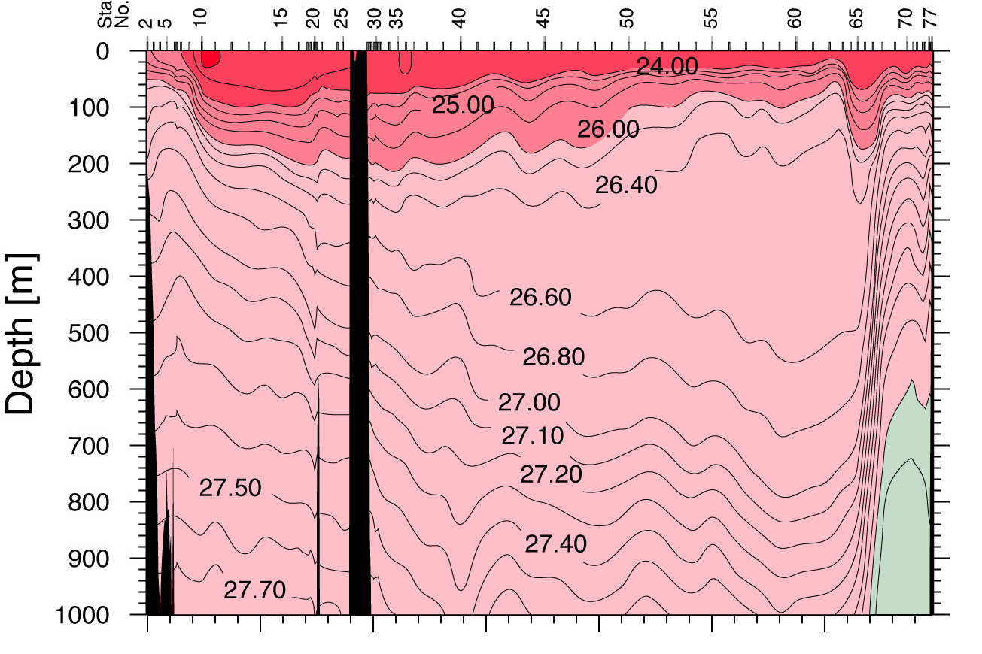
Thermostad : Subtropical Mode Water (Eighteen Degree Water)
WHP Atlas Atlantic
Pot.
Temp.
θ
Section across Gulf Stream
Thickening of isotherms/isopycnals is the thermostad/pycnostad
Forms at surface as a thick mixed layer near Gulf Stream in late winter.
Circulates into the interior south of the Gulf Stream along isopycnals
Neutral density

Slide 60
Mode Water in the Upper Ocean
Pycnostads/thermostads embedded in the pycnocline occur in identifiable regions
They usually occur on the warm (low density) side of strong currents
Example (previous slide): Gulf Stream has a pycnostad/thermostad at about 18°C on its south (warm) side.
Because a pycnostad has a large volume of water in a given temperature-salinity interval, these waters were termed “Mode Waters”, to indicate that the the mode of the distribution of volume in T/S space occurs in these particular T/S ranges.

Slide 61
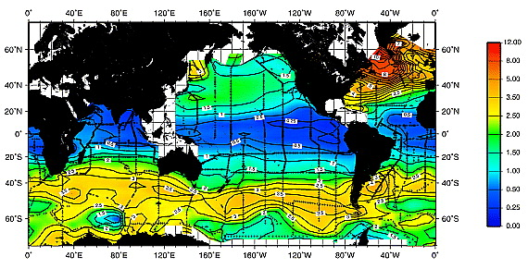
Importance of mode waters for dissolved gas inventories
Chlorofluorocarbon (CFC) water column inventory
(conservative anthropogenic tracer)
Willey et al. (GRL 2004)

Slide 62
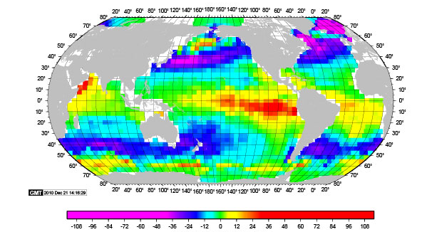
Sea-to-air CO₂ flux

Slide 63
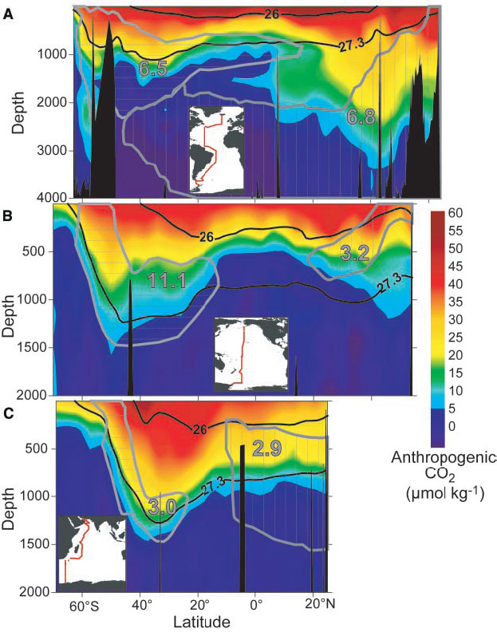
Distribution of fossil fuel CO₂
Ocean absorbs about 1/4 - 1/3 of anthropogenic carbon emission each year.
What part of the oceans is the carbon going to?

Slide 64
Intermediate layer
Characterization: large-scale salinity maximum and minimum layers.
Location: just below the pycnocline in most of the ocean (especially tropics and subtropics), roughly 1000 to 2000 m depth.
Originate from very specific sources (“injection sites”) in the Labrador Sea (“Labrador Sea Water”), the Mediterranean Sea (“Mediterranean Water”), the Red Sea (“Red Sea Water”), the Okhotsk Sea (“North Pacific Intermediate Water”), and the Drake Passage region (“Antarctic Intermediate Water”).
Formation mechanisms: Deep convection (reaching to about 1500 m); brine rejection; vigorous mixing where boundary currents meet; otherwise nearly-isopycnal spreading

Slide 65
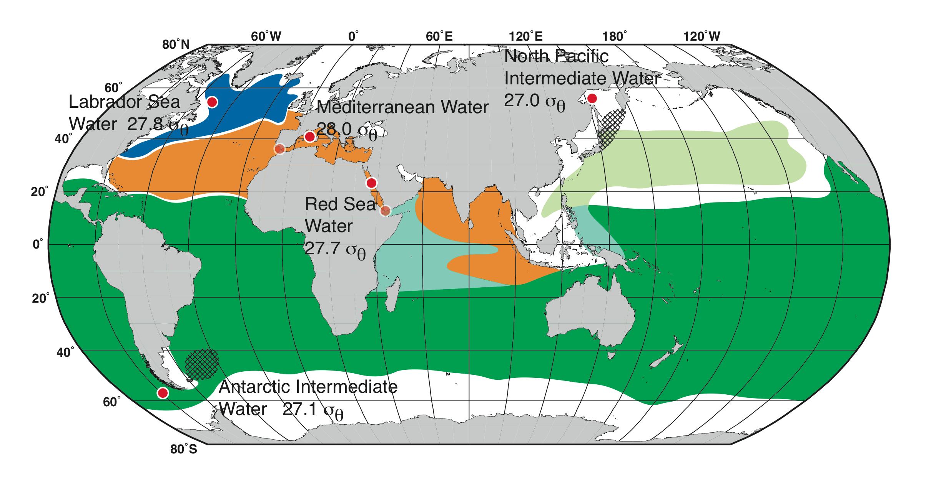
Intermediate water masses (salinity minimum)
Low salinity intermediate layers (salinity minimum layers)
High salinity intermediate layers (salinity maximum layers)
DPO Fig. 14.13

Slide 66
Intermediate water production sites
DPO Fig. 14.13
Labrador Sea Water: salinity minimum, deep convection in Labrador Sea
Mediterranean Overflow Water: salinity maximum, evaporation and cooling in Mediterranean Sea, overflow
Antarctic Intermediate Water: salinity minimum, medium convection in Drake Passage region
Red Sea Overflow Water: salinity maximum, evaporation in Red Sea, overflow
North Pacific Intermediate Water (Okhotsk Sea): salinity minimum, brine rejection in the Okhotsk Sea

Slide 67
Pacific intermediate waters
Intermediate depth (500-2000 m), vertical salinity minima
Antarctic Intermediate Water (AAIW)
North Pacific Intermediate Water (NPIW)
DPO Fig. 4.12

Slide 68
Atlantic intermediate waters
Intermediate depth (500-2000 m), vertical salinity minima AND maximum
Mediterranean Water (MW)
Antarctic Intermediate Water (AAIW)
Labrador Sea Water (LSW)
DPO Fig. 4.11

Slide 69
Review question
What water mass contains “thermostad”?
  Mixed layer
  Mode waters
  Intermediate waters
  Deep waters
  Bottom waters

Slide 70
Review question
What is the most important formation mechanism for the mode waters?
  Deep convection in the polar ocean
  Brine rejection following seaice formation
  Winter-time heat loss and convection at mid-latitudes
  Summer-time mixing due to the wind-driven turbulence

Slide 71
Deep layer
Characterization: This is a thick layer below the intermediate layer and above the bottom waters, characterized by extrema of salinity, oxygen, nutrients.
Location: Roughly from 2000 to 4000 m depth.
The “North Atlantic Deep Water” originates through deep water formation processes north of the N. Atlantic (joined by Labrador Sea and Mediterranean Sea intermediate waters). It is relatively “new”.
The “Pacific Deep Water” originates through slow upwelling of bottom waters in the Pacific, and is the oldest water in the ocean. The “Indian Deep Water” is similar to the PDW.
The “Circumpolar Deep Water” is a mixture of these new (NADW) and old (PDW and IDW) waters, plus new deep waters formed in the Antarctic (Weddell Sea etc.).

Slide 72
Deep layer (continued)
Formation mechanisms and history: varied including
deep convection (Nordic Seas, Labrador Sea)
brine rejection (Antarctic contribution to deep water) upwelling (ocean-wide)
vigorous mixing at specific sites (strait overflows)
spreading along isopycnals with minimal mixing

Slide 73
Bottom layer
Characterization: Densest, coldest layer
Location: ocean bottom, usually connotes very dense water from the Antarctic.
In the Antarctic region, “Antarctic Bottom Water”
Elsewhere, “Lower Circumpolar Deep Water”
Formation mechanism: brine rejection close to Antarctica: coastal polynya

Slide 74
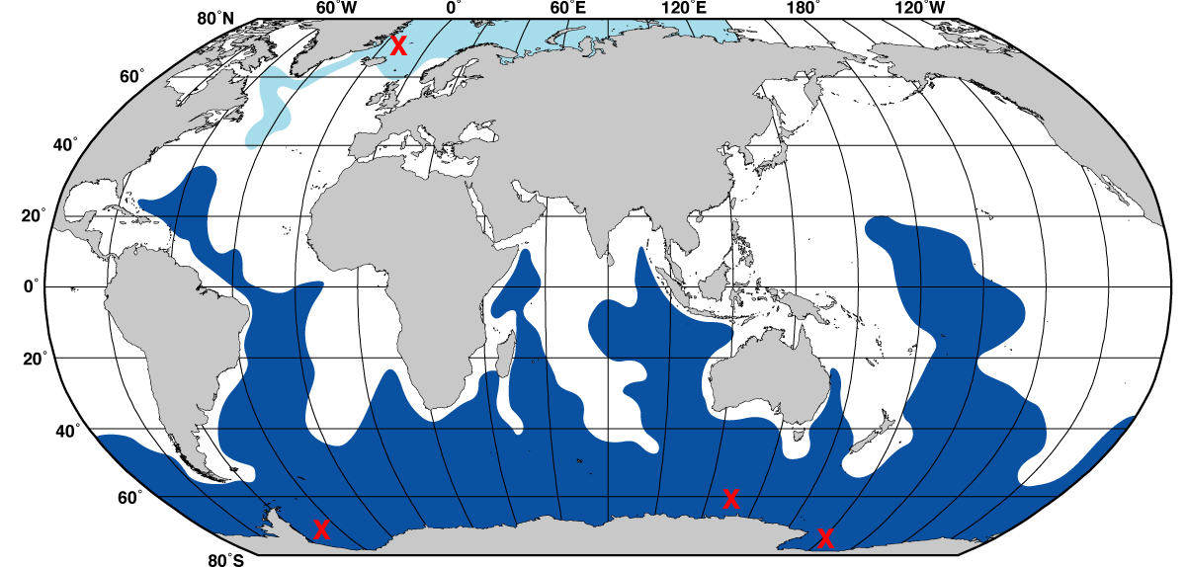
Ventilation of the deep ocean
Localized deep convection or brine rejection at high latitudes, with subsequent local turbulent mixing and then flow mostly along isopycnals
DPO Fig. 14.14a

Slide 75
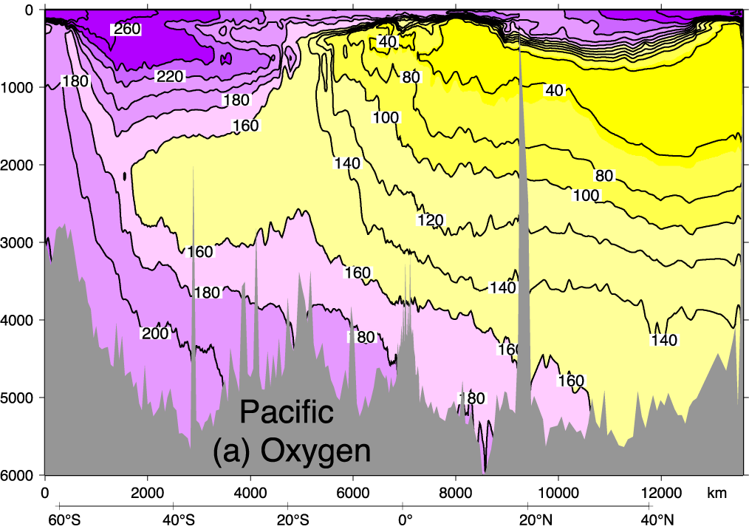
Deep Ventilation
Flow and mixing is mostly along isopycnals (constant potential density surfaces)
Ocean circulation is mainly adiabatic --- movement/mixing of water is primarily oriented along isopycnals

Slide 76
Deep and bottom water
Deep and bottom water production sites sites
DPO Fig. 14.14a
North Atlantic Deep Water: high salinity, high oxygen; mixture of NSOW, LSW and MOW; formed at sea surface through deep convection
Antarctic Bottom Water: very cold, high oxygen; formed near sea surface along coast of Antarctica through sea ice formation-brine rejection
Indian and Pacific Deep Waters: low oxygen, high nutrients; slow upwelling and slow deep mixing of inflowing NADW and AABW

Slide 77
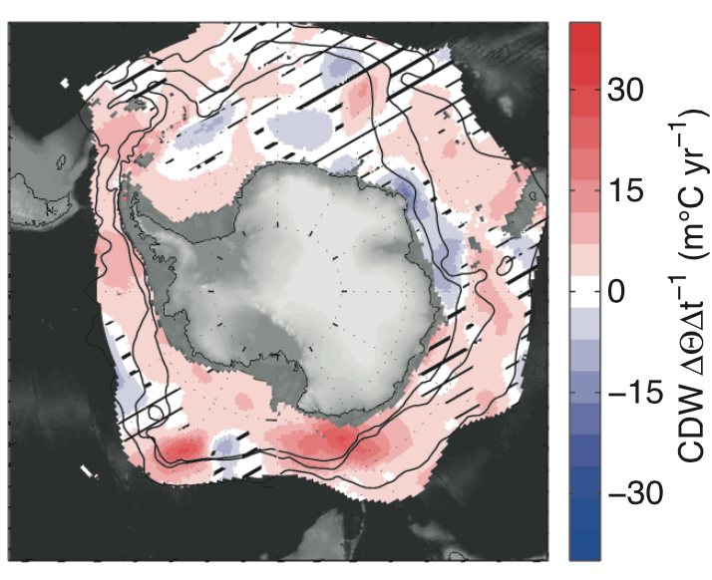
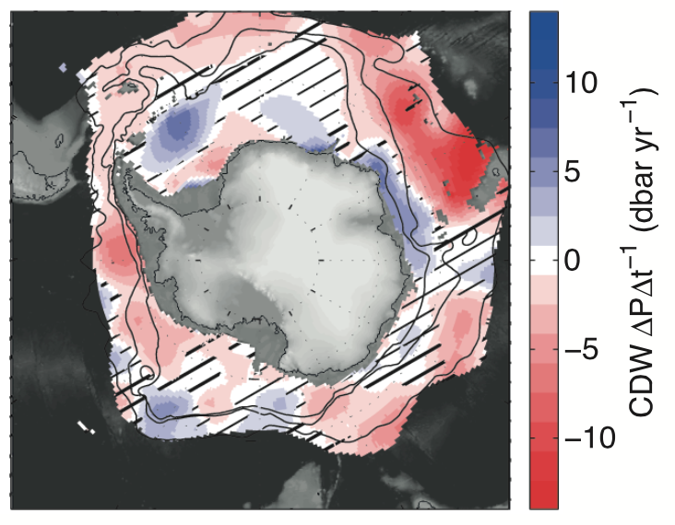
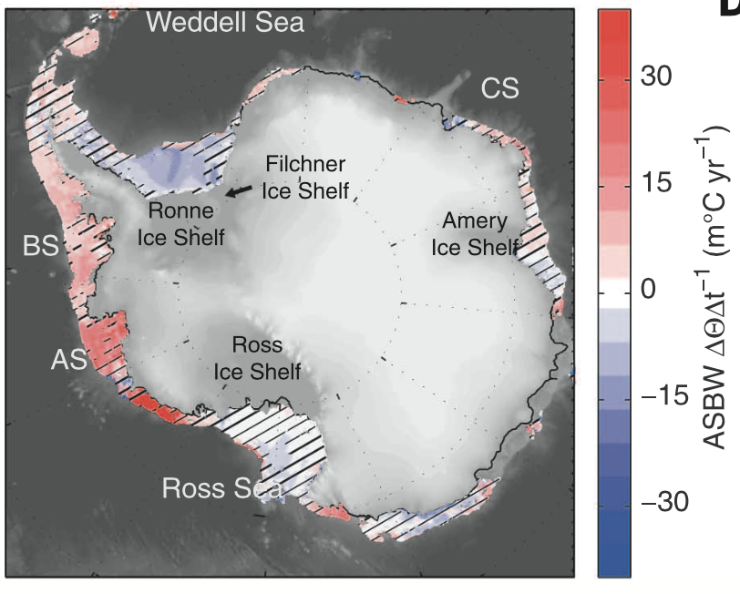
Subsurface changes: Circumpolar Deep Water
Gille 2002, 2008; Schmidtko et al., 2014
Core of CDW = Tmax layer
Trend at CDW core
Since 1970s CDW is generally warming up and shoaling
Trend is not zonally uniform
Shelf warming promotes basal melting in the AS/BS sector
Trend at shelf bottom

Slide 78
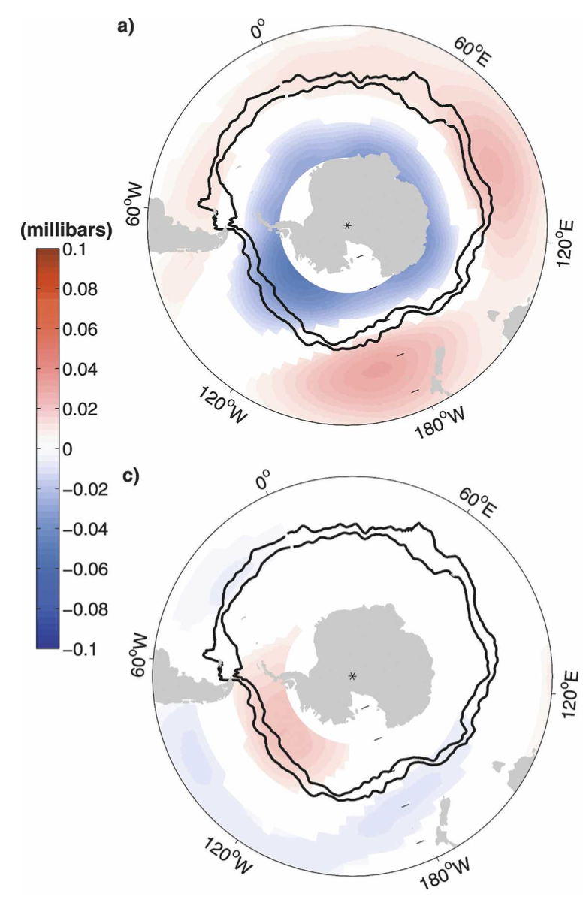
Recent changes in the Antarctic climate
SAM
Positive trend in SAM = intensified, poleward-shifted zonal wind
SAM index
ENSO
Marshall et al., 2016
Sallee et al., 2008

Slide 79
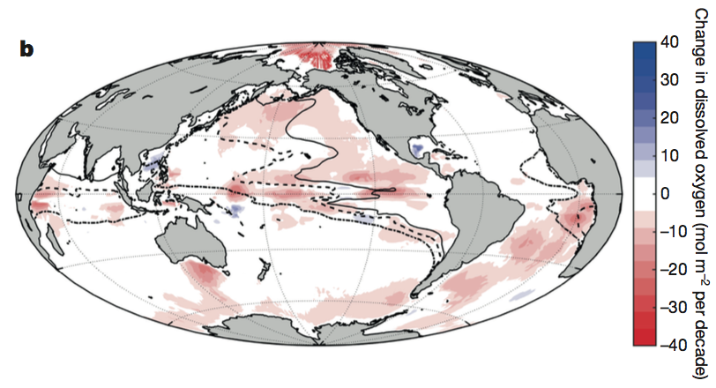


Deoxygenation
Large scale obs analysis (Schmidtko et al., 2017; Ito et al., 2017)
Vertical profiles (S4P, 1992 & 2011)
T
S
O₂
1960-2010 column O₂ trend
CDW is getting shallower, warmer and less oxygenated
Green (300m); Red (1000m); Blue (3000m)

Slide 80

Changes in Deep Waters
Purkey and Johnson, 2013; Desbruyeres et al., 2013
Freshening of AABW and glacial melt (Rignot et al., 2008; Jacobs and Giulivi 2010; Swift and Orsi 2012)
Weakening of the lower limb MOC (Purkey and Johnson 2012; Kouketsu et al., 2011) → consistent with deep O₂ loss
Sea Surface Temperature in the Antarctic region has been neutral or even cooling during this time, but there is a widespread warming in the subsurface

Slide 81
Summary: deep waters
Deep water forms only in the North Atlantic and the Southern Ocean
  Deep nutrient and carbon has a large inter-basin gradient
  Deep water accumulates respired nutrients and carbon
  Deep North Pacific has the highest nutrient and lowest oxygen concentration

