Slide 1
Physics and Chemistry of the Oceans
EAS4305/6305
Fall 2018

Slide 2
Logistics
Class: Tuesday and Thursday 12:00-13:15
My office: EST 1st floor, 1102
Email: taka.ito@eas.gatech.edu
Course materials will be uploaded on http://shadow.eas.gatech.edu/~Ito/webdata/teaching.html
Grader: Daoxun Sun (sdxmonkey@gatech.edu)
Informal TA: Filippos Tagklis (ftagklis@gatech.edu)

Slide 3
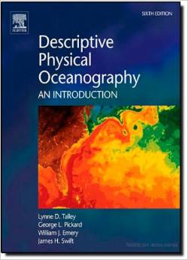
Textbooks
Main
Secondary on chemistry-related topics
Talley et al., (2011) Available both in print and electronic copy ~ $60
Sarmiento and Gruber (2006) Available both in print and electronic copy ~ $90

Slide 4
Expectations
  Come to class
    Covers basic concepts
  Read textbook
    About one chapter/week
  Do homework
    Problem solving
    Computer exercises

Slide 5
Evaluation
40% homework
  Weekly assignment
  Graduate student may get extra questions
20% midterm
  In-class exam (80 min)
  Sample questions distributed in advance
30% term paper
10% attendance/participation

Slide 6
Schedules
Part 1. Thermodynamics and fluid mechanics (week 1 through 10 and midterm exam; October 25th)
Part 2. Biogeochemical processes (week 11 through 16)

Slide 7
Term paper
A review
  Choose a topic, read reference papers, synthesize your findings
  You could ask your academic advisor/mentor about potential topics
  Examples: thermohaline circulation; ice-ocean interaction; global warming impacts; decadal ocean variability; phytoplankton bloom; oxygen minimum zones; ocean acidification; sediment-water interaction; ocean eddies

Slide 8
Week 1: Ocean bathymetry and properties of seawater
Talley’s book chapter 1-3

Slide 9
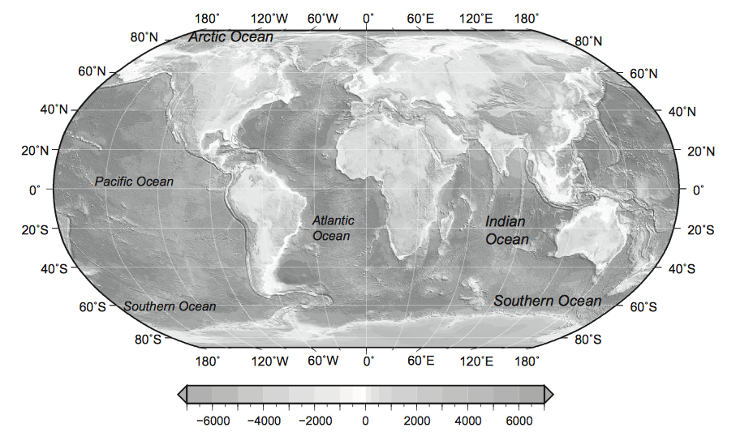
Ocean basins
Talley Fig 2.1
70% of the surface of the Earth is covered by the oceans.
Major ocean basins are connected through narrow pathways, the Southern Ocean and the Arctic Ocean.

Slide 10
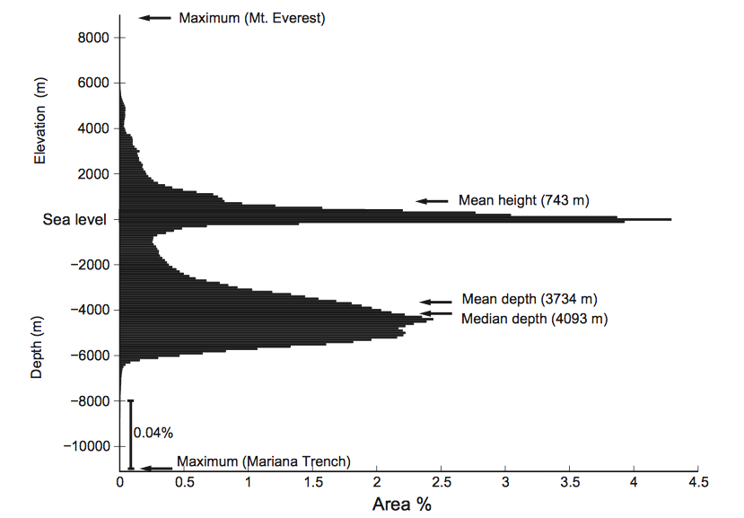
Mean and median depth of the oceans
Per 100m interval

Slide 11
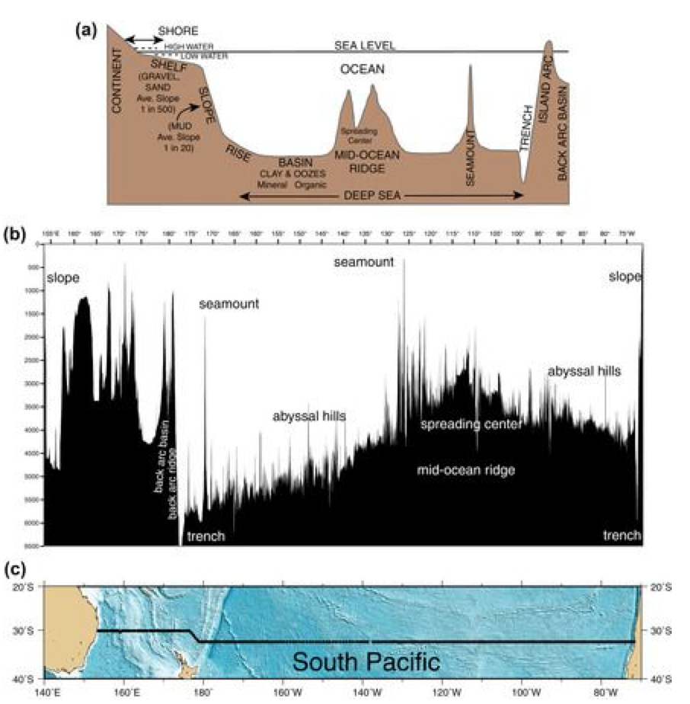
Transect of the ocean bathymetry (=shape of seafloor)
Open (pelagic) ocean has average depth of ~ 4,000m
Shelf is a continuation of the continent

Slide 12
Physical properties of the seawater
1. Pressure
2. Depth
3. Temperature
4. Salinity

Slide 13
1. Pressure
Pressure = weight of overlying water + air
Units = Force / area
What is “force”?
Newton’s law: F = ma where F and a are 3-D vector force and acceleration, and m is mass.
Units of force: mass x length / (time)²
cgs: 1 dyne = 1 gm cm / sec ²
mks: 1 Newton = 1 kg m / sec ²

Slide 14
1. Pressure
What are the units of “pressure”?
Units of pressure: dyne/cm² and N/m²
SI: 1 Pascal = 1 N/m²
Conventional: 1 bar = 10⁶ dynes/cm² = 10⁵ N/m²
approximately the atmospheric pressure at sea level
1 atmosphere = 1000 millibar = 1 bar
1 decibar = 0.1 bar
Decibar or “dbar” is the most common pressure unit used in oceanography because it is so close to 1 m, given the density of seawater: approximately the pressure for 1 meter of seawater. (Don’t use the abbreviation “db” because dB is used for decibels – sound intensity.)

Slide 15
2. Relating pressure and depth
“Hydrostatic balance”
From Newton’s law, use the force balance in the vertical direction (per unit area)
P: vertical force = pressure
: mass = density integrated over the vertical extent of the fluid
-g: vertical acceleration = gravity (positive upward)
Newton’s law: P =
Differential form
where ρ is the density of seawater, ρ ~1025 kg/m³,
Gravitational constant, g ~9.8 m/s²

Slide 16
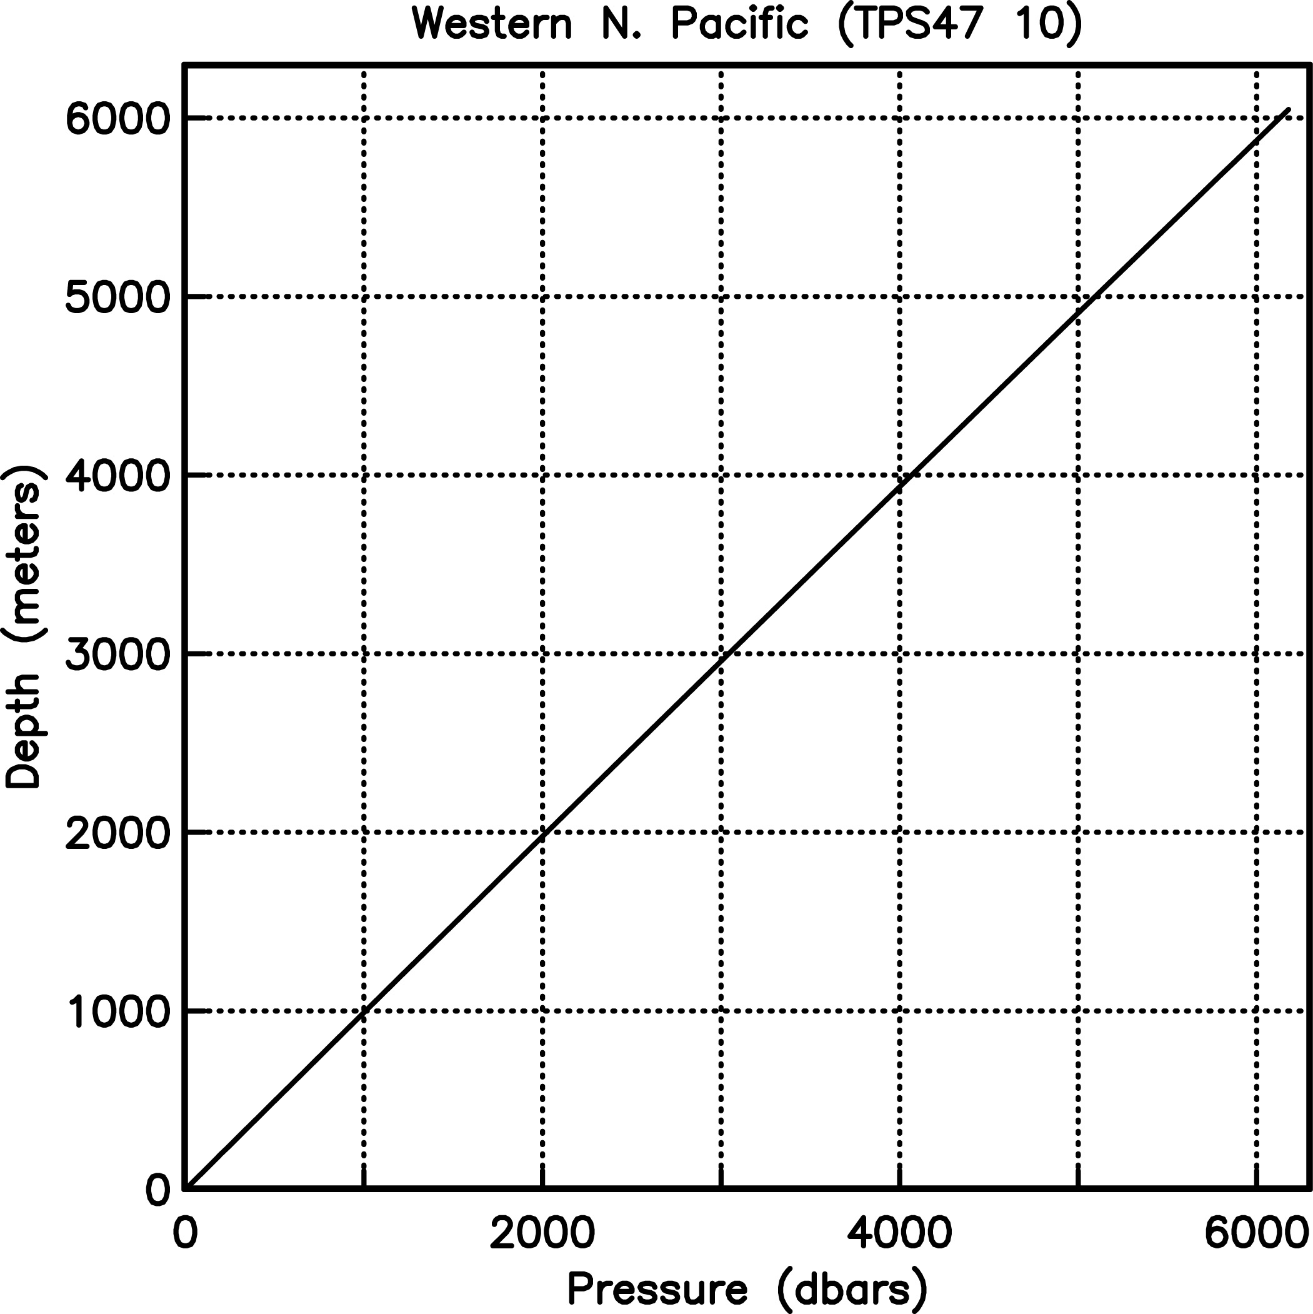
2. Relating pressure and depth
We can then solve for the change in pressure for a given change in depth.
For:
Δz = 1 meter, density ρ ~1025 kg/m³, and g = 9.8 m/s², we get
Δp = - ρ g Δz = (1025 kg/m³)(9.8 m/s²)(1 m) =
10045 kg/(m s²) = 0.10045 bar = 1.0045 dbar
Z

Slide 17
3. Temperature
Temperature units: Kelvin and Celsius
Kelvin is absolute temperature, with 0 K at the point of zero entropy (no motion of molecules)
Celsius 0°C at melting point at standard atmosphere (and no salt, etc)
T_{K} = T_{C} + 273.16°
Ocean temperature range: freezing point to about 30° or 31°C
(Freezing point is < 0°C because of salt content)

Slide 18
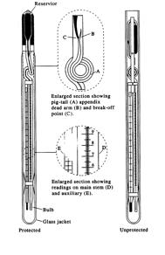
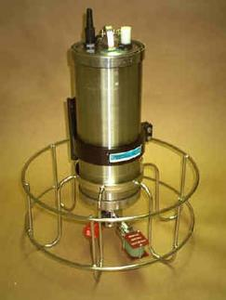
Observing pressure & temperature
Reverse thermometer pair (old)
Quartz transducer (electrical)
Thermistor (electrical)

Slide 19
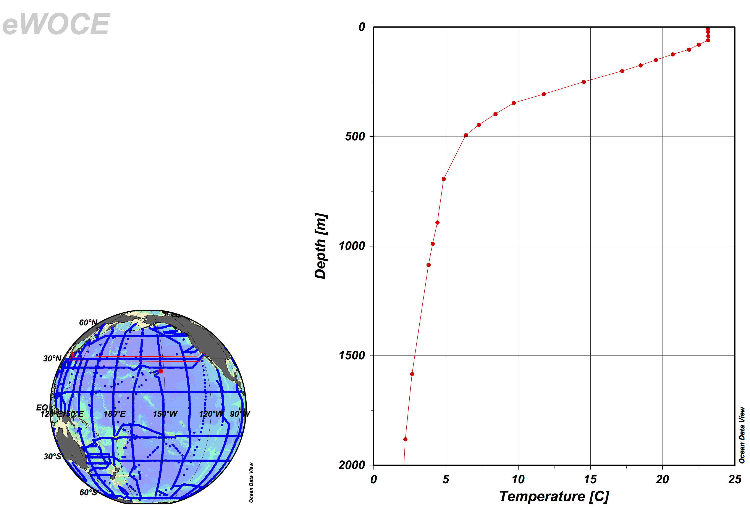
Temperature “profile”
Mixed layer
Thermocline
Deep ocean

Slide 20
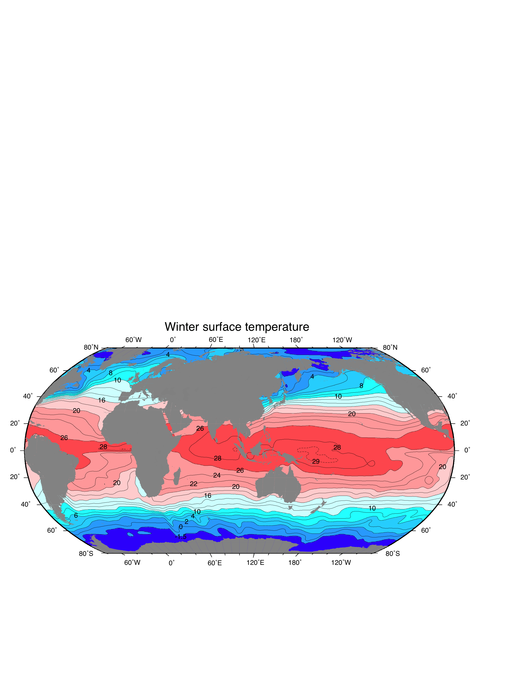
Surface temperature (°C)
Note total range and general distribution of temperature
DPO Figure 4.1: Winter data from Levitus and Boyer (1994)

Slide 21
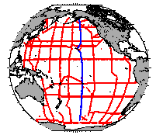
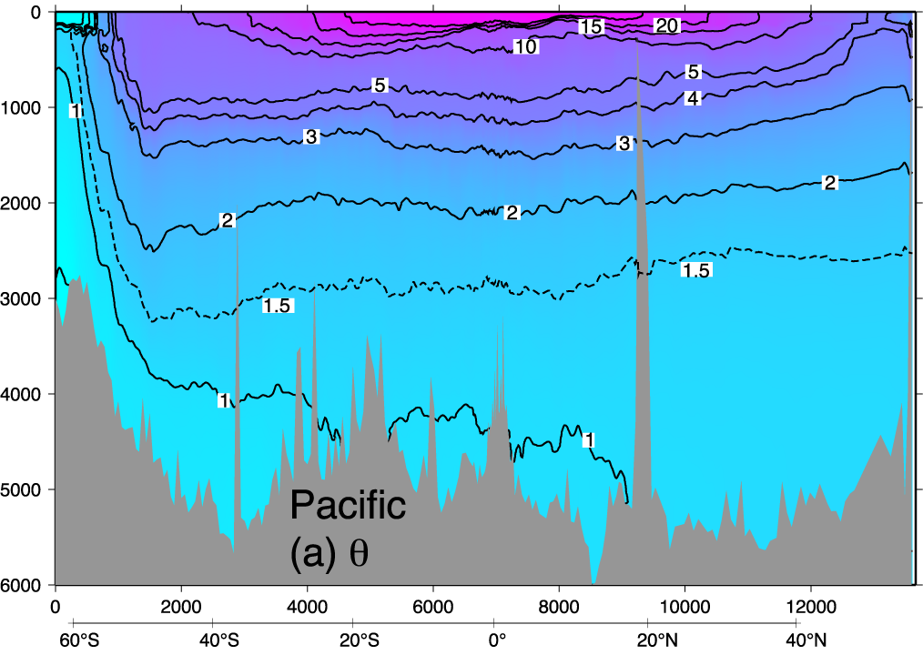
Pacific potential temperature section (“potential” defined on later slides)
Note total range and general distribution of temperature
DPO Fig. 4.12a

Slide 22
Potential temperature
Water (including seawater) is compressible.
If we compress a volume of water adiabatically (no exchange of heat or salt), then its temperature increases. (“adiabatic compression”)
When we think of vertical motion in the ocean, we are not interested in the adiabatic compression effect on temperature. We prefer to track something that is conserved following the parcel.
Define “potential temperature” as the temperature a parcel of water has if moved adiabatically (without heat exchanges or mixing) to the sea surface.
Use the Greek letter θ to denote potential temperature.
Potential temperature is always lower than measured temperature except at the sea surface (where they are the same by definition)
Notes:
Ended here Day 1

Slide 23
Potential temperature expressions
The change in temperature with pressure that is due solely to pressure is called the “adiabatic lapse rate”:
Γ(S,T,p) = ∂ T/∂ p (> 0)
In the atmosphere, the adiabatic lapse rate is equivalent to 6.5°C per 1000 m altitude.
In the ocean, the adiabatic lapse rate is about 0.1°C per 1000 m depth (1000 dbar pressure).
Potential temperature is defined as
Again: potential temperature is always lower than measured temperature except at the sea surface (where they are the same by definition) (p_{ref} = 0 dbar, p is > 0 dbar)
Notes:
Integration limits: lower is p, upper is pref. If gamma is constant, expression becomes theta = T + gamma*(pref – p)

Slide 24
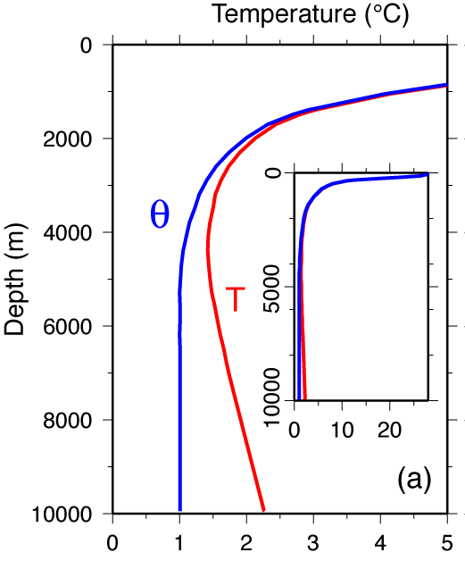
Pressure effect on temperature:
Mariana Trench (the most extreme example because of its depth)
Note the measured temperature has a minimum around 4000 dbar and increases below that.
Potential temperature is almost exactly uniform below 5000 m: the water column is “adiabatic”.(This is because all of the water in this trench spilled into it over a sill that was at about 5000 m depth.)
X
DPO Figure 4.9

Slide 25
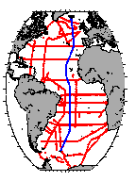
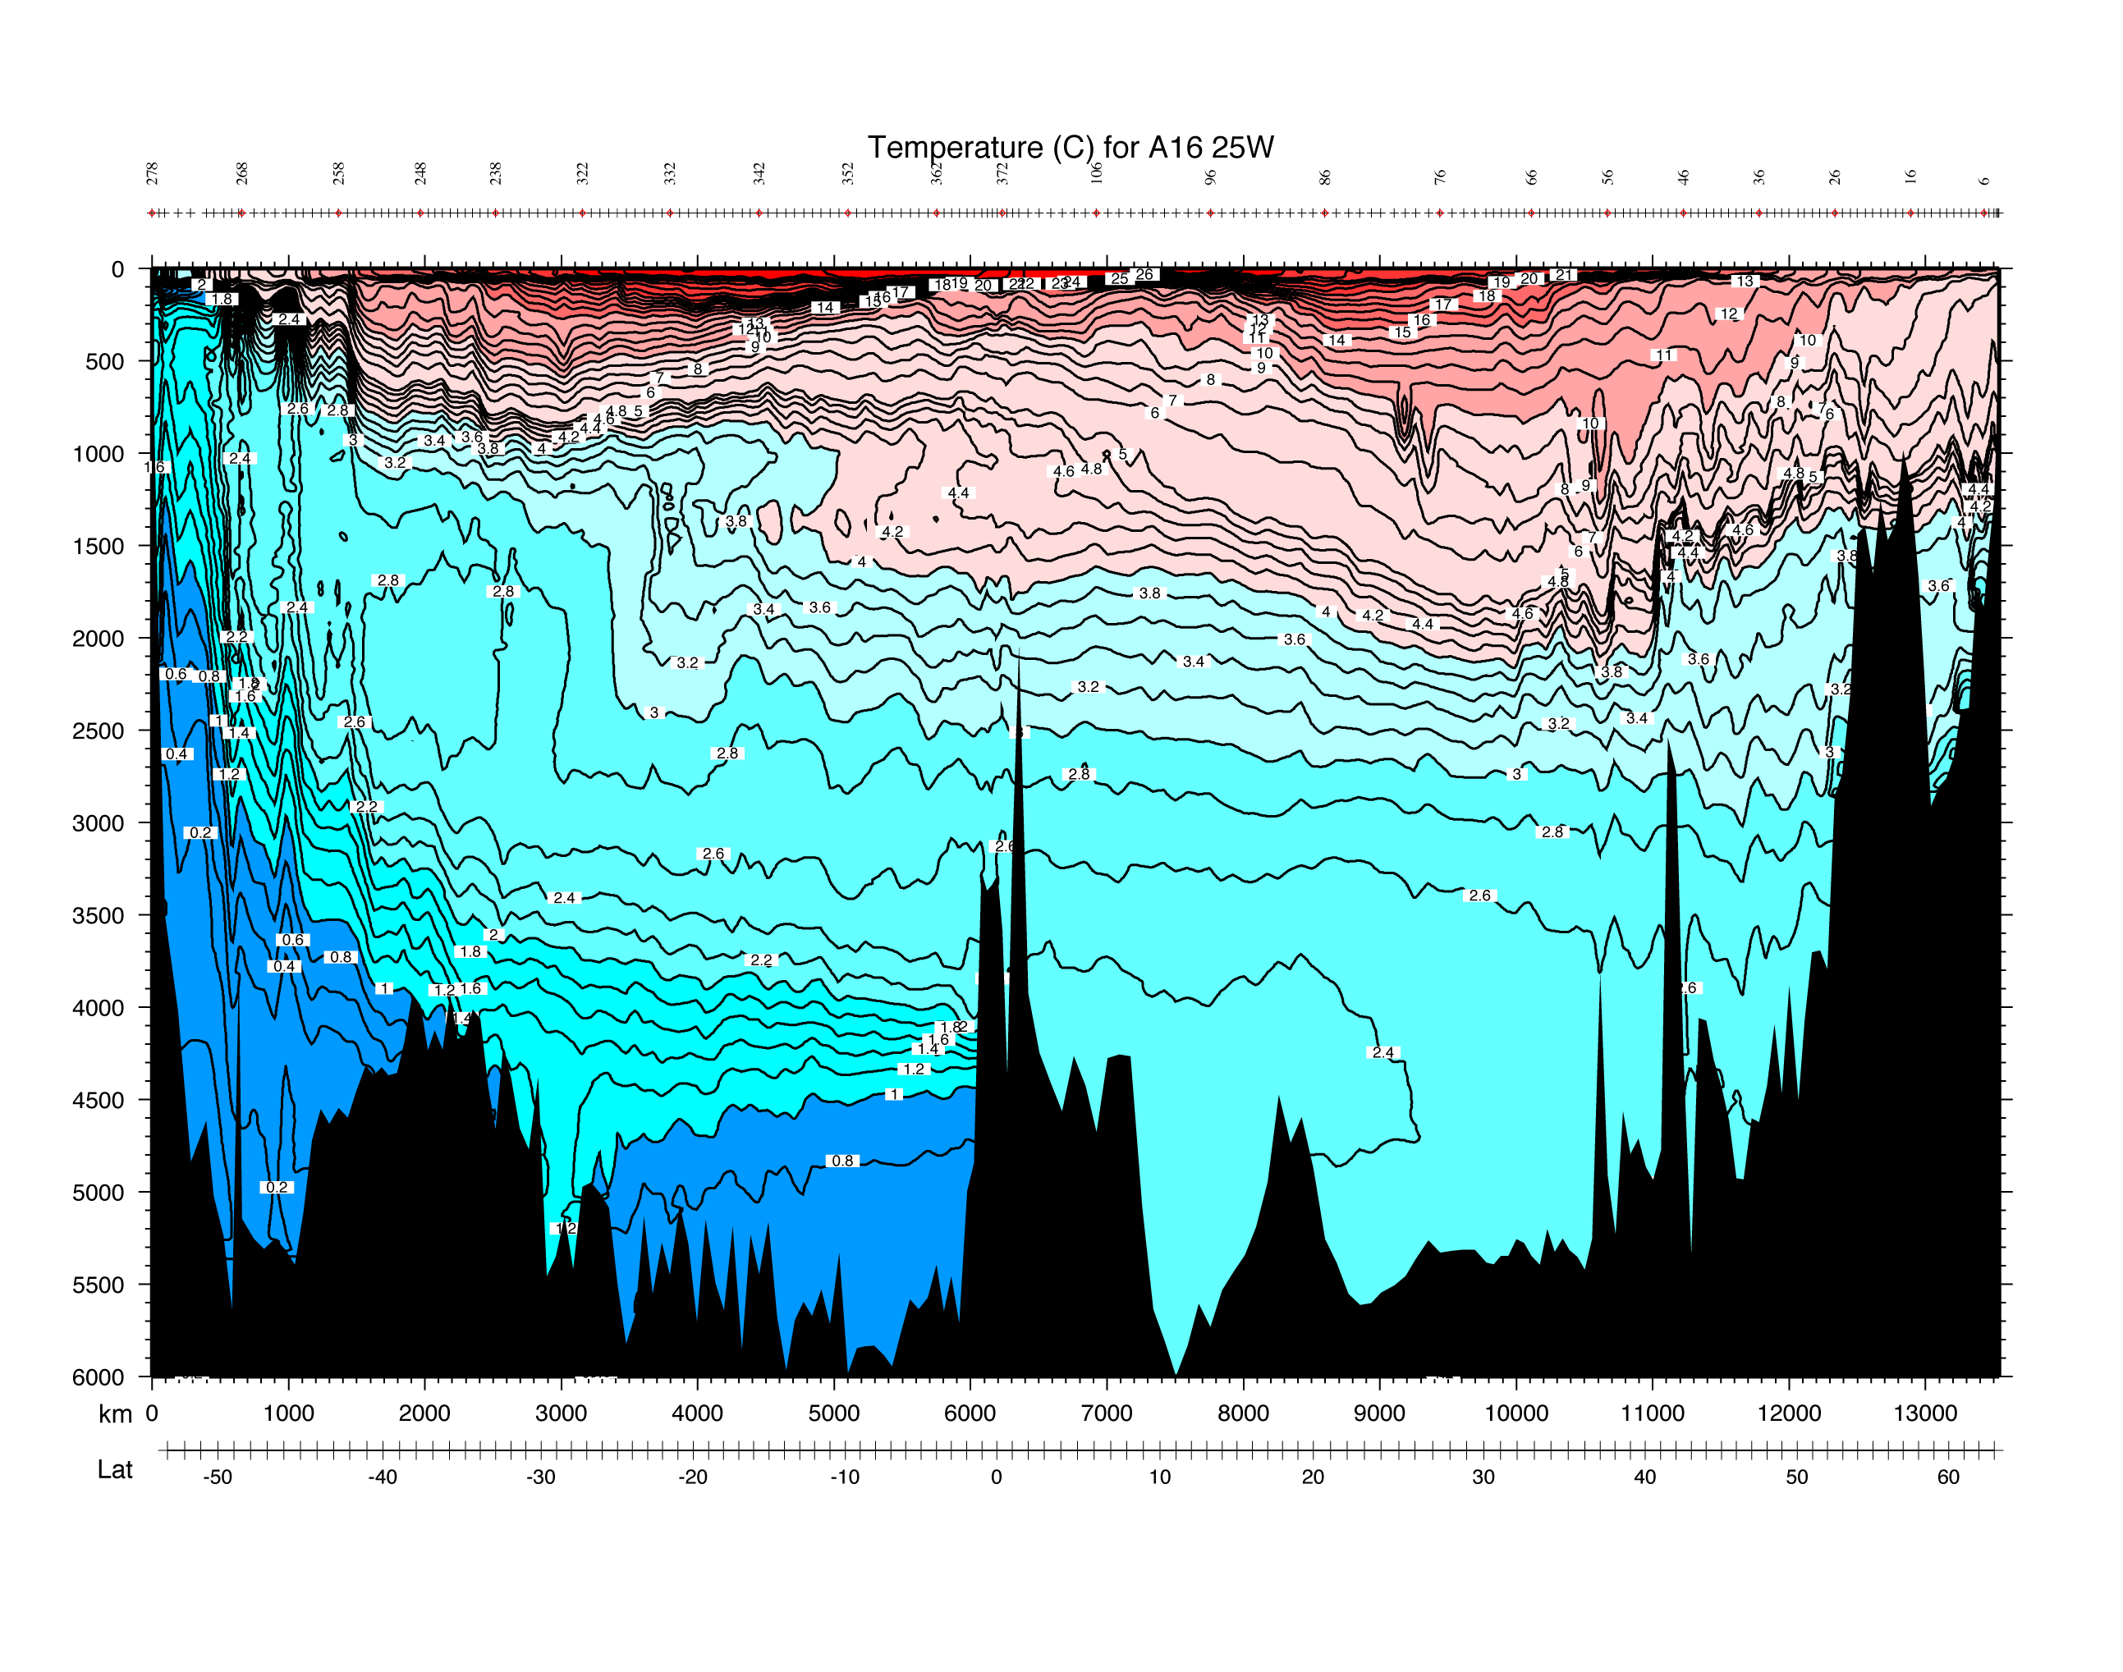
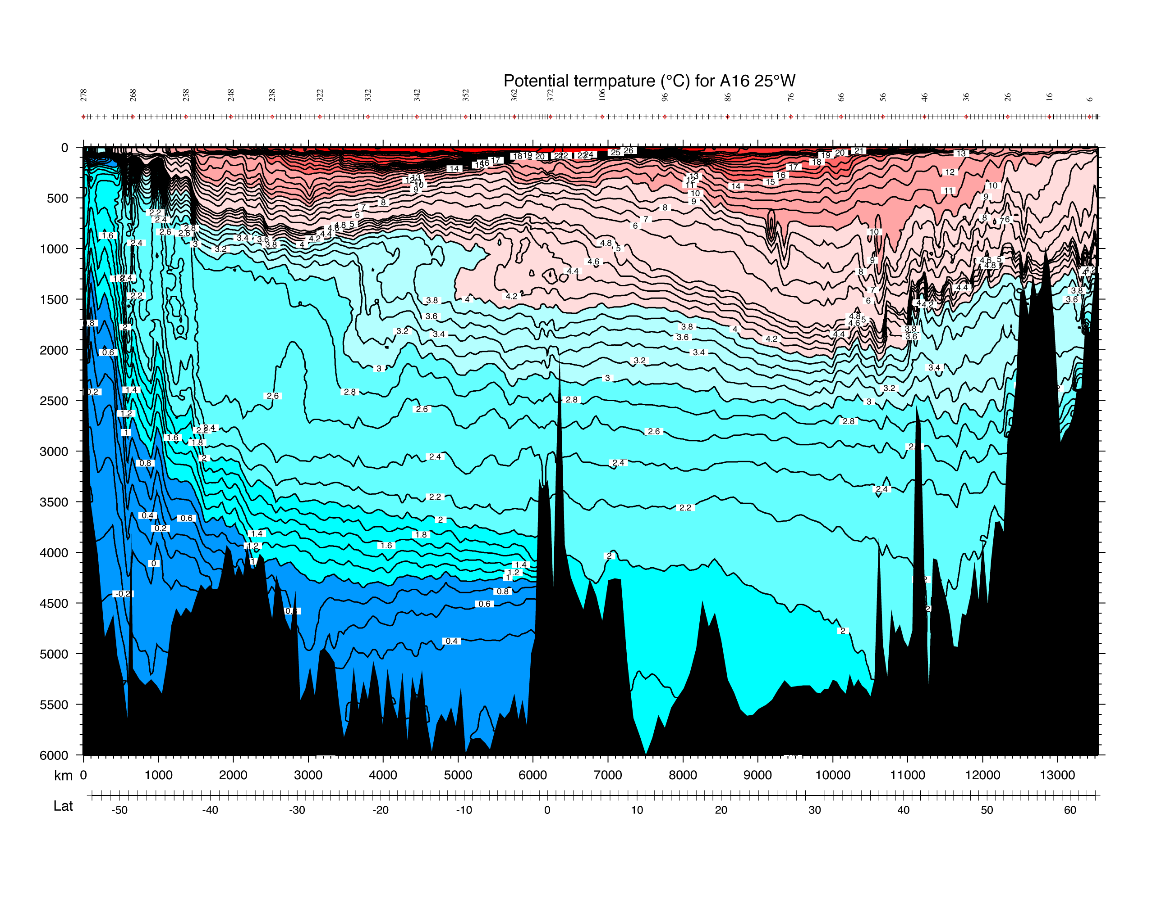
Atlantic temperature and potential temperature sections for contrast
Temperature
Potential temperature

Slide 26
Surface temperature (°C)
Note total range and general distribution of temperature
DPO Figure 4.1: Winter data from Levitus and Boyer (1994)

Slide 27
Recent changes in surface temperature
https://data.giss.nasa.gov/gistemp/maps/

Slide 28
Zonal mean temperature trend
Zonal mean = average across the constant latitude circles

Slide 29
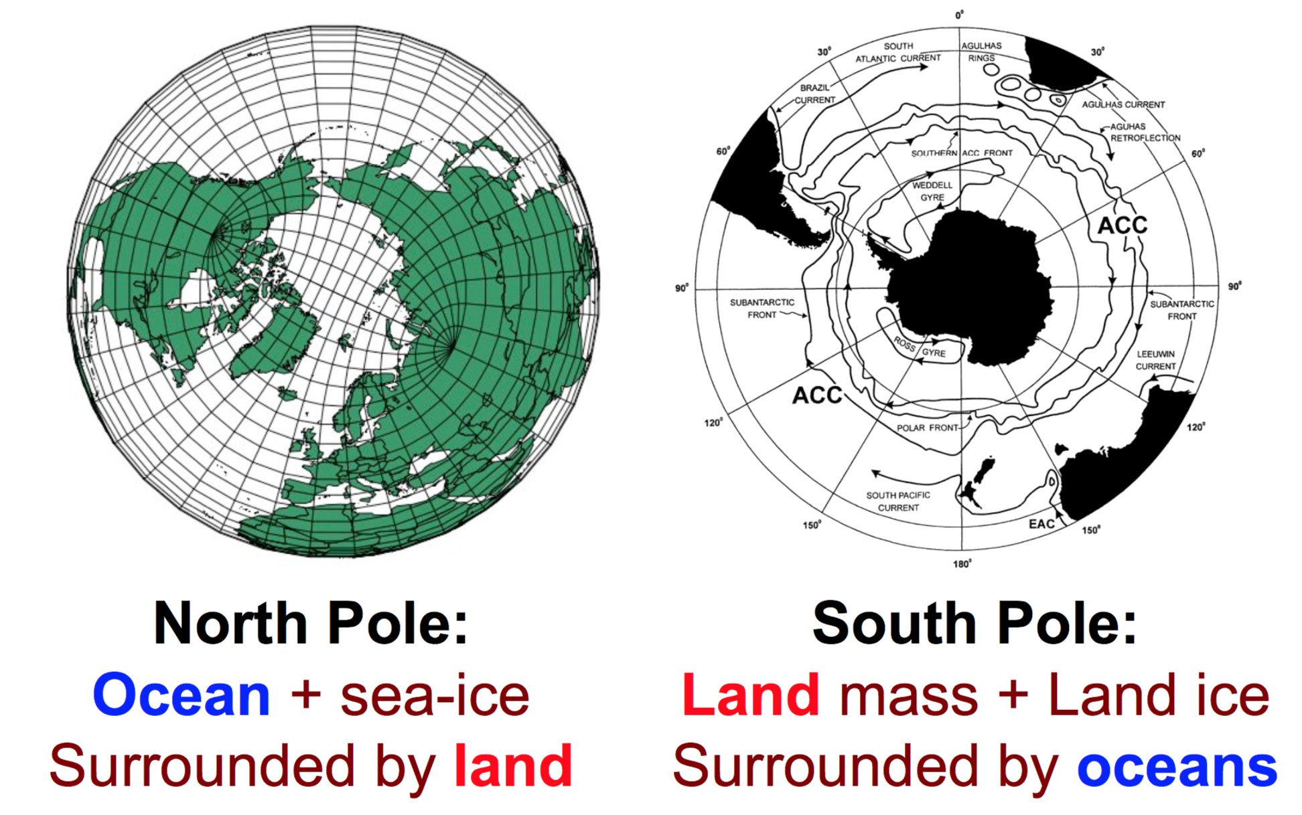

Slide 30
Sea ice area
J. Steven, NASA Earth Observatory

Slide 31
4. Salinity
“Salinity” in the oldest sense is the mass of matter (expressed in grams) dissolved in a kilogram of seawater = Absolute salinity
Units are parts per thousand (o/oo) or “psu” (practical salinity units), or unitless (preferred UNESCO standard, since salinity is mass/mass, but this has now changed again, in 2010)
The concept of salinity is useful because all of the constituents of sea salt are present in almost equal proportion everywhere in the ocean.
This is an empirical “Law of equal proportions”
(There are really small variations that are of great interest to marine chemists, and which can have a small effect on seawater density, but we mostly ignore them; note that the new definition of salinity in TEOS-10* takes these small variations into account.)
*TEOS-10 is “Thermodynamic Equation of State 2010”

Slide 32
4. Salinity
“Salinity” in the oldest sense is the mass of matter (expressed in grams) dissolved in a kilogram of seawater = Absolute salinity
Amount of salt per unit mass of seawater
S in a typical seawater is about 35.

Slide 33
Salinity measurement
Typical ocean salinity is 34 to 36 (i.e. 34 to 36 gm seasalt/kg seawater)
Measurements:
Oldest: evaporate the seawater and weigh the salts
Old: titration method to determine the amount of chlorine, bromine and iodine (prior to 1957)
Modern: Use seawater conductivity, which depends mainly on temperature and, much less, on salinity, along with accurate temperature measurement, to compute salinity.
Modern conductivity measurements:
(1) in the lab relative to a reference standard
(2) profiling instrument (which MUST be calibrated to (1))

Slide 34
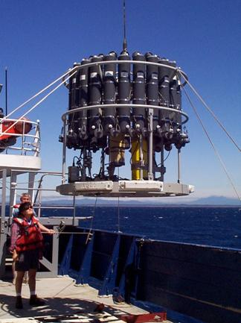
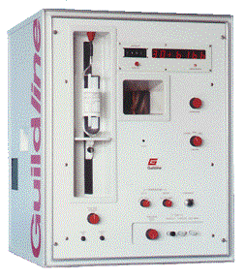
Salinity instruments
CTD (conductivity, temperature, pressure) for measuring conductivity in a profile (on the fly)
Autosalinometer for running salinity analyses relative to standard seawater
Bottles for collecting water samples

Slide 35
TEOS-10: Thermodynamic Equation of State 2010
There are really small variations* that are of great interest to marine chemists, and which can have a small effect on seawater density, but we mostly ignore them; note that the new definition of salinity in TEOS-10* takes these small variations into account.
These variations comes from the spatial variation in silicate, nitrate and alkalinity.

Slide 36
“Absolute salinity” (TEOS-10)
Absolute salinity = reference salinity + correction for other stuff
S_{A} = S_{R} + δS_{A}
Reference salinity S_{R} = 35.16504/35 * Practical salinity = 1.0047*psu
Reference salinity has been corrected for new knowledge (since 1978) about sea water stoichiometry as well as new published atomic weights.
The correction δS_{A} is for dissolved matter that doesn’t contribute to conductivity variations: silicate, nitrate, phosphate, etc.

Slide 37
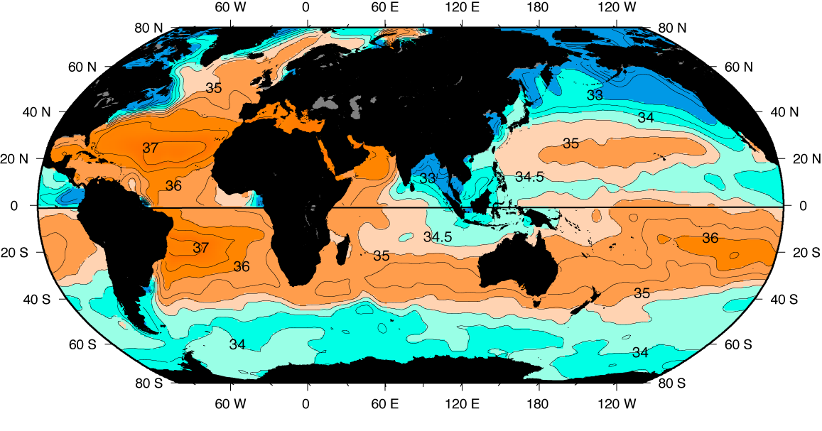
Surface salinity
Note range of values and general distribution
Surface salinity (psu) in winter (January, February, and March north of the equator; July, August, and September south of the equator) based on averaged (climatological) data from Levitus et al. (1994b).
DPO Figure 4.15

Slide 38
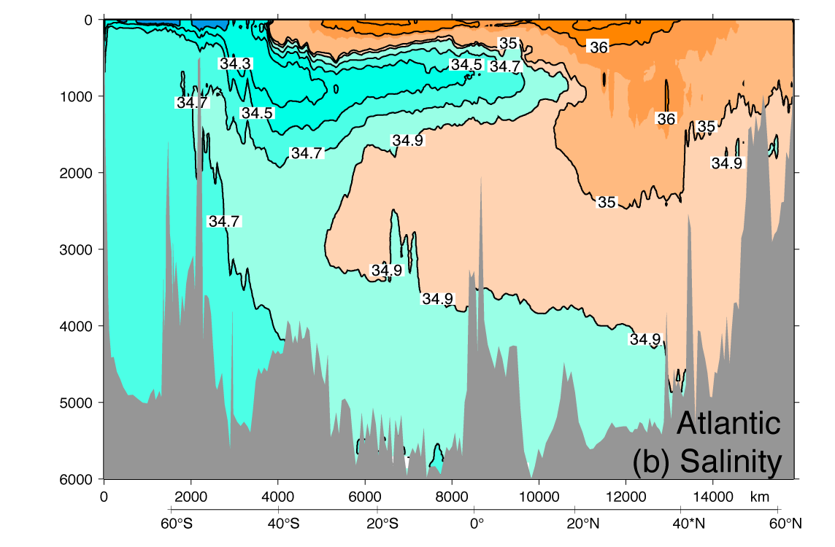
Atlantic salinity section
DPO Figure 4.11b

Slide 39
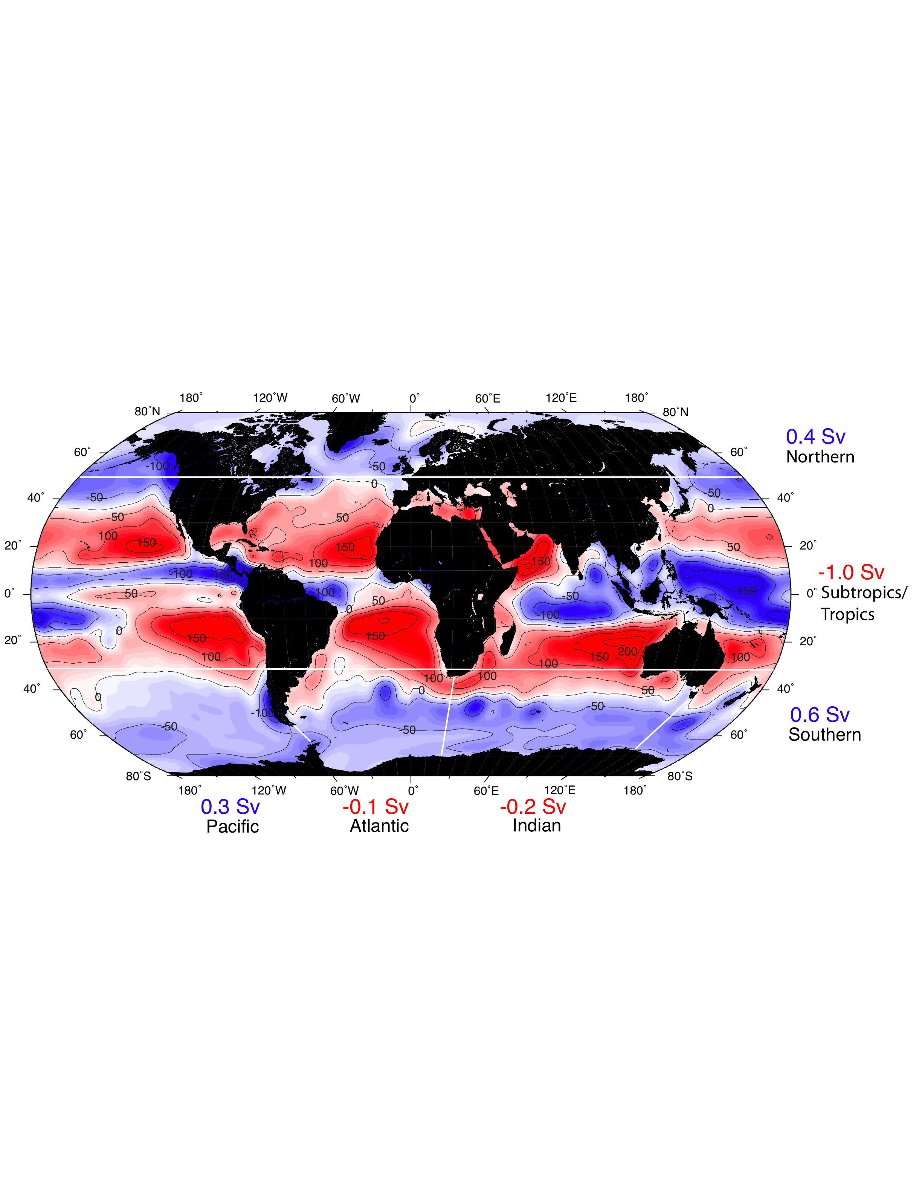
What sets salinity? Precipitation + runoff minus evaporation (cm/yr)
Salinity is set by freshwater inputs and exports since the total amount of salt in the ocean is constant, except on the longest geological timescales
NCEP climatology DPO 5.4

Slide 40
Return to Atlantic potential temperature: what about this inversion – why is it vertically stable?

Slide 41
Density of seawater
Seawater density depends on S, T, and p
ρ = ρ(S, T, p) units are mass/volume (kg/m³)
Specific volume
α = 1/ρ units are volume/mass (m³/kg)
Pure water has a maximum density (at 4°C, atmospheric pressure) of
ρ(0,4°C,1bar) = 1000 kg/m³ = 1 g/cm³
Seawater density ρ ranges from about 1022 kg/m³ at the sea surface to 1050 kg/m³ at bottom of ocean, mainly due to compression

Slide 42
Equation of state (EOS)
Common way to express density is as (“sigma”)
σ (S, T, p) = ρ(S, T, p) - 1000 kg/m³
The EOS is nonlinear
This means it contains products of T, S, and p with themselves and with each other (i.e. terms like T², T³, T⁴, S², TS, etc.)
You will calculate density of seawater in HW#2.

Slide 43
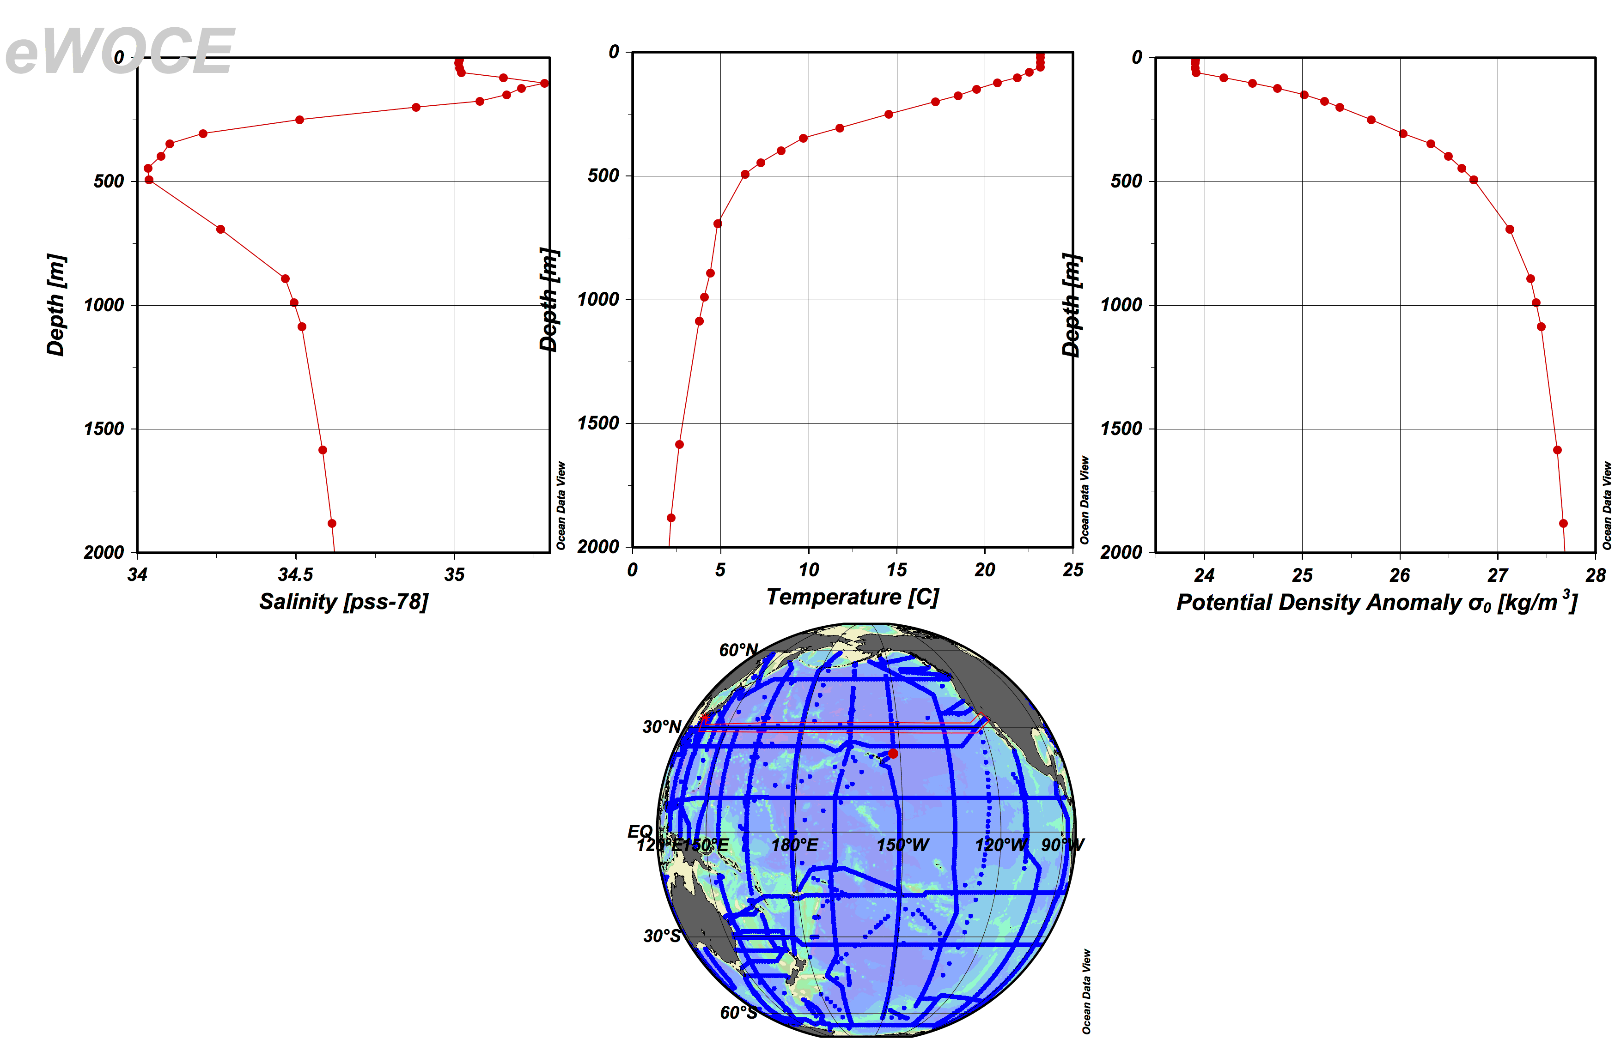
Salinity, temperature and density

Slide 44
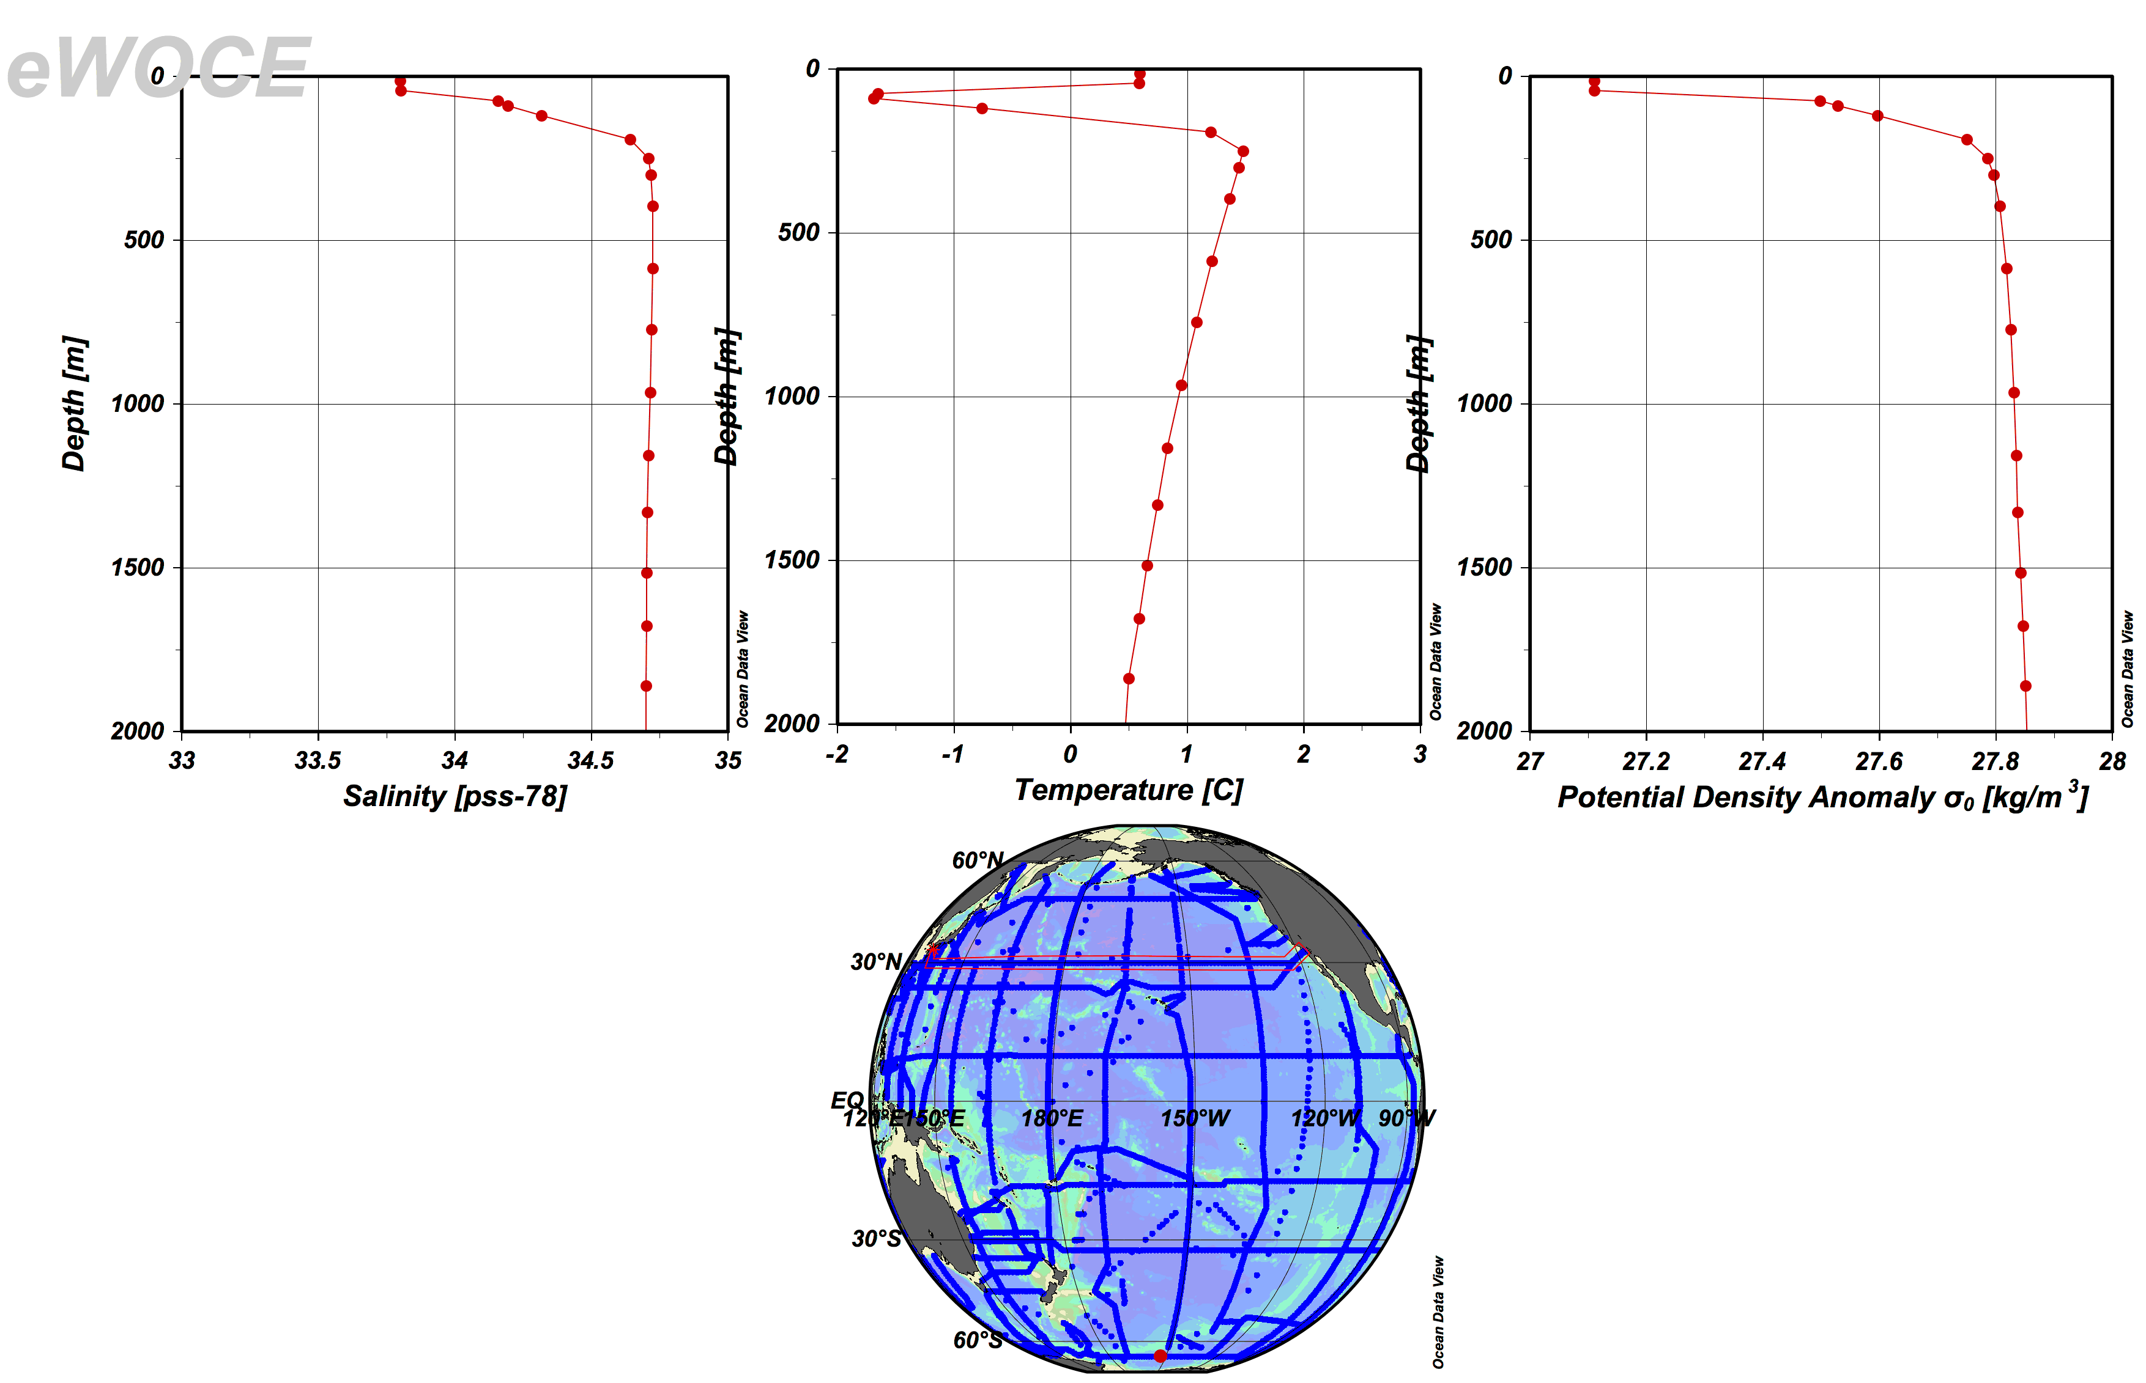

Slide 45
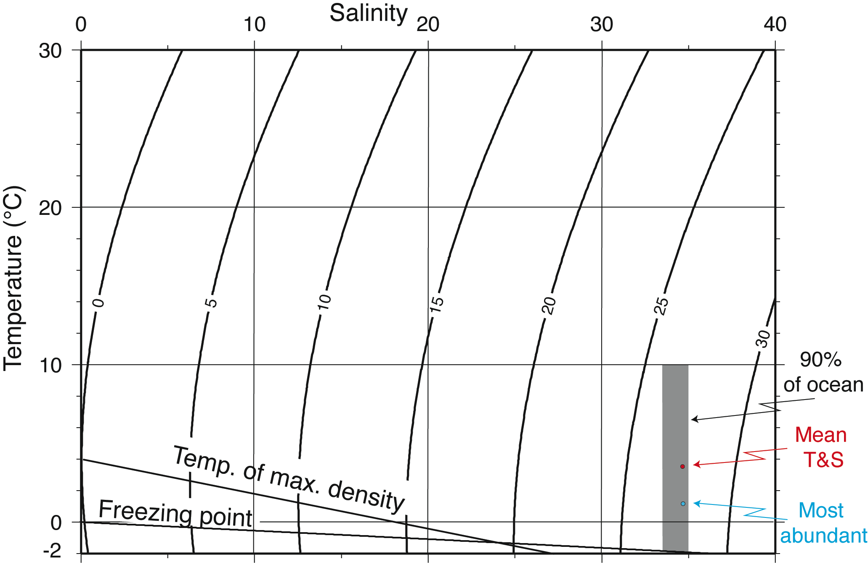
Seawater density, freezing point
DPO Figure 3.1
Notes:
Return to in Distributions lecture

Slide 46
Where does most of the volume of the ocean fit in temperature/salinity space?
75% of ocean is 0-6°C, 34-35 psu
50% is 1.3-3.8°C, 34.6-34.7 psu (σ_{θ}=27.6 to 27.7 kg/m³)
Mean temperature and salinity are 3.5°C and 34.6 psu
DPO Figure 3.1
Notes:
First set of slides repeats what was shown in physical properties lectures

Slide 47
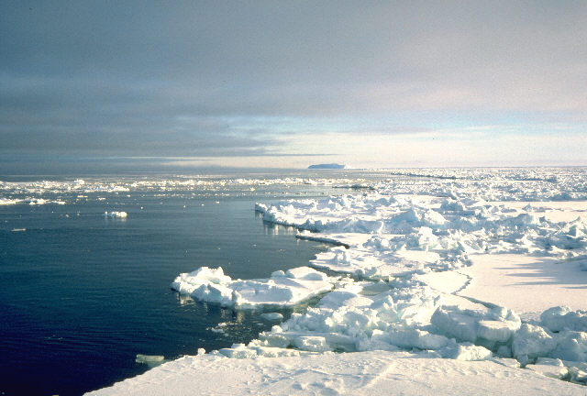
freezing point and sea ice
Freezing point temperature decreases with increasing salinity
Temperature of maximum density decreases with increasing salinity
They cross at ~ 25 psu.
Most seawater has maximum density at the freezing point
Deep water is generally
colder than 4°C. Density of
deep water is controlled by
salinity more than
temperature.

Slide 48
Brine rejection
Brine rejection: as sea ice forms, it excludes salt from the ice crystal lattice.
The salt drips out the bottom, and the sea ice is much fresher (usually ~3-4 psu) than the seawater (around 30-32 psu)
The rejected brine mixes into the seawater below. If there is enough of it mixing into a thin enough layer, it can measurably increase the salinity of the seawater, and hence its density
This is the principle mechanism for forming the densest waters of the world ocean.

Slide 49
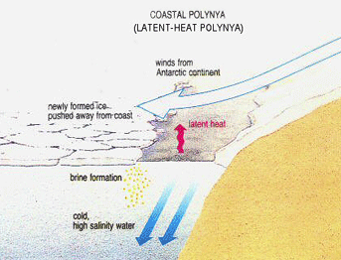
Polynya, seaice production, dense water formation

Slide 50
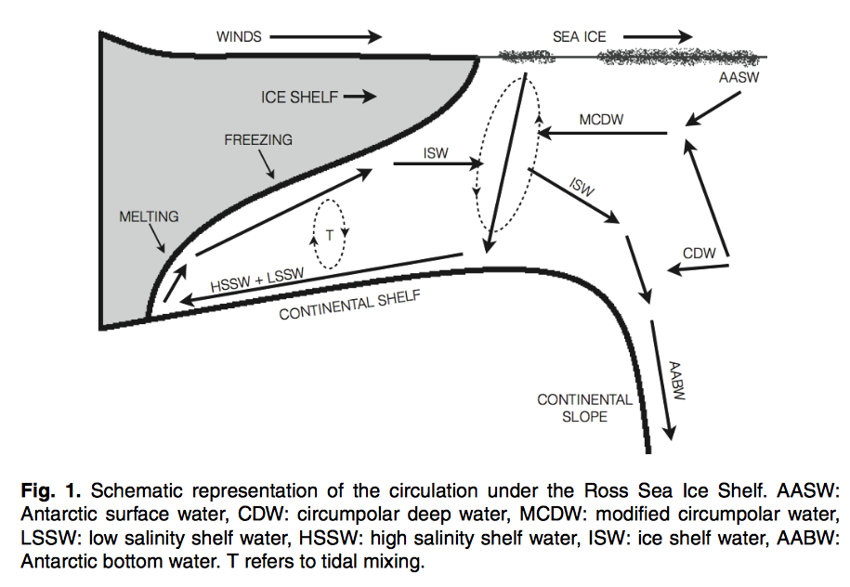
Tonelli et al., 2012

Slide 51
Continue to week 2

