Slide 1
Week 8: Seasonality, air-sea interaction and ventilation
Satellite SST: NASA JPL http://podaac.jpl.nasa.gov/AnimationsImages/Animations

Slide 2
What we cover this week
Atmosphere-Ocean interaction on seasonal timescale
Surface heating / cooling
Buoyancy flux
Mixed layer convection
Vertical circulations in the ocean
Ventilation
Formation of thermocline and deep waters
Thermohaline circulation

Slide 3
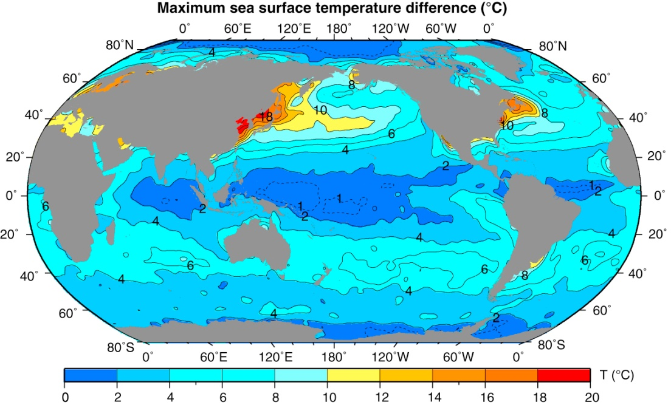
Seasonality of SST
Annual range of sea surface temperature (°C), based on monthly climatological temperatures from the World Ocean Atlas (WOA05) (NODC, 2005a, 2009).

Slide 4
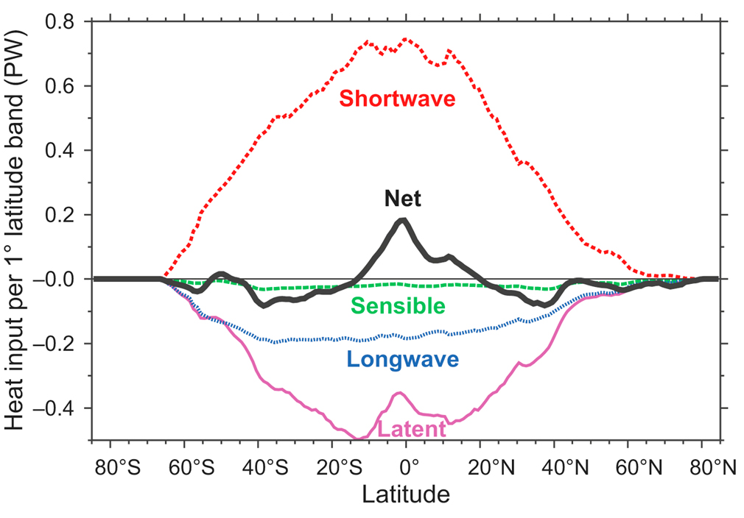
Air-sea exchange of heat
Annual mean, zonally averaged surface heat fluxes
Heat flux components: [W/m²]
Short-wave radiation
Long-wave radiation
Sensible heat flux
Latent heat flux

Slide 5
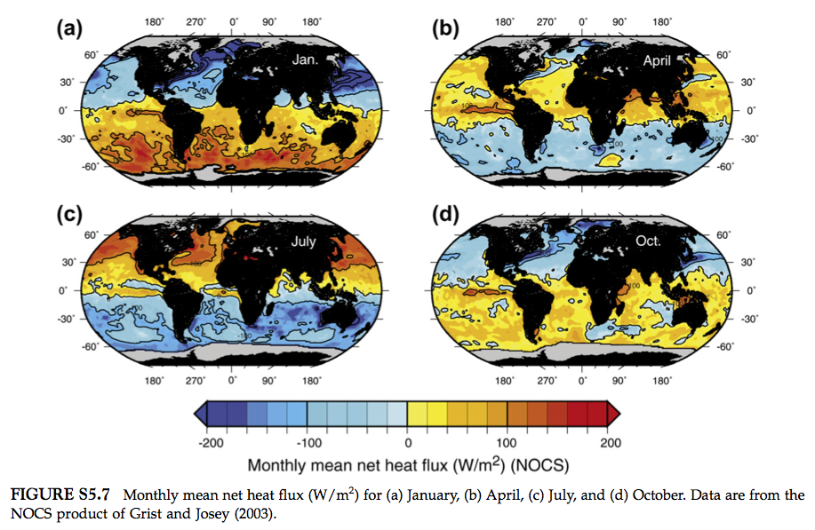
Seasonality of net heat flux

Slide 6
Air-sea heat flux
Short wave radiation is the dominant source of heat among the four components of air-sea heat fluxes. The strongest heating occurs in the summer. It is also a function of cloud cover.
Latent heat flux is the largest heat sink for the surface water. It is proportional to the rate of evaporation. The strongest cooling occurs in the winter.
Evaporation rate depends on the difference between SST and air temperature directly above the sea surface, wind speed, and relative humidity.
The net heat flux shows a strong seasonality and its amplitude generally increases with latitude.

Slide 7
Thermodynamic equation
Heat balance
H: heat flux (positive into the ocean)
ρ₀ : reference density ~ 1025 kgm⁻³ c_{P} : specific heat of seawater ~ 3900 Jkg⁻¹K⁻¹

Slide 8
Salinity
Seasonal cycle of S reflects the imbalance evaporation and precipitation
Consider conservation of salt in the mixed layer
For unit area:
Continuity equation for salinity

Slide 9
Air-sea exchange of buoyancy
T and S together control the density of s.w.
What is buoyancy?
Seasonal cycle of T and S leads to density changes → affects dynamics: mixing and circulation

Slide 10
Air-sea buoyancy flux
Combine temperature and salinity equations to write down the equation for buoyancy

Slide 11
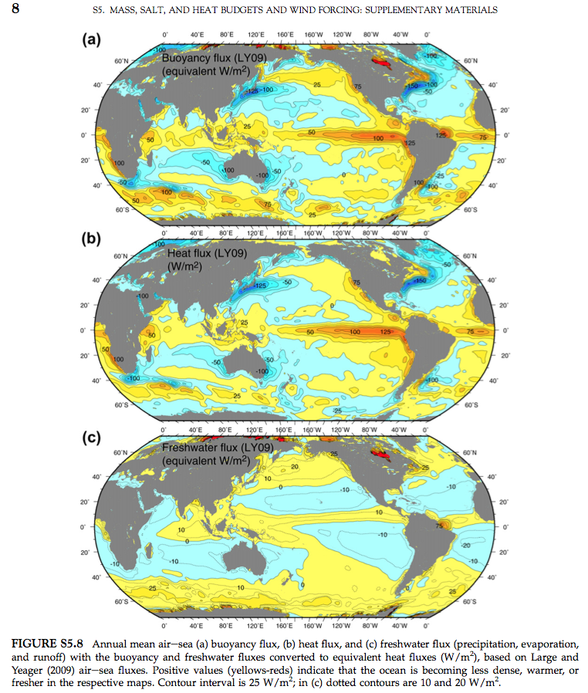
T, S and buoyancy flux (annual mean)
b
T
S

Slide 12
Air-sea exchange of momentum
Wind stress is what drives the ocean (waves, currents).
Wind speed is measured above the sea surface. In practice measurements are at different heights. For consistency, adjust all measurements to a 10 meter height.
Actual stress on the ocean: Units of wind stress: N/m²
τ = c_{D}ρu₁₀²
where u₁₀ is the wind speed at 10 meters, ρ is the air density 1.3 kg/m³, and c_{D} is the (dimensionless) drag coefficient, which is determined empirically.

Slide 13
Drag coefficient
Again, wind stress is τ = ρc _{D} u₁₀ ² in units of N/m²
where u₁₀ = wind speed at 10 m height
ρ is air density 1.3 kg/m³
c _{D} is a “drag coefficient” (dimensionless)
At low wind speeds, c _{D} ≈ 1.1 x 10⁻³
At higher wind speeds, c _{D} ≈ (0.61 + 0.063 u) x 10⁻³
Fairall et al. (2003, J. Climate)

Slide 14
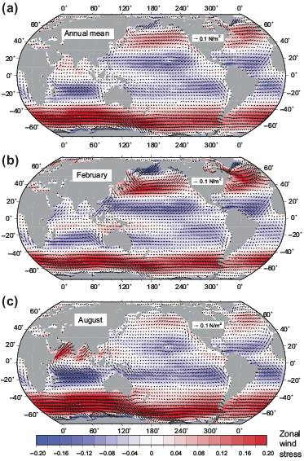
Annual mean
NH winter
NH summer

Slide 15
What regulates the seasonality in the oceans?
Heat flux
SW radiation in the summer and latent heat loss in the winter
Temperature and salinity controls the density (buoyancy) flux, which is primarily temperature-driven
Wind stress
The wind stress is generally stronger in the winter seasons
Monsoon wind is driven by the seasonal reversal of land-ocean temperature gradient

Slide 16
Seasonality of the surface mixed layer
NH winter
NH summer

Slide 17
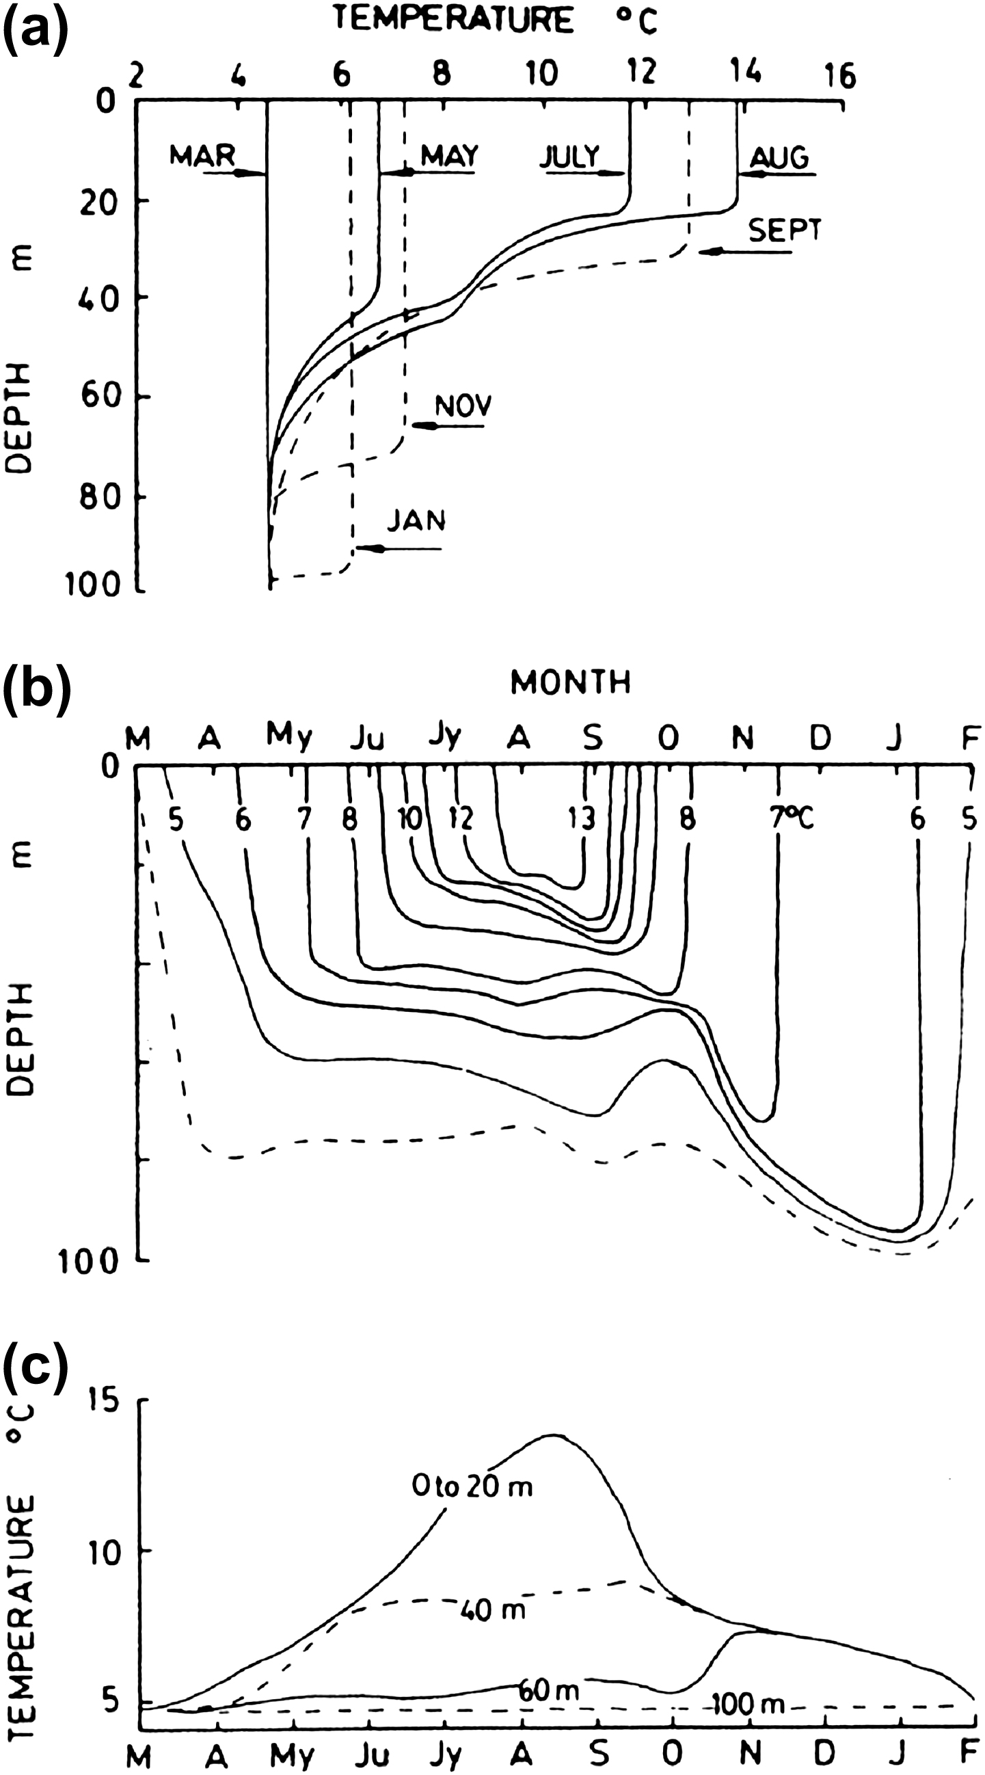
Vertical structure of seasonal T change
Observed in the subpolar North Pacific
Vertical temperature profiles
Time series of isothermal contours, and
Time series of temperatures at depths shown.

Slide 18
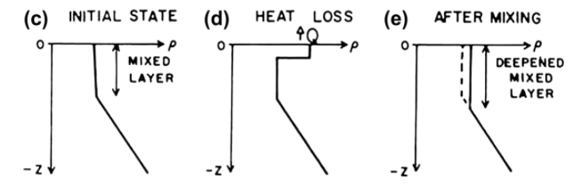
What controls the mixed layer depth?
Cooling → Makes surface water dense → Dense water sinks/mixes with deeper layer → Deepens the mixed layer
The vertically integrated density increase (buoyancy decrease) balances the net heat loss at the surface

Slide 19
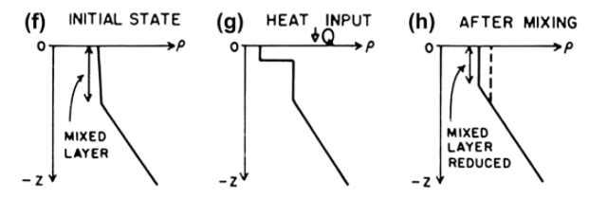
What controls the mixed layer depth?
Heating → Makes surface water light → Shoals the mixed layer
The vertically integrated density decrease (buoyancy increase) balances the net heat gain at the surface

Slide 20
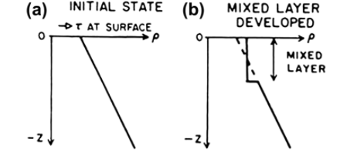
Wind driven mixing
Wind stress → Intensify the surface currents → Intensify the near-surface turbulence → Deepens the mixed layer
Vertically integrated buoyancy is conserved in this scenario

Slide 21
Energetics of mixed layer convection
Potential energy (per unit volume) = ρgz
Two cases:
1. Well-mixed with thickness h
2. Stratified (Δρ) with equal thickness h/2
h/2
ρ−Δρ
h
ρ
h/2
ρ+Δρ

Slide 22
Energetics of mixed layer convection
(2) Stratified state
(1) Well-mixed state
-
-
h/2
ρ−Δρ
h
ρ
h/2
ρ+Δρ
Well-mixed state has higher potential energy. Transition from (2) to (1) requires energy input.

Slide 23
Energetics of mixed layer convection
Mixing the stratified fluid requires energy input
This compensates the potential energy increase
Wind stress (kinetic energy source ➔ conversion to the potential energy)
Cooling (making surface layer heavy ➔ potential energy gain)
Heating (making surface layer light ➔ potential energy loss)
(Potential energy gain due to deepening of ML)
(Potential energy input due to buoyancy loss)
(Wind kinetic energy input)

Slide 24
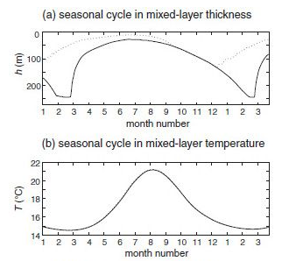
A bulk mixed layer model
Klaus and Turner (1967)
Where

Slide 25
Seasonal asymmetry
SST integrates the heat flux
Max SST lags behind the maximum heating
Min SST also lags behind the max cooling
MLD
Rapid shoaling in spring
Heating from the top during spring and summer
Heating occurs only the top thin layer
Gradual deepening
Mixing/Entrainment of subsurface water from the deeper layer

Slide 26
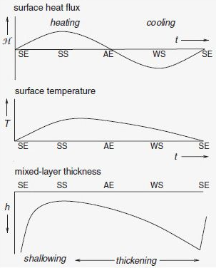
Heat flux, SST and MLD
Heat flux
SST
MLD

Slide 27
“Ventilation” and “Subduction”
“Ventilation” means that the surface mixed layer water sinks into the thermocline or deep ocean and becomes a subsurface water. “Subduction” essentially means the same with emphasis on the advective transfer of mass from the surface mixed layer to the interior ocean.
Ventilation of thermocline (mode water) happens in the mid-latitudes through subduction.
Ventilation of deep water happens in the polar oceans through deep convection and/or overflows.

Slide 28
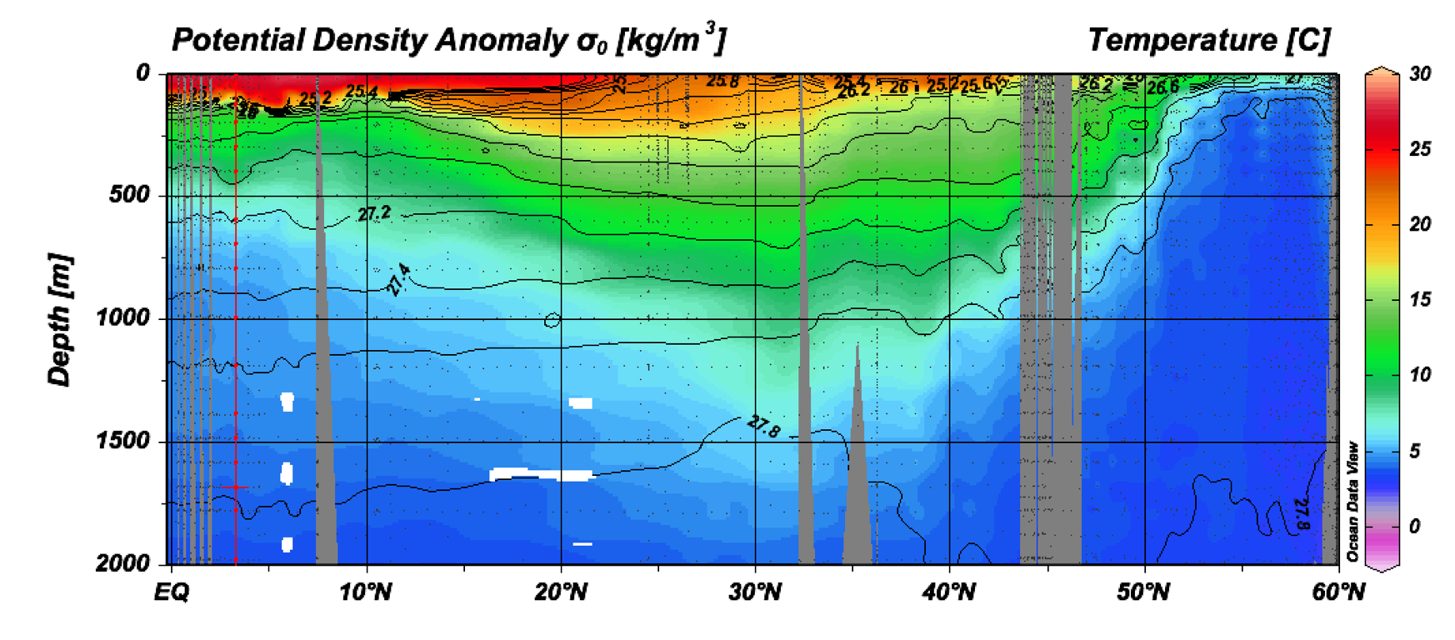
Atlantic transect

Slide 29
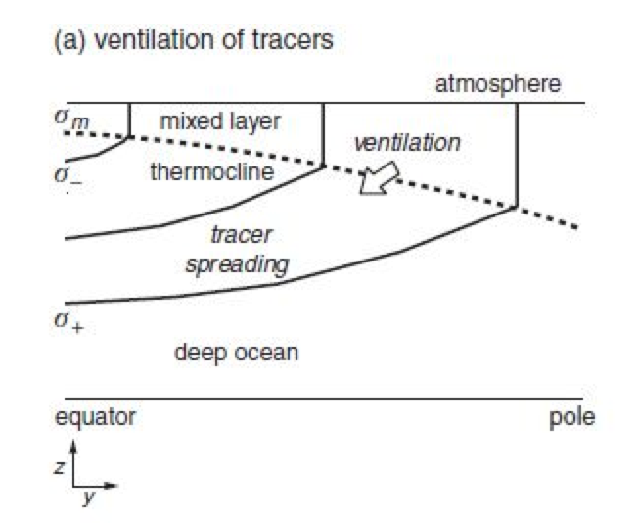
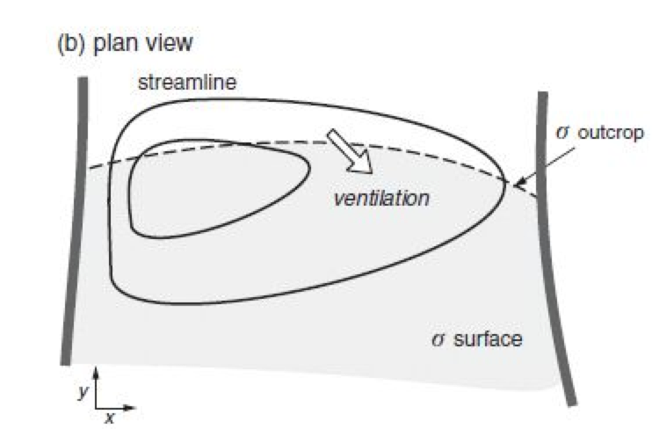
Mid-latitude thermocline ventilation
Isopycnals intersect the base of the winter-time mixed layer at the outcrop (ventilation happens here).

Slide 30
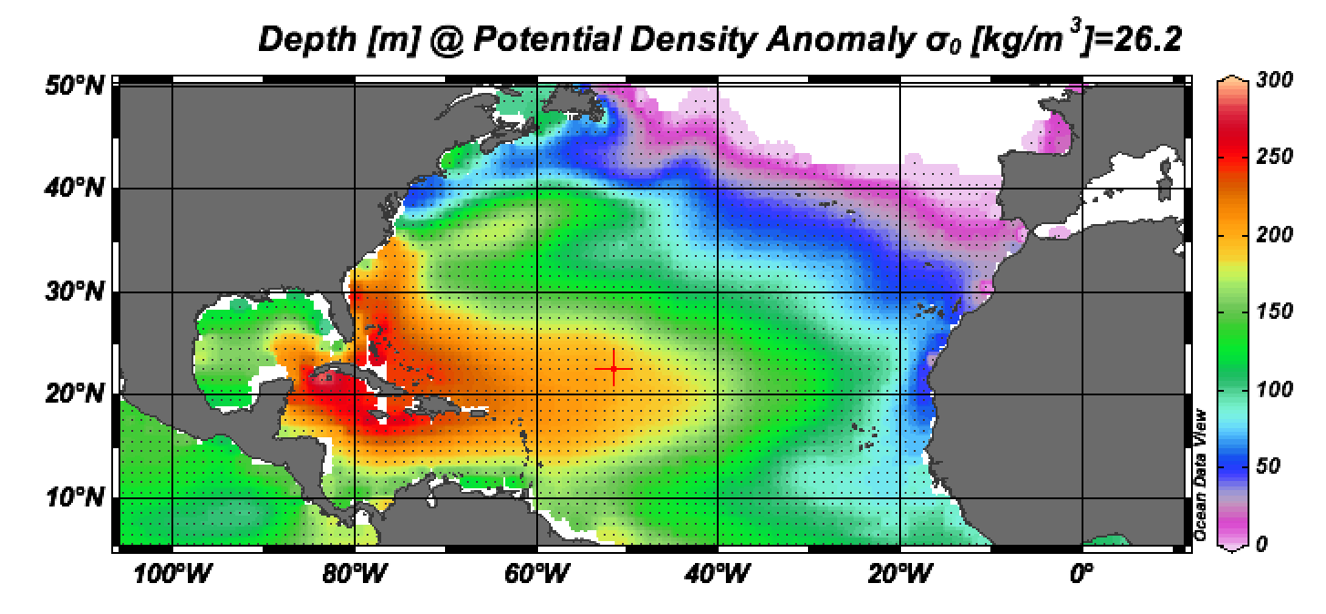
Subtropical Mode Water
Sigma-0 26.2: upper thermocline water
Eastward shoaling of the thermocline depth in the subtropical gyre

Slide 31
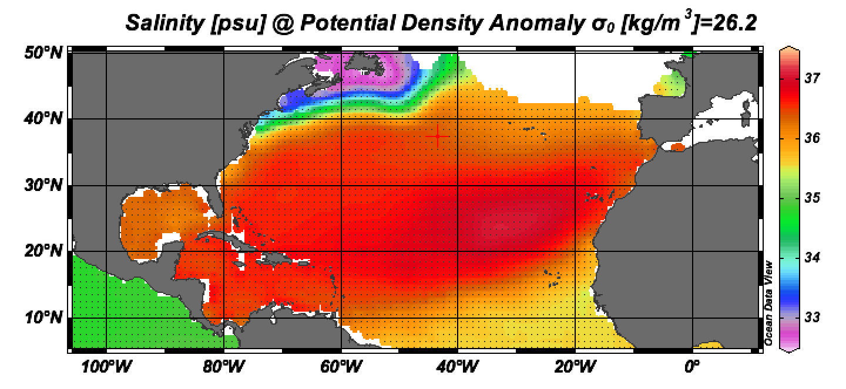
Subtropical Mode Water
Sigma-0 26.2: upper thermocline water
Following the density layer, (T,S) properties are nearly constant

Slide 32
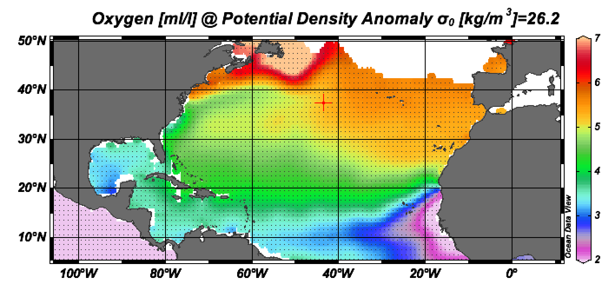
Subtropical Mode Water
Sigma-0 26.2: upper thermocline water
Oxygen decreases away from the isopycnal outcrop

Slide 33
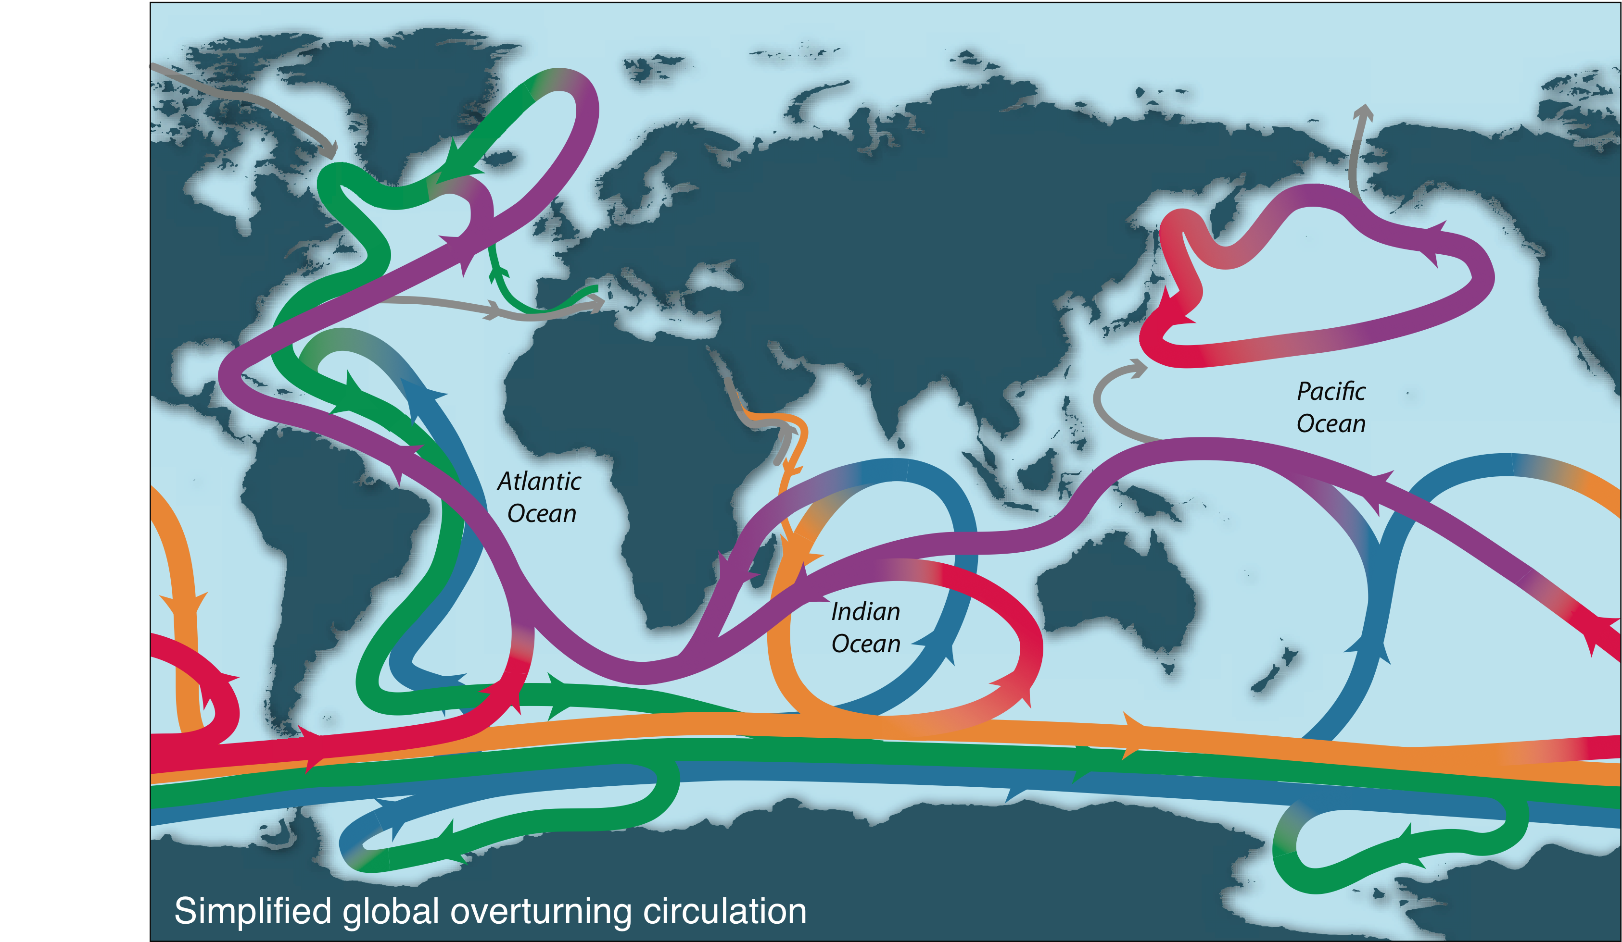
Subpolar circulation & meridional overturning circulation

Slide 34
Some terminologies
Thermohaline circulation refers to large-scale overturning circulation, involving formation of dense, cold water and return of warm water to the sinking regions
Meridional Overturning Circulation refers to essentially the same class of circulation, with emphasis on the north-south and vertical circulation, often abbreviated as “MOC”
Abyssal circulation also refers to essentially the same circulation, with emphasis on the circulation of the deep sea.

Slide 35
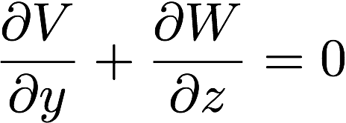
Meridional overturning stream function
Remember mass continuity of the incompressible fluid:
We zonally (east-west) integrate it.
We can define a meridional overturning stream function, Φ, so that the (V, W) will satisfy the mass continuity equation.

Slide 36
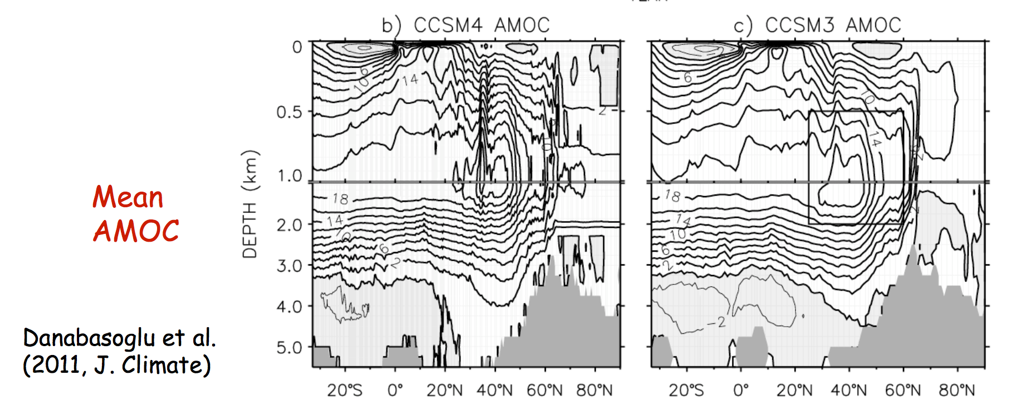
Simulated meridional overturning stream function

Slide 37
North Atlantic MOCs
Subtropical cells: upper ocean, shallow MOCs that involves sinking at mid-latitudes and upwelling in tropics.
Atlantic Meridional Overturning Circulation (AMOC)
Sinking and export NADW from the N. Atlantic
Antarctic Bottom Water (AABW) cell
Sinking in the polar Southern Ocean

Slide 38
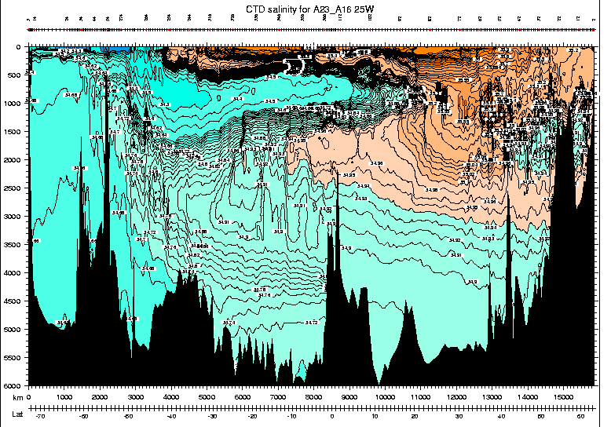
Atlantic Meridional Overturning Circulation (AMOC)
AAIW
MOW
LSW
NADW
NSOW
AABW

Slide 39
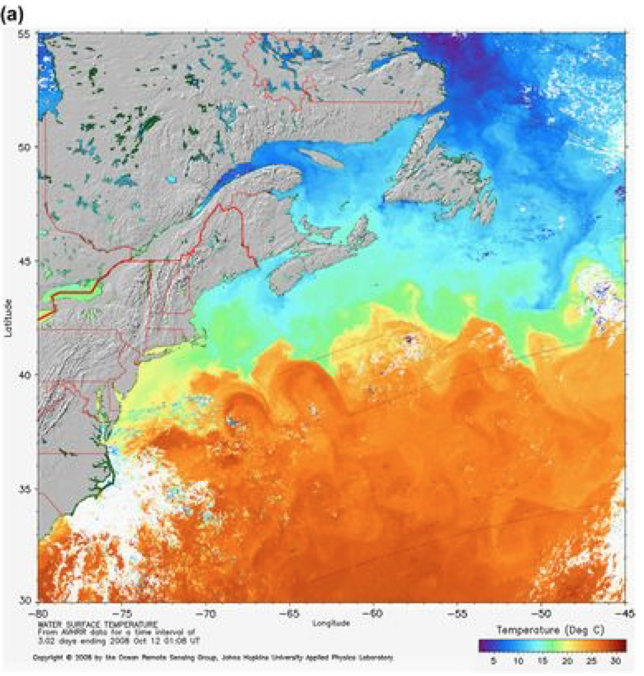
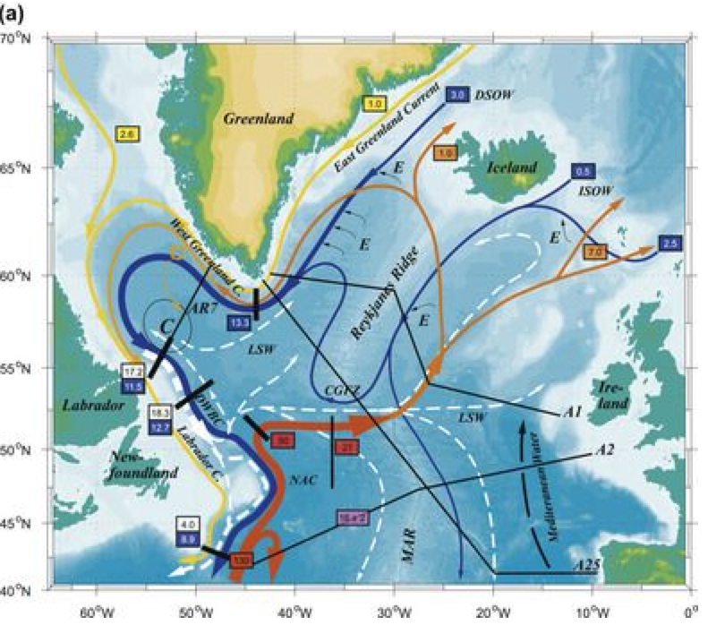
Subpolar North Atlantic
Gulf Stream becomes North Atlantic Current (NAC)
Poleward flowing NAC feeds the warm water to the sinking region ~ 15-20 Sv
Gulf stream ~ 90 Sv becomes NAC and much of it recirculates back to the south as the subtropical gyre circulation.

Slide 40
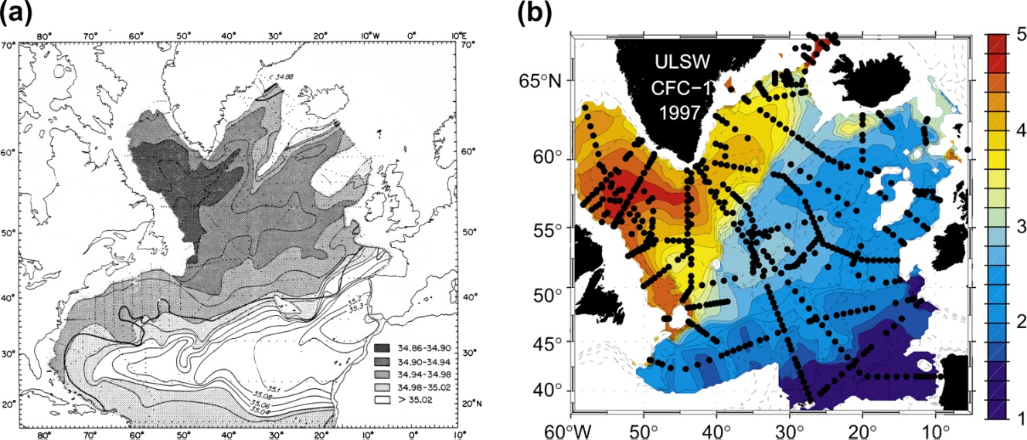
NADW source: Labrador Sea Water
Salinity on isopycnal typical of LSW: fresh in Labrador Sea
Chlorofluorocarbons in the Labrador Sea Water, highs indicating recent ventilation
Notes:
Freon from Rhein - total inventory

Slide 41
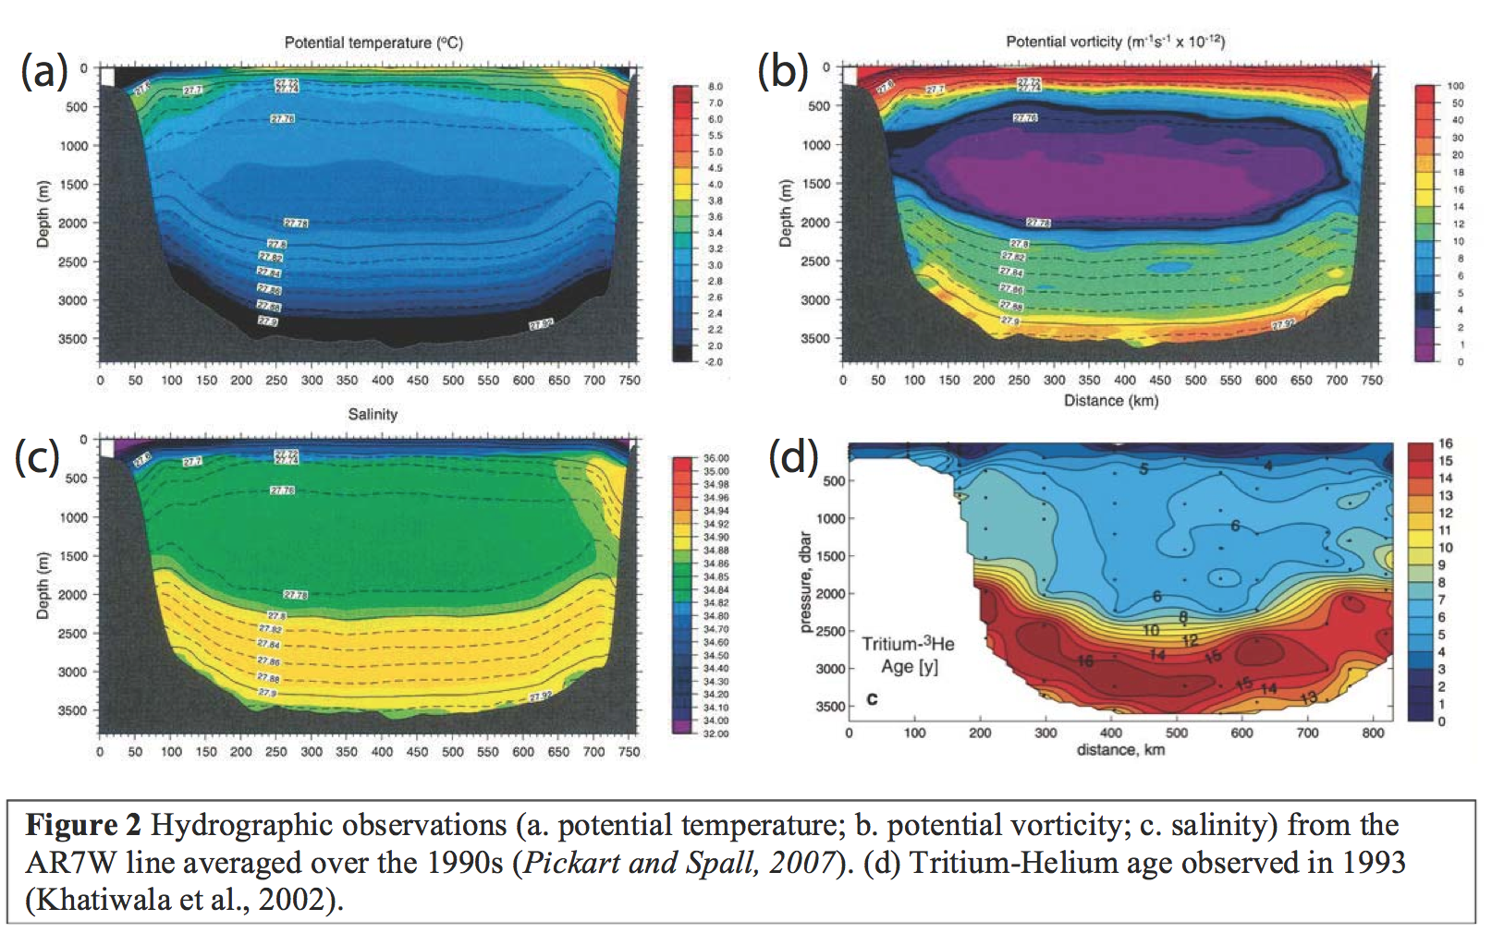
Labrador Sea hydrography

Slide 42
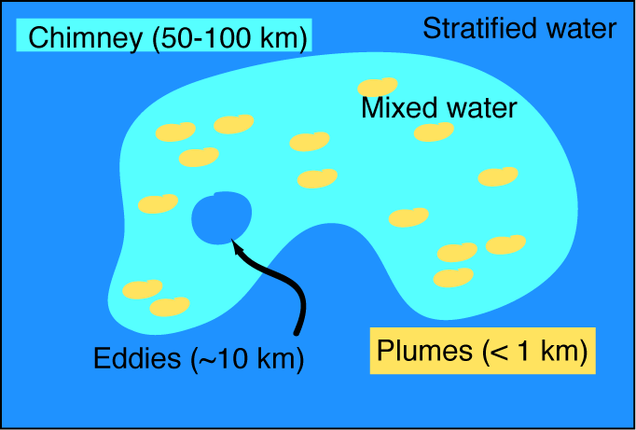
Open Ocean Deep convection
Lateral structure of convection regions
DPO S7.39

Slide 43
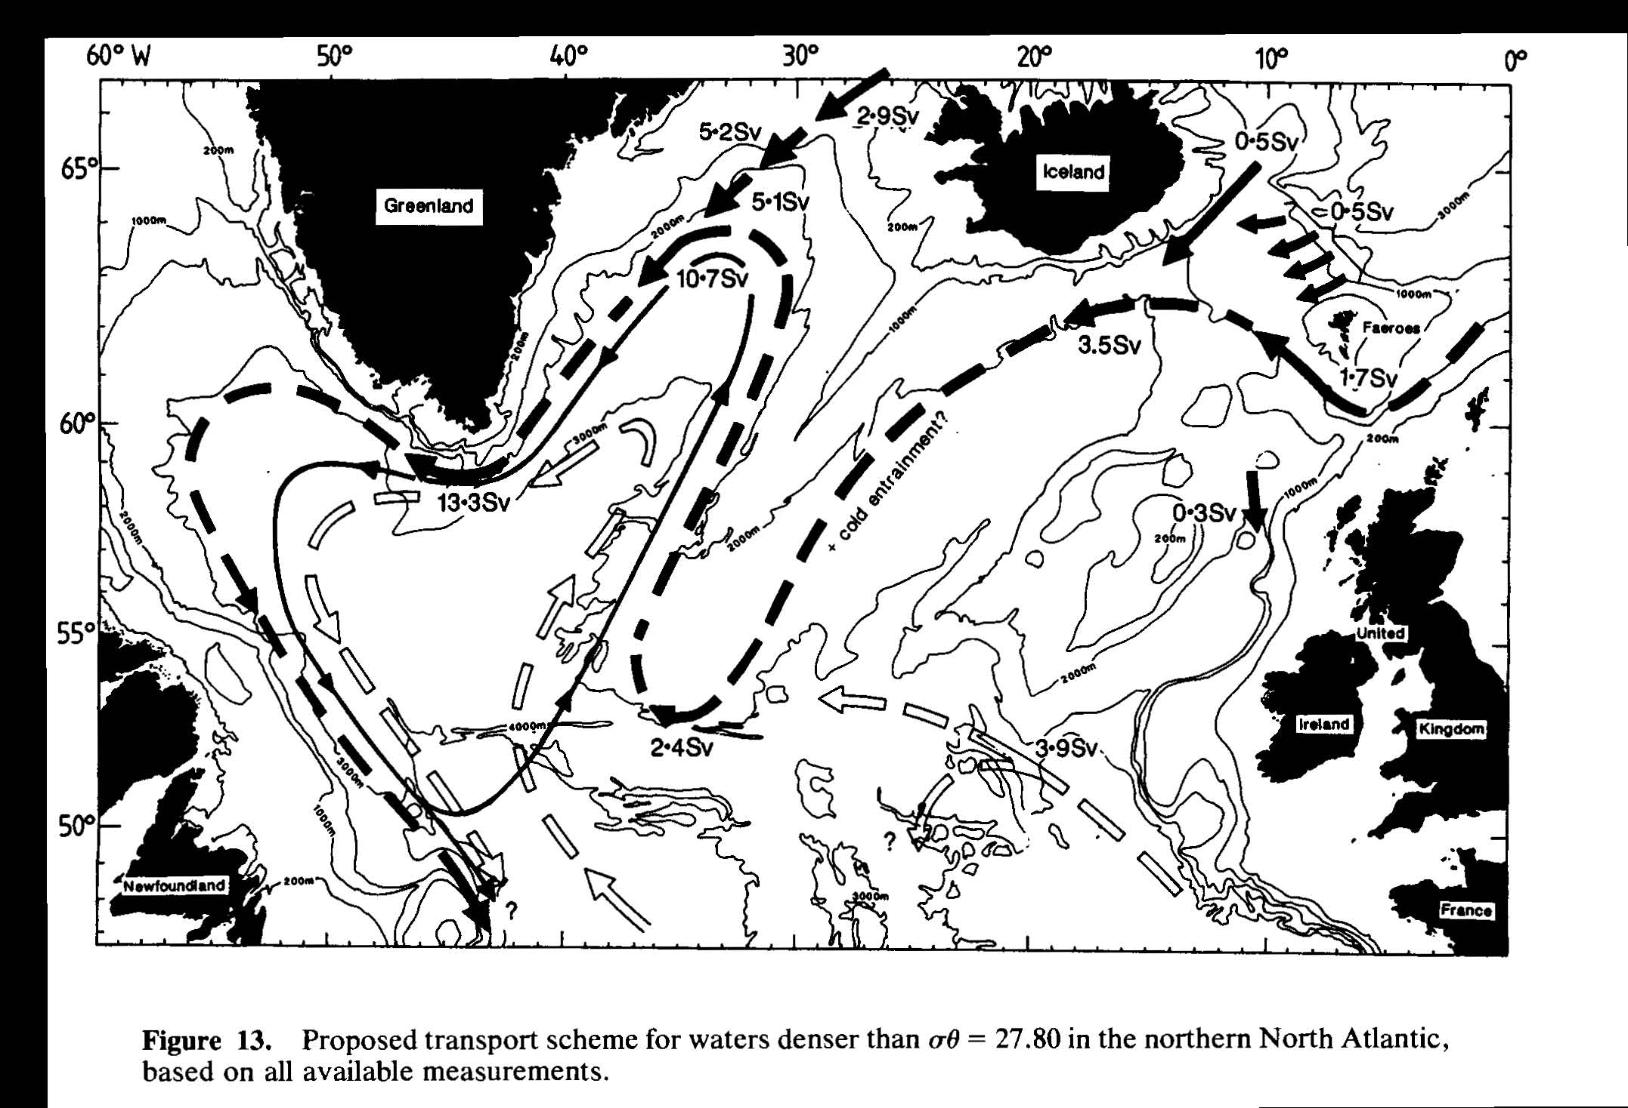
NADW sources: Nordic Seas Overflow Water
Deep convection in the Greenland Sea.
Overflow into the N. Atlantic over sills that are about 500-600 m deep.
Pathways: (1) Denmark Strait between Greenland and Iceland and (2) Iceland-Faroe Ridge
Dickson and Brown (1995)

Slide 44
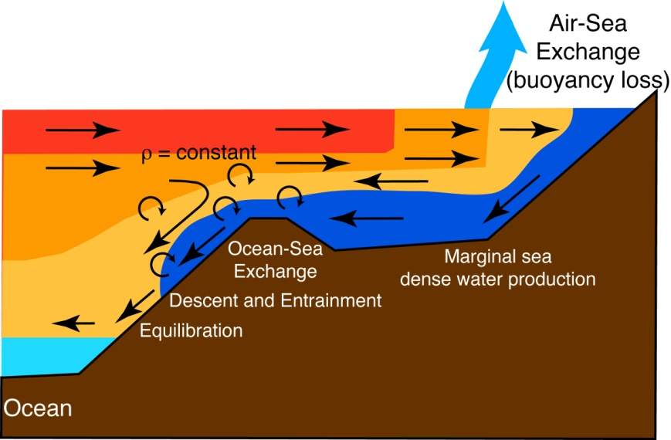
What happens in the “Overflow”?
1. Buoyancy loss by air-sea flux and/or brine rejection
2. Formation of Dense Shelf Water
3. The reservoir of the Dense Shelf Water enters into the open ocean mixing with the ambient water

Slide 45
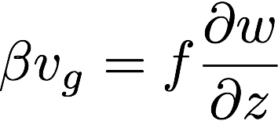
Deep Western Boundary Current
The export of NADW from the subpolar North Atlantic to the southern basins occurs through the deep western boundary current.
Stommel-Arons theory (1958) explains this phenomenon. It is the application of Sverdrup balance to the abyssal circulation.

Slide 46
Abyssal circulation dynamics
Wide-spread distributed upwelling
localized
sinking
Pole
Equator
Notes:
Animated stommel arons

Slide 47
Abyssal circulation dynamics
Wide-spread distributed upwelling
localized
sinking
Water column is “stretching” due to upwelling. It tends to increase its absolute vorticity by moving poleward.
Notes:
Animated stommel arons

Slide 48
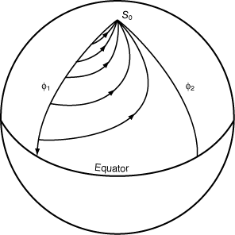
Deep western boundary current
Uniformly distributed upwelling leads to the poleward Sverdrup circulation, which then returns equatorward along the western boundary of the basin. This is joined by the water sinking at the polar latitude.
Thus the intensity of the deep WBC can be much greater than the rate of deep water formation.

Slide 49
Stommel-Arons theory (1958)
Deep water formation is localized but the upwelling occurs more uniformly.
Upwelling drives poleward geostrophic flow in the deep ocean due to the beta-effect.

Slide 50
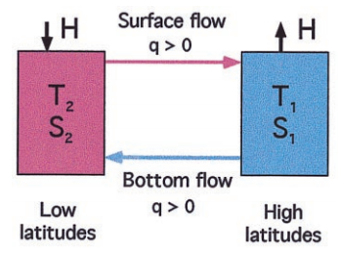
How stable is the thermohaline circulation?
Stommel (1961)’s two-box model
Re-discovered in 1980s
Two stable solutions: sinking in high versus low latitudes under the same atmospheric condition (thermal gradient and E-P)
Different initial states lead to different solution for MOC
Increasing precipitation (E-P) at high latitudes lead to a shift between the two states
Redrawn by Marotzke (2000)

Slide 51
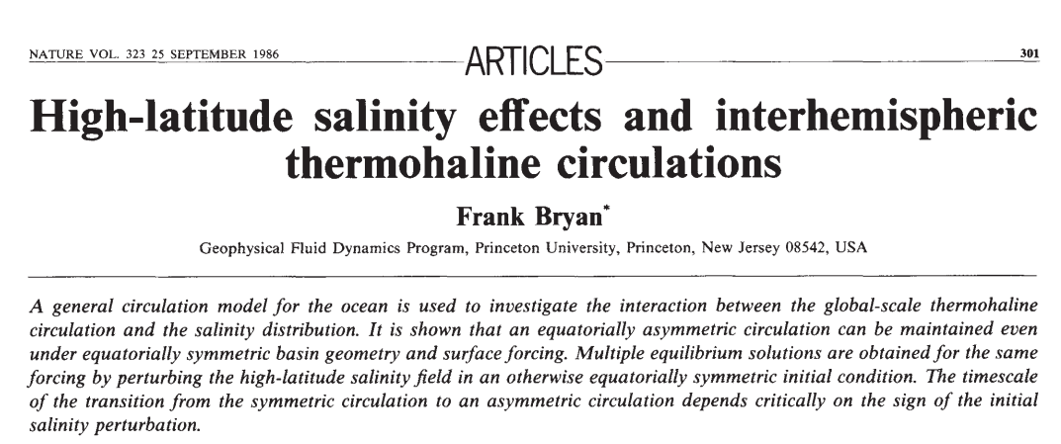
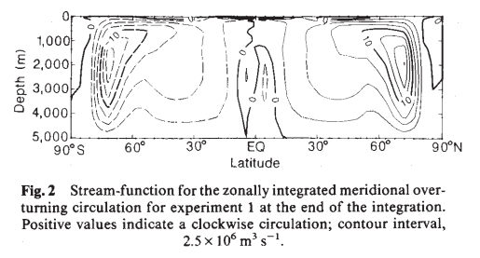
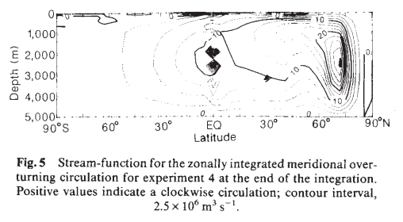
Multiple equilibria happens in 3D ocean model

Slide 52
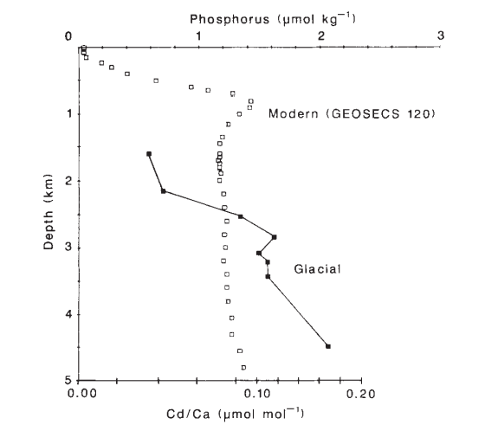
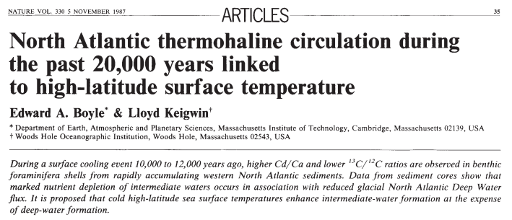
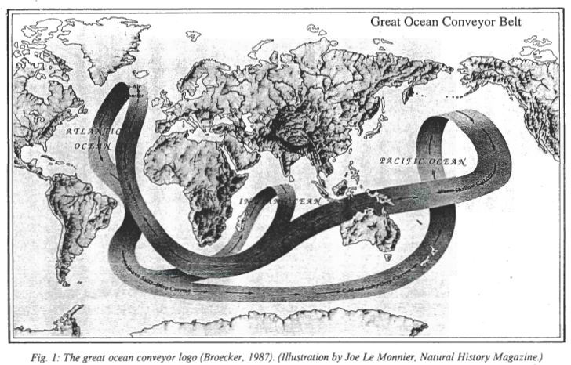
Insights from paleoceanographic data
Boyle and Keigwin (1987)
(Broecker , 1991)

Slide 53
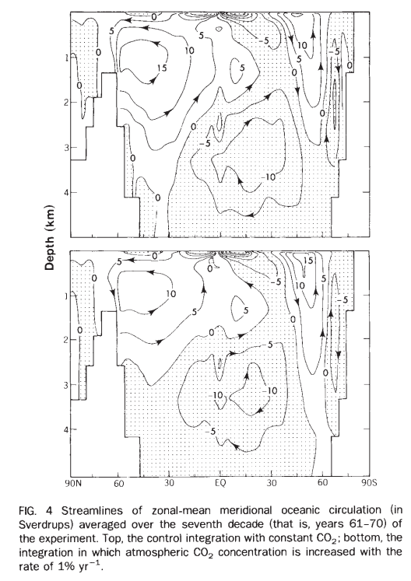
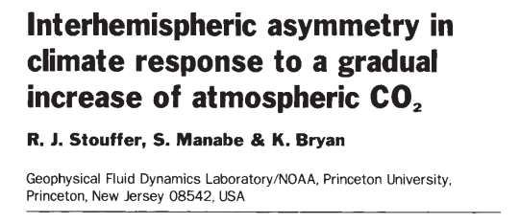
Can global warming shut down AMOC?
Washington and Meehl (1989, Clim. Dyn.)
Stouffer et al. (1989, Nature)

Slide 54
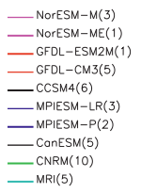
Current climate model projections
Cheng et al., (2013) J. Climate
RCP4.5
RCP8.5

Slide 55
Observation of AMOC
Blue = Florida strait (telephone cable data)
Green = Ekman (wind data)
Pink = Upper Mid-Ocean
(mooring data)
26N Rapid observation (2004-)
UK-RAPID

