Slide 1
Week 6-7: Wind-driven ocean circulation
Tally’s book, chapter 7

Slide 2
Recap so far…
Our goal (since week 3) has been to understand large-scale ocean circulation and its underlying physics, and to learn how to quantify them using available observations.

Slide 3
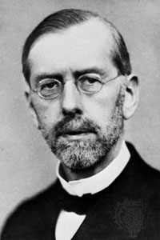
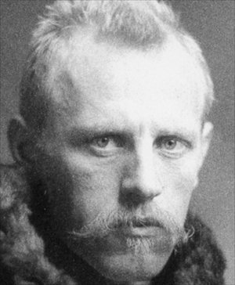
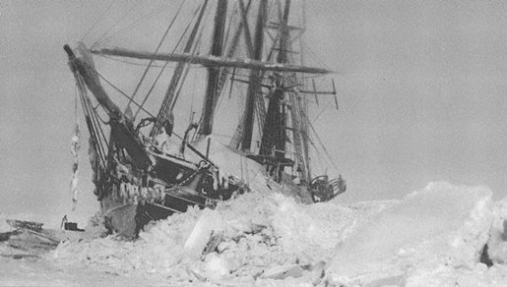
1902
Vagn Walfrid Ekman (1874-1954)
Univeristy of Lund
Fridtjof Nansen (1861-1930)
The Fram Expedition (Frist, 1893-1896)

Slide 4
Ekman flow
Ekman circulation
  Direct effect of wind on the surface current.
  Balance of forces: Coriolis effect VS. wind stress
  Ekman spiral (downward clockwise spiral in NH)
  Ekman transport (90° to the right of wind direction in NH)
  Ekman layer : approx. top 20-30m of the ocean

Slide 5
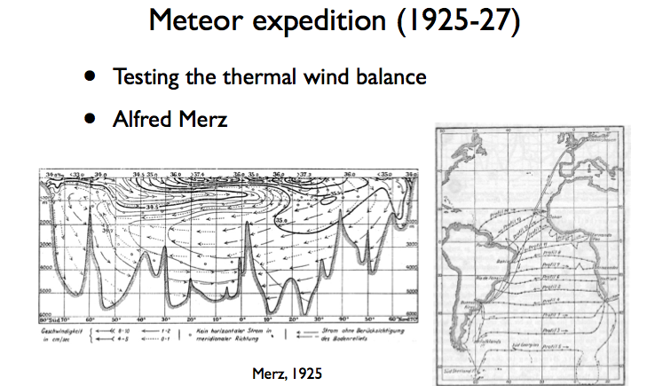
1925

Slide 6
Geostrophic flow
Balance between Coriolis force and Pressure Gradient Force
Use the “balance of forces” to determine ocean current speed and direction
  Assume: frictionless and small Rossby number (slow speed, large-scale)
  Cyclonic circulation (CCW in NH) around the low pressure
  Anticyclonic circulation (CW in NH) around the high pressure

Slide 7
Thermal wind
Calculating geostrophic circulation using T-S measurements
  YOU WANT: Horizontal current speed and direction
  YOU NEED: Horizontal pressure gradient
  AVAILABLE MEASUREMENT: T and S.
  Use thermal wind relation: practically, we calculate dynamic topography → Steric sea level
    Dynamic height is higher for the warmer water column → Anti-cyclonic flow in subtropics
    Dynamic height is lower for the colder water column → Cyclonic flow in subpolar region
  Level of no motion
    We assume that the deep ocean is motionless (u=v=0 in the deep ocean, say z=2,000m) so we can apply thermal wind.
    The velocity field you get from the dynamic topography is relative to the deep (e.g. 2000m) reference level.

Slide 8
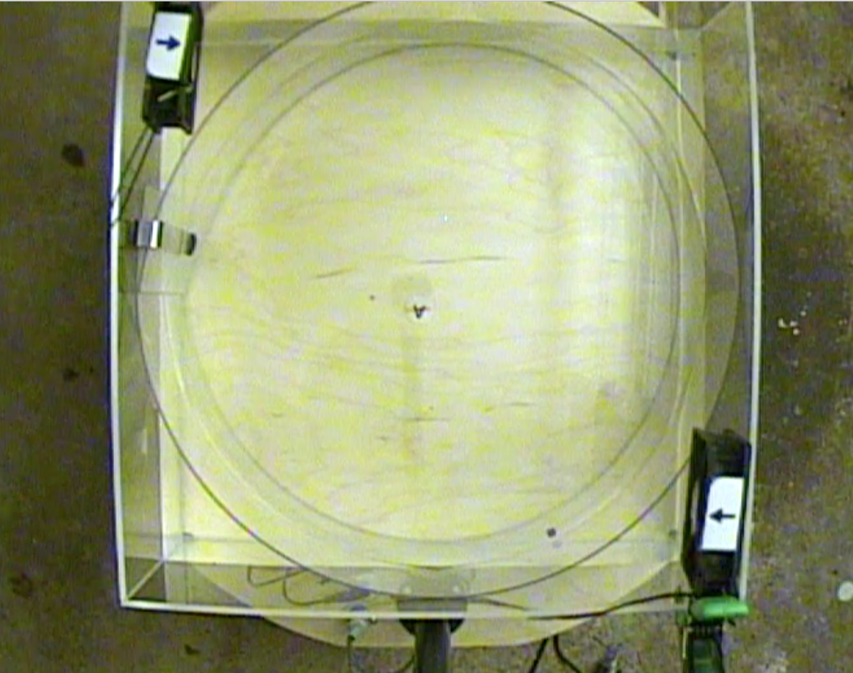
Tank experiment for Ekman flow
NORTH
Round wall
Computer fan
WEST
EAST
The view of the camera on top of the tank

Slide 9
The “anti-cyclonic” wind stress caused the surface Ekman flow to converge in the center
NORTH
Computer fan
WEST
EAST

Slide 10
Wind-driven vertical motion
Cyclonic wind stress ➔ Ekman upwelling
Anti-cyclonic wind stress ➔ Ekman downwelling (Ekman pumping)

Slide 11
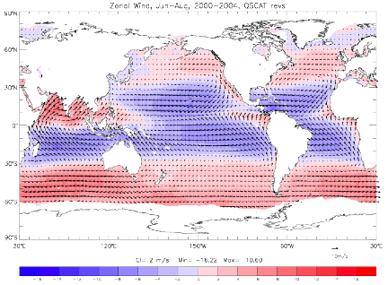
Observed wind stress
Blue = westward (trade wind)
Red = eastward (westerly wind)

Slide 12
Wind along the eastern boundary
Blue = westward (trade wind)
Red = eastward (westerly wind)

Slide 13
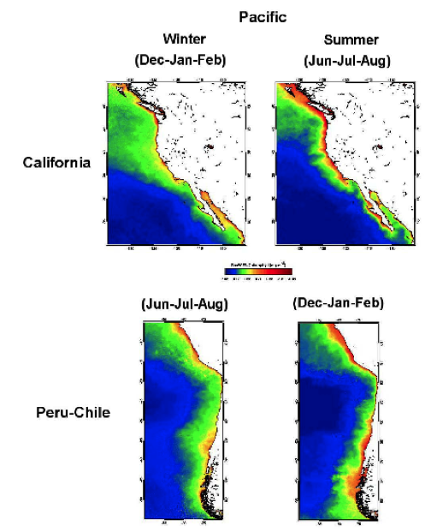
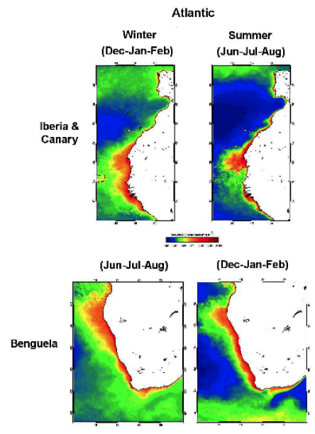
Eastern boundary current system

Slide 14
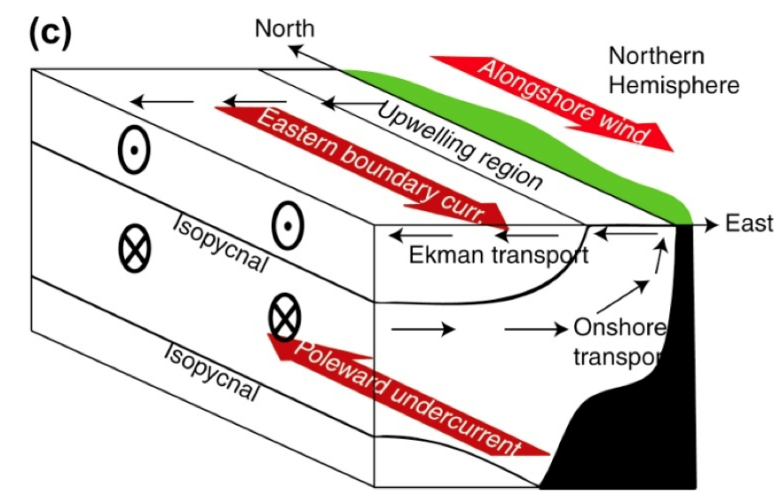

Coastal Ekman upwelling
Thermal wind
Density gradient

Slide 15
Observed wind stress
Blue = westward (trade wind)
Red = eastward (westerly wind)

Slide 16
Observed surface wind stress
Westerly wind
Blue = westward (trade wind)
Red = eastward (westerly wind)

Slide 17
Observed surface wind stress
Cyclonic wind stress
Anti-cyclonic wind stress
Blue = westward (trade wind)
Red = eastward (westerly wind)

Slide 18
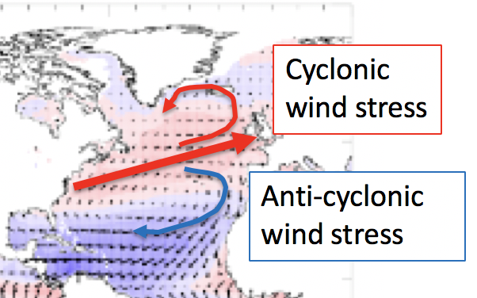
Wind stress curl
Wind stress curl measures the spin of the wind stress
  Use your right hand
  Counter clockwise = thumb up = positive curl
  Clockwise = thumb down = negative curl
  Vertical velocity depends on the wind stress curl
Positive wind stress curl
(Ekman upwelling)
Negative wind stress curl
(Ekman pumping)

Slide 19
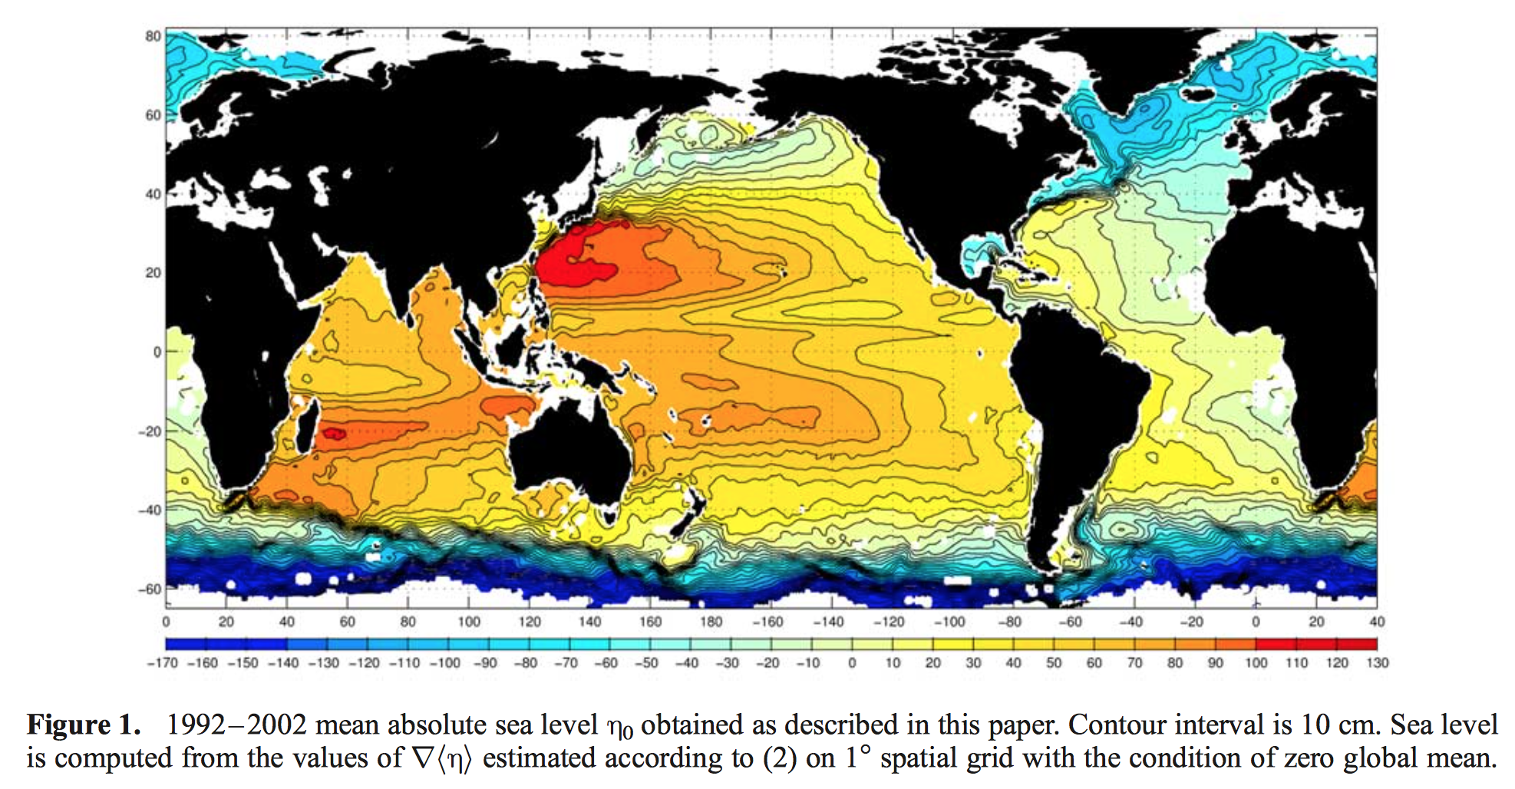
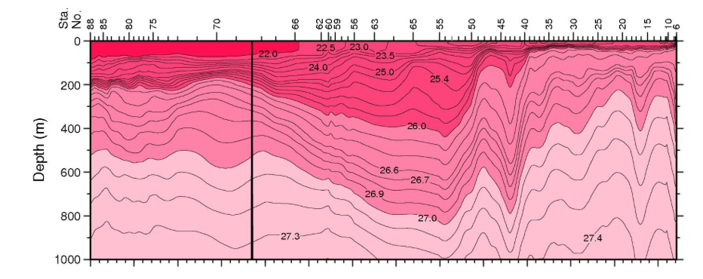
Effect of Ekman upwelling/downwelling on the ocean density structure
The high SSH of the western subtropics is reflected in the deep thermocline (i.e. high steric height).

Slide 20
Wind-driven gyres
Ekman flow is only active in top 20-30m of the ocean.
Geostrophic circulation extends much deeper depths, over several hundreds of meters.
→ Ekman upwelling/downwelling can drive the horizontal geostrophic circulation.

Slide 21
1947: Sverdrup balance
Consider 3-way balance between Coriolis, pressure gradient and frictional forces

Slide 22
Sverdrup balance
Consider 3-way balance between Coriolis, pressure gradient and frictional forces

Slide 23
Theory for the ocean gyres
Integrating from top to bottom of the ocean,
Northward motion leads to increased planetary spin
Curl of the wind stress
The input of spin by the wind
Positive (negative) wind stress curl → northward (southward) motion for water column

Slide 24
The beta (β) effect
Coriolis parameter changes with latitude. df/dy = β.
The β effect has profound influence on geophysical fluid dynamics.
One of the examples is the ocean gyres where the spin of wind stress drives horizontal (north-south) motion.

Slide 25
Vorticity (spin) balance
Wind stress can introduce spin into the ocean.
Fluid can spin up/down (relative vorticity)
Coriolis parameter (f) measures the planetary spin (planetary vorticity)
f increases poleward. Thus, poleward motion increases its planetary spin.

Slide 26
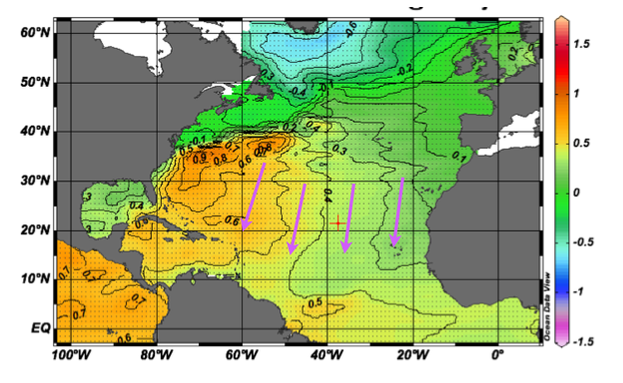
SSH fields: southward interior flow

Slide 27
Issues with Sverdrup circulation
Sverdrup circulation is equatorward everywhere in the subtropics (wind stress curl <0)
Does not conserve mass (poleward return flow is required)

Slide 28
1948
H. Stommel developed the theory for the western boundary current, followed by Munk (1950) and Fofonoff (1954).

Slide 29
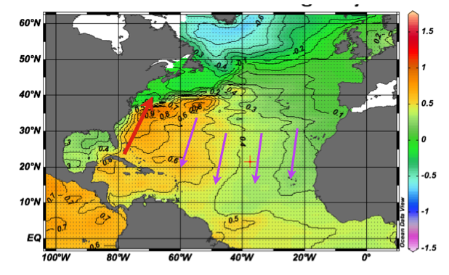
Western boundary current
Northward return pathway for the Sverdrup circulation

Slide 30
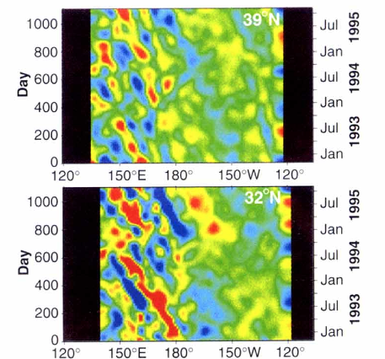
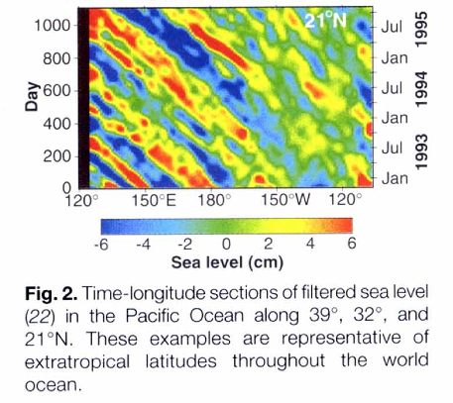
Rossby waves (as observed by satellite SSH)
Chelton and Schlax (1996) Science
Rossby wave propagates westward. It also transfers large scale energy to the west.

Slide 31
Subtropical gyre circulation
Atmosphere applies negative wind curl (clockwise spin) over the subtropical NH oceans
  Transient response: Rossby waves are excited, transferring the spin (energy) towards the western boundary
  Frictional dissipation at the western boundary is the ultimate sink of the spin (energy)
Steady response: Sverdrup circulation transports mass southward, which is balanced by the northward western boundary current

