Slide 1
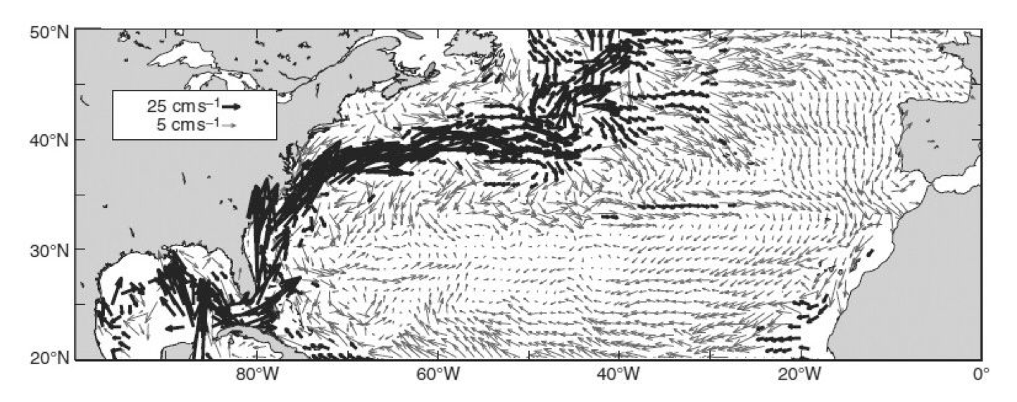
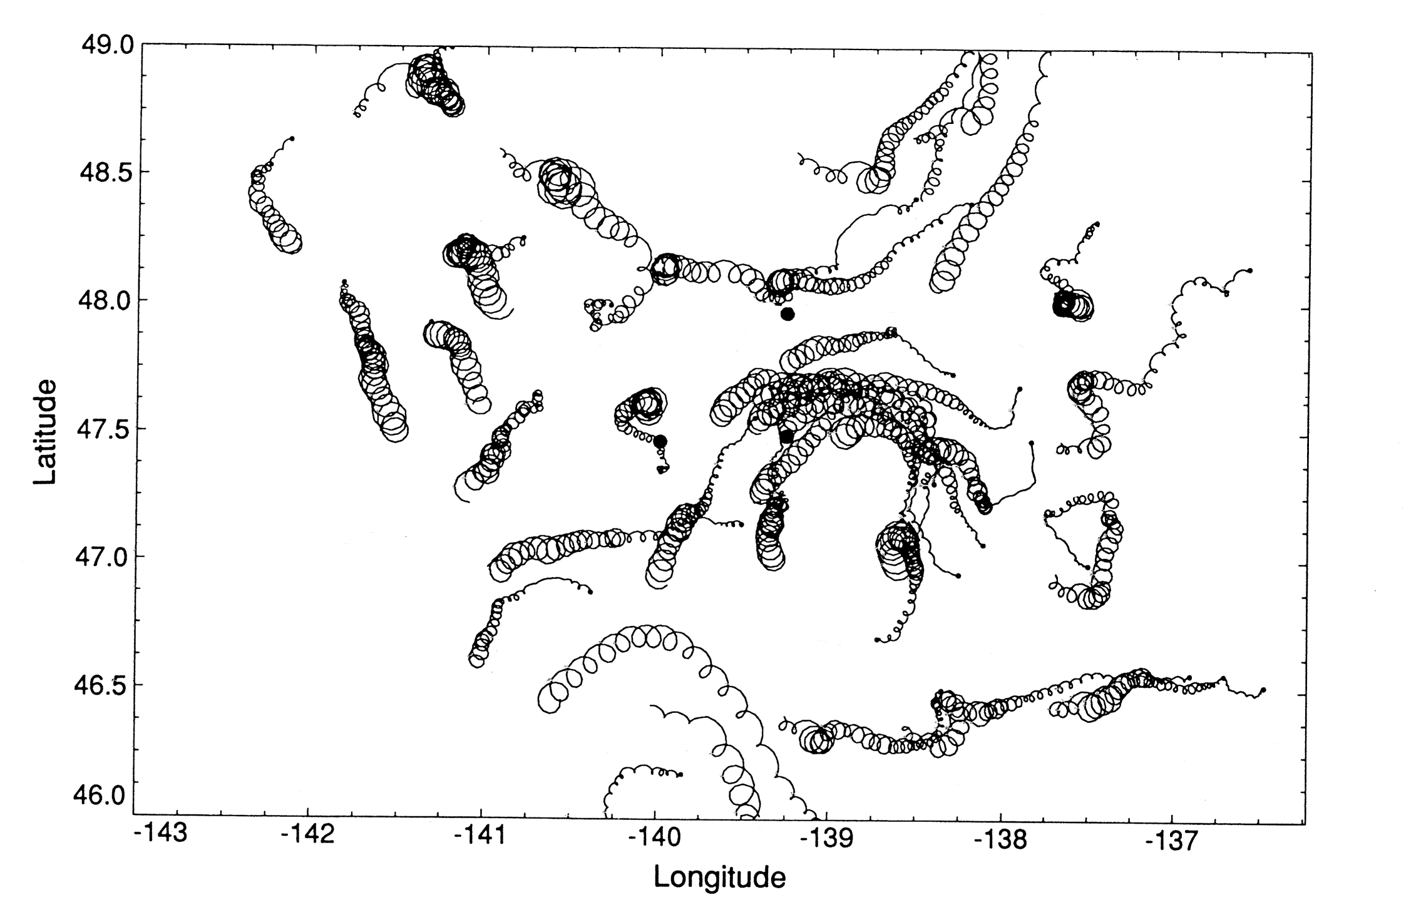
Week 5: Thermal wind, dynamic height and Ekman flow

Slide 2
Term Project outline
Due date: October 4th
Develop an outline based on your questions.
Based on the research questions, identify a few key papers.
Develop a list of papers to read
Major journals (annual reviews, reviews of geophysics, Nature, Science, PNAS, etc). Citation search.
You just need to develop a list. You don’t have to read all of the references to write/submit the outline.
Download PDFs. Start reading.
When reading references, focus on the main points
Write your own summary
You don’t need to understand every detail to get the big picture
Find more papers, building up your reference list (aim for 10+)

Slide 3
Observed density profile across the Florida Strait

Slide 4
A tank experiment
Initially, metal container separates dyed salty (dense) water from the surrounding freshwater (less dense)
After the tank is in solid body rotation, the container is removed.
What will happen?

Slide 5
Evolution of circulation and isopycnal tilt
Gravity pull down the dense water downward
Convergence at the top, divergence at the bottom
Coriolis effect defects the horizontal motion, the circulation starts to spin around the dense water

Slide 6
Isopycnal tilt and geostrophic circulation
“Thermal wind balance” = Coriolis force balancing the buoyancy force acting on the tilted isopycnal surface

Slide 7
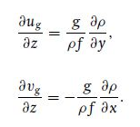
Thermal wind balance
Assume geostrophy in horizontal, and hydrostatic balance in vertical
Eliminate pressure
If we measure ρ(x,y,z) and the value of u and v at a given depth, we can calculate the geostrophic velocity

Slide 8
Thermal wind balance and geostrophic currents
The PGF is calculated as the difference of pressure between two stations at a given depth (relative to the geoid).
If the velocity is known at a given depth, then the PGF at that depth is also known (from geostrophy).
b) From the measured density profiles at the two stations, we can calculate how the velocity change with depth.
c) Using the known velocity from (a), which we call the reference velocity, and knowing how velocity changes with depth from (b), we can compute velocity at every depth.
c-alt) If a reference velocity is NOT available, assume deep water is not moving, approximating the reference velocity to be 0 (at arbitrarily set depth in the abyss = level of no motion).
Notes:
Got to here 11/7

Slide 9
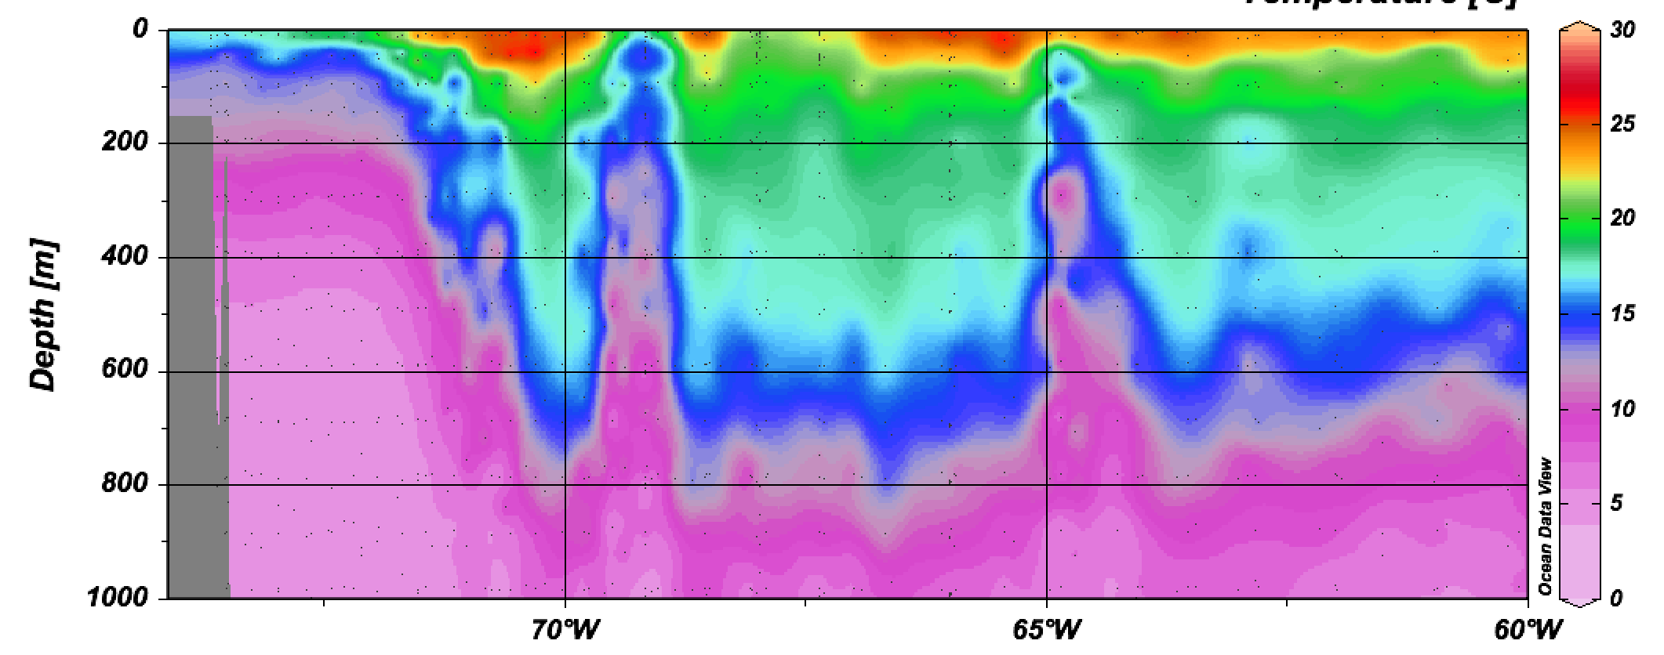
Observed isopycnal tilt in the Gulf Stream

Slide 12
Geostrophic calculation for the subsurface currents
At the surface, horizontal SSH gradient tells us the geostrophic current (e.g. HW4).
Thermal wind balance tells us how geostrophic current vary in depth → Vertical integration of the horizontal density gradient
Dynamic height / Geopotential anomaly

Slide 13
Geostrophy in pressure coordinate
Pressure decreases with height (hydrostatic balance).
We care about the horizontal variation of pressure that controls geostrophic circulation
If one follows a surface of constant pressure, high pressure region has a slightly shallower depth (greater z).

Slide 14
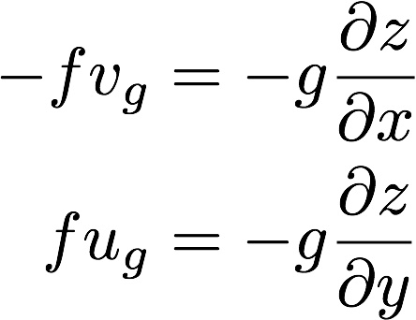
Geostrophy in pressure coordinate
Using pressure as a vertical coordinate, the height of the pressure surface can be used to calculate PGF.

Slide 15
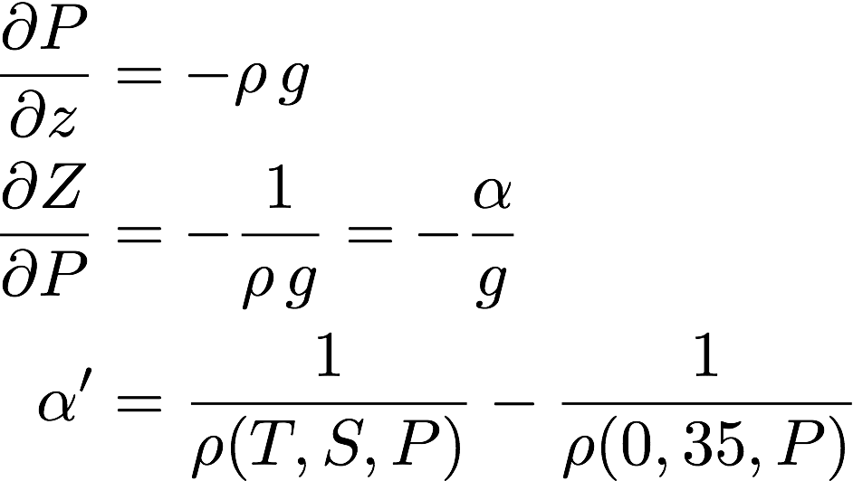
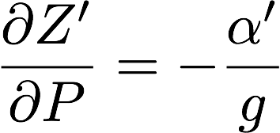
Dynamic height
Given the measurements of T and S, we can calculate the “dynamic height”, i.e. steric height at a given pressure level.
α is the specific volume (inverse of density)

Slide 16
Dynamic height
Given T and S, calculate density (and specific volume anomaly, α’) at every pressure level.
Then vertically integrate (-α’/g) to get Z’
IF P_{ref} is chosen to be 2,000dbar, Z’ is then called the “dynamic height with respect to the 2,000dbar reference level”.
Geopotential anomaly is defined as Φ=gZ’

Slide 17
Thermal wind calculation and dynamic height
To get the change in PGF between two pressure levels 1 to 2, calculate the geopotential anomaly (or dynamic height) change between the levels 1 and 2.
ΔZ = Z₂ - Z₁ = dynamic height difference
f (v₂ - v₁) = g∂ΔZ/∂x
f (u₂ - u₁) = -g∂ΔZ/∂y
If one set of the velocities are known, then the thermal wind balance will tell us the other set of the velocities are also known.

Slide 18
Reference level
Reference velocities:
Level of no motion: Old-fashioned - assume 0 velocity at some great depth, and compute velocities at all shallower depths. This is useful if you are focused on very energetic upper ocean flows, but not useful if you want to look at small deep flows.
Level of known motion: Much better - observe or determine through external means (use of tracers, mass balance, etc) a good guess at the velocity at some depth. This is essential if you want to study deep circulation.

Slide 19
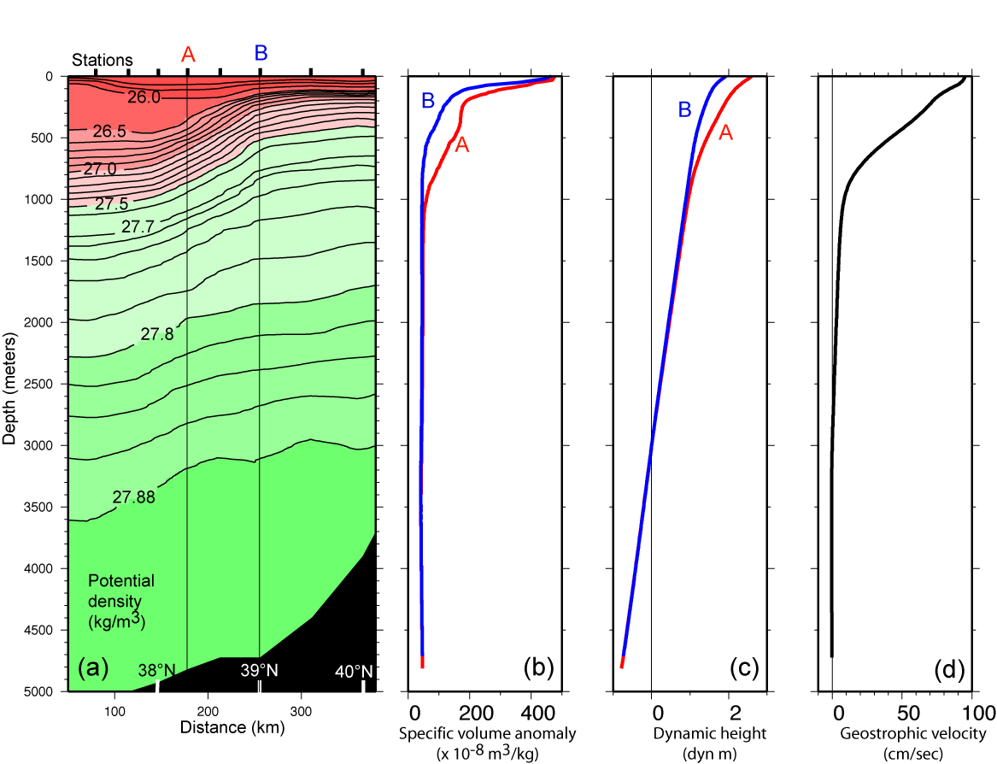
Gulf Stream density, dynamic height and geostrophic velocity
In this example, compute geostrophic velocities relative to 0 cm/sec at 3000 dbar. If we KNOW v at 3000 dbar, then just add it to the whole profile
DPO Fig. 7.11

Slide 20
Steric height at 1000 dbar in the N. Atlantic. Values are similar to sea surface height in meters. (Reid, 1994)
DPO Fig. S9.2b

Slide 21
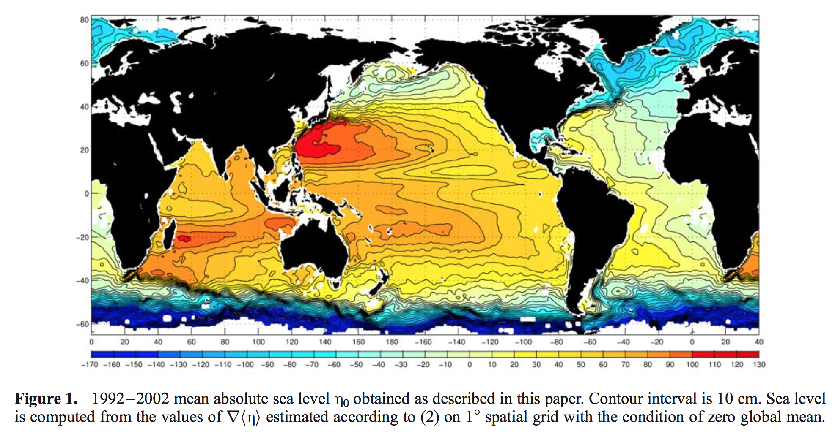
Global SSH, Niiler et al., 2003

Slide 22
WOCE line P16
Relatively high SSH of the subtropics is reflected in the deep thermocline (i.e. high steric height).

Slide 23
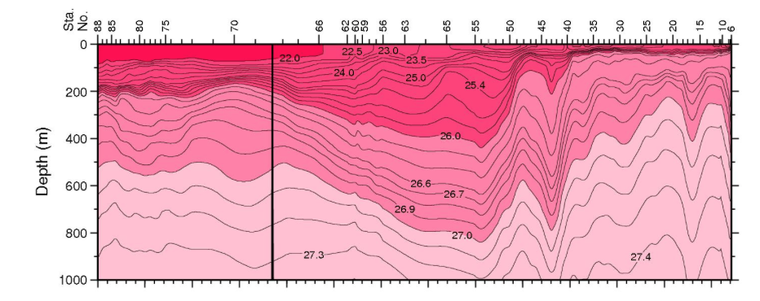
WOCE line P13
The high SSH of the western subtropics is reflected in the deep thermocline (i.e. high steric height).

Slide 24
Wind driven flow: Ekman circulation
Ekman flow: Coriolis and Frictional force by wind
X (east-west)
Y (north-south)
Z (vertical)

Slide 25
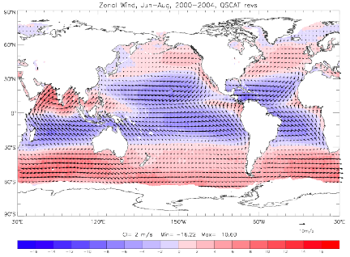
Observed wind stress
Blue = westward (trade wind)
Red = eastward (westerly wind)

Slide 26
Observed wind stress
Blue = westward (trade wind)
Red = eastward (westerly wind)

Slide 27
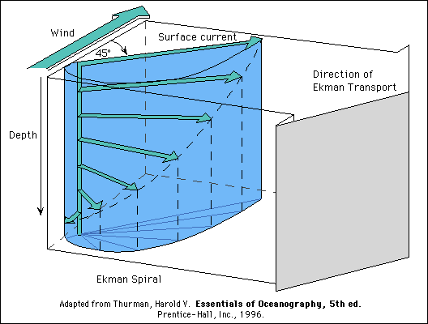
Ekman spiral
Vertical scale of the Ekman layer ~ 20-60m
Top layer moves at 45 degrees to the right of the wind direction in NH.
This layer pushes the layer underneath. Layer by layer, it spirals downward clockwise.

Slide 28
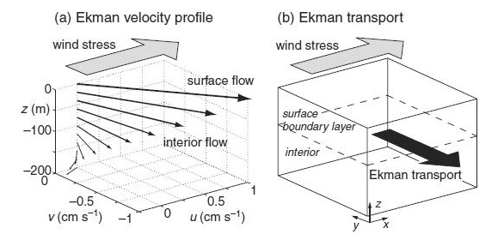
Vertically integrated Ekman transport

Slide 29
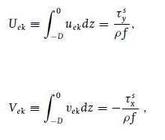
Mathematical expression for Ekman layer
Vertically integrated Ekman flow is 90 degree to the right of the direction of the wind

Slide 30
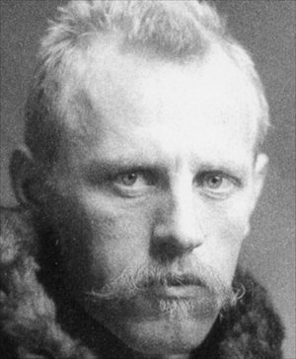
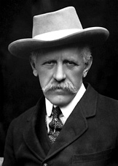
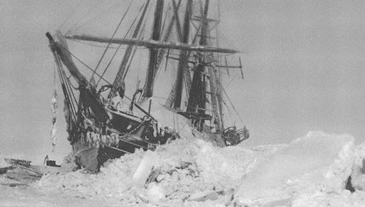
Wind-driven ocean current
The Fram Expedition (Frist, 1893-1896)
Fridtjof Nansen (1861-1930)
From Fram Museum and Nobel Foundation

Slide 31
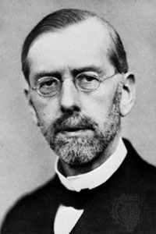
Ekman current
Vagn Walfrid Ekman (1874-1954)
Univeristy of Lund

Slide 32
Observed wind stress
Blue = westward (trade wind)
Red = eastward (westerly wind)

Slide 33
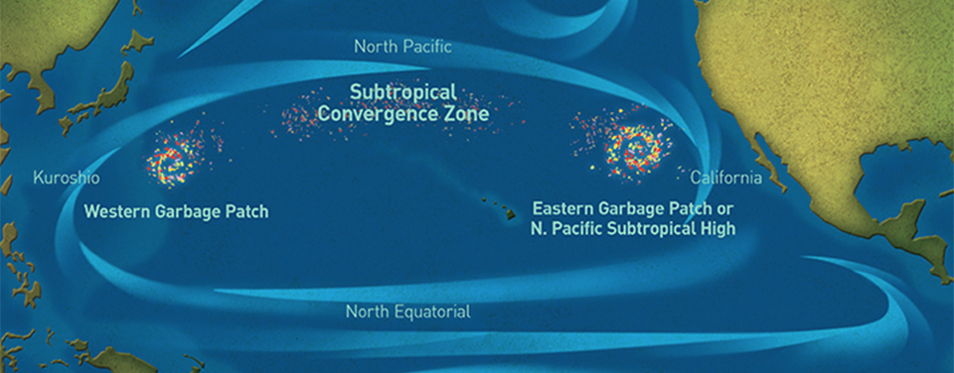
Marine debris
“The great garbage patch”
http://marinedebris.noaa.gov/

Slide 34
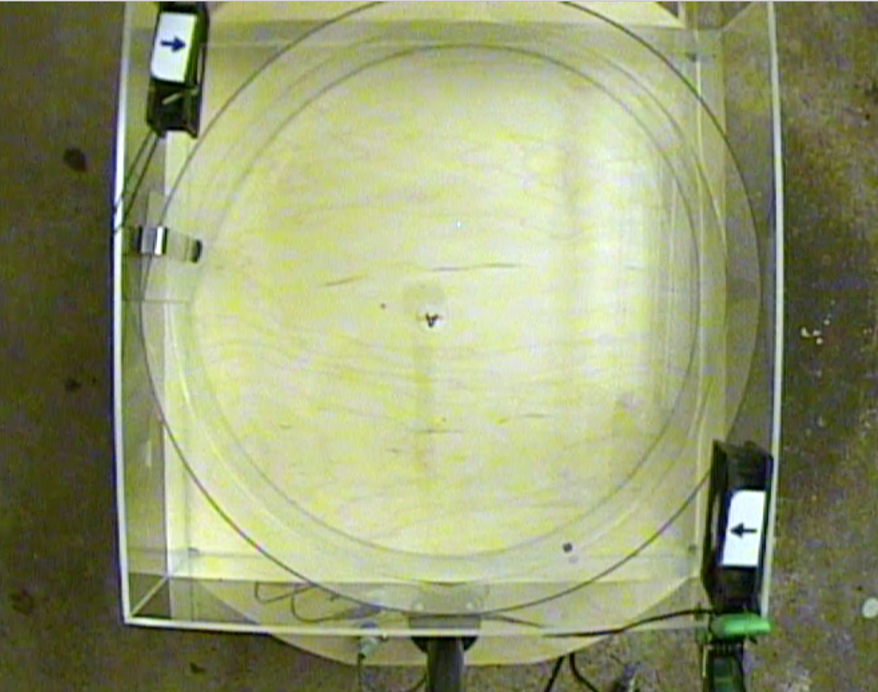
Tank experiment
NORTH
Round wall
Computer fan
WEST
EAST
The view of the camera on top of the tank

Slide 35
Ekman convergence in the subtropics

Slide 36
Equatorial upwelling

Slide 37
Vertical motions induced by the Ekman flow

