Slide 1
Review quiz
What is the meaning of thermobaricity?

Slide 2
Review quiz
What is the meaning of thermobaricity?
Colder water is more compressible. In another words, density contour in T-S diagram becomes flatter under higher pressure (deeper depth)

Slide 3
Review quiz
Which property of the seawater is NOT a conservative tracer?
  (a) Density
  (b) Potential temperature
  (c) Salinity
  (d) Neutral density

Slide 4
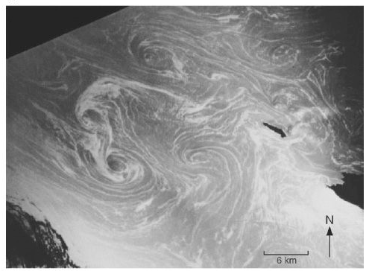
Week 3: Transport and mass balance
Textbook: Chap 5.

Slide 5
Lagrangian and Eulerian
Lagrangian
  Particle view of the fluid
  Describes the trajectory of a specific water parcel
  Obs platform: drifters, floats
Eulerian
  Field view of the fluid
  Describes the motion at a specific location (x,y,z) and time (t)
  Obs platform: ocean time series, mooring

Slide 6
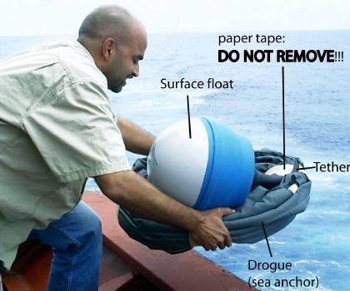
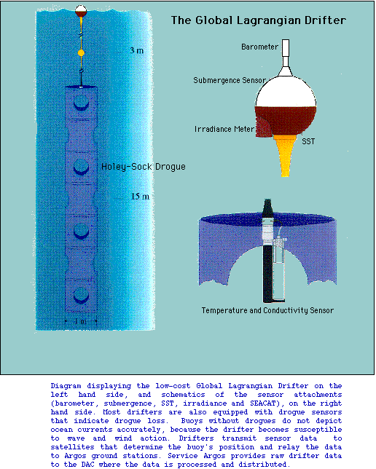
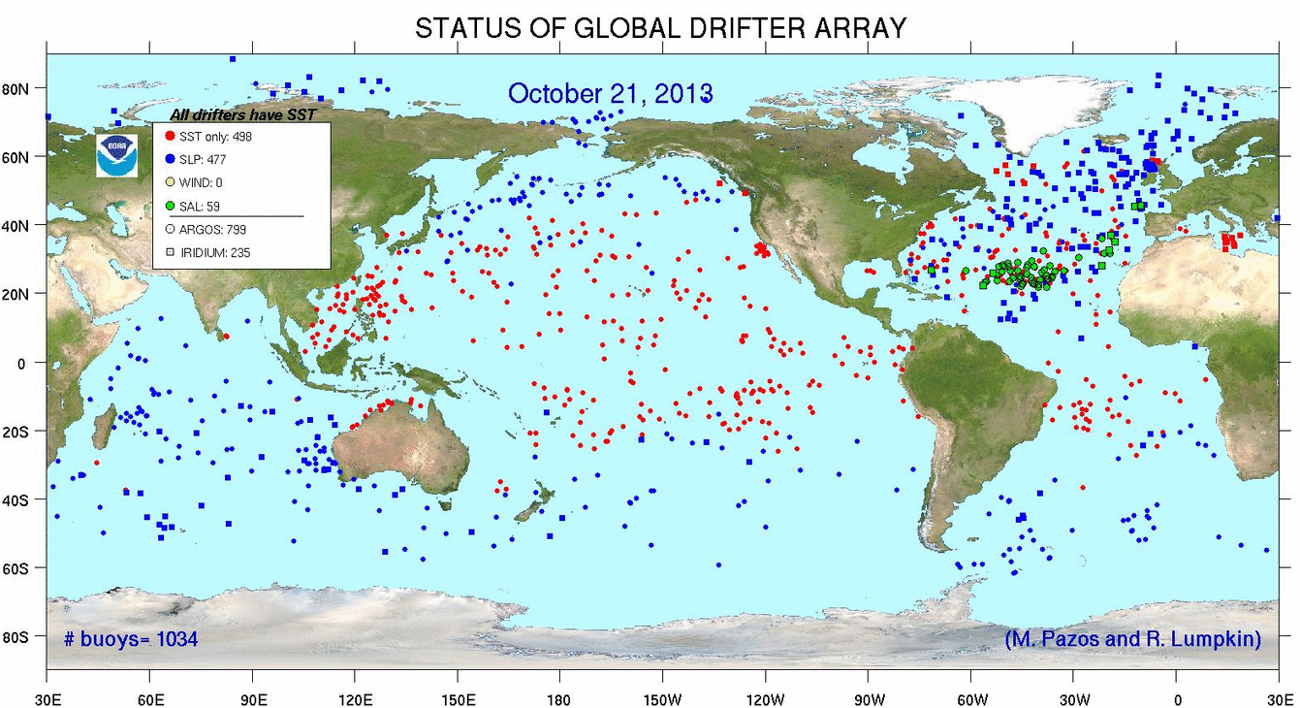
Autonomous (Lagrangian) observation
Surface drifters: velocity and a few sensors (SST, SSS, air pressure are common)

Slide 7
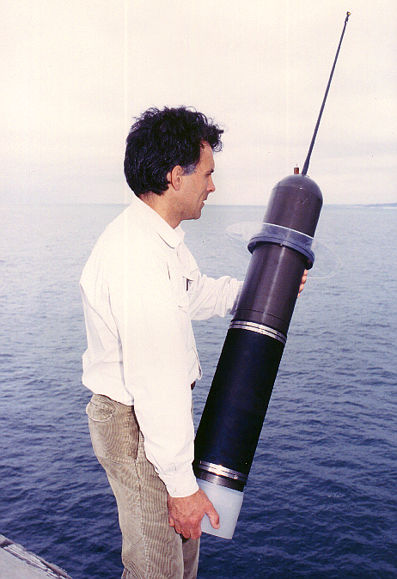
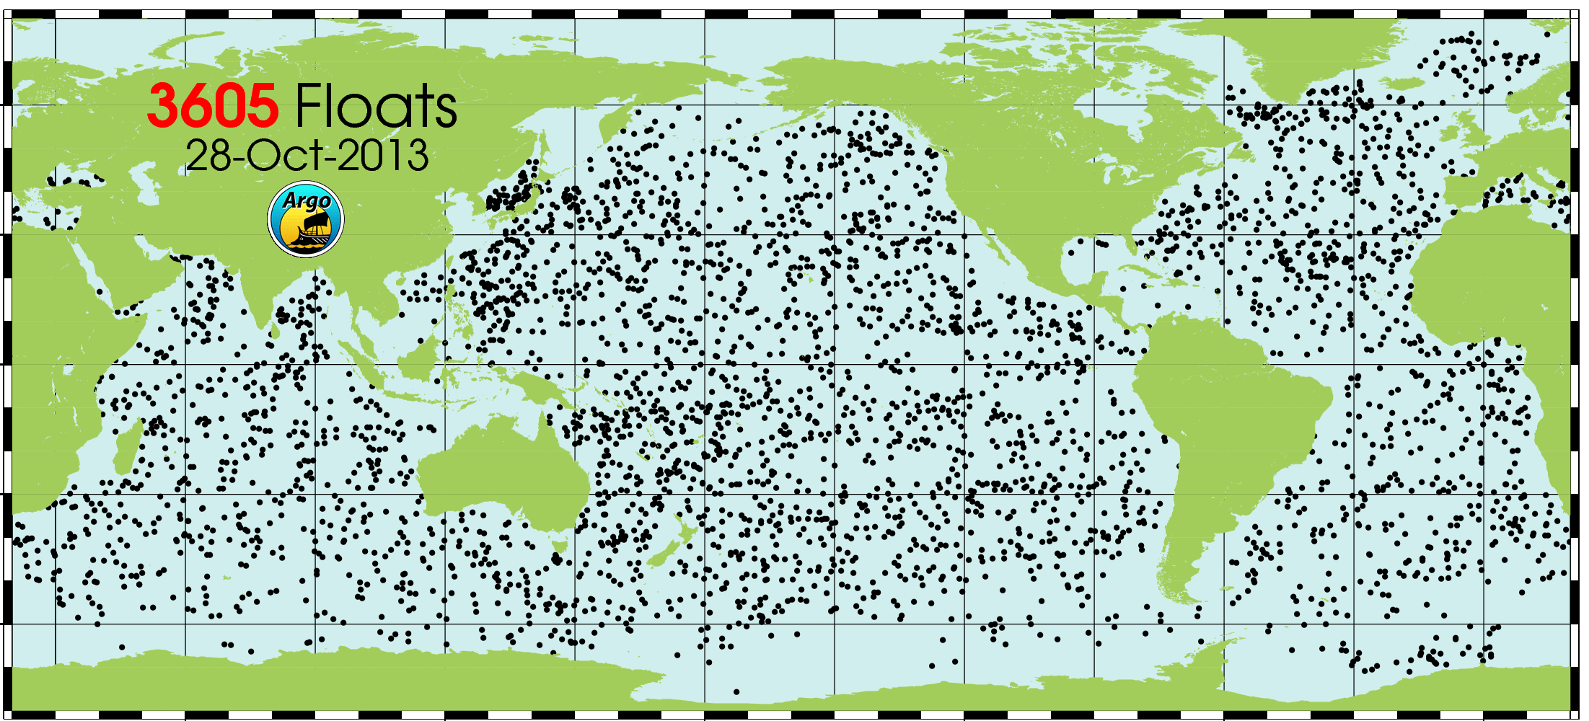
ARGO: subsurface, free-drifting floats
Profile to 2000 m and tracked every 5 to 10 days
Best for repeat profiling of water column (core ARGO mission measures T and S only, but newer generation floats can also measure O₂, NO₃, pH, chl fluorescence)
Up to 180 profiles for the life of battery cell

Slide 8
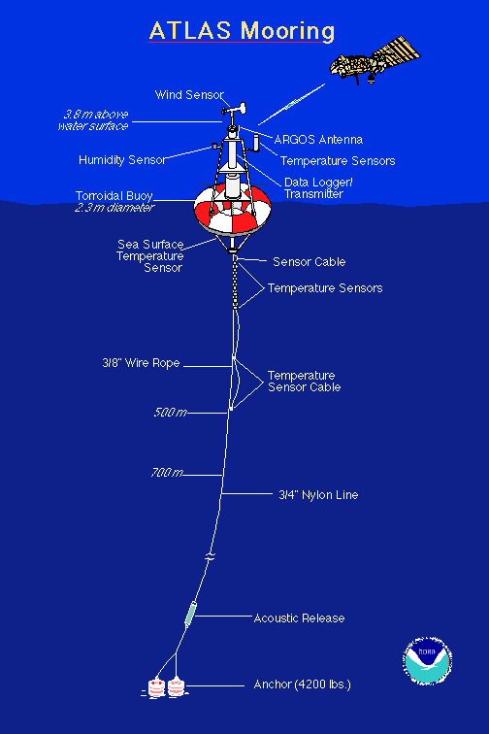
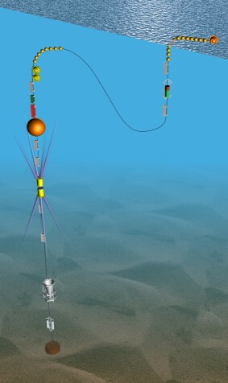
Mooring (fixed to bottom: Eulerian)
Moorings can sample with high rate, from surface to bottom, many simultaneous sensors, and can carry heavy instruments

Slide 9
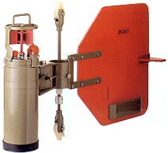
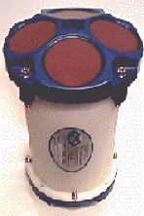
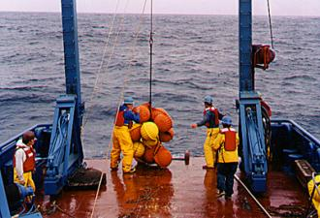
Moored current meters (Eulerian)
Acoustic Doppler Current Profiler (ADCP)

Slide 10
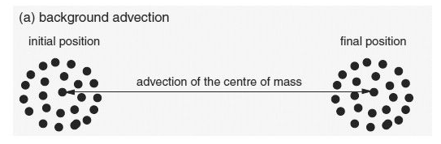
Advection
Fluid properties (mass, T, S, nutrients, etc) moves with the flow of fluid (ocean currents)

Slide 11
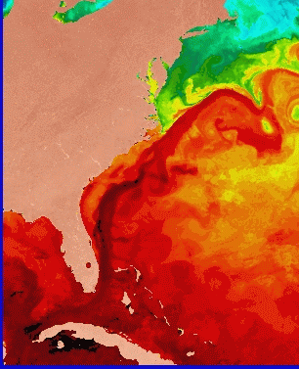
Quantify transport resulting from the gulf stream
Sea surface temperature
Gulf Stream “advects” volume, mass, warm water northward
How much water, how much mass is carried by the G.S past a certain point ?
Draw a vertical plane across the current (x,z are across-stream and vertical)
Measure current velocity at each point in the plane, normal to the plane
Compute volume transport (velocity times area) for each small location in the plane and add them up (integrate) for total transport through the cross-section
z
x

Slide 12
Quantify volume transport (advection) (example)
Gulf Stream velocities are about 5 cm/sec at the bottom, up to more than 100 cm/sec at the top of the ocean. Assume an average of 20 cm/sec for this simple calculation.
Assume a width of the current of 100 km
Assume a depth of the current of 5 km
The area of the G.S. is then 500 km²
Volume transport is then 20 cm/sec x 500 km²
z
x
= 100 x 10⁶ m³/sec = 100 Sverdrups = 100 Sv
Notes:
Define 1 Sverdrup = 10e6 m3/sec

Slide 13
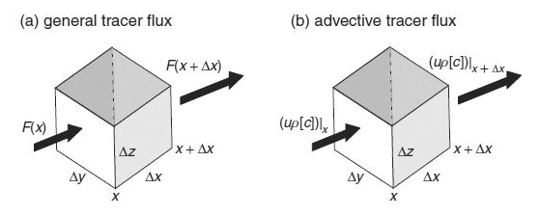
Flux
A measure of transport
Transport can be measured by the flux
  Amount of mass/carbon/nutrients moving through a cross section per unit time

Slide 14
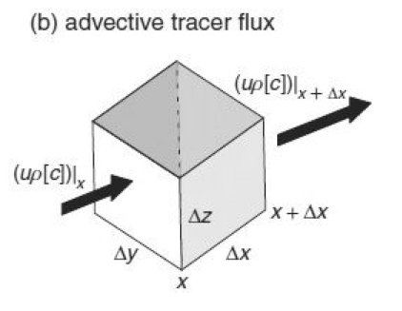
Advective tracer flux
Tracer continuity equation
  For a cross section of unit area:
    Volume flux = (velocity)
    Advective flux = (velocity) x (Concentration per vol) = (velocity) x (density) x (Conc. per mass)

Slide 15
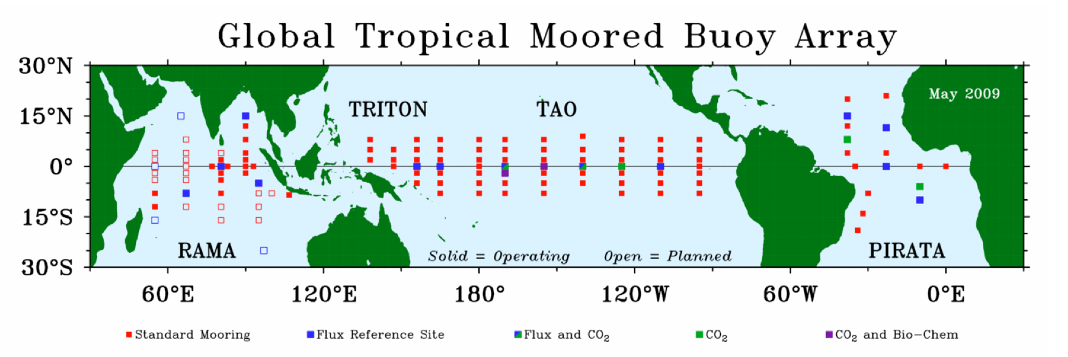
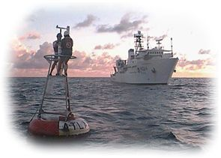
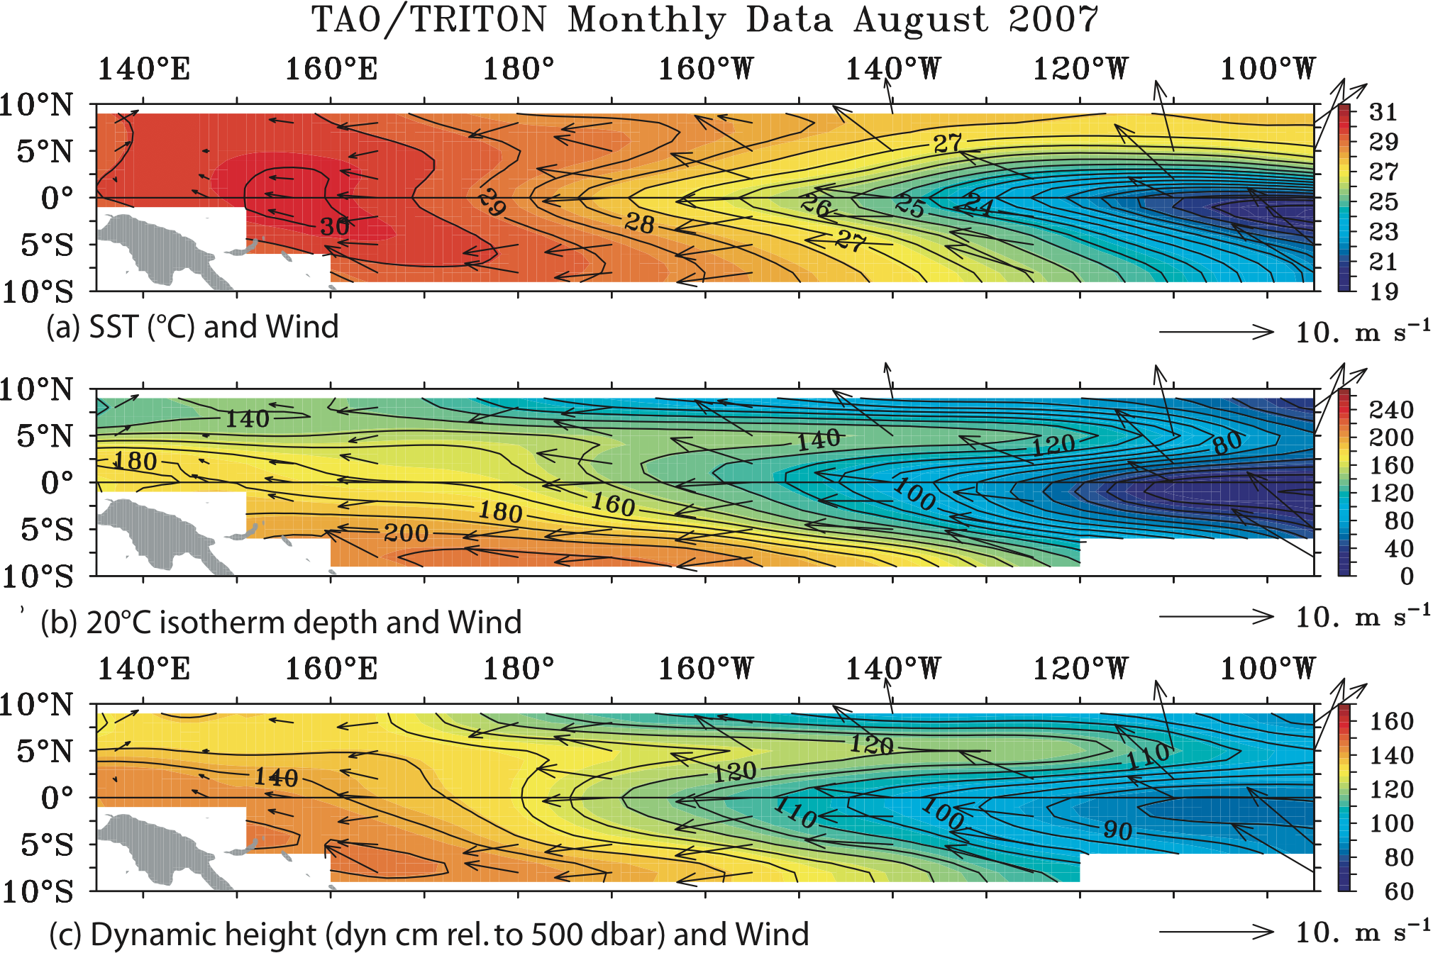
TAO array: tropical ocean - atmosphere

Slide 16
Lagrangian kinematics
Velocity = d/dt of the particle position
  Consider following a drifter’s trajectory
Conservation laws

Slide 17
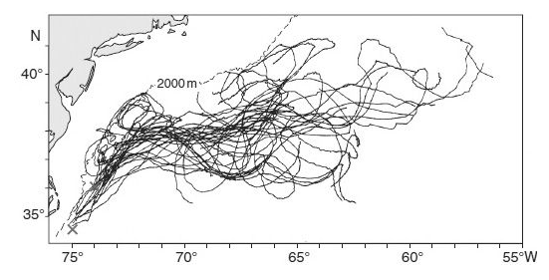
Float trajectories

Slide 18
Eulerian kinematics
Velocity field
Tracer field
Conserved property: whiteboard discussion
→ Consider data reported from a mooring

Slide 19
Expression of advection using vector calculus
Nabla
Inner product with velocity

Slide 20
Continuity equation
(Rate of change) = (input) – (output) = (Flux convergence)
  One dimensional example
  Three dimensional version

Slide 21
Mass continuity
Conservation of mass expressed in Eularian frame
  Rate of change following a moving water “parcel”
  In oceanography, we often use incompressible form
*If the divergence of volume flux is zero, the fluid is incompressible

Slide 22
Review quiz
The water mass with the largest volume is:
  (1) Pacific Deep Water
  (2) Antarctic Intermediate Water
  (3) Mode Water
  (4) Labrador Sea Water

Slide 23
Review quiz
The water mass with the largest volume is:
  (1) Pacific Deep Water
  (2) Antarctic Intermediate Water
  (3) Mode Water
  (4) Labrador Sea Water

Slide 24
Review quiz
A Lagrangian measurement
  (1) follows the water
  (2) is made from a ship
  (3) is made from a mooring
  (4) is made using a satellite

Slide 25
Review quiz
A Lagrangian measurement
  (1) follows the water
  (2) is made from a ship
  (3) is made from a mooring
  (4) is made using a satellite

Slide 26
Review quiz
A water parcel has a temperature of 2 degree C at the surface. If the water parcel is adiabatically moved down to 2000 dbar, what would be its temperature?
  (1) Lower than 2 degree
  (2) At 2 degree
  (3) Higher than 2 degree
  (4) Not enough information is given to answer this

Slide 27
Review quiz
A water parcel has a temperature of 2 degree C at the surface. If the water parcel is adiabatically moved down to 2000 dbar, what would be its temperature?
  (1) Lower than 2 degree
  (2) At 2 degree
  (3) Higher than 2 degree
  (4) Not enough information is given to answer this

Slide 28
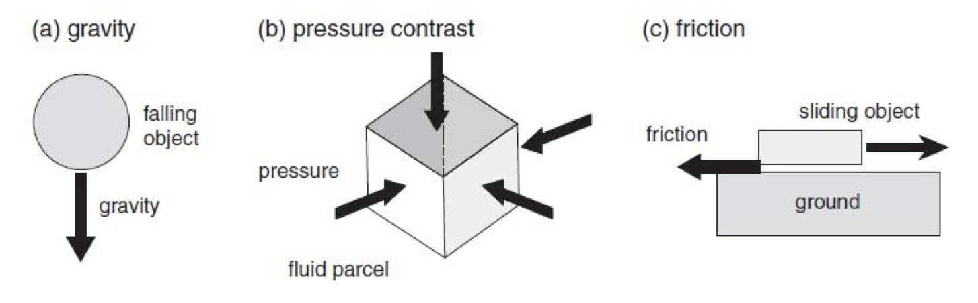
Newton’s law
ma = F applied to a Lagrangian water parcel (with a unit volume)
Acceleration : rate of change in velocity
density : mass per unit volume
Three types of forces we consider here:

Slide 29
Gravitational force
Points to the center of the Earth
  In Cartesian coordinate (x, y, z), it is vertically downward
  Unit vector in (x, y, z) direction is (i, j, k).

Slide 30
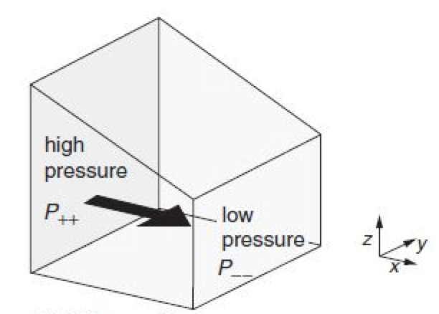
Pressure Gradient Force
Pressure variation exerts force on the fluid parcel
In this example, pressure decreases in x direction

Slide 31
Newton’s law with gravity and PGF
ma = F applied to a Lagrangian water parcel (with a unit volume)
In x-, y-, z- components
Primitive equation in inertial frame of reference (non-rotating).

Slide 32
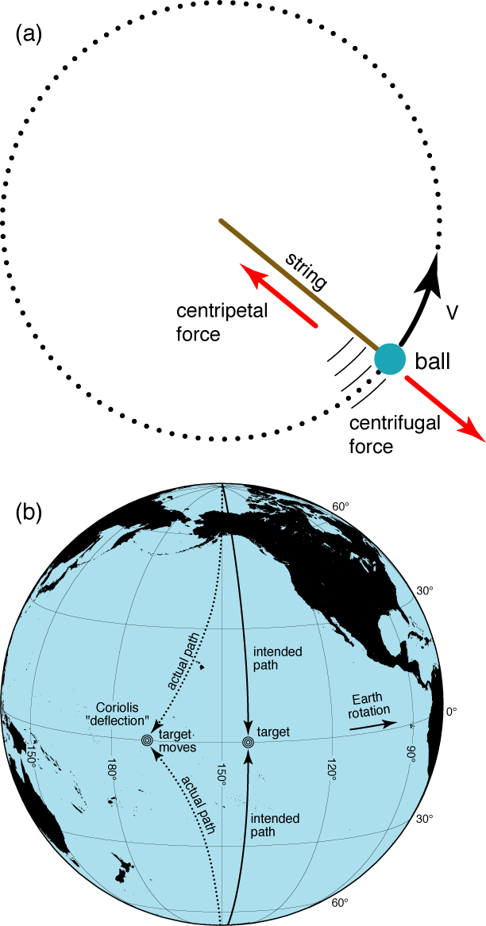
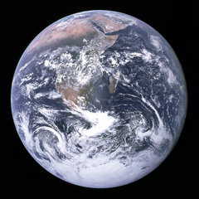
Rotating coordinates
Rotation vector that expresses direction of rotation and how fast it is rotating:
  vector pointing in direction of thumb using right-hand rule, curling fingers in direction of rotation
R

Slide 33
Rotating coordinates
The Earth is rotating. We measure things relative to this “rotating reference frame”.
Quantity that tells how fast something is rotating:
  Angular speed or angular velocity Ω = angle/second
  360° is the whole circle, but express angle in radians (2π radians = 360°)
  For Earth: 2π / 1 day = 2π / 86,400 sec = 0.707 x 10⁻⁴ /sec
  Also can show Ω = v/R where v is the measured velocity and R is the radius to the axis of rotation (therefore v = Ω R)
R
Notes:
At home: calculate speed you are traveling through space if you are at the equator (radius of earth is about 6371 km), then calculate it at 30N as well. (Do some geometry to figure out the distance from the axis at 30N.)

Slide 34
The effect of rotation
Additional forces due to the Earth’s rotation
  Centrifugal force
    Direction: Radially outward w.r.t. the axis of rotation
    Magnitude: Proportional to (rotation rate)² and distance from the axis of rotation
    Effect: Modifies gravity

Slide 35
Effect of centrifugal force on the Earth
Centrifugal force acts on the ocean and earth. It is pointed outward away from the rotation axis.
Therefore it is maximum at the equator (maximum radius from axis) and minimum at the poles (0 radius).
Ω = 0.707 x 10⁻⁴ /sec
At the equator, R ~ 6380 km so Ω²R = .032 m/s²
Compare with gravity = 9.8 m/s²
Notes:
A = 6000 km; omega = 2pi/86400 sec = 7.292e10-4/sec
Omega2 a cos(latitude) = 3.17 cm/sec2 x cos(latitude)
Compare 3.17 with gravity of 980 cm/sec2
Earth surface should be 0.3% farther out at equator = 20 km

Slide 36
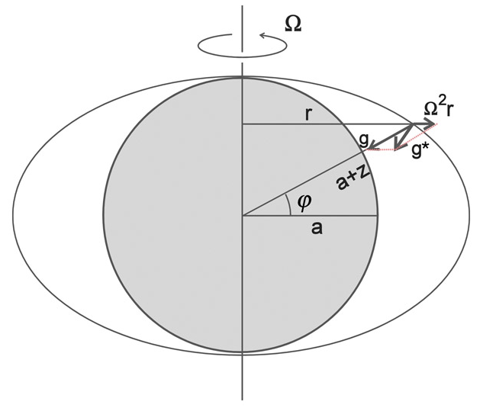
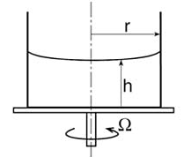
Geoid on a spherical planet
Centrifugal force bulges out the surface away from the axis of rotation
Geoid ≈ ellipsoid
Apparent gravity is deflected outward
The Earth’s geoid has irregularities due to spatially varying gravity (shape) of the planet

Slide 37
More on the geoid
When we calculate horizontal pressure gradients, or height of sea surface, they are relative to a “reference level” along which the pressure gradient vanishes (no force, no motion)
What do we mean by mean sea level?
Earth’s mass is not distributed evenly AND Earth is not a perfect ellipsoid. That is, the “reference level” surface is not locally “flat”.
This “reference surface”, surface of constant geopotential, i.e. along which the gravitational force has no changes, is the “geoid”

Slide 38
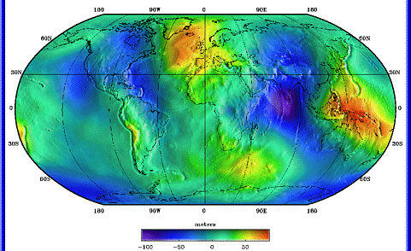
Observed geoid
Earth’s mass is not distributed evenly AND Earth is not a perfect ellipsoid
Geoid map using EGM96 data, from
http://cddis.gsfc.nasa.gov/926/egm96/egm96.html

Slide 39
The effect of rotation
Forces due to the Earth’s rotation
  Centrifugal force
  Coriolis force
    Direction: Perpendicular to the motion of the object
    Magnitude: Proportional to the speed of the object and the rotation rate
    Effect: Deflects moving object

Slide 40
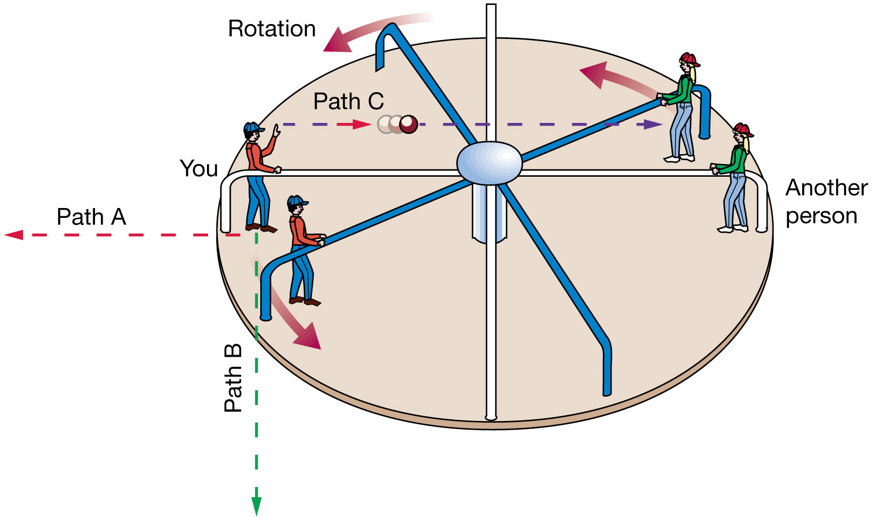
Coriolis force
Exmaple: playing catch on a merry-go-round
Straight path in inertial (non-rotating) frame
Deflection to the right in rotating frame

Slide 41
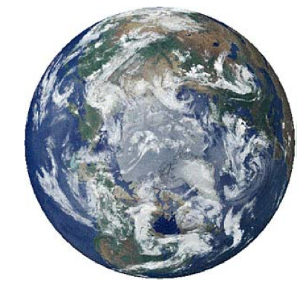
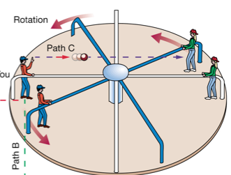
Coriolis force
In northern hemisphere, planetary rotation is counter-clockwise.
A moving object is deflected to the right in rotating frame of reference

Slide 42
Rotating table experiments
Deflection of marbles
IF the table is rotating counterclockwise, the marble always deflect to the right of the direction of its motion
IF the table is rotating clockwise, the marble always deflect to the left of the direction of its motion

Slide 43
Continue to next week

Slide 44
Conservation of mass in a semi-enclosed basin
Mass conservation:
F ≡ ρ _{o}V_{o} - ρ_{i} V_{i} = (R + AP) - AE
(F = “freshwater” = net amount of rain in kg, evaporation, runoff into the area); A = surface area in m²; R = runoff in kg; P = precipitation kg/m²; E = evaporation per unit area kg/m²
DPO Fig. 5.1
Notes:
Fin = Fout + net((E-P-R)rho Area

Slide 45
Conservation of salt
(2) Salt conservation: V_{i} ρ_{i} S_{i} = V_{o} ρ _{o} S_{o}
*Note that river inflow, evap and precip do not carry salt
DPO Fig. 5.1
Notes:
Fin = Fout + net((E-P-R)rho Area

Slide 46
Conservation of freshwater
Mass: F = ρ _{o}V_{o} - ρ_{i} V_{i} = (R + AP) - AE
Salt: V_{o} ρ _{o} S_{o} - V_{i} ρ_{i} S_{i} = 0
Eliminate V_{i} ρ_{i} and write the relationship between F and salinity.
F ~ ρ V ( S_{i} - S_{o} ) / S_{i}
So the freshwater input calculated from the difference in salinity between inflow and outflow equals the net precipitation, evaporation, runoff

Slide 47
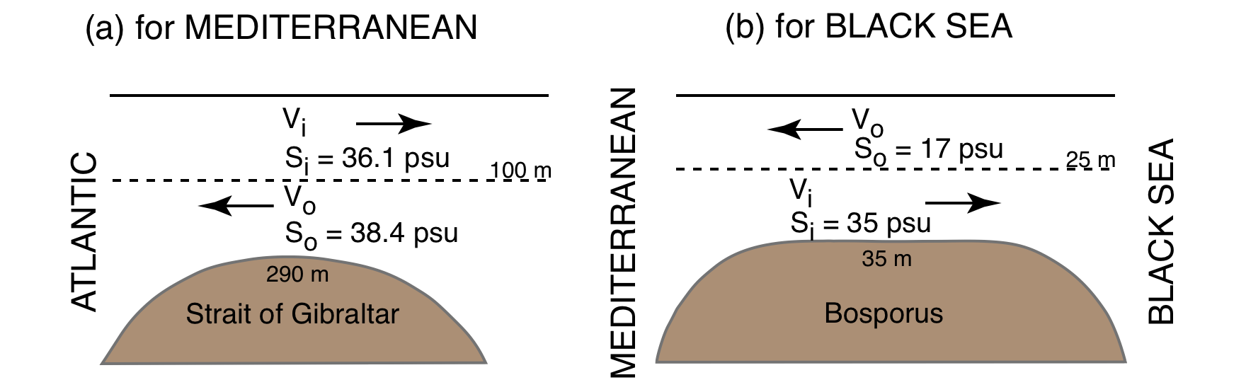
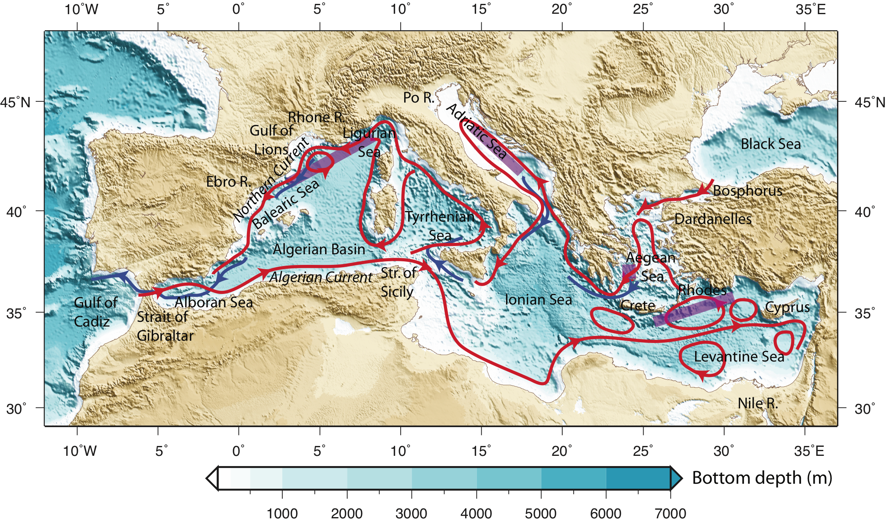
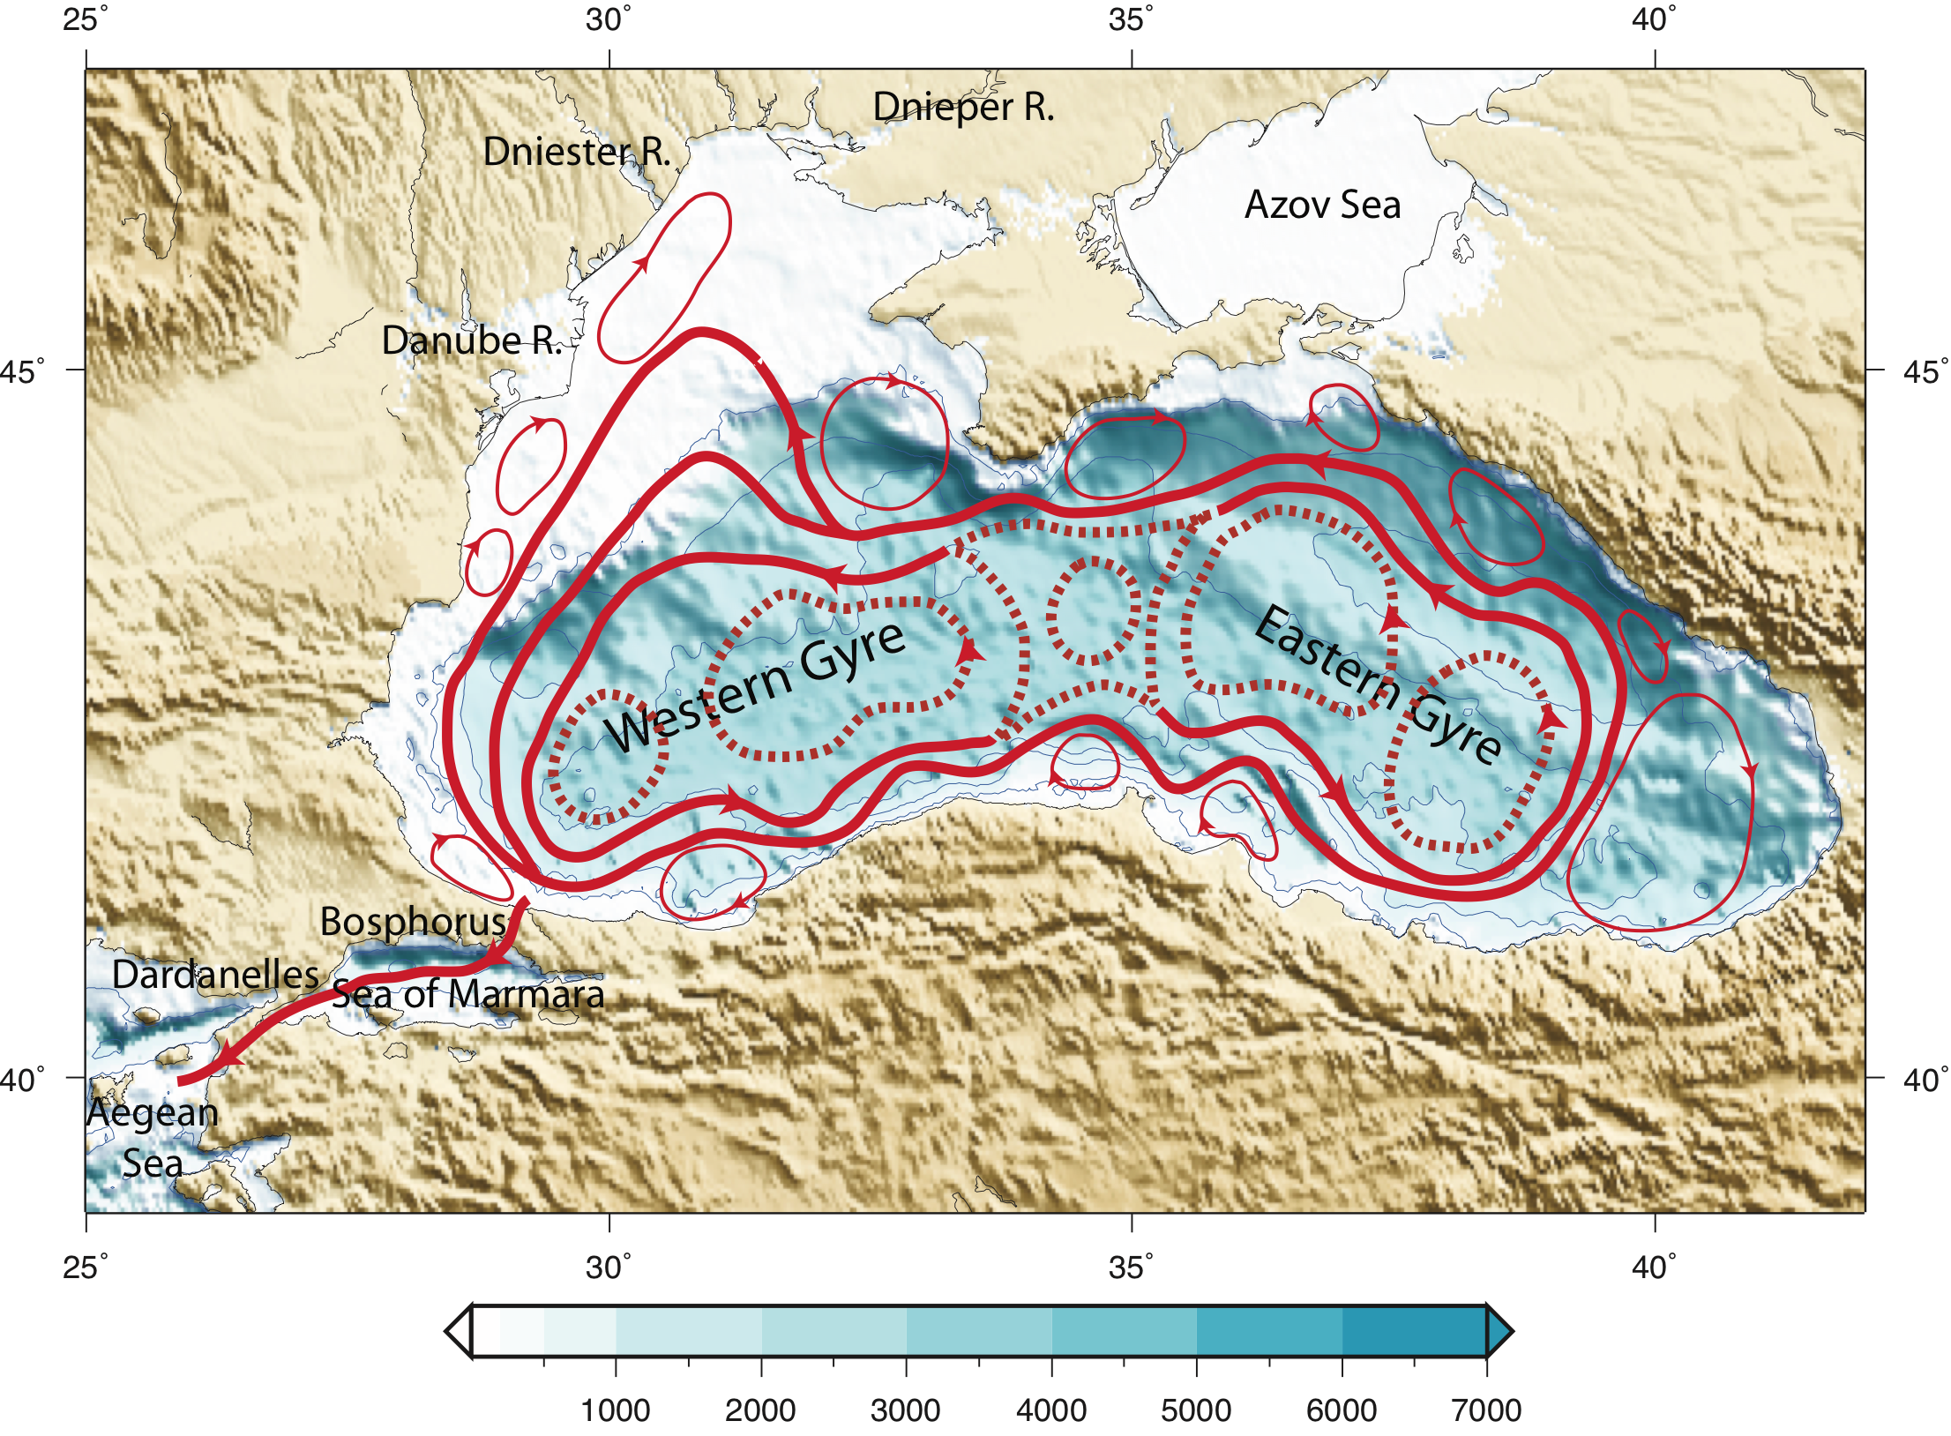
Freshwater transport: Mediterranean and Black Seas
Evaporative basin Runoff/precipitation
DPO Figure 5.3

