Slide 1
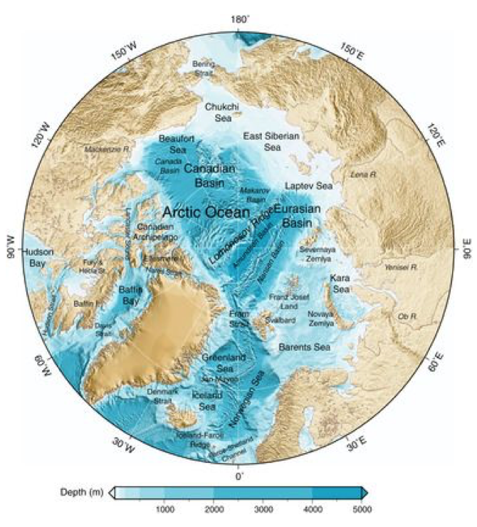
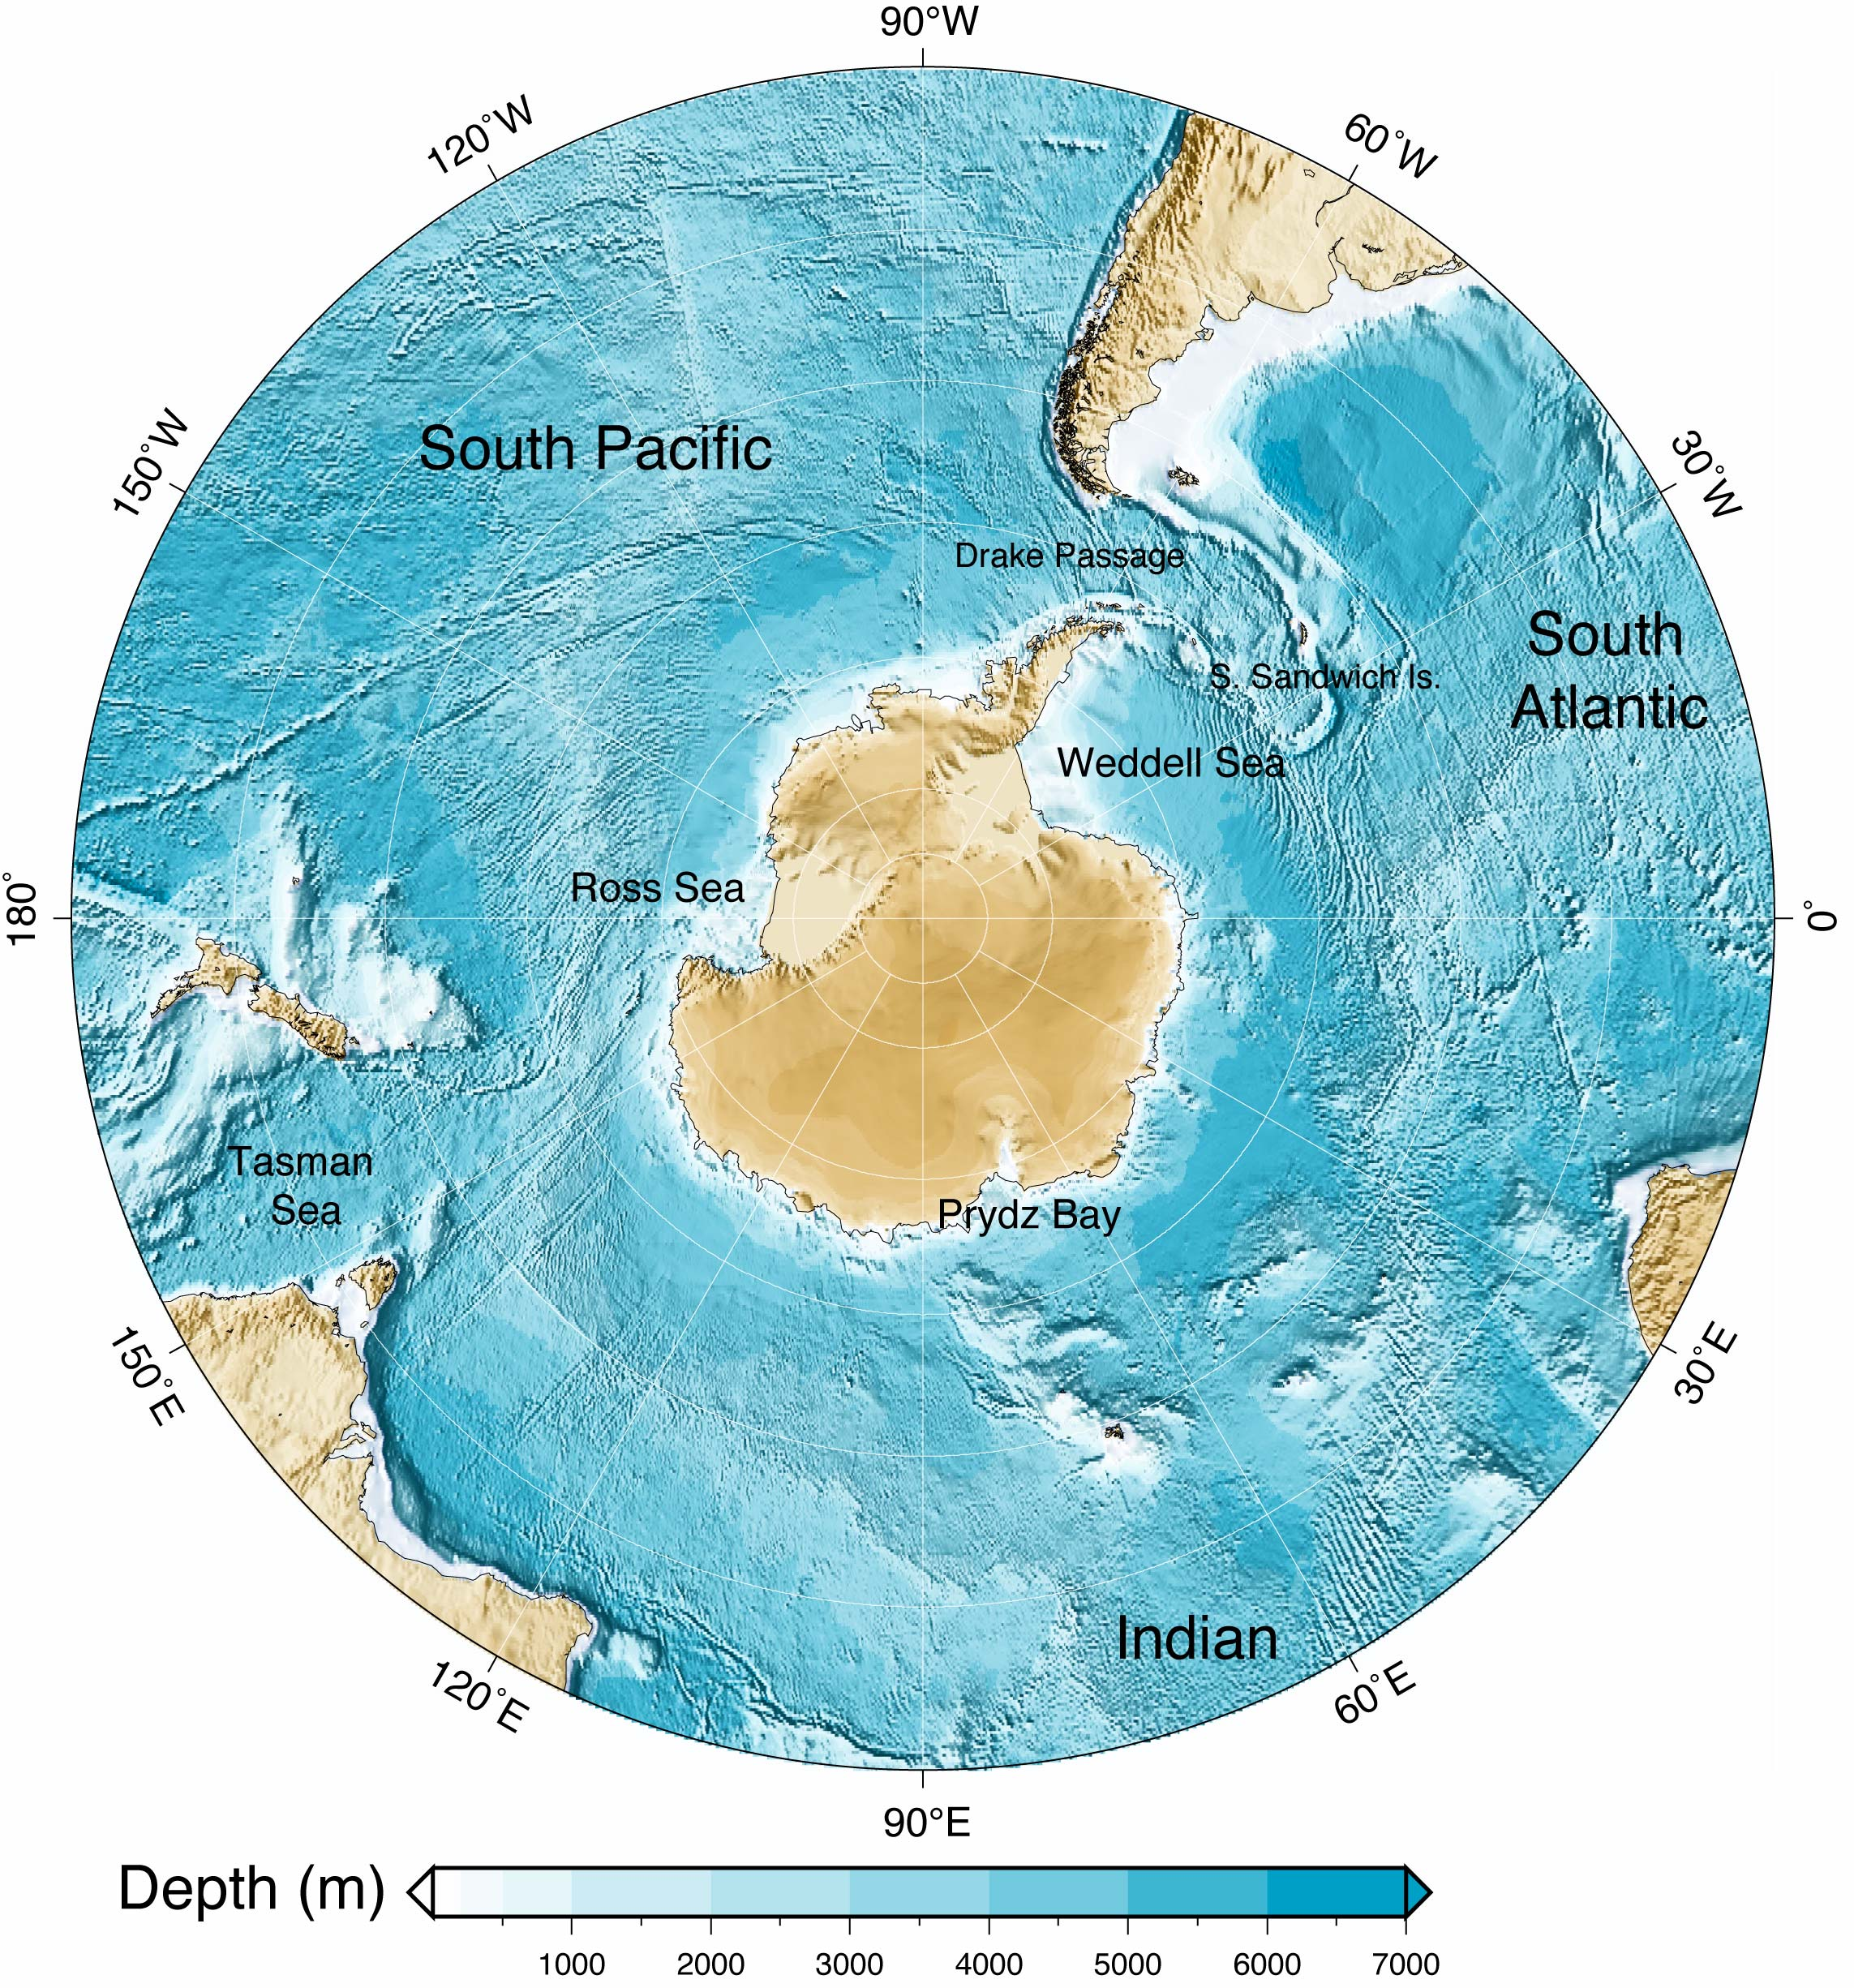
Week 13: the Polar Oceans
Talley’s book chap 12 and 13

Slide 2
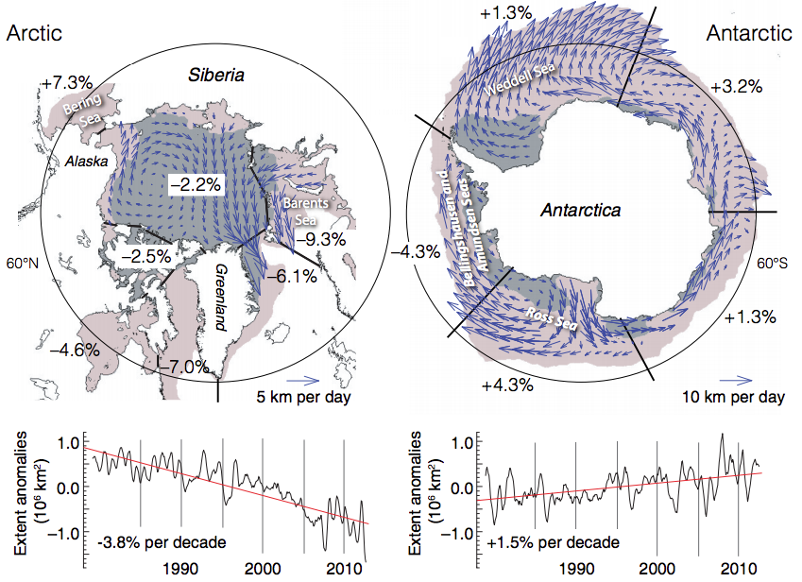
Sea ice and its trends
IPCC AR5 (2014)

Slide 3
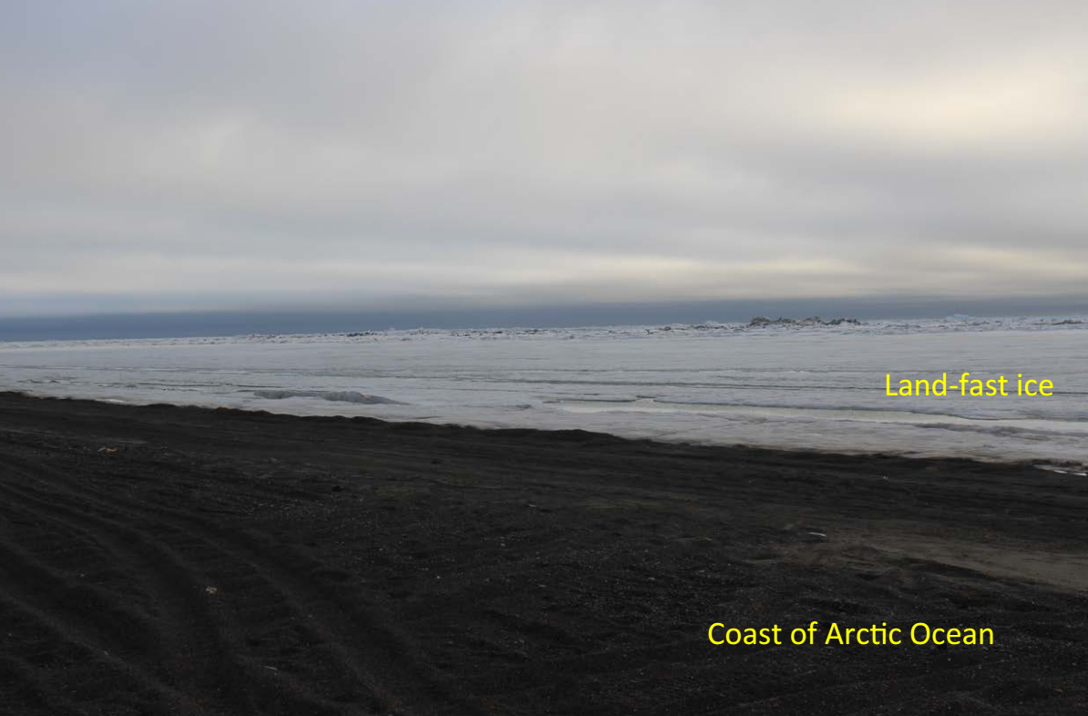
Seaice
Seaice = floating ice on the surface ocean
  Fast ice (land-fast ice): seaice attached to the coastline (does not move)
  Pack ice (drift ice): seaice drifting with wind and ocean currents

Slide 4
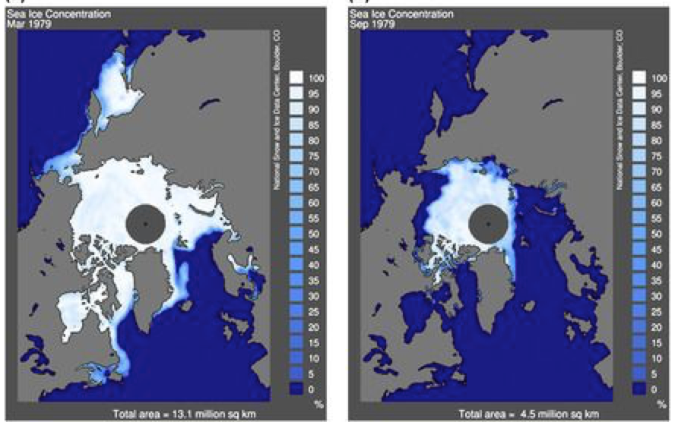
Arctic seaice
Polar cap ice = dominant ice type in the Arctic ocean, usually several years old, covering about 70% of the Arctic Ocean and is 3-3.5m thick
Late Winter
Late Summer
Fig 12.20: Satellite image of Arctic seaice extent (late 1970s)

Slide 5
Arctic seaice
Polar cap ice = dominant ice type in the Arctic ocean, usually several years old, covering about 70% of the Arctic Ocean and is 3-3.5m thick
Pack ice = surrounds the polar cap ice. It is younger and thinner, a few meters, and covers about 25% of the Arctic.
Fast ice = attached to the land. It is a first year ice. It melts during the summer months.
Seaice transport: Up to one-third of Arctic seaice are exported through the Fram Strait in the East Greenland Current out to the North Atlantic. This is a major factor for the freshwater budget of the Arctic Ocean

Slide 6
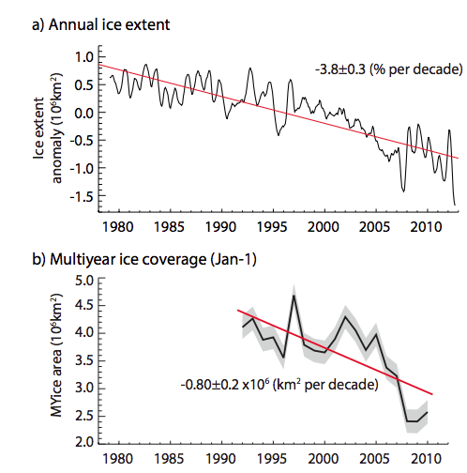
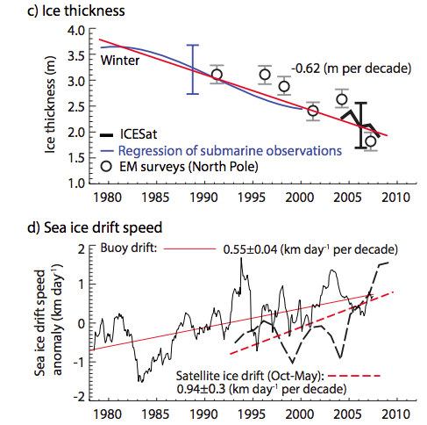
Arctic seaice extent (area) is shrinking (especially in the summer), getting younger, thinner and more mobile.

Slide 7
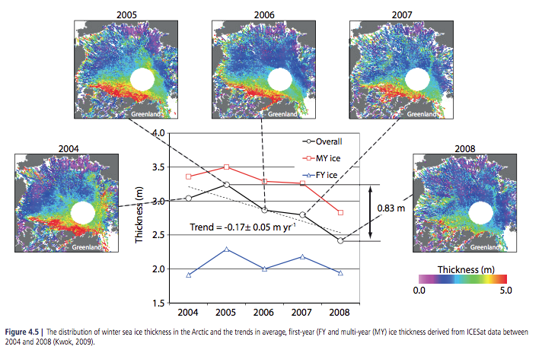
Thinning of the Arctic seaice

Slide 8
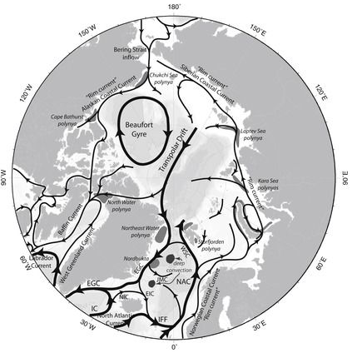
Arctic surface circulation
Canadian basin
Beaufort gyre ➔ wind-driven, anti-cyclonic circulation
Eurasian basin
Deep basin ~ 4,200m deep, Cyclonic circulation
Greenland Sea → deep water formation
Nordic Seas → deep water formation
Transpolar Drift in between the two basins
Exchanges with Pacific through Bering Strait (130m deep) and with Atlantic through Nordic Seas
Talley DPO 12.1

Slide 9
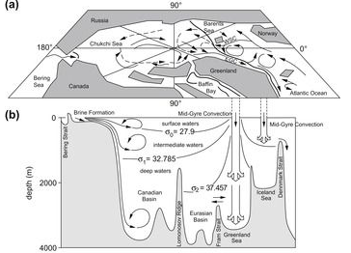
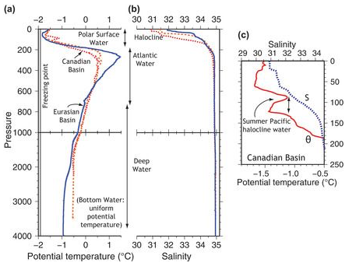
Arctic ventilation
Canadian basin ~ 3,800m deep
Eurasian basin ~ 4,200m deep
Approx. 1 Sv of freshwater inflow from the Bering Strait
Deep convection in the Greenland Sea and Nordic Seas

Slide 10
Topographic steering
Taylor-Proudman theorem
  Circulation cannot change in the direction of the rotation vector in a slow, friction-less barotropic fluid
  Barotropic = No horizontal density variation (on pressure surface)
  Baroclinic = horizontal density variation
Density variations are small in the polar oceans. Surface currents often follows the deep sea topography. Consider the two Arctic basins separated by the ridge.

Slide 11
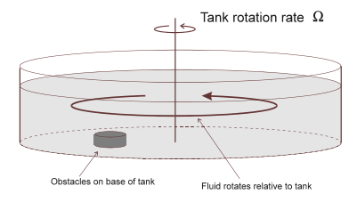
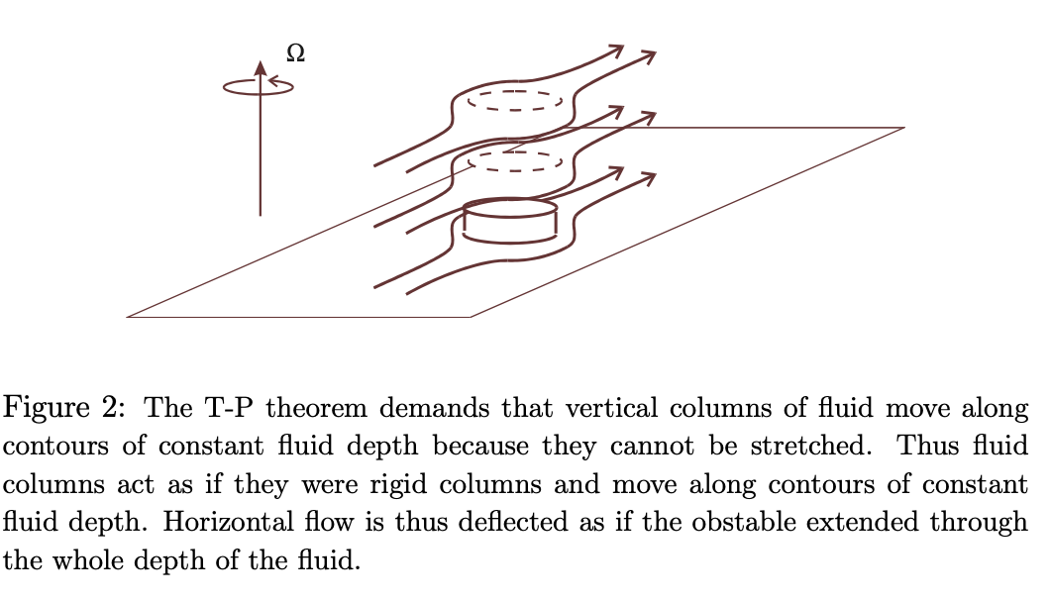
Topographic steering
Taylor-Proudman theorem
This is relevant to the pattern of ocean currents reflecting the seafloor topography
Density variations are small in the polar oceans = circulation is more barotropic

Slide 12
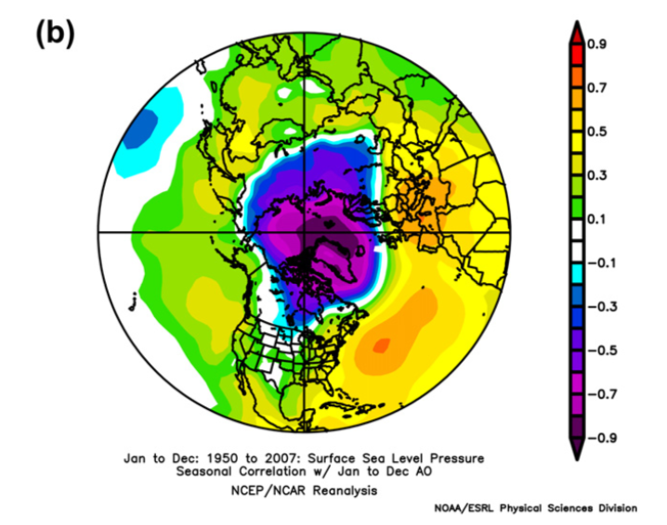
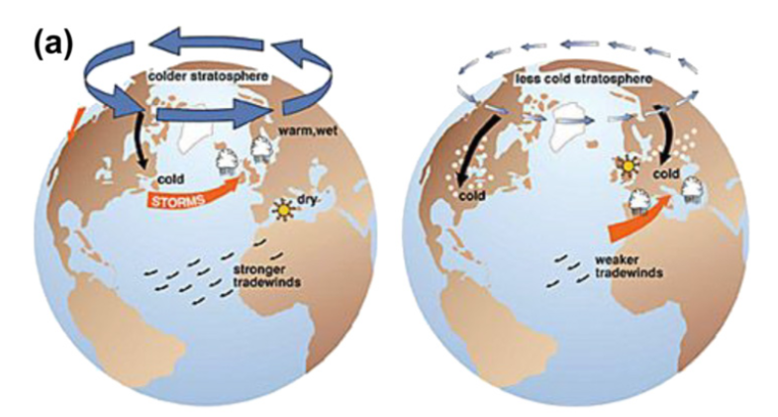
Climate variability in the Arctic
Arctic Oscillation
North Atlantic Oscillation
Atlantic Multidecadal Oscillation
Supplementary chapter 15
http://booksite.academicpress.com/DPO/suppchapters.php
Sea level pressure pattern under +AO condition
+AO - AO

Slide 13
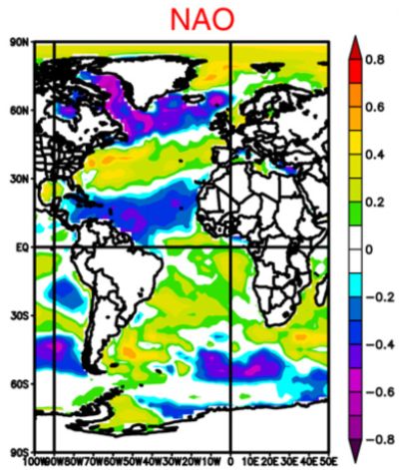
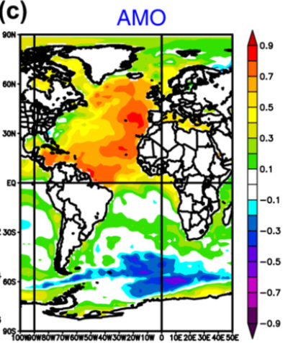
Climate variability in the Arctic
Arctic Oscillation
North Atlantic Oscillation
Atlantic Multidecadal Oscillation
Supplementary chapter 15
Sea surface temperature pattern associated with NAO and AMO

Slide 14
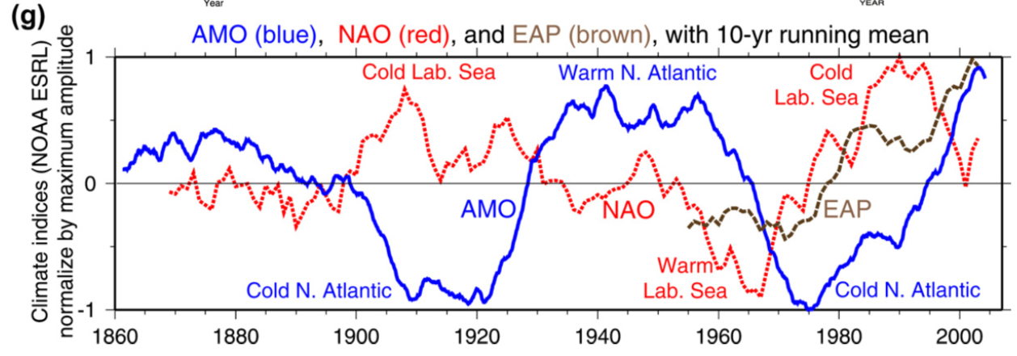
Climate variability in the Arctic
Arctic Oscillation
North Atlantic Oscillation
Atlantic Multidecadal Oscillation
Supplementary chapter 15

Slide 15
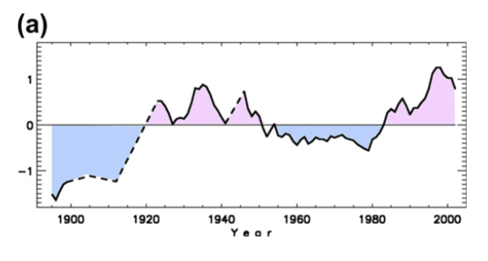
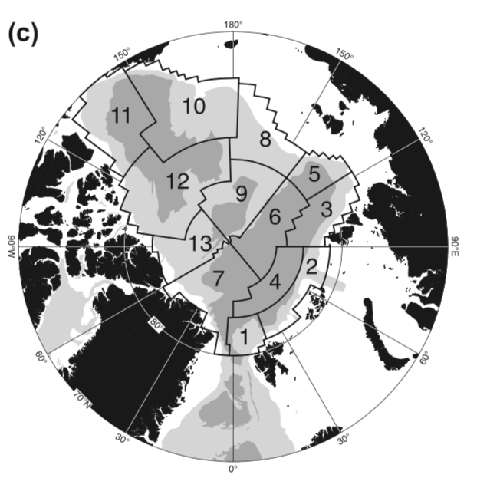
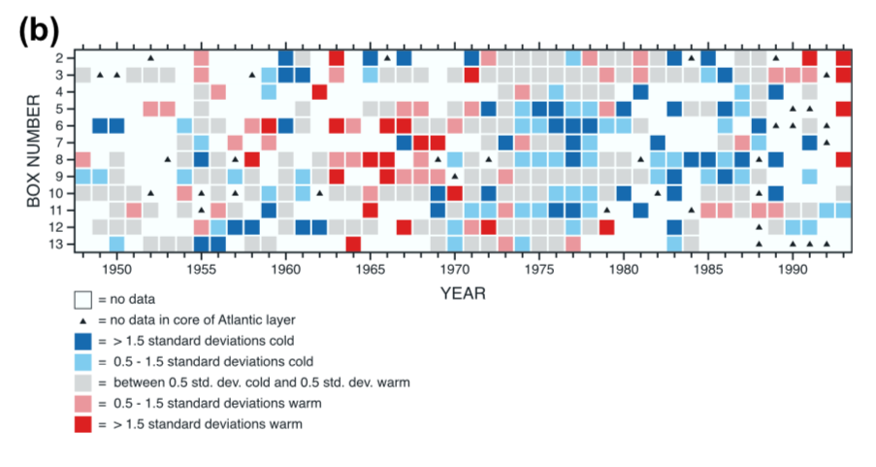
Climate trend in the Arctic
Arctic temperature anomaly
Supplementary chapter 15
Breakdown into 10 sub-regions

Slide 16
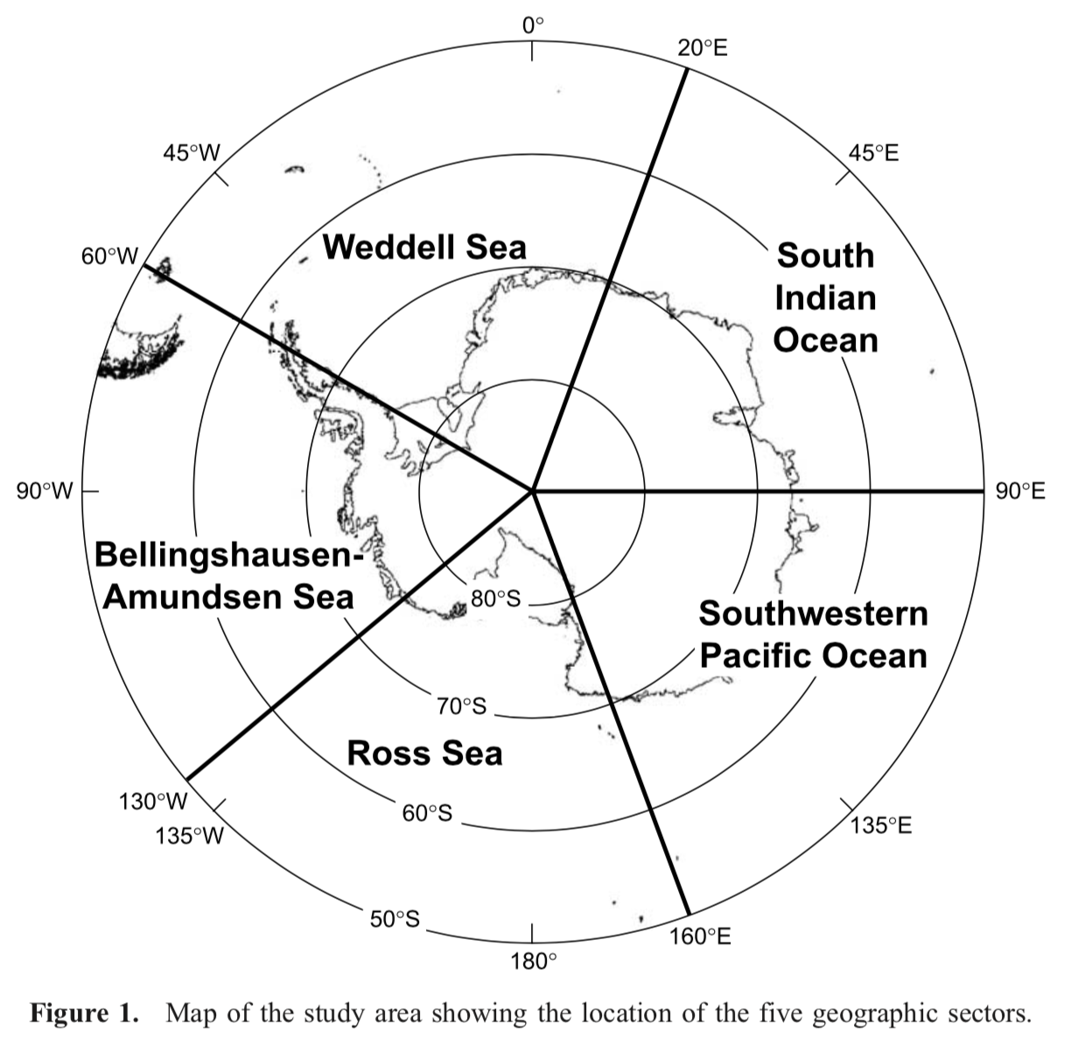
Southern Ocean
Broad geographic regions
Two polar gyres:
Weddell Sea and Ross Sea
Bellingshausen-Amundsen Sea → Southeastern Pacific sector
South Indian Ocean
Southwestern Pacific Ocean
Arrigo et al., (2008)

Slide 17
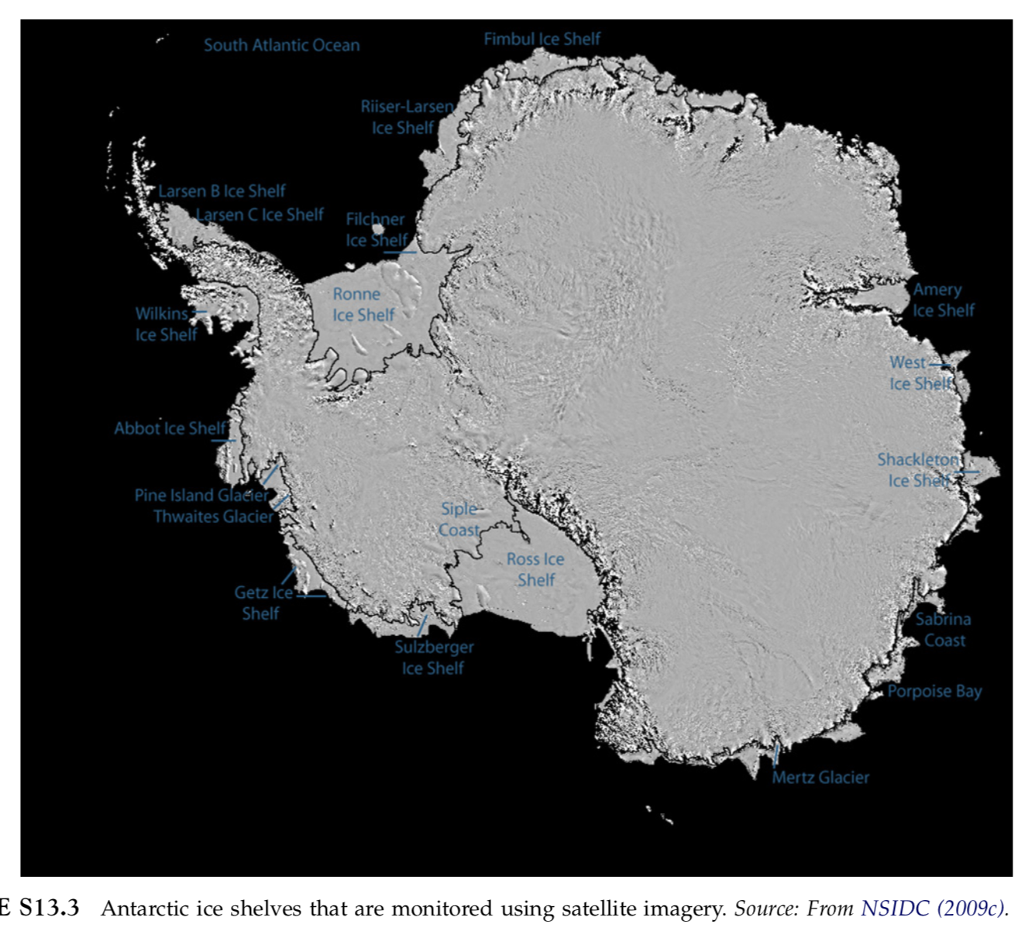
Ice shelves
Ice shelves are continental ice sheets flowing into the coastline
East Antarctica
West Antarctica

Slide 18
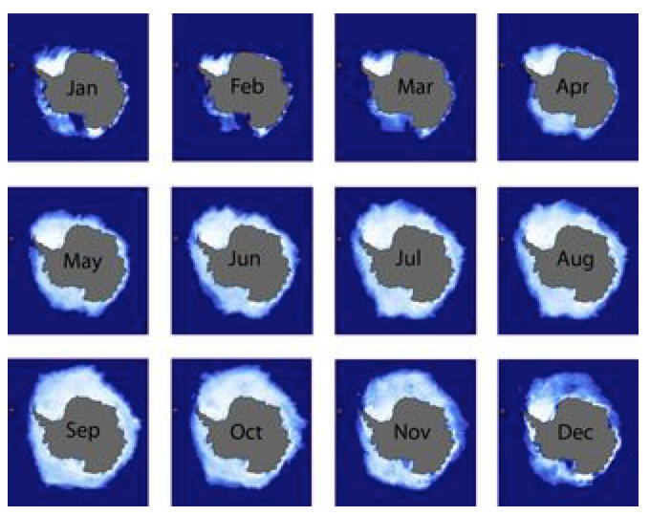
Seaice

Slide 19
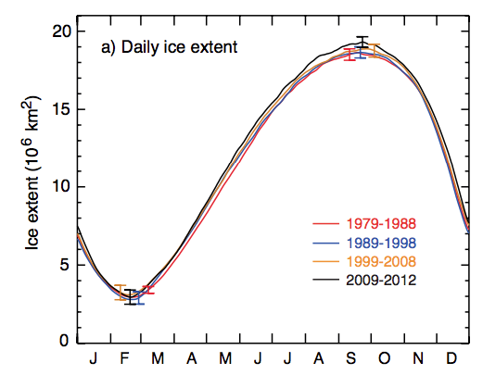
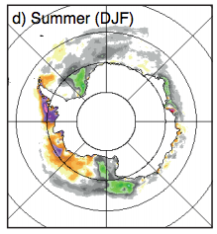

Antarctic seaice
Antarctic seaice as a whole is not changing its areal coverage. Its age is generally younger (less than 2 years). There are regions of increasing/ decreasing seaice cover. They tend to average out if integrated globally.

Slide 20
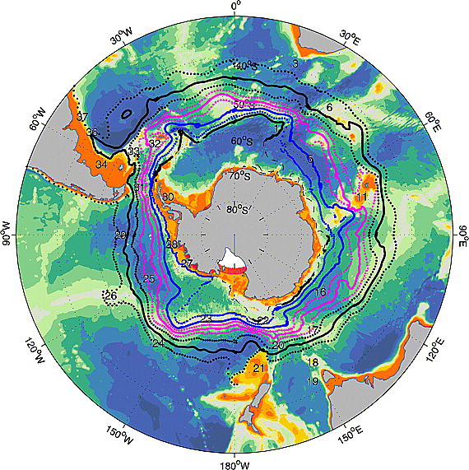
Antarctic Circumpolar Current
Sokolov and Rintoul (2009) JGR-Oceans

Slide 21
Southern Ocean circulation
Sverdrup balance does not hold in the Southern Ocean in the latitudes of the Drake Passage because of the lack of the continental boundary to support the western boundary current.
Instead, the Southern Ocean circulation is dominated by the eastward flowing, Antarctic Circumpolar Current (ACC) and associated fronts and eddies.
The ACC jet is in thermal wind balance with the N-S density gradient (Shear of about .5 m/s near the surface to .1 m/s near the bottom).

Slide 22
Bottom topography and Antarctic Circumpolar Current
Topographic constraints:
Drake Passage
Agulhas basin
Kerguelen Island
Campbell Plateau
Udintsev Fructure Zone
**Remember the shape of the winter sea ice extent
Sokolov and Rintoul (2009) JGR-Oceans

Slide 23
Sea ice and its trends
IPCC AR5 (2014)

Slide 24
Bottom topography and Antarctic Circumpolar Current
Southern Ocean Fronts:
(From north to south)
STF (Subtropical Front)
SAF (Subantarctic Front)
PF (Polar Front)
SACCF (Southern ACC Front)
Abrupt changes in hydrographic properties are observed (T, S, nutrients)
Sokolov and Rintoul (2009) JGR-Oceans

Slide 25
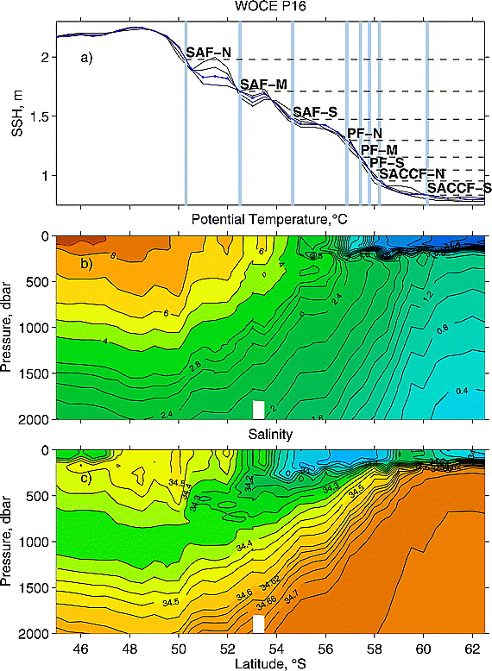
Fronts of the Antarctic Circumpolar Current
Southern Ocean Fronts:
(From north to south)
STF (Subtropical Front)
SAF (Subantarctic Front)
PF (Polar Front)
SACCF (Southern ACC Front)
Abrupt changes in hydrographic properties are observed (T, S, nutrients)
Sokolov and Rintoul (2009) JGR-Oceans

Slide 26
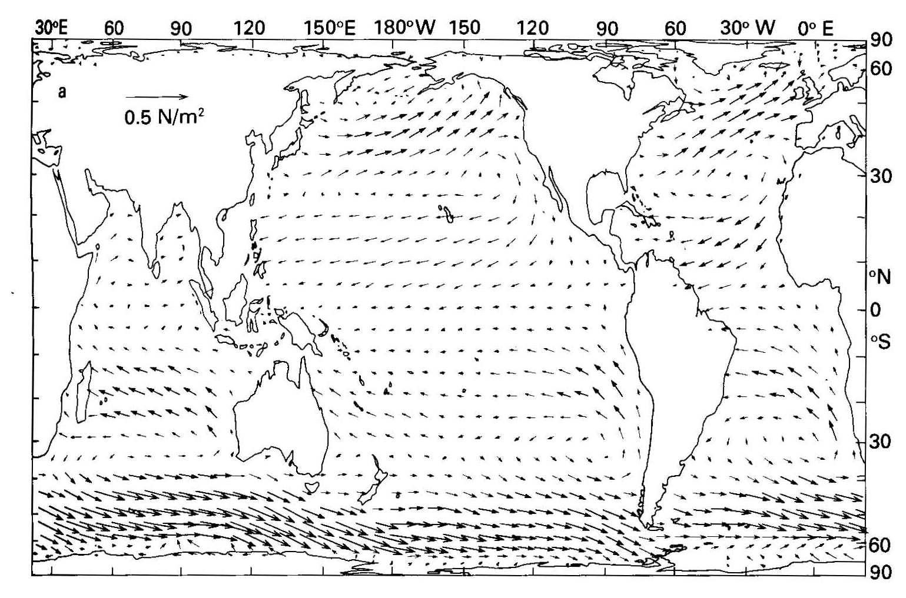
Wind forcing

Slide 27
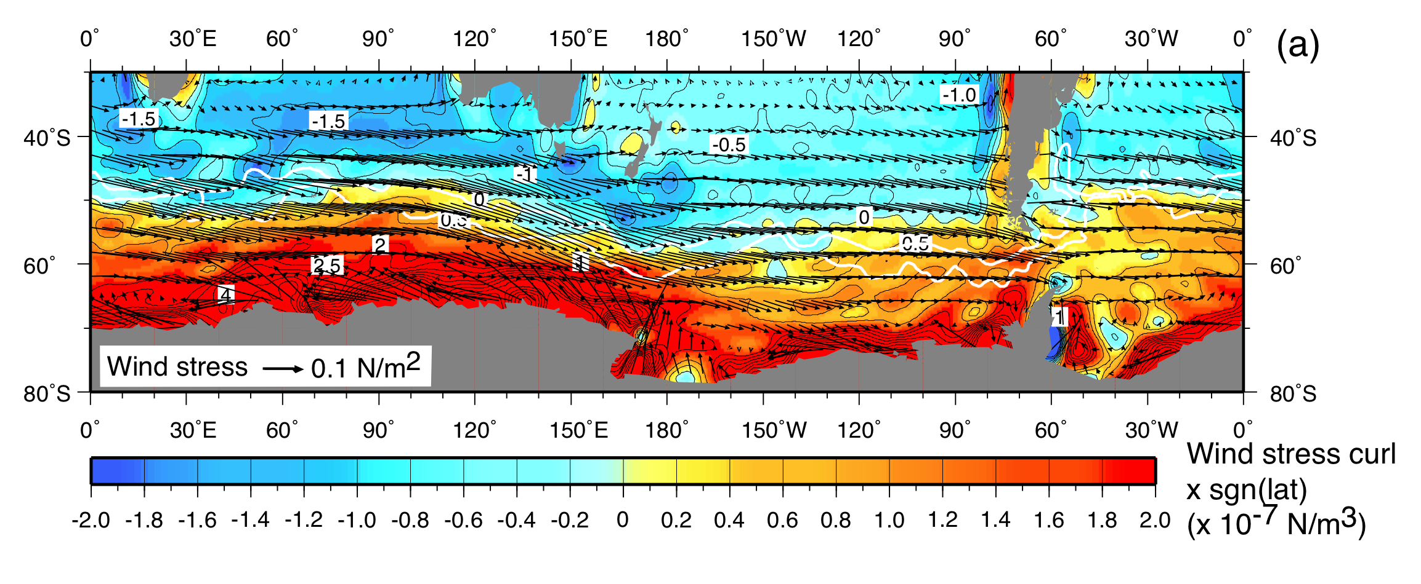
Wind stress curl and Ekman upwelling

Slide 28
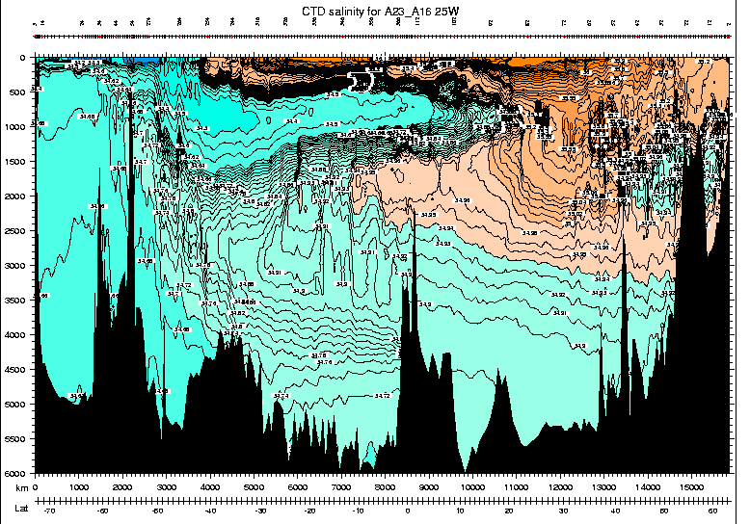
Upwelling of NADW in the Southern Ocean
AAIW
MOW
LSW
NADW
NSOW
AABW

Slide 29
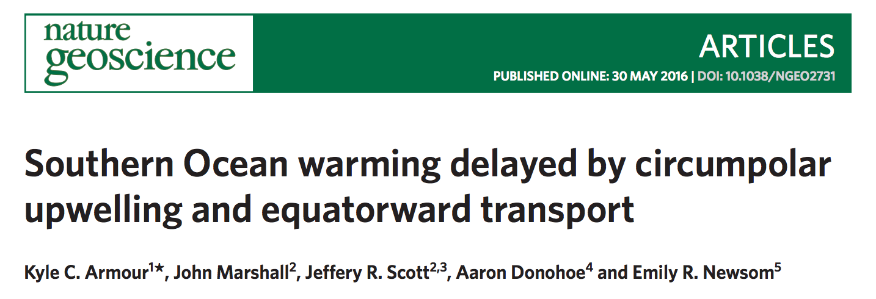
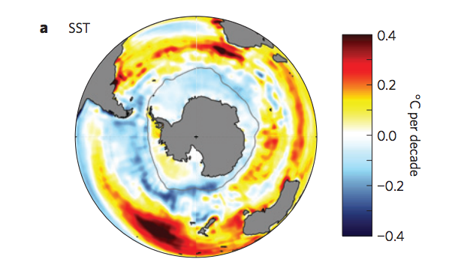
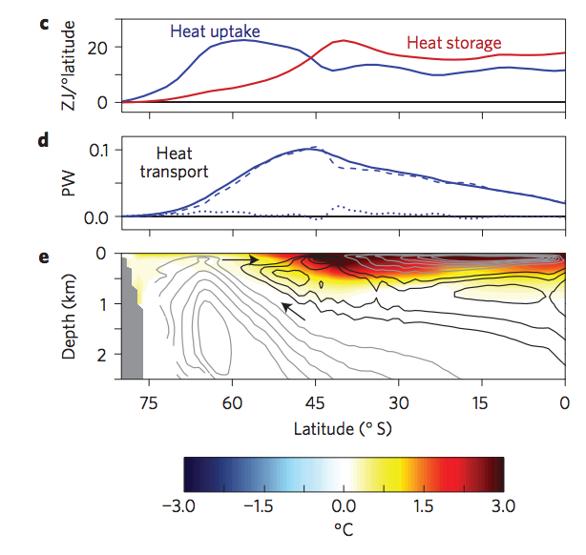
Last ~30 years, the SST of the polar Southern Ocean did not warm up. Rather it slightly cooled.

Slide 30
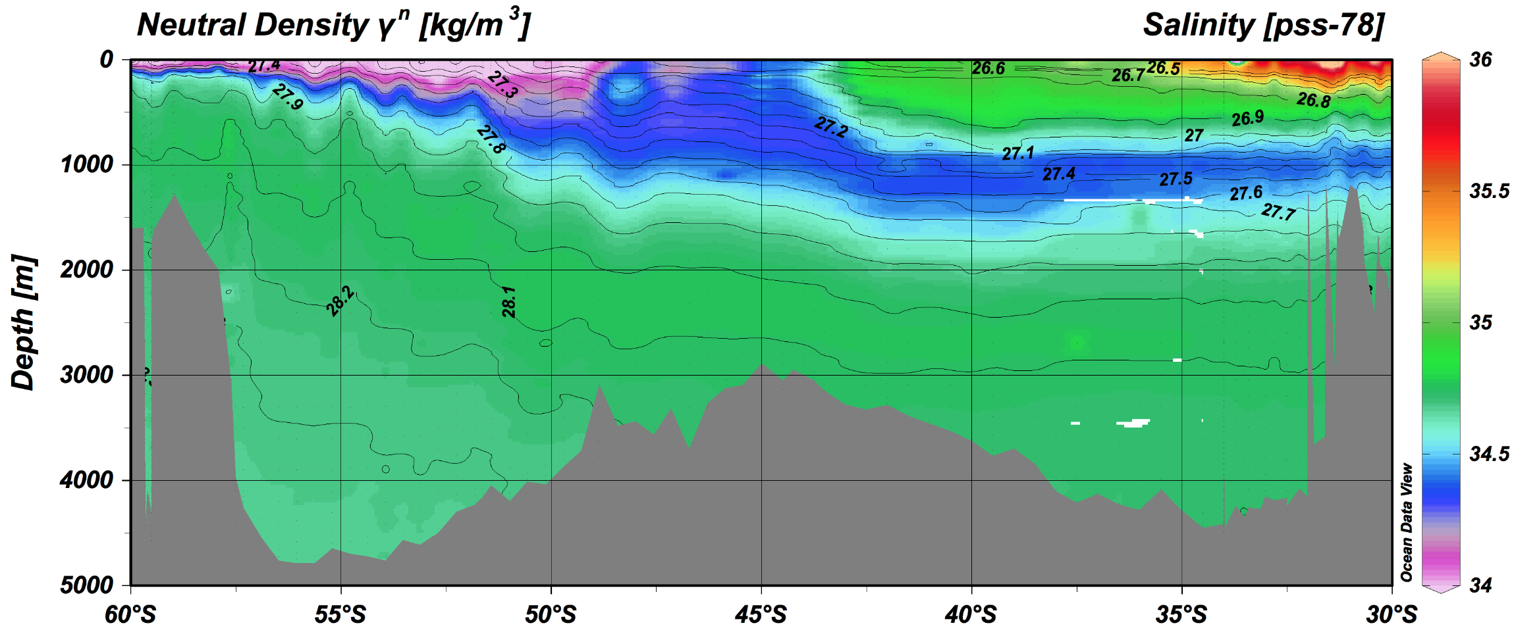
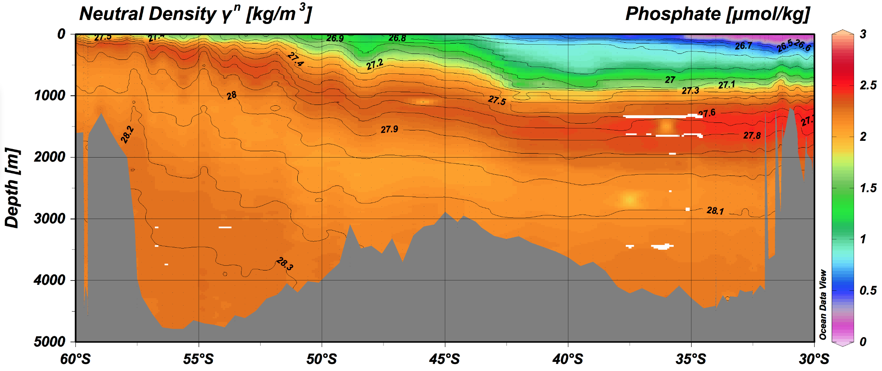
Water Masses
SAMW
AAIW
CDW
AABW
UCDW
LCDW
AABW

Slide 31
Major water masses in the Southern Ocean
SAMW (Subantarctic Mode Water) = warm and salty water ventilated in the north of the ACC (σ_{θ} ~ 26.8 to 27.0)
AAIW (Antarctic Intermediate Water) = colder and fresh water ventilated from the deep mixed layer near the polar front (σ_{θ} ~ 27.2)
CDW (Circumpolar Deep Water) is mixture of NADW and Pacific Deep Water. Relatively warm and salty.
AABW (Antarctic Bottom Water) is very cold and fresh dense bottom water formed as a mixing product of CDW and the Dense Shelf Water in the Weddell and Ross Sea.

Slide 32
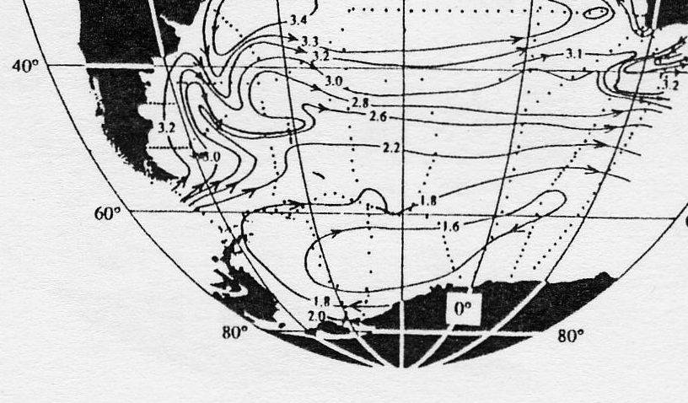
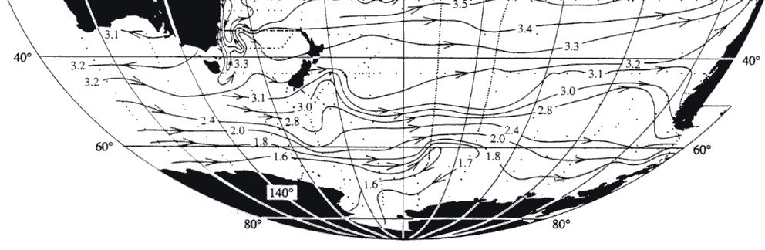
Polar gyres: Weddell & Ross Sea
Cyclonic gyres in the south of the ACC

Slide 33
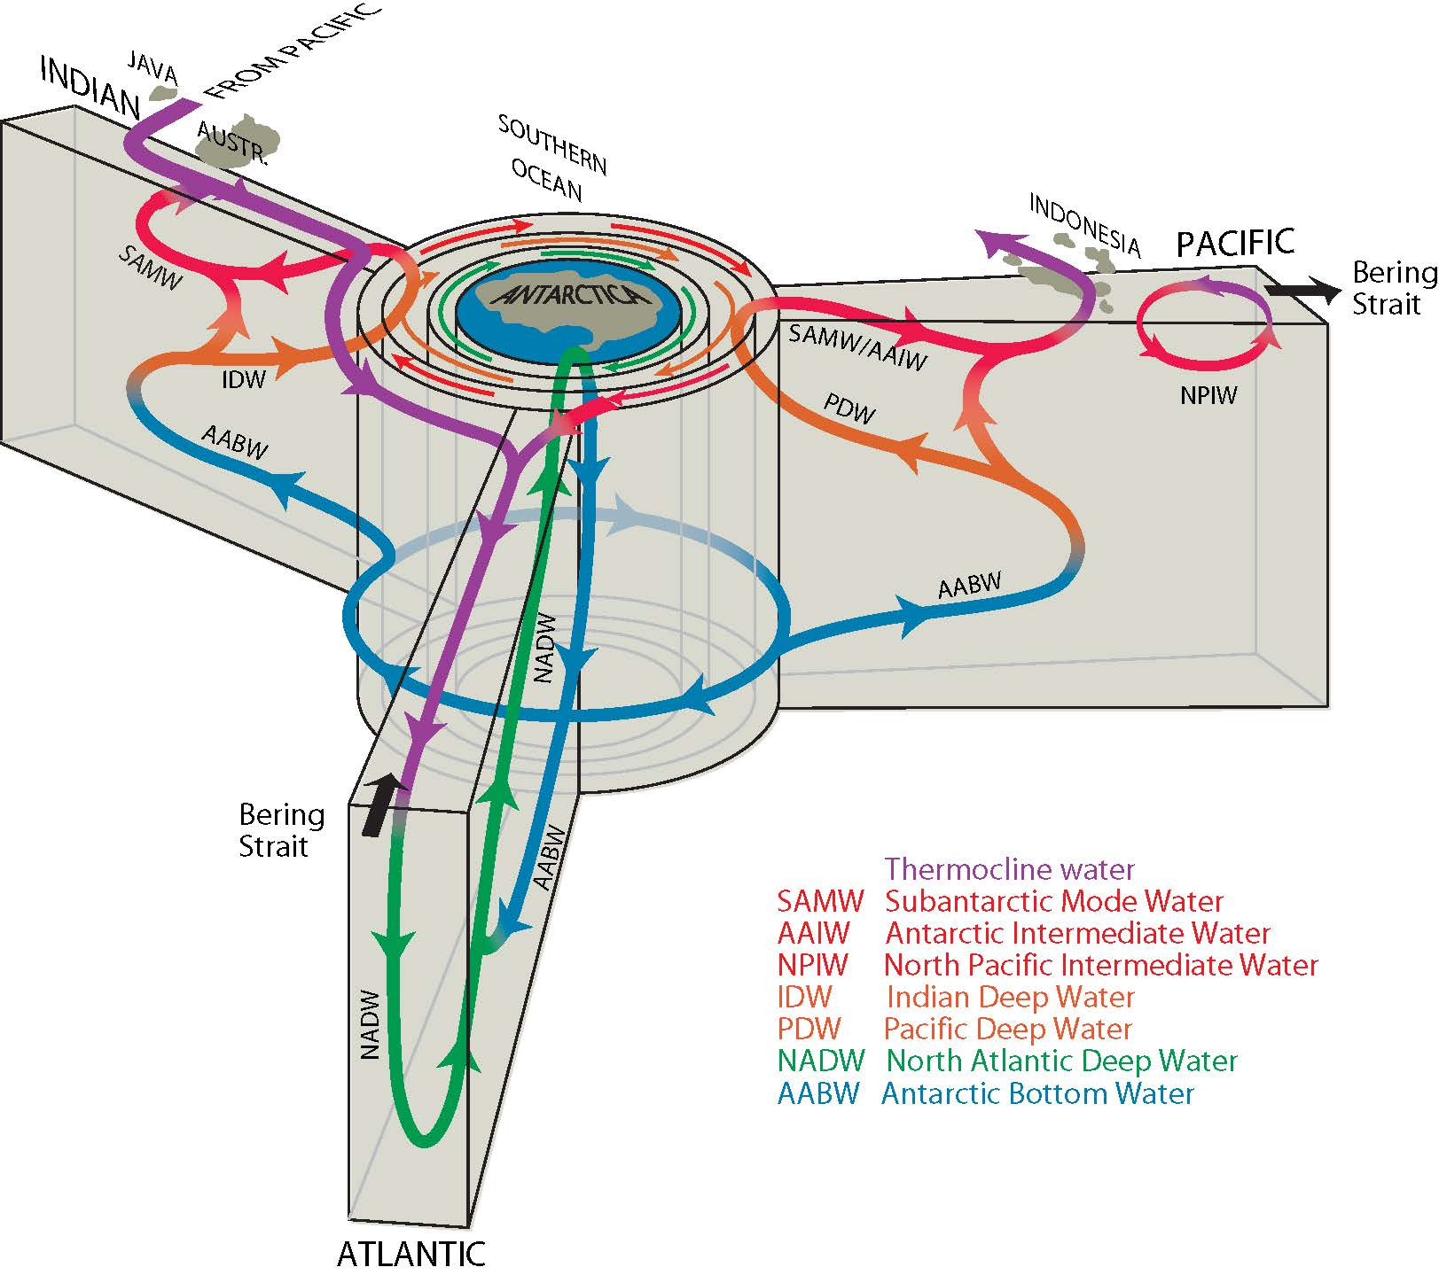
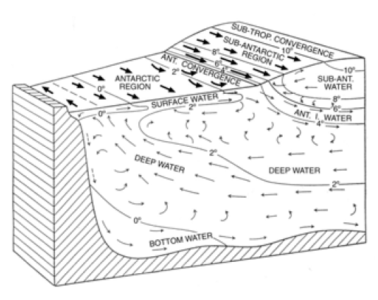
The Southern Ocean MOC
Sverdrup (1942)
L. Talley
In the Southern Ocean, the deep water formed in the North Atlantic upwells to the surface. At the same time, new deep water is created to fill the abyss.

Slide 34
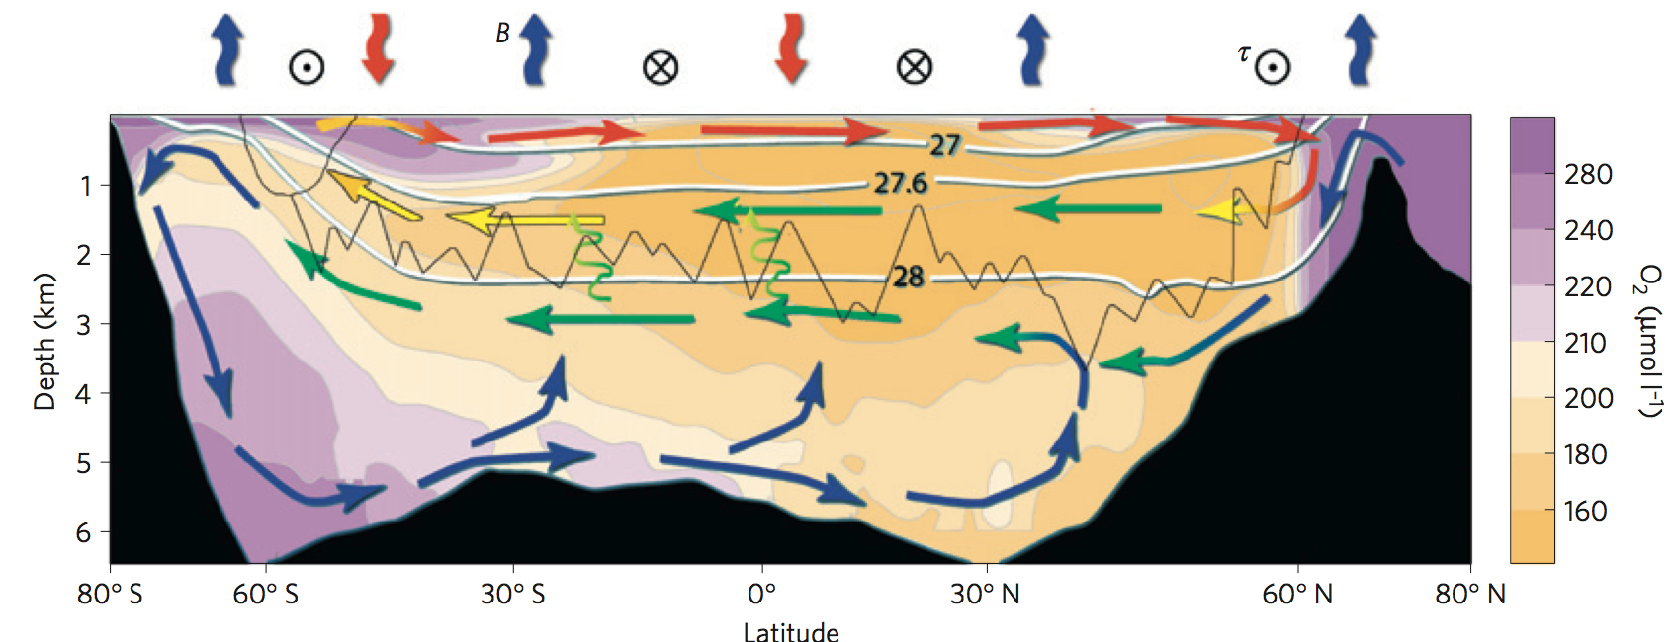
Balancing northern sinking and southern upwelling
Marshall and Speer (2012) Nat. Geosci.
What regulates the intensity of ocean’s deep overturning cells?
Dense water formation in the North Atlantic? Upwelling in the Southern Ocean?

Slide 35
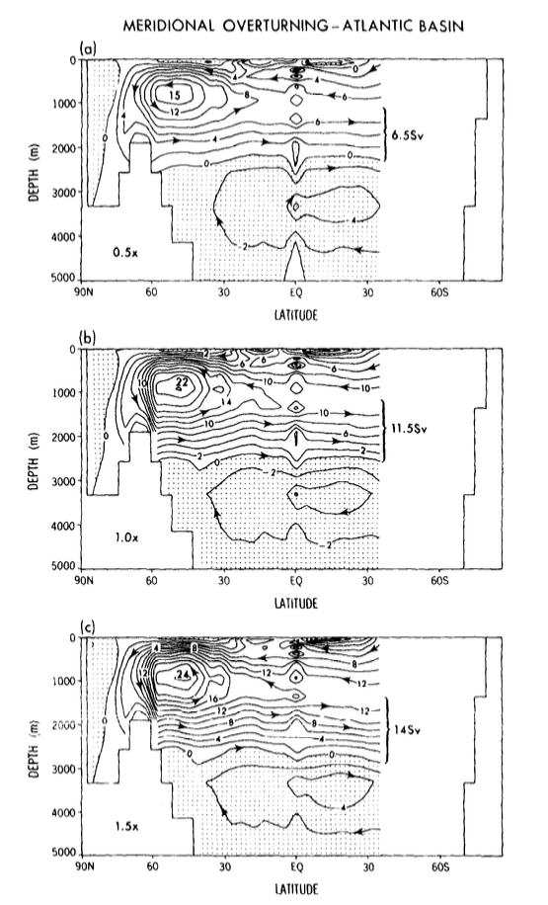
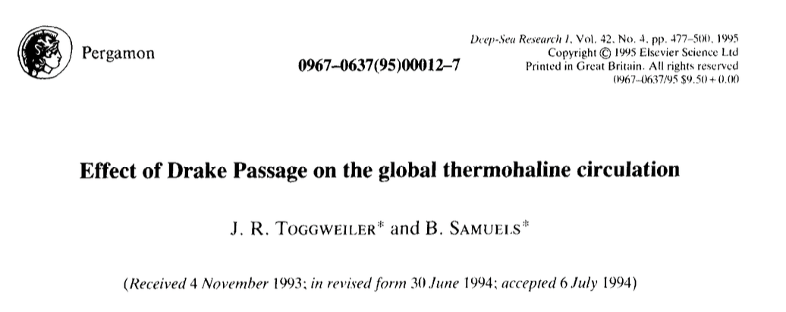
Can the wind-driven upwelling in the Southern Ocean control the NADW formation?
Toggweiler and Samuels (1994) applied different intensity of the wind stress over the Southern Ocean in an ocean GCM, showing increasing NADW formation under stronger wind-drive upwelling.

Slide 36
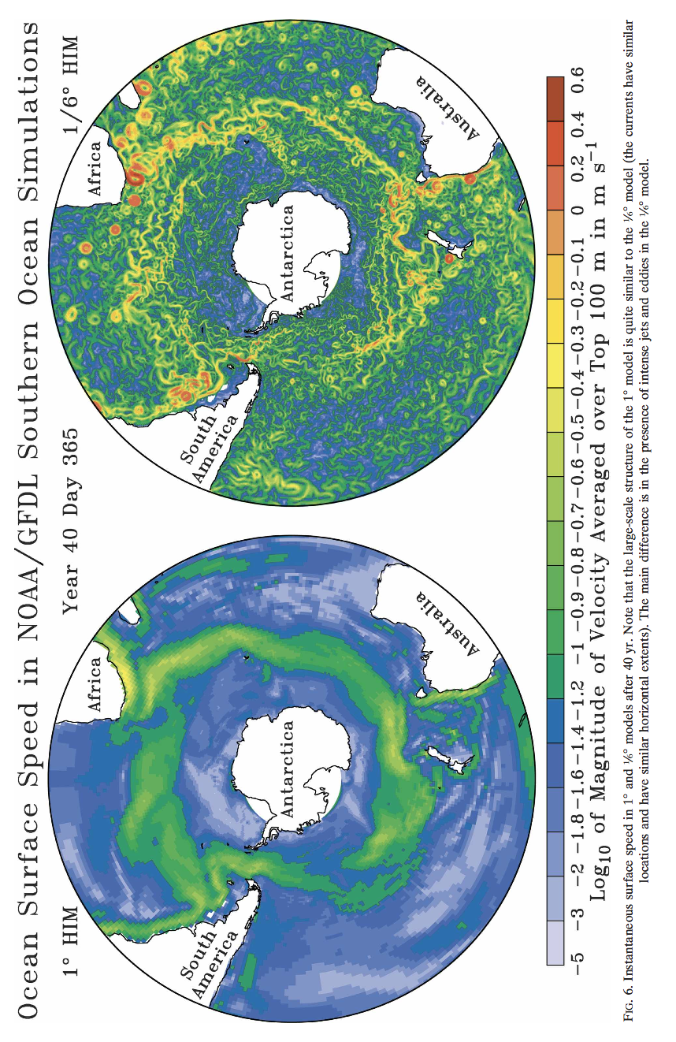
Southern Ocean jets and eddies
Hallburg and Gnanadesikan (2006)

Slide 37
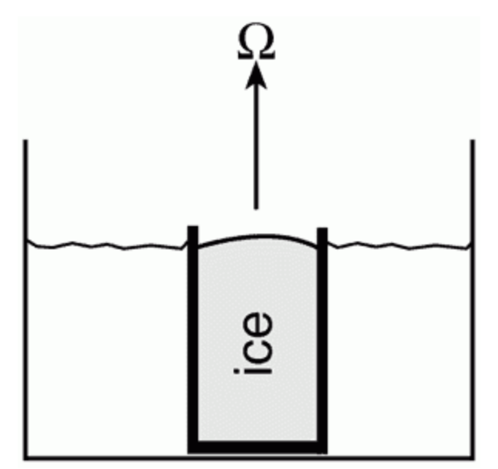
Tank experiment
Baroclinic instability

Slide 38
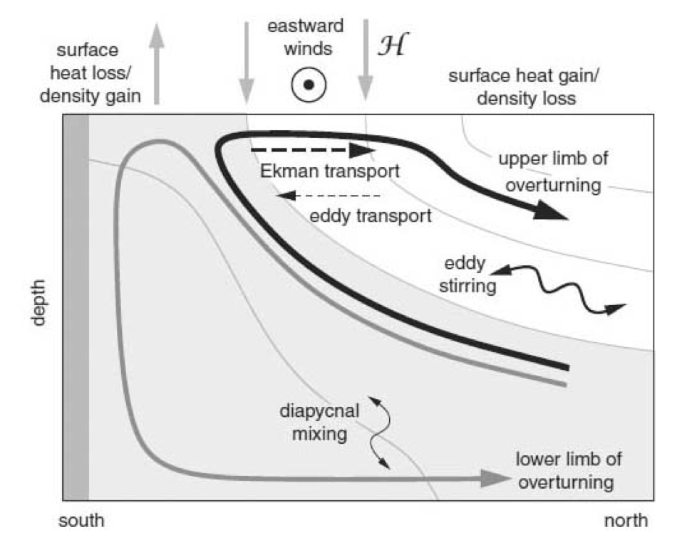
Wind- and eddy-driven overturning circulations
Notes:
Ended here…

Slide 39
Eddy-induced overturning circulation?
Southern Ocean eddies transport heat (and mass) southward.
→ mediates the density gradient (i.e. tends to weaken thermal wind)
→ it also flattens isopycnal surfaces
Eddies are in geostrophic balance, and adiabatic below the mixed layer
The eddy transport (of mass, nutrients, carbon etc.) occurs along isopycnal surfaces.

Slide 40
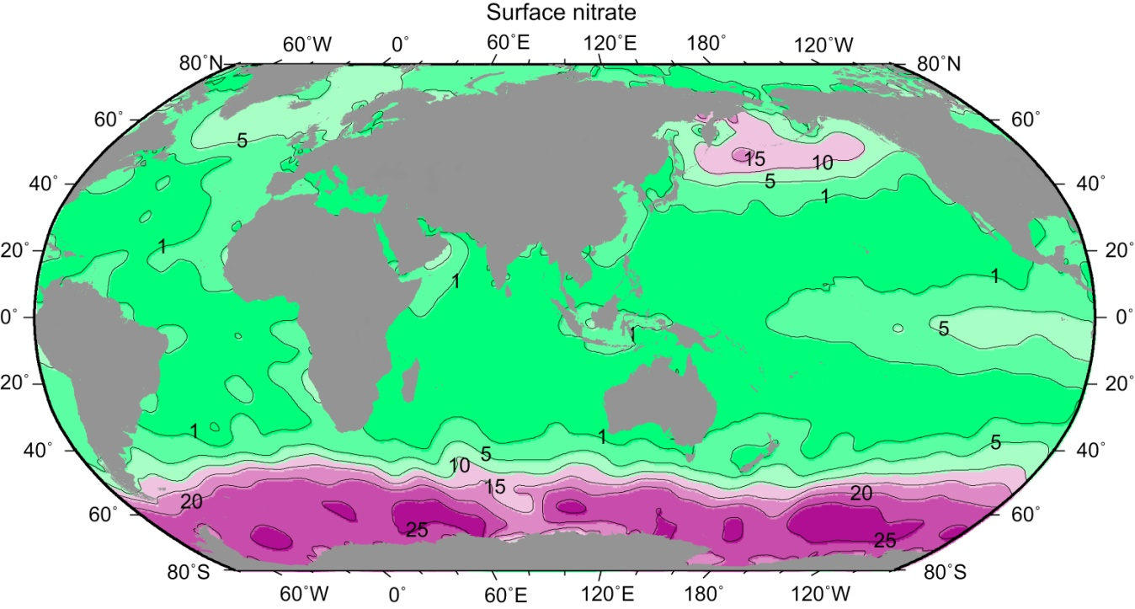
Surface nitrate
Nitrate (μmol/L) at the sea surface, from the climatological data set of Conkright, Levitus, and Boyer (1994). Clearly nitrate is not limiting the biological productivity in the Southern Ocean.

Slide 41
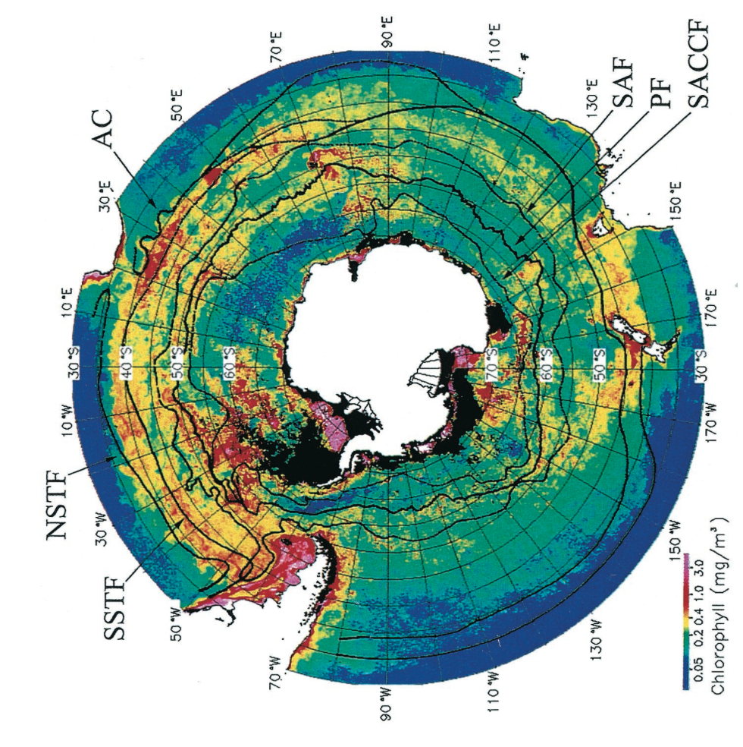
Southern Ocean Chl-a
Moore and Abbott (2002)

Slide 42
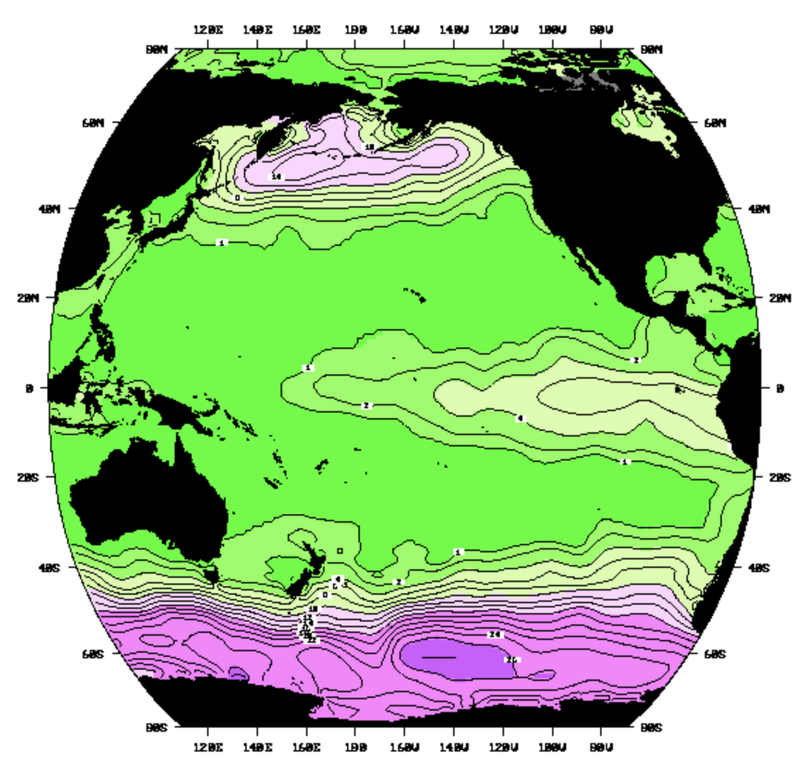
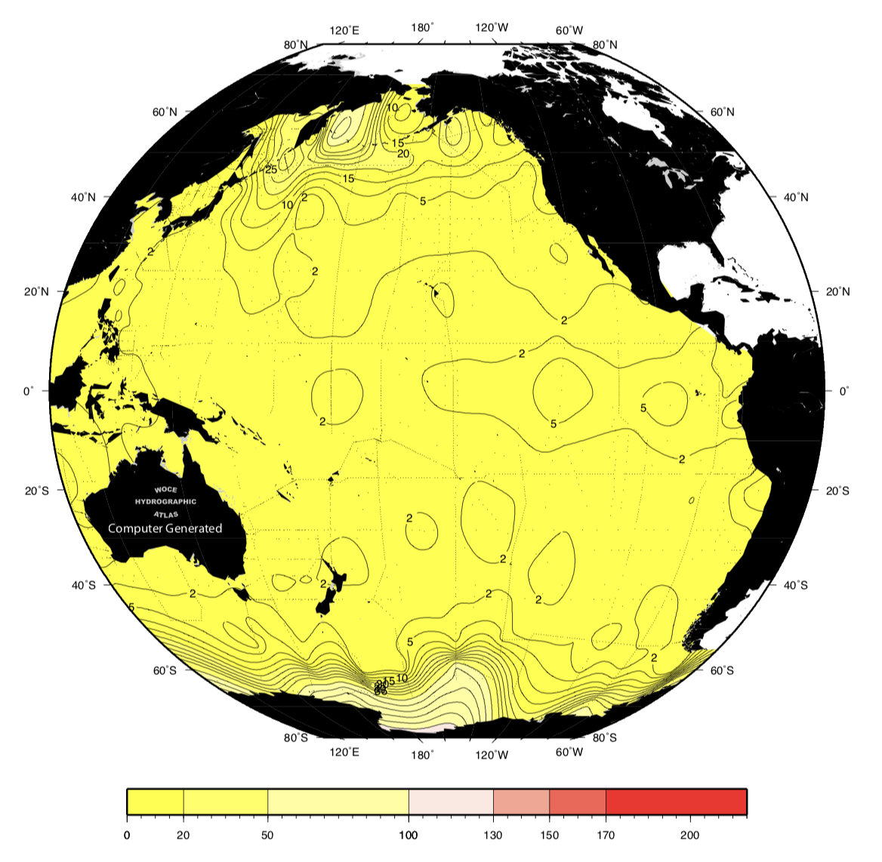
Silicate and nitrate gradients
Nitrate front ~ SAF
Silicate front ~ PF
Southern Ocean is relatively enriched in macro-nutrients. However, silicate is depleted in the polar frontal zone, reflecting strong biological uptake by diatom.

Slide 43

Anthropogenic carbon uptake
Khatiwala et al., (2009) Nature
More than 40% of anthropogenic carbon uptake occurs in the south of 40°S and most of the anthropogenic carbon is stored in the SAMW and AAIW.

Slide 44


Mean state: upwelling and carbon flux
GFDL CM2.6; Morrison et al., 2015
The Southern Ocean is outgassing natural (preindustrial) carbon and absorbing anthropogenic carbon. They are about the same magnitude poleward of 60∘S.

Slide 45

Mean state: upwelling and carbon flux
GFDL CM2.6 (Morrison et al., 2015)
The Southern Ocean is outgassing natural (preindustrial) carbon and absorbing anthropogenic carbon. They are about the same magnitude poleward of 60∘S.

Slide 46

Mean state: upwelling and carbon flux
GFDL CM2.6 (Morrison et al., 2015)
The Southern Ocean is outgassing natural (preindustrial) carbon and absorbing anthropogenic carbon. They are about the same magnitude poleward of 60∘S.

Slide 47

Variability: forcing mechanisms
SAM
Positive trend in SAM = intensified, poleward-shifted zonal wind
SAM index
ENSO
Marshall et al., 2016
Sallee et al., 2008

Slide 48

Changes: upwelling and carbon flux
SAM index
Positive trend in SAM = intensified, poleward-shifted zonal wind
Predict:
Stronger natural C outgassing
Stronger anthro C uptake
Less uptake
CCSM/POP hindcast; Lovenduski et al., 2008
< 35˚S
+ natural
+ net C uptake
++ anthropogenic
More uptake

Slide 49

Observed changes in sea-air CO₂ flux
Fay and McKinley (2013) found relatively constant CO₂ uptake during 1980 to early 2000s and then enhanced uptake following mid-2000s (due to cooler SST → higher K_{H})
Landschützer et al., 2015
Less uptake
More uptake

Slide 50

Post-2000s intensification of C uptake?
Less uptake
Landschützer et al., 2015
More uptake
Rödenbeck et al., 2015 SOCOM (surface ocean pCO₂ mapping intercomparison project)
Data mapping approaches can make a large differences!

Slide 51

What’s going on?
Landschützer et al., 2015

Slide 52

A model-data comparison
Less uptake
Landschützer et al., 2015
More uptake
< 35˚S
Ocean-Ice config of CESM model forced by the observed atmospheric state (CORE2-IAV forcing)
This model does not explicitly include eddies!

Slide 53


Observed changes in the SO
Seaice
  More in Ross Sea
  Less in AP / Weddel Sea
Warming
  Recent subsurface heating
Stammerjohn et al. 2008
Gille et al. 2008

Slide 54



Subsurface changes: CDW
Gille 2002, 2008; Schmidtko et al., 2014
Core of CDW = Tmax layer
Trend at CDW core
Since 1970s CDW is generally warming up and shoaling
Trend is not zonally uniform
Shelf warming promotes basal melting in the AS/BS sector
Trend at shelf bottom

Slide 55

Subsurface changes: Deep Waters
Purkey and Johnson, 2013; Desbruyeres et al., 2013
Freshening of AABW and glacial melt (Rignot et al., 2008; Jacobs and Giulivi 2010; Swift and Orsi 2012)
Weakening of the lower limb MOC (Purkey and Johnson 2012; Kouketsu et al., 2011) → consistent with deep O₂ loss

Slide 56
Possible causes of decadal variability
Zonally asymmetric(standing wave) atmospheric circulation pattern
ENSO teleconnection
Post-2000s stronger CO₂ uptake (?)
Relatively flat CO₂ uptake during 1980-1990s (?)
SAM
Warming, shoaling and O₂ loss in CDW
Deep warming and O₂ loss
Nutrient & C accumulation (?)

