Slide 1
Week 14-15: Tropical Circulation and El-Nino Southern Oscillation

Slide 2
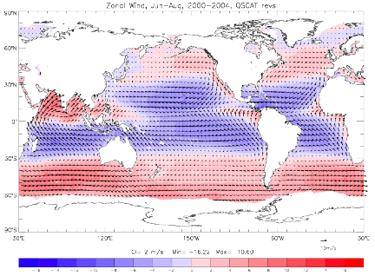
Observed surface wind stress
Blue = westward (trade wind)
Red = eastward (westerly wind)

Slide 3
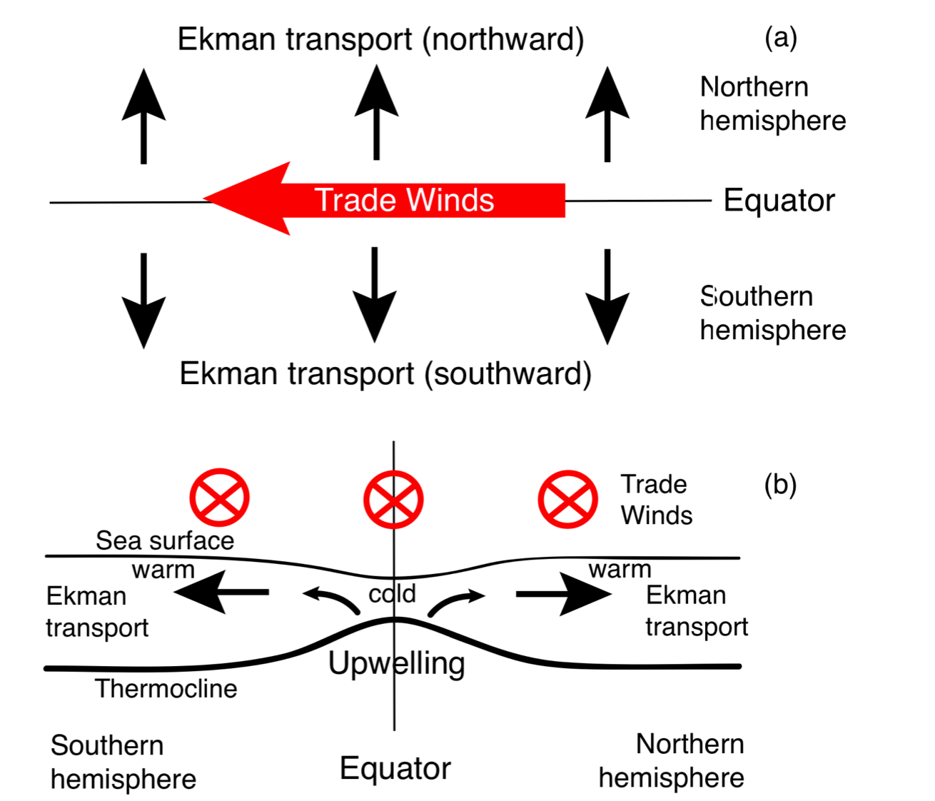
Equatorial upwelling

Slide 4
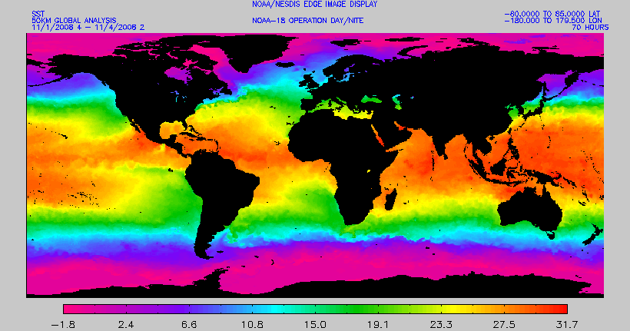
Sea surface temperature (satellite)
Cold tongue (colder water along equator in east)
Warm pool (warmer water along equator in west)

Slide 5
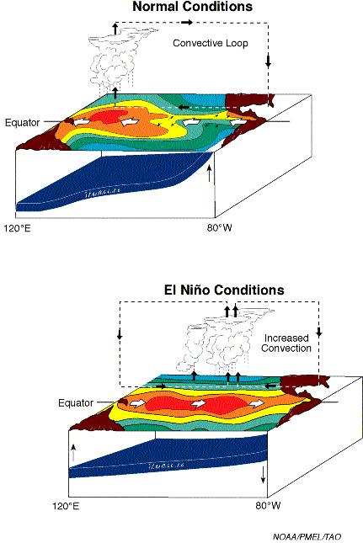
Pacific equatorial structures: mean state
1. Trade wind on the equator (driven by atmospheric Walker circulation)
2. Poleward Ekman transport creates meridional PGF, supporting westward geostrophic flow off-equator
3. Westward surface flow on equator by direct effect of the wind (no Coriolis effect there)
4. Equatorial upwelling due to (a) Ekman divergence and (b) the westward surface flow
5. As a result of (b), thermocline is tilted: shallower in the eastern margin
Warm pool
Cold tongue
Figure credit: NOAA PMEL

Slide 6
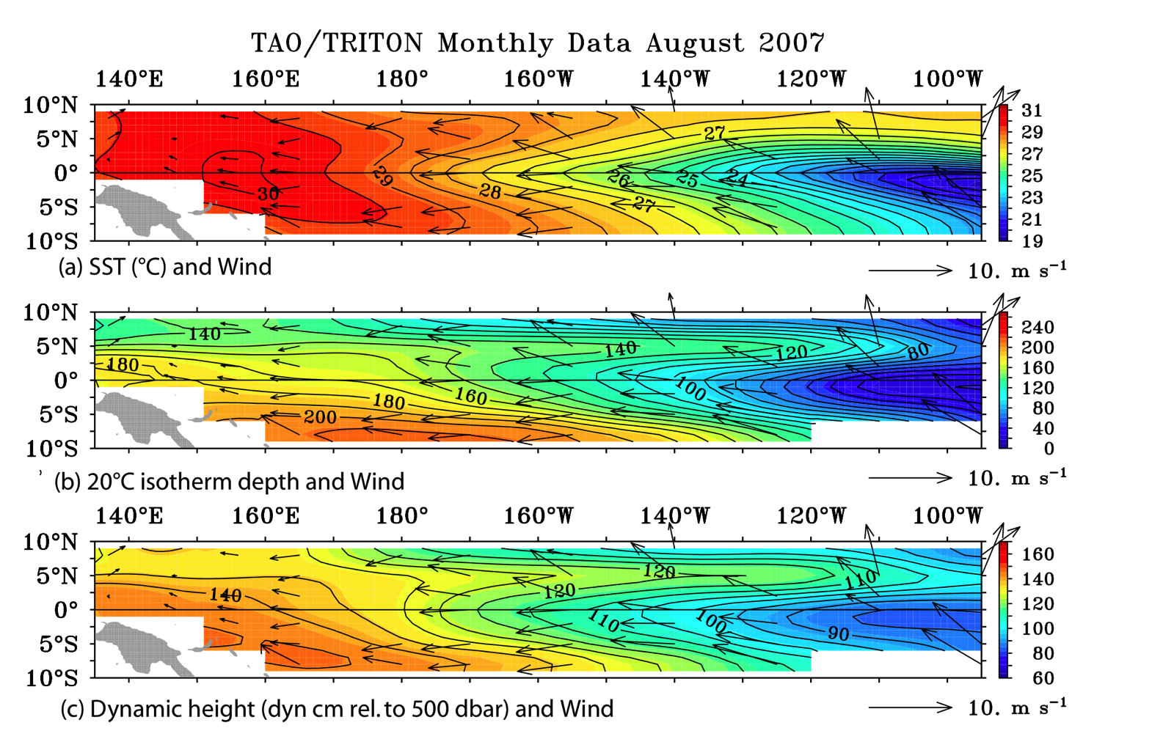
Equatorial Pacific SST, SSH and thermocline
Normal / La Nina condition

Slide 7
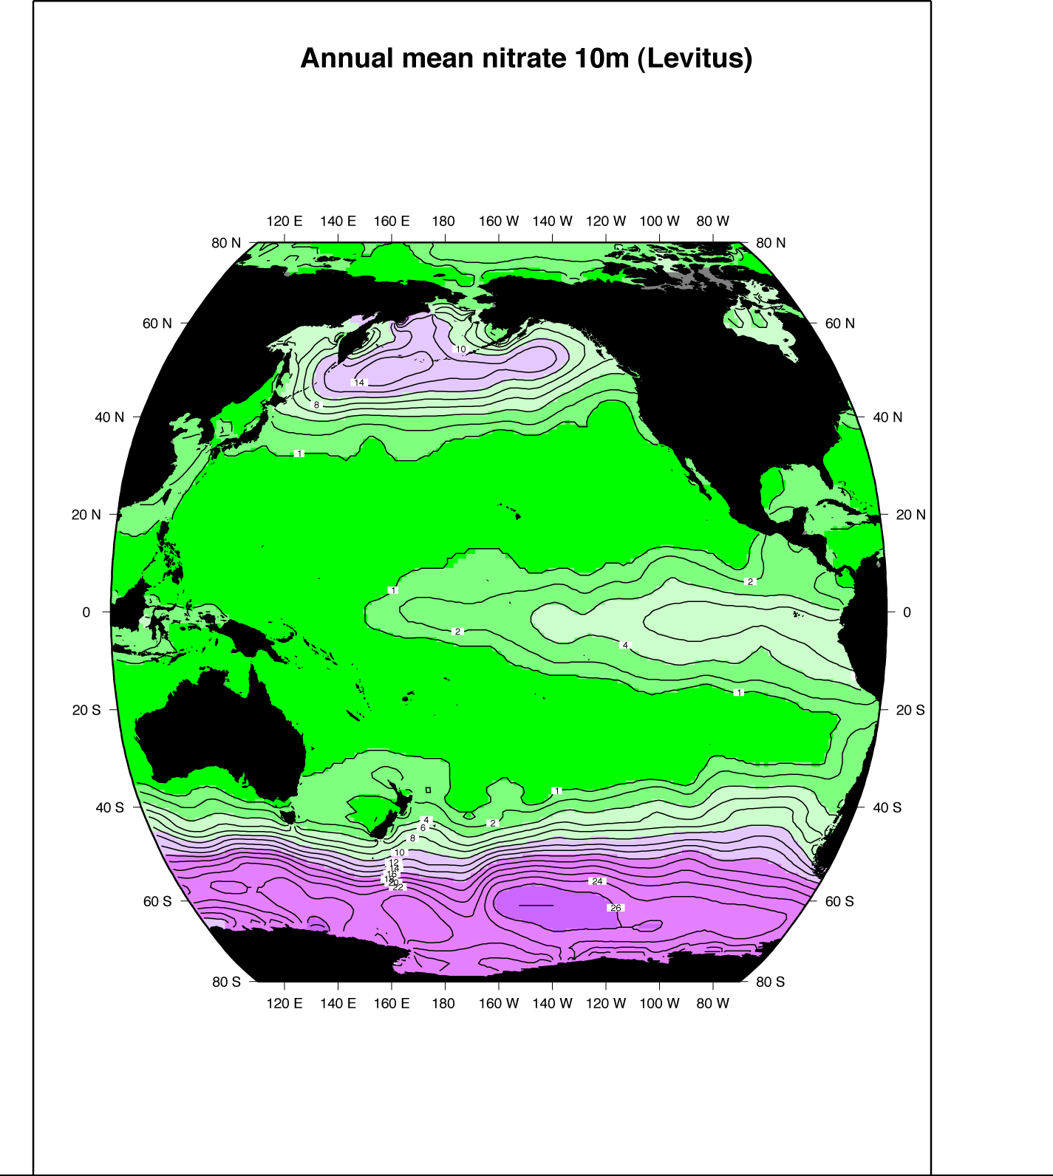
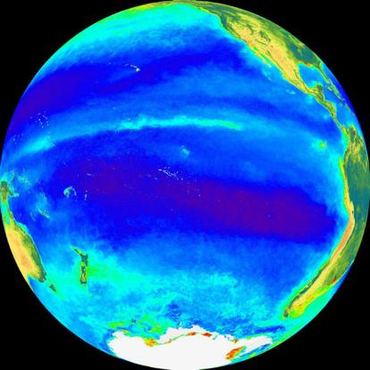
Effects on surface nutrients and productivity
Ocean color: chlorophyll Nitrate at 10 m depth
Equatorial upwelling brings nutrients to sea surface, enhanced in cold tongue

Slide 8
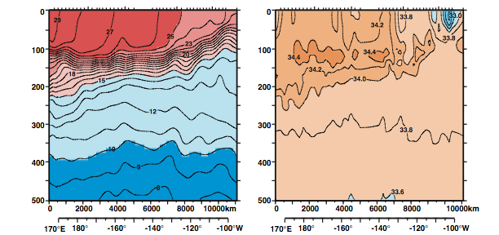
Vertical structure of the equatorial currents
Temperature
Salinity
Western Pacific Warm Pool
Cold Tongue
Depth
Longitude
Longitude

Slide 9
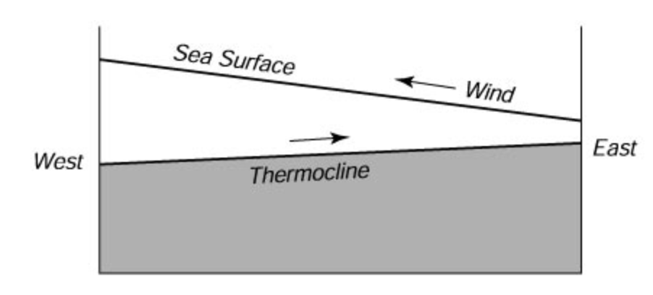
Equatorial Undercurrent (EUC)
  Down-gradient flow driven by the equatorial PGF: causes eastward flow along the equator. This is called the Equatorial Undercurrent. The strongest current in the global ocean > 150 cm/sec, but very thin and restricted to very close to the equator.

Slide 10
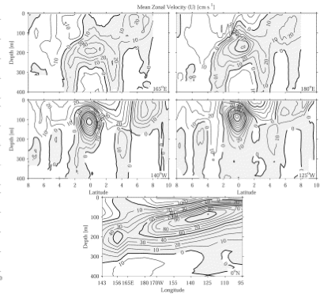
Section across the EUC
North-South Section across the equator
Shading indicates the direction of the flow:
White = westward
Gray = eastward
165E
180E
140W
125W
Johnson et al., (2002)

Slide 11
Vertical structure of the equatorial currents
Temperature
Salinity
Surface: westward Equatorial current
Depth
Thermocline: eastward EUC
Longitude
Longitude

Slide 12
Atmospheric wind and its curl
Right on the Equator, the wind stress curl is very small. There is a band of positive wind stress curl at about 10ºN (under ITCZ)
Positive curl → Ekman upwelling just below the surface → Poleward Sverdrup transport

Slide 13
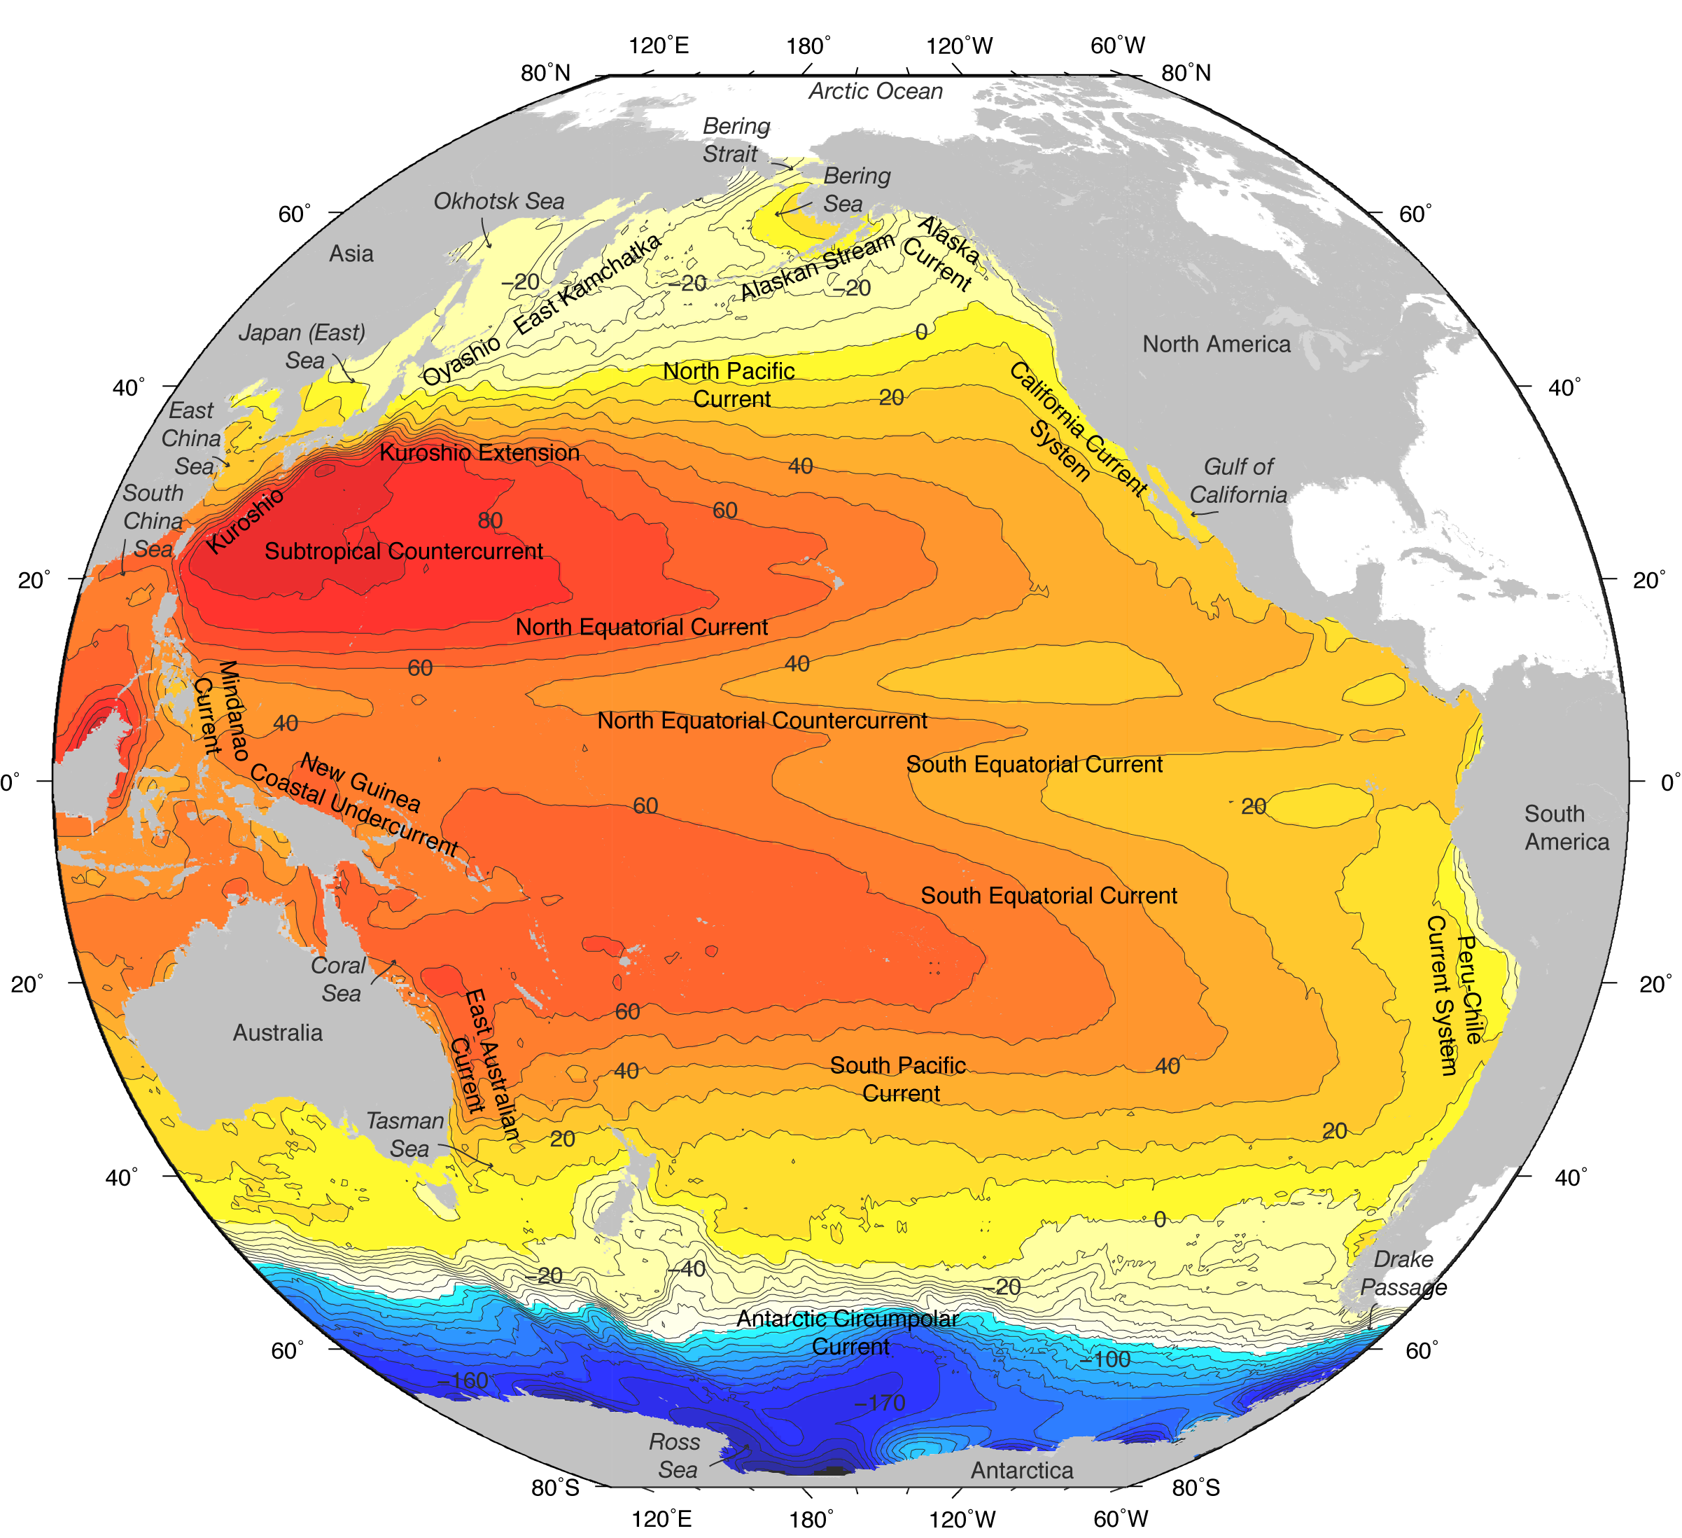
Sverdrup circulation off the Equator
At slightly north (south) of the Equator, there is a positive (negative) wind stress curl, leading to a northward (southward) Sverdrup flow.
This circulation must close through the western boundary current (Mindanao current/North Equatorial current/North Equatorial countercurrent)
Talley Fig S10.1

Slide 14
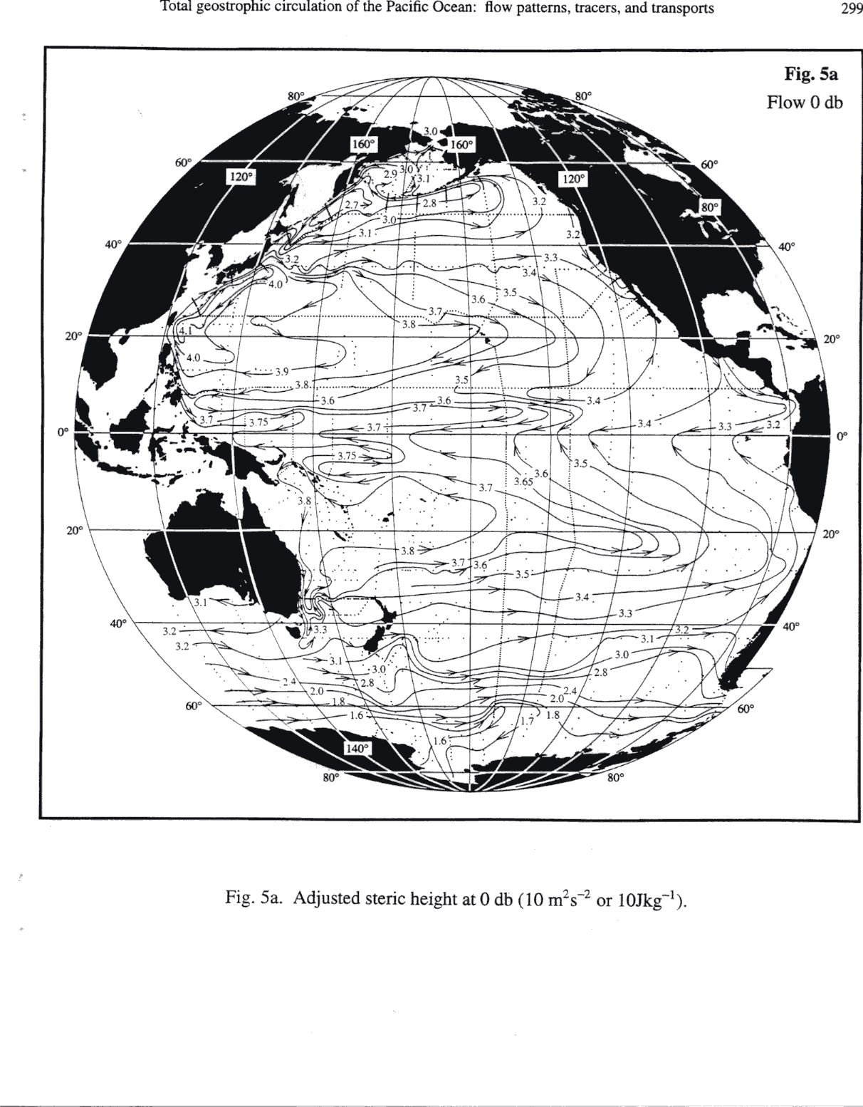
Equatorial current system (Reid, 1997)
North Equatorial Countercurrent (eastward)
North Equatorial Current (westward)
Mindanao Current (western boundary current for the NEC/NECC cyclonic circulation)
South Equatorial Current (westward)
NOTE: The mean surface flow on the equator is westward
(Talley Fig. 10.1)
Notes:
1. southward interior flow (North Pacific Current is the eastward portion and the North Equatorial Current is the westward portion)
2. northward western boundary current: Kuroshio

Slide 15
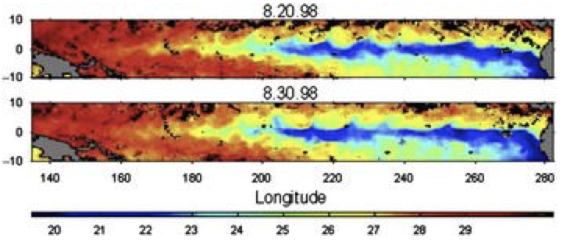
Tropical ocean variability
Tropical Instability Wave (TIW) are oscillation of SST in the equatorial oceans. Its spatial scale is of the order of 1,000km with periods of 20-40 days. The equatorial currents are unstable and spontaneously produce meanders and waves. They form at the edge of the cold tongue, and the pattern propagates westward at the speed of 0.2-0.5 m/s.

Slide 16
Tropical ocean variability
Equatorial waves generally include three types of waves. Inertia-gravity waves (fast), Kelvin wave (eastward propagating, fast) and Rossby wave (westward propagating, slow). Due to the vanishing effect of the Coriolis effect, the equator acts as a wave guide, supporting these waves only in the vicinity of the equator. These waves exist both in the atmosphere and oceans. The width of the equatorial wave guide is determined by the Equatorial deformation scale (L_{β}). Kelvin wave can travel across the Pacific ocean in about 1-2 months, whereas Rossby wave is much slower (about 6 months).
Equatorial waves are important component of the El-Nino Southern Oscillation.

Slide 17
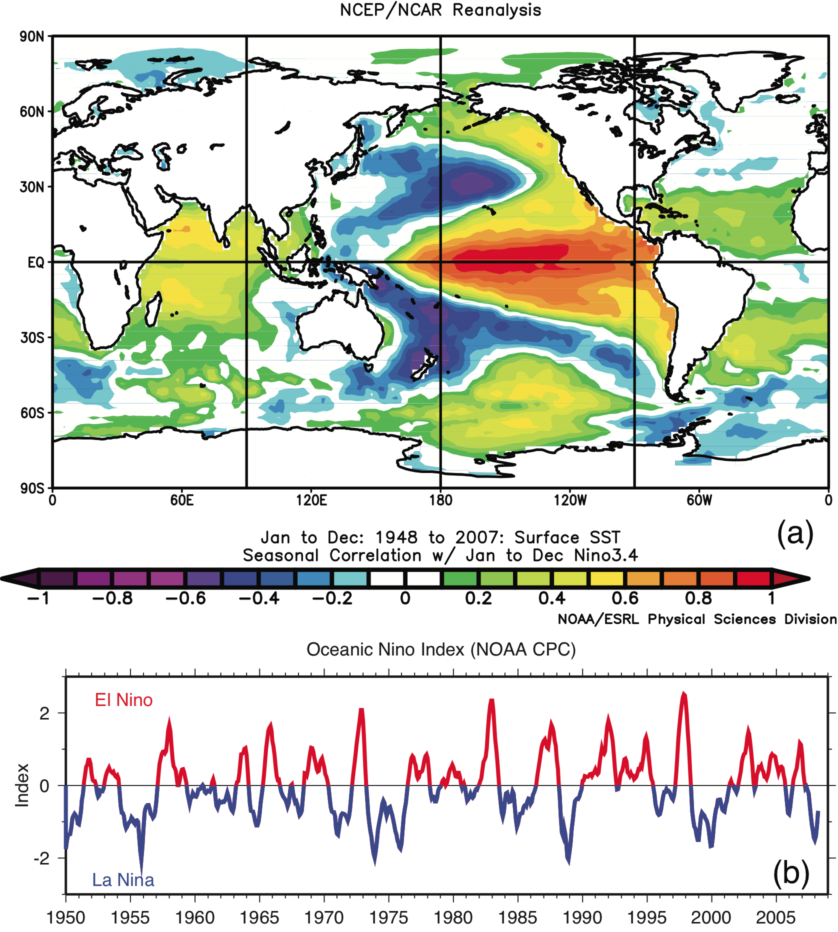
El-Nino Southern Oscillation (ENSO)
Correlation of SST with El Niño index (“Nino3.4” index = Eastern Equatorial Pacific SST, will discuss later)
El-Nino event = Warming of eastern tropical Pacific (>28C)
La-Nina event = Cooling of eastern tropical Pacific (<25C)
*named by Peruvian fisherman, dating back to 1600s, as the ocean warms (cools) always around Christmas in the El Nino (La-Nina) year. Also, the warming is accompanied by the massive loss in ocean productivity.

Slide 18
El-Nino Southern Oscillation (ENSO)
Atmospheric counterpart is the Southern Oscillation Index, defined as the sea level pressure (SLP) difference between Darwin and Tahiti.
The SOI (that is based on SLP) is closely related to the El Nino – La Nina events (that is based on SST). Since southern oscillation is a part of the same phenomenon that causes El Nino events, we now call them ENSO (El-Nino Southern Oscillation) as a single climate pattern.
Darwin
Tahiti

Slide 19
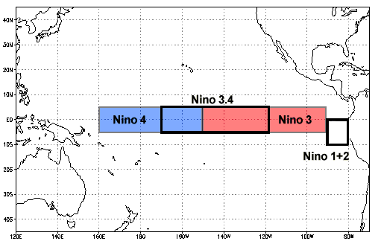
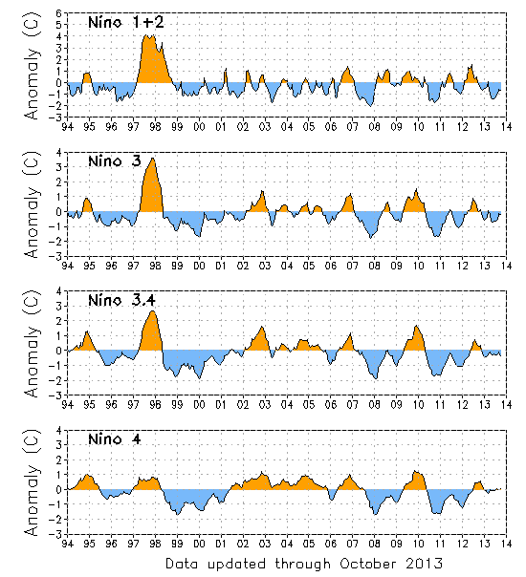
Nino indices for tropical SST
Nino 3.4 is most commonly used for its wide coverage of cold tongue SST. If it exceeds the mean by 0.5 degree C, it is operationally classified as El-Nino condition

Slide 20
What controls what?
Cold tongue – Warm pool is sustained by the tropical trade wind
Walker circulation (whose surface expression is the tropical trade wind) is sustained by the heat from the Warm pool
If trade winds weaken, then
Equatorial current weakens, allowing western Pacific warm waters to move eastward
Warm pool cools down, cold tongue warms up
Convection shifts to the central Pacific
Walker cell (this trade wind) weakens, reinforcing the original weakening of the wind
This then becomes the El Nino condition.

Slide 21
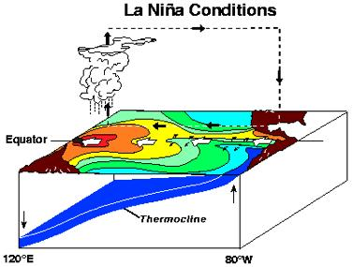
*Bjerknes Feedback (La Nina)
If trade winds strengthen, then
Equatorial current strengthens, warm pool stays in west
Upwelling in the east sustains cold SST there
Convection over the warm pool is sustained, thus trade wind is reinforced
This then becomes the La Niña condition.
Atmospheric convection preferentially occurs over the warmest SST.
*Jacob Bjerknes, a Norwegian-American meteorologist who founded UCLA’s Atmospheric Science Department, and also is the son of Vilhelm Bjerknes, a Norwegian physicist and early meteorologist, establishing Bergen school of Meteorology, whose students included Ekman and Rossby.

Slide 22
Expressions of ENSO
What are the typical metric for El-Nino?
1. Eastern Tropical SST
2. High SSH in central and eastern equatorial Pacific and low SSH anomaly over the Warm Pool
3. Deep thermocline depth in the east, shallow thermocline in the west
4. Winds: weakened trade wind
5. Atmospheric pressure anomalies (measure of the walker circulation, Southern Oscillation Index)

Slide 23
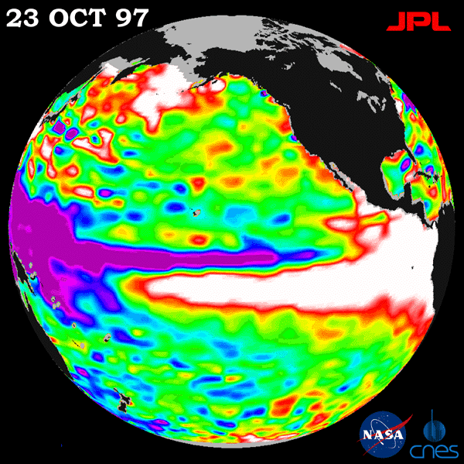
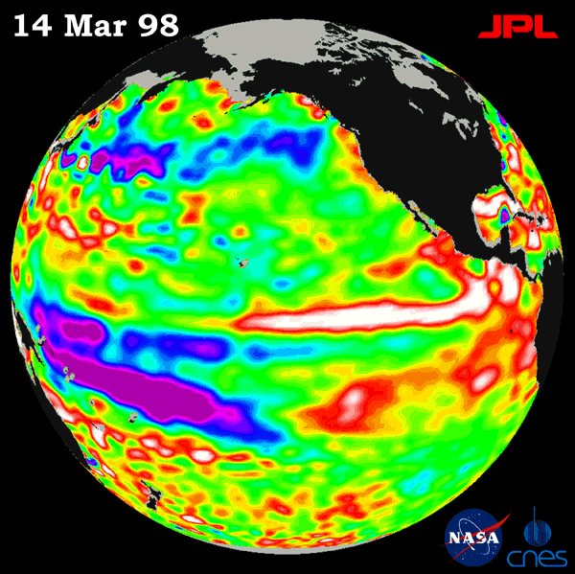
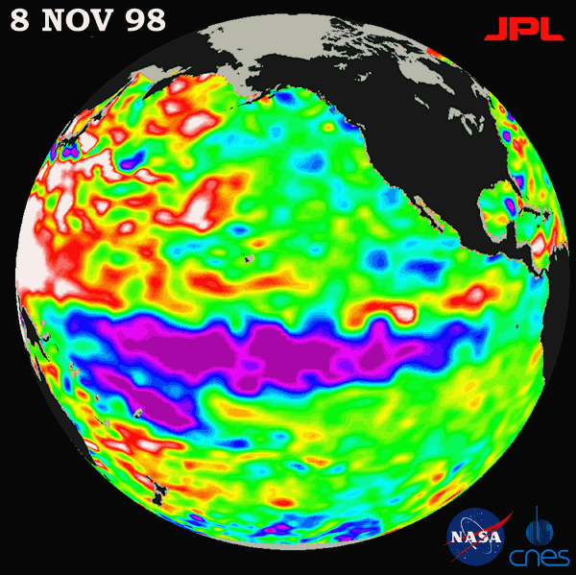
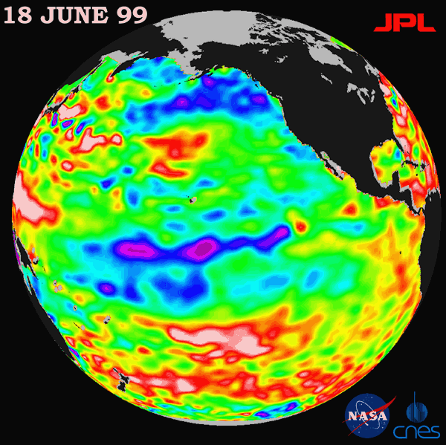
Sea surface height images http://topex-www.jpl.nasa.gov/elnino/index.html
(top left) Full El Niño condition
(top right) El Niño retreating
(bottom left) Full La Niña condition
(bottom right) La Niña fading

Slide 24
1997-1998 vs 2015-2016

Slide 25
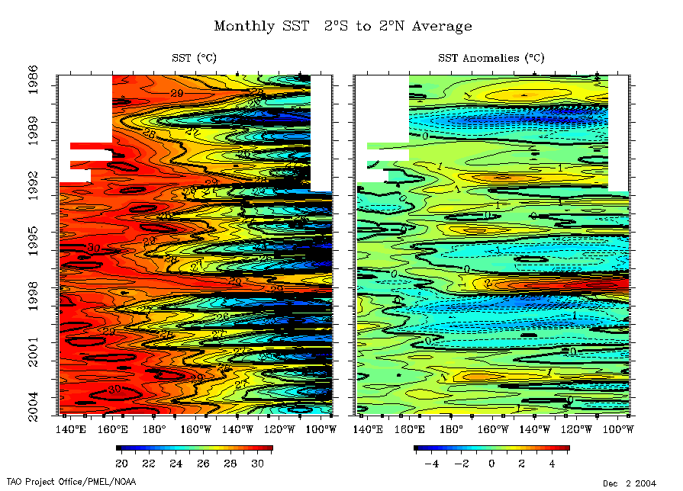
Time series: SST at equator

Slide 26
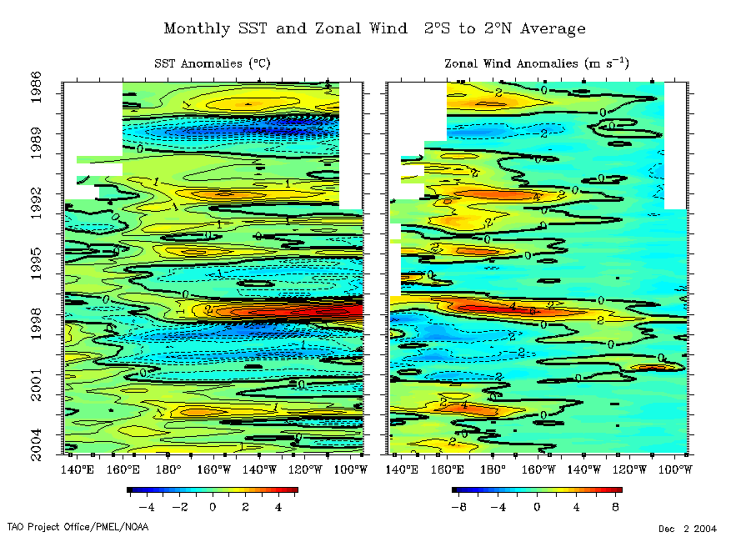
SST and zonal wind anomalies, equator

Slide 27
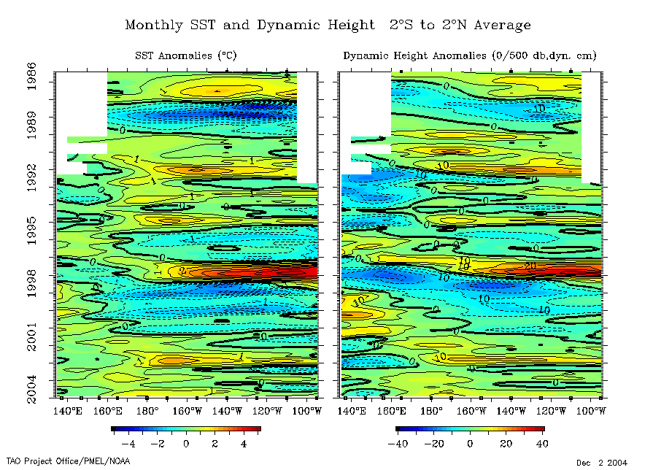
SST and dynamic height anomalies, equator

Slide 28
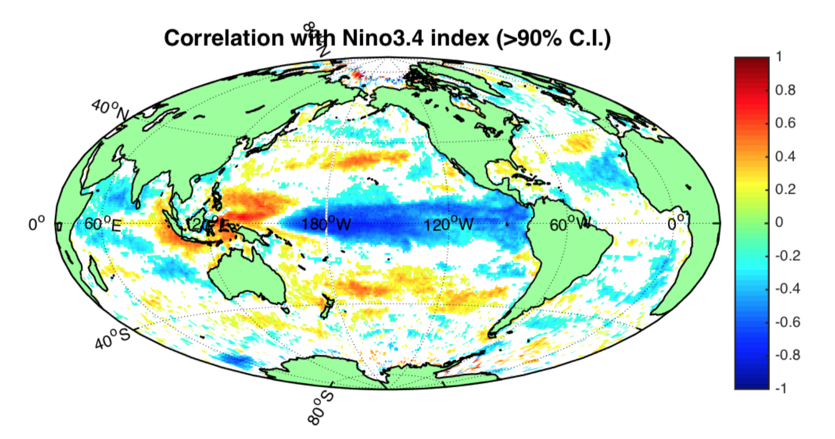
Biogeochemical impacts
Deseasonalized, detrended Chlorophyll-a anomalies (1998-2010) from SeaWiFS satellite negatively correlates with Nino3.4 index

Slide 29
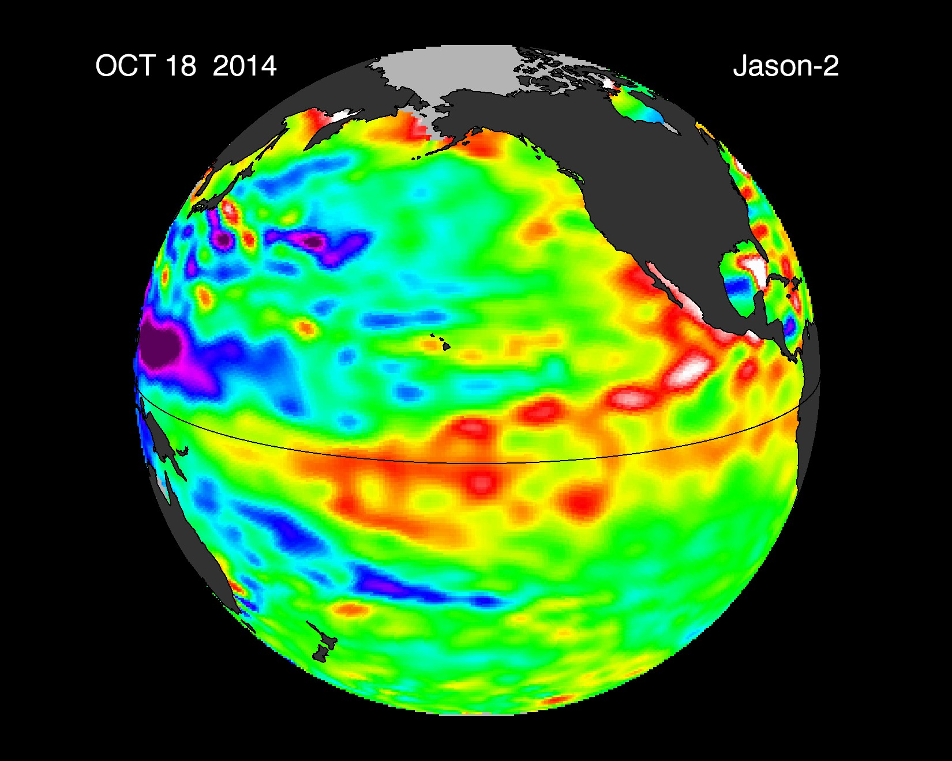
2014: Pacific SSH from satellite obs

Slide 30
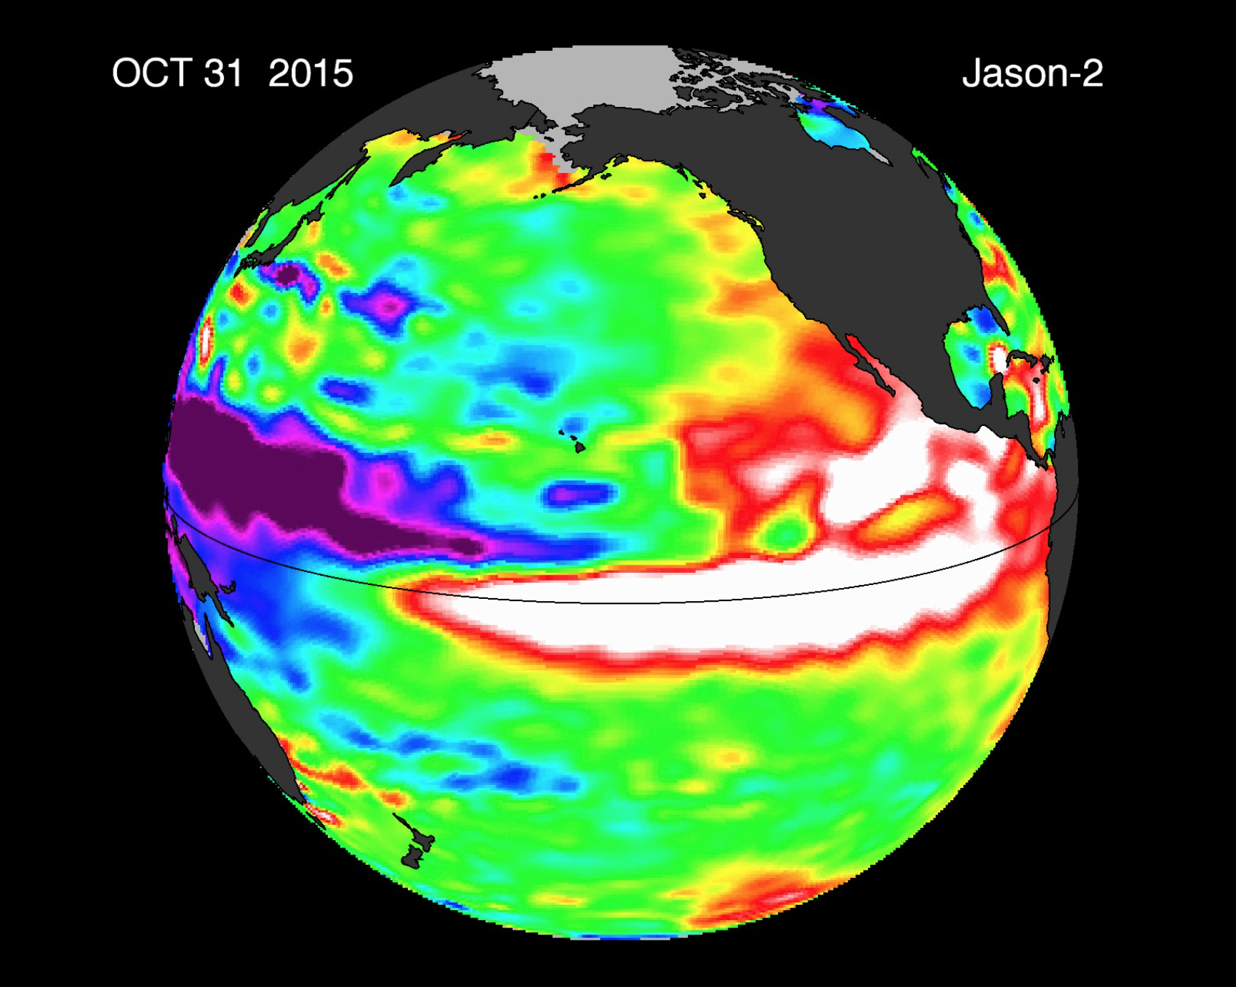
2015: Pacific SSH from satellite obs

Slide 31
2016: Pacific SSH from satellite obs

Slide 32
2017: Pacific SSH from satellite obs

Slide 33
2018: Pacific SSH from satellite obs

Slide 34
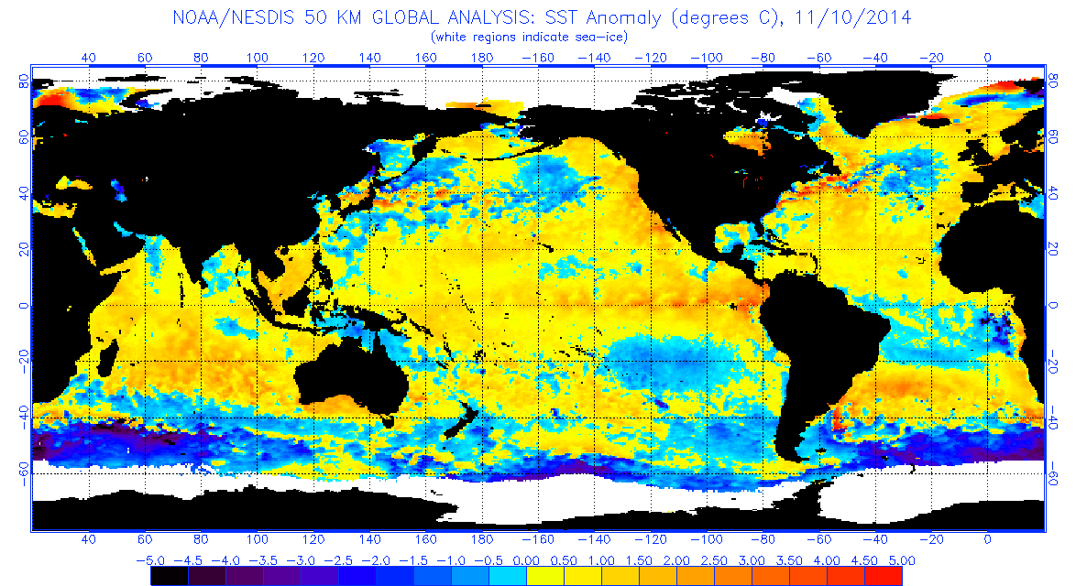
2014: SST anomaly
At that time, the prediction was that 58% chance of El Niño during the Northern Hemisphere winter (NOAA Climate Prediction Center)

Slide 35
2015: SST anomaly
Much stronger SST anomaly in 2015 compared to 2014, expected to peak in the winter of 2015-2016.

Slide 36
2016: SST anomaly
The 2015-2016 El Nino has ended. We are heading towards La Nina.

Slide 37
2017: SST anomaly
Cold SST establishing in the tropical Pacific. 2017-2018 is La Nina.

Slide 38
2018: SST anomaly
Mild El-Nino state developing in Nov 2018.

Slide 39
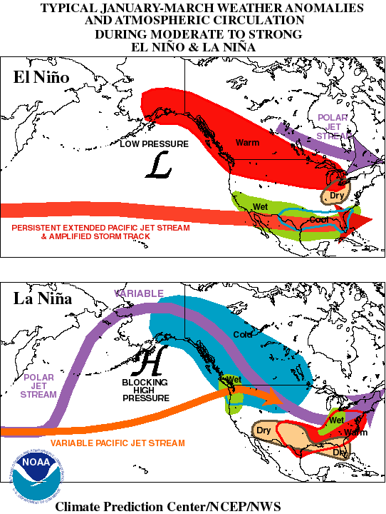
ENSO anomaly effects
“warm episode” = El Niño condition
Related to shift in winds, especially the Walker circulation and its “teleconnections” to mid-latitude winds

Slide 40
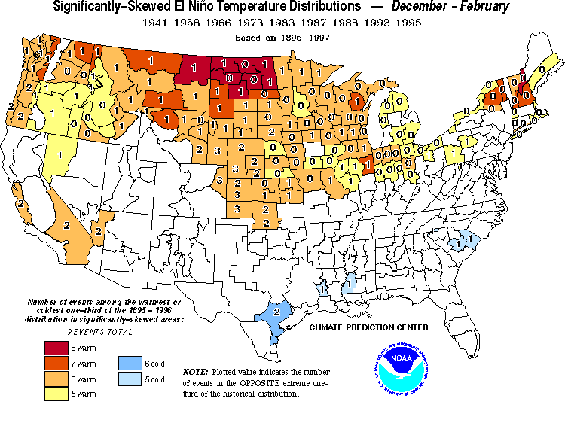
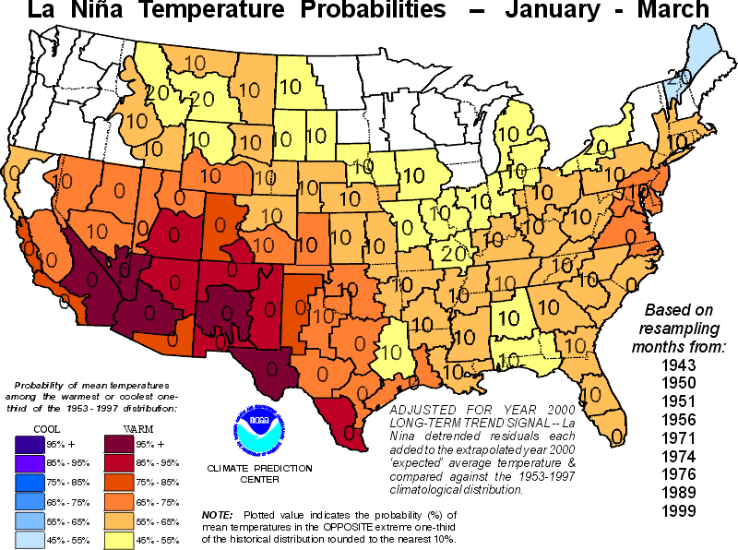
USA impacts of El Niño and La Niña: temperature
El Niño winter T anomaly
La Niña winter T anomaly

Slide 41
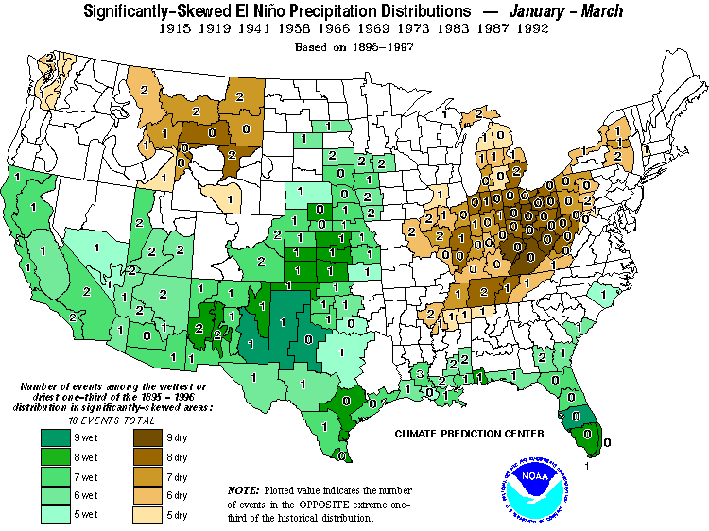
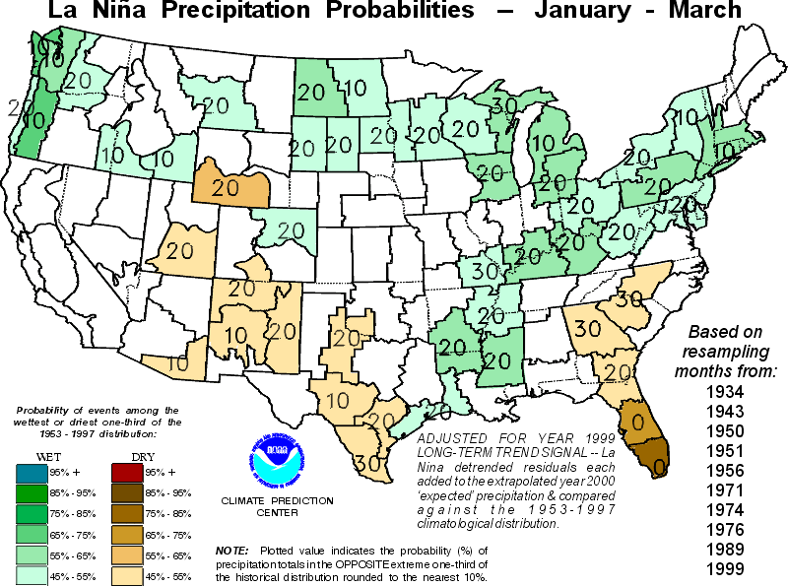
USA impacts of El Niño and La Nina: precipitation
El Niño winter precip anomaly
La Niña winter precip anomaly

Slide 42
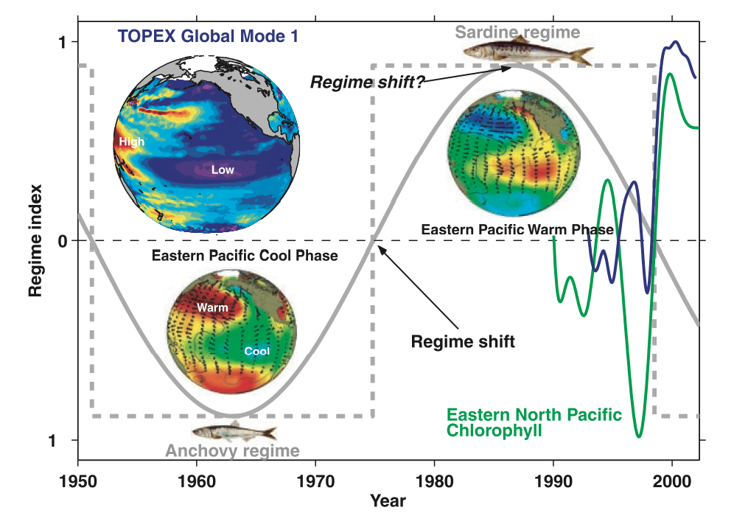
Decadal scale changes in the Pacific
ENSO cycle timescale : 3-7 years
PDO (Pacific Decadal Oscillation) is a decadal scale, ENSO-like changes : ~ 25 years?!
Chavez paper

Slide 43
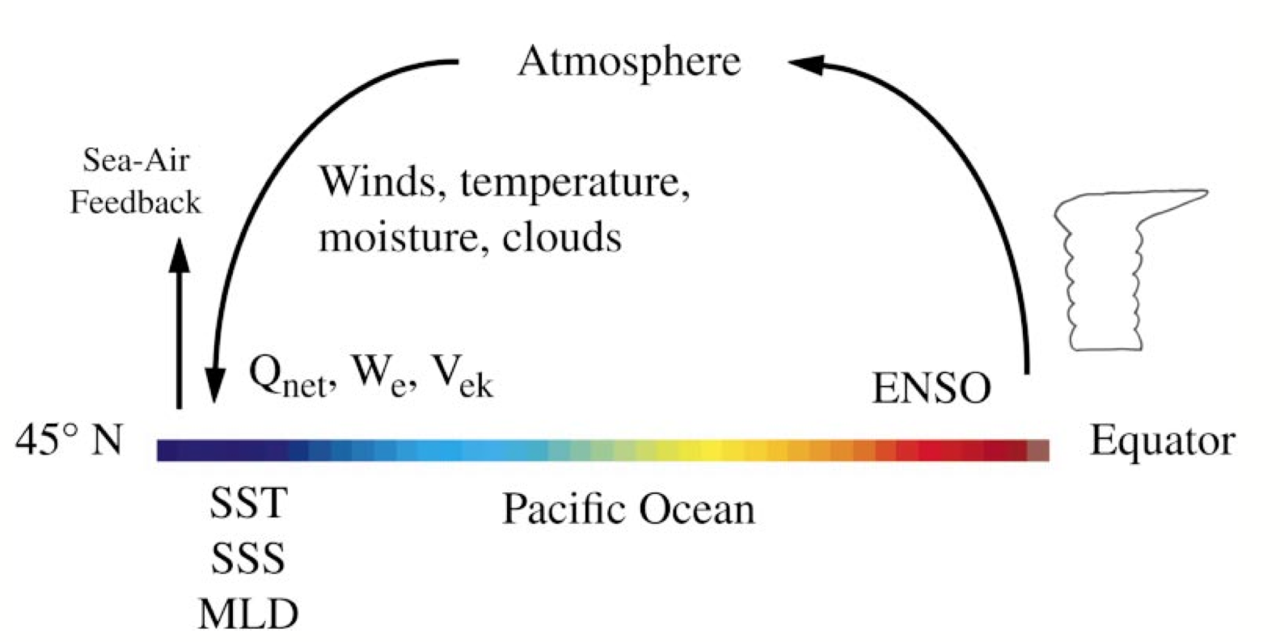
Mechanisms for PDO
To date, no self-sustaining oscillatory mechanism is found on the decadal timescale
  PDO may be driven by ENSO and atmospheric variability (Aleutian low etc)
The link between ENSO and mid-latitude climate is established through “atmospheric bridge”
  So the SST pattern somewhat looks alike between ENSO and PDO
Alexander et al., (2002); Newman et al., (2003)

Slide 44
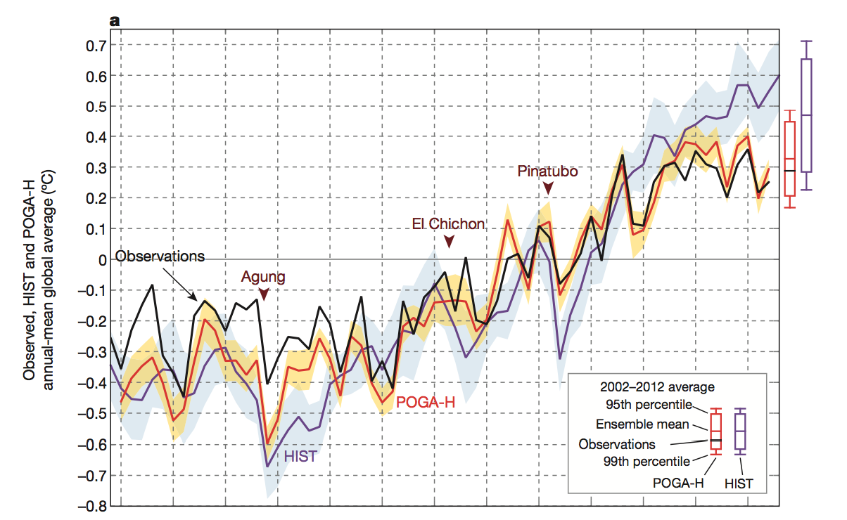
Global warming vs PDO
Global mean surface temperature has not increased since ~2000 while the greenhouse gas concentration has been rising steadily. Climate modelers instructed their model to have observed SST in the eastern tropical Pacific (i.e. cool SST during 2000s due to PDO). They were able to reproduce the global mean T hiatus (stagnant T after 2000).
PDO has a global influence
Future change in PDO may accelerate global warming…
Kosaka and Xie (2013)

Slide 45
Review question
2018-2019 is going to be a El Nino year. Will the biological productivity of the tropical Pacific be higher or lower than normal condition?
  1. Higher due to warmer sea surface temperature
  2. Higher due to higher nutrient supply
  3. Lower due to colder sea surface temperature
  4. Lower due to lower nutrient supply

Slide 46
ENSO theory: oscillation
Bjerknes feedback (Bjerknes, 1969) Weakened trade wind causes warm SST in the eastern tropical Pacific. The warm SST slows down the atmospheric, Walker circulation keeping the trade wind weak → the “El-Nino” state
How does it switch between El-Nino and La-Nina?
In another words, what is the mechanism behind the oscillation of the tropical climate?
Hypothesis 1 : Delayed oscillator theory (equatorial waves)
Hypothesis 2 : Recharge oscillator theory (heat content)

Slide 47
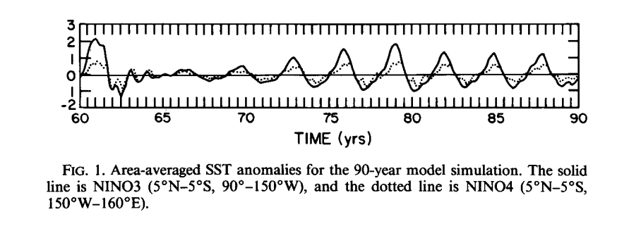
Zebiak and Cane (1987)
Developed coupled ocean-atmosphere model of equatorial waves.
Without external forcing, this model spontaneously oscillates, and it reproduces many features of ENSO cycles (SST, trade wind, themocline depth)

Slide 48
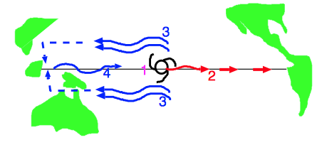
Mechanism: Equatorial waves (Schopf, 1987; Battisti 1988)
There are two waves that are crucial. Kelvin and Rossby waves.
It starts with the weakened trade wind in the central Pacific. It triggers El-Nino.
But it also seeds two Rossby waves that eventually destroy the El-Nino state
1. Weaker trade wind excites Kelvin wave
2. Within 1-2 months, the eastern Pacific warms up
3. Weaker trade wind also excites cold Rossby wave
4. Rossby wave reflects at the western boundary as cold Kelvin wave, then it takes 6 months to reach the eastern Pacific, terminating the El-Nino event → “Delayed Oscillator Theory (Schopf, 1987; Battisti 1988)”

Slide 49
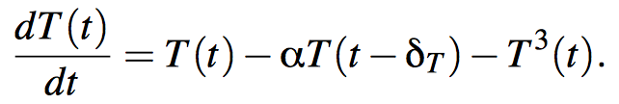
Delayed oscillator model: tropical wave
1. Weaker trade wind excites Kelvin wave
2. Within 1-2 months, the eastern Pacific warms up
3. Weaker trade wind also excites cold Rossby wave
4. Rossby wave reflects at the western boundary as cold Kelvin wave, then it takes 6 months to reach the eastern Pacific, terminating the El-Nino event → “Delayed Oscillator Theory (Schopf, 1987; Battisti 1988)”. The following simple equation was used to illustrate the point by Suarez and Shopf (1988)
Non-linear effect (leads to decay)
Bjerknes feedback (leads to growth)
Wave effect (leads to decay)

Slide 50
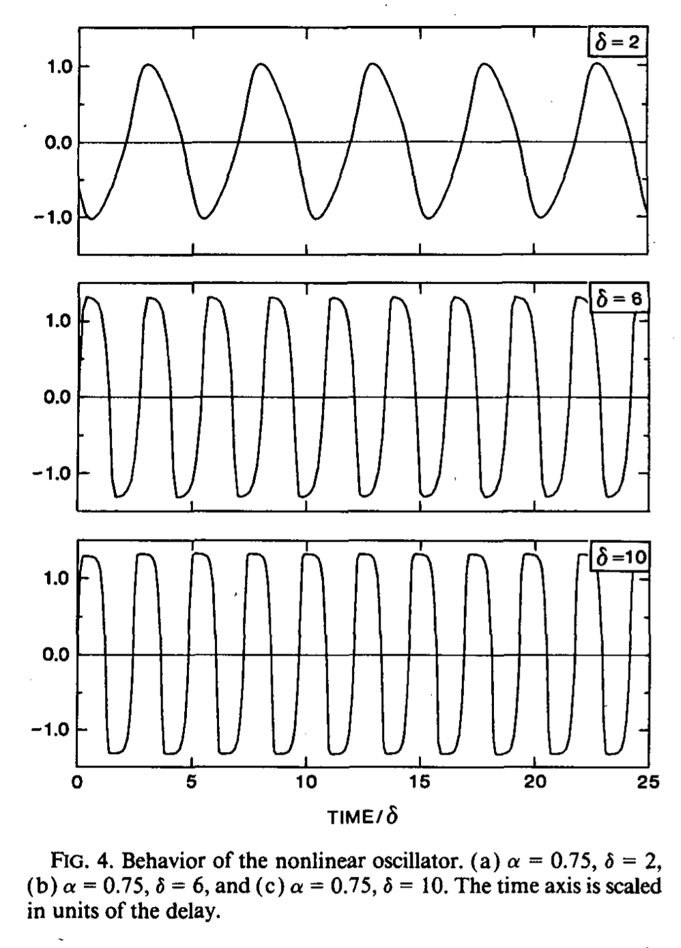
Suarez and Shopf (1988)
Delayed, negative feedback = Rossby wave
Stability analysis/numerical calculation show that the typical period is several times the delay.

Slide 51
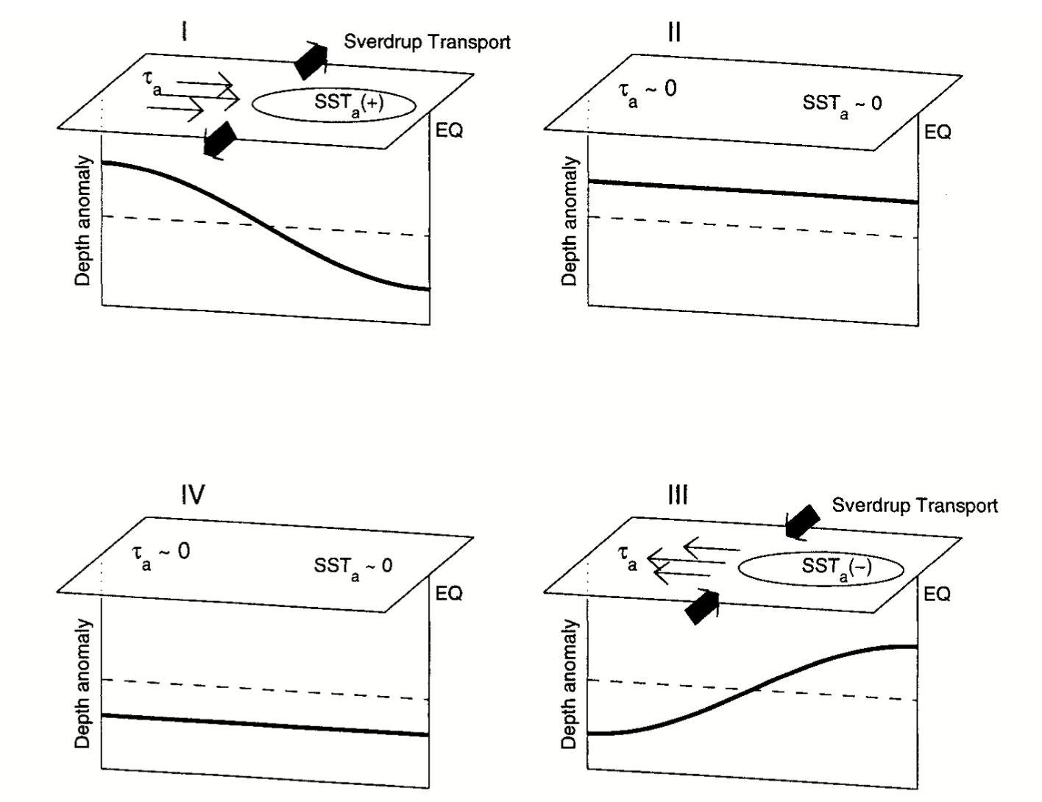
Hypothesis 2: Recharge oscillator theory
Jin (1997) put forward the theory, Meinen and McPhaden (2000) showed it with observation

Slide 52
Recharge oscillator theory
1. During the El-Nino condition, trade wind is weaker (equivalent of anomalous westerly wind)
2. Sverdrup circulation gradually discharges warm water under the equator to off-equatorial regions
3. Ocean heat content decreases under the equator, leading to a shallower thermocline depth → cooler SST
4. Cooler SST initiates La Nina condition. Stronger trade wind.
5. Sverdrup circulation gradually recharges warm water under the equator from off-equatorial regions → deeper thermocline
6. Deeper thermocline → Warmer SST → El Nino returns.

Slide 53
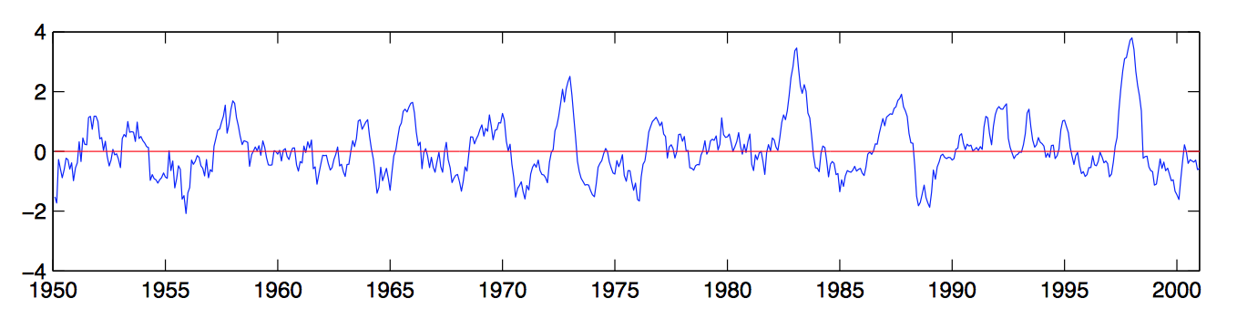
On irregularity
Data (e.g. Nino3.4) shows that ENSO irregular
On average, El-Nino event occurs every 3-7 years, and each event lasts 12-18 months. But the ENSO cycles are irregular and difficult to predict. Simple theory predicts self-sustained oscillation (e.g. delayed oscillator/recharge oscillator theory) with a consistent amplitude and periodicity. Reality is not.

Slide 54
Issues with coupling mechanism
Atmospheric trade wind driven by SST
Thermocline tilt driven by the trade wind
SST change driven by the thermocline tilt
Generation of propagation of the equatorial waves
Simple models (delayed oscillator, recharge oscillator) assumes strong, consistent coupling to reproduce the oscillatory behavior. If any one of couplings becomes weak, oscillation may dampen and the system may require external energy input ← source of irregularity. Also the coupling strength may change seasonally.

Slide 55
ENSO theory: feedback
Besides the Bjerknes feedback, what other climate feedbacks are there?
In another words, what is the mechanism behind the tropical climate variability and ENSO cycles?
WES feedback (Wind-Evaporation-SST feedback)
Cloud Feedback

Slide 56
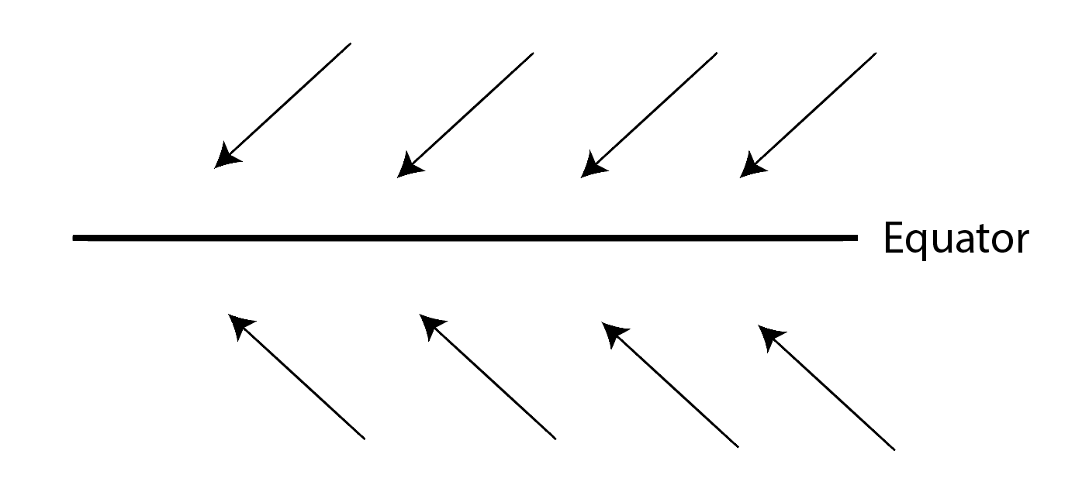
WES feedback
Wind – Evaporation – SST (WES) feedback, Xie and Philander (1994)
  Thermodynamic coupling; exists in Atlantic and Pacific
  Weaker wind → Less evaporation → Warmer SST
  Stronger wind → More evaporation → Cooler SST

Slide 57
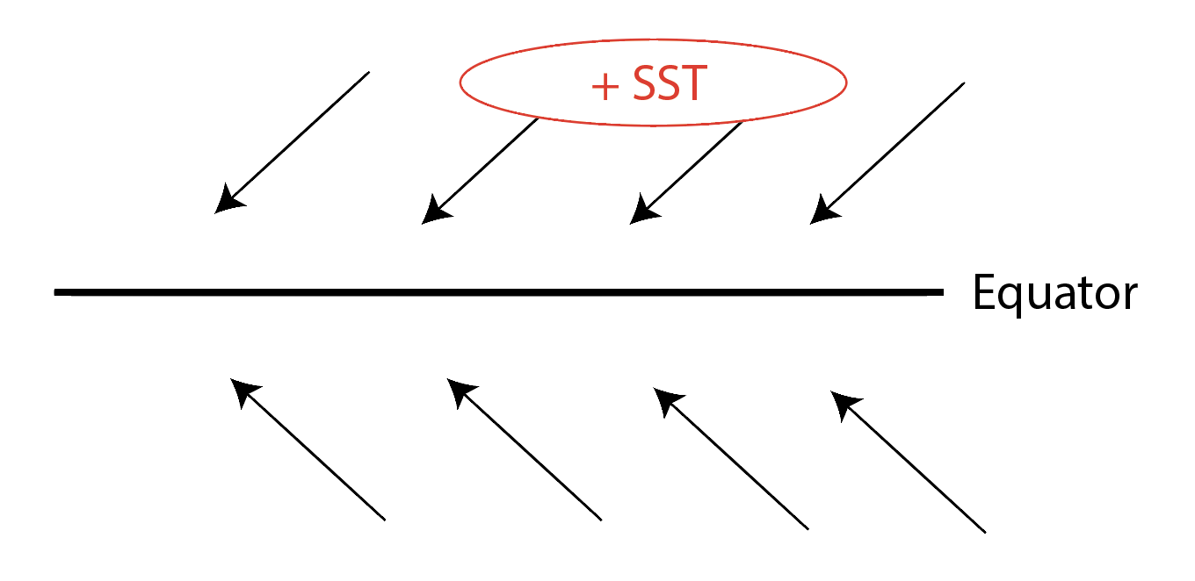
WES feedback
Wind – Evaporation – SST (WES) feedback, Xie and Philander (1994)
  Thermodynamic coupling; exists in Atlantic and Pacific
  Weaker wind → Less evaporation → Warmer SST
  Stronger wind → More evaporation → Cooler SST

Slide 58
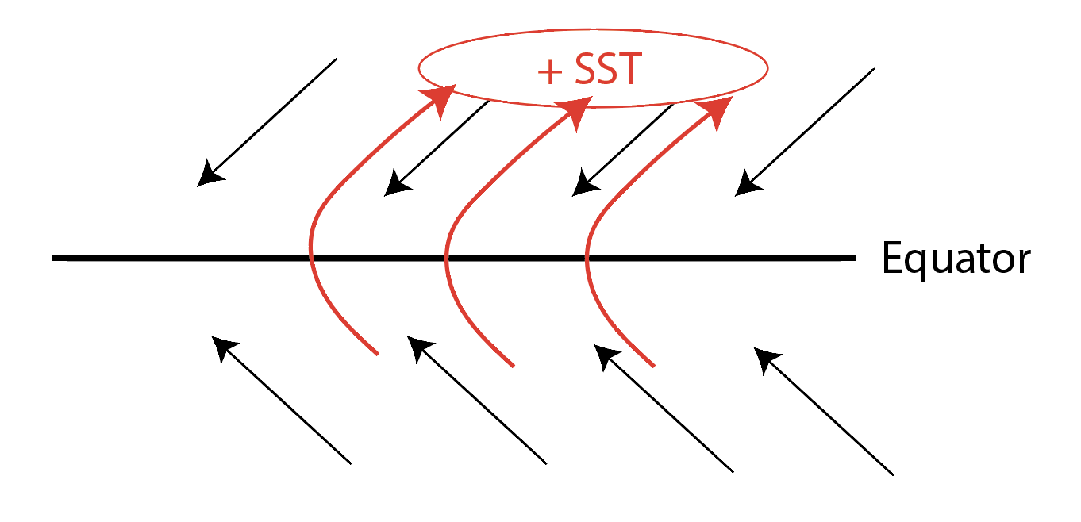
WES feedback
Wind – Evaporation – SST (WES) feedback, Xie and Philander (1994)
  Thermodynamic coupling; exists in Atlantic and Pacific
  Weaker wind → Less evaporation → Warmer SST
  Stronger wind → More evaporation → Cooler SST

Slide 59
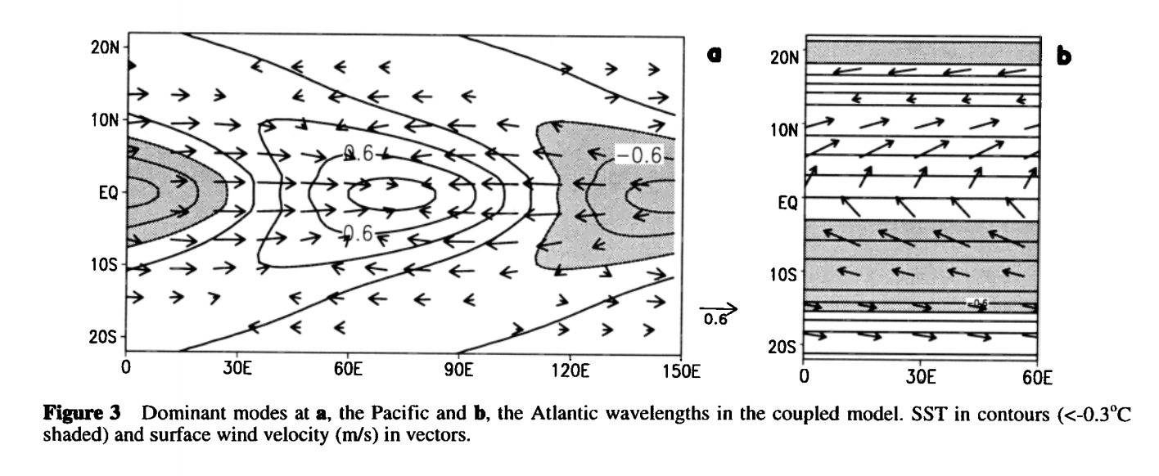
“Zonal Mode” and “Meridional Mode”
Zonal Mode refers to the SST variability associated with ENSO, primarily reflecting the Bjerknes feedback
Meridional Mode refers to the SST variability associated with the WES feedback
Zonal Mode
Meridional Mode
Xie (1999) GRL

Slide 60
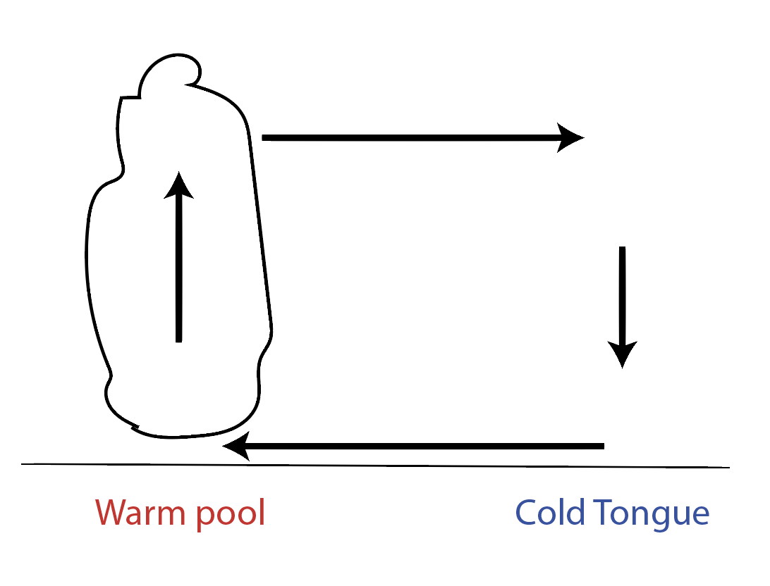
Cloud feedback
In the tropics, deep convection (cumulonimbus clouds) generally occurs over warm SST (>27C), and cloud cover increases with SST → Dense cloud cover reflects sunlight, cooling the SST (negative feedback).

Slide 61
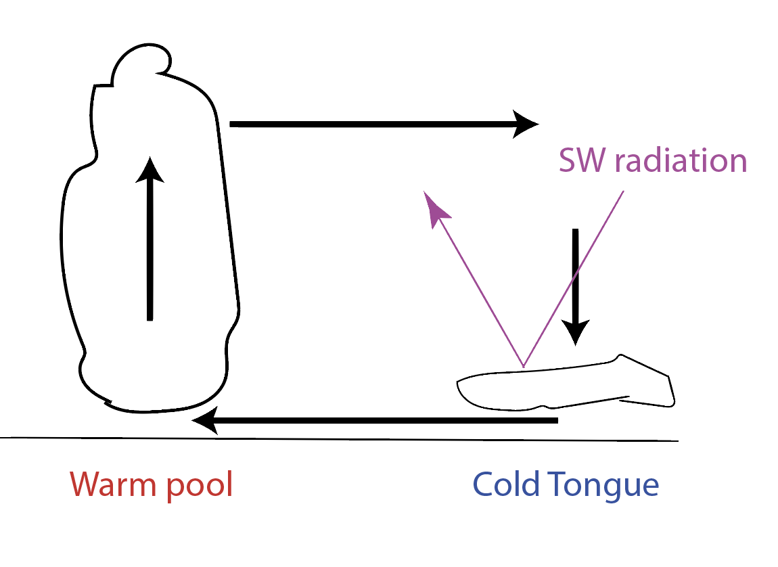
Cloud feedback
In the tropics, deep convection (cumulonimbus clouds) generally occurs over warm SST (>27C), and cloud cover increases with SST → Dense cloud cover reflects sunlight, cooling the SST (negative feedback).
Over the cold tongue region, dense shallow (stratus) clouds dominates. Cloud cover decreases with SST. (positive feedback)

Slide 62
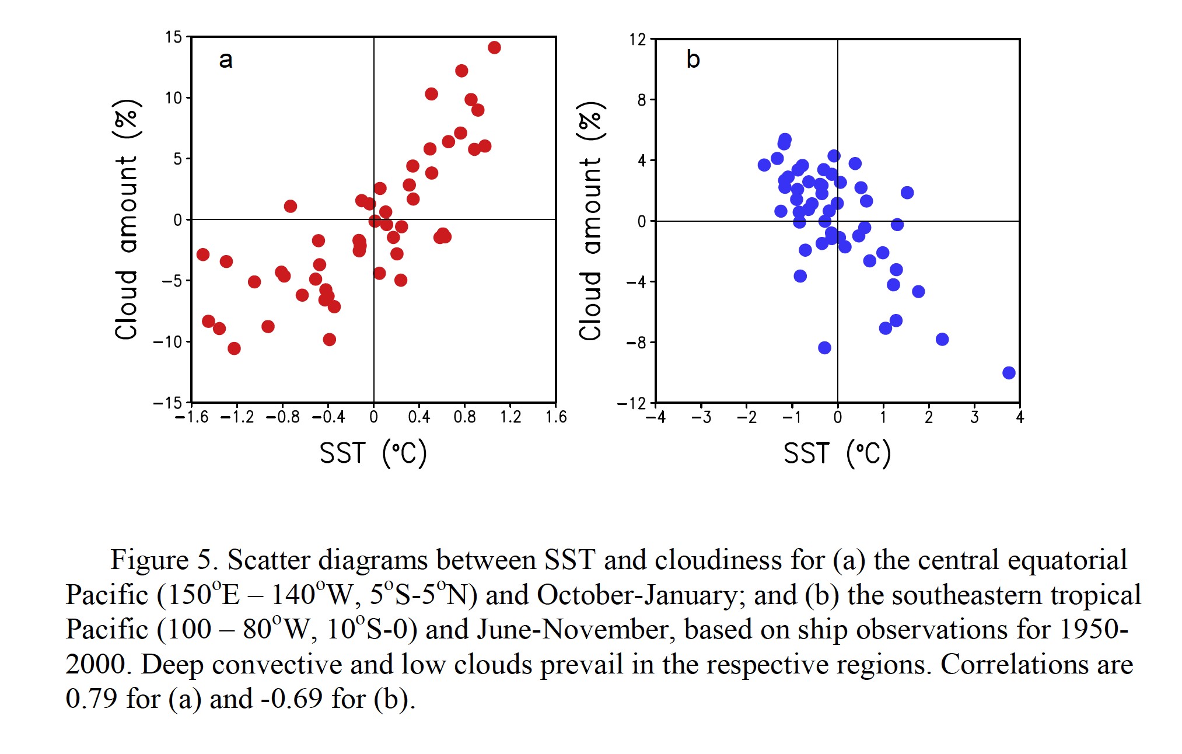
Cloud feedback
In the tropics, deep convection (cumulonimbus clouds) generally occurs over warm SST (>27C), and cloud cover increases with SST → Dense cloud cover reflects sunlight, cooling the SST (negative feedback).
Over the cold tongue region, dense shallow (stratus) clouds dominates. Cloud cover decreases with SST. (positive feedback)

Slide 63
ENSO theory: triggers
Are there any events that can cause the onset of an El-Nino event?
Westerly wind burst (WWB) = a westerly wind anomaly over the central Pacific. It starts a warm Kelvin wave that initiates an El-Nino event.
Madden Julian Oscillation (MJO) = tropical intra-seasonal variability.
Extratropical influences = influences from the subtropics. Seasonal footprinting mechanism (Vimont 2003). Meridional Mode.

Slide 64
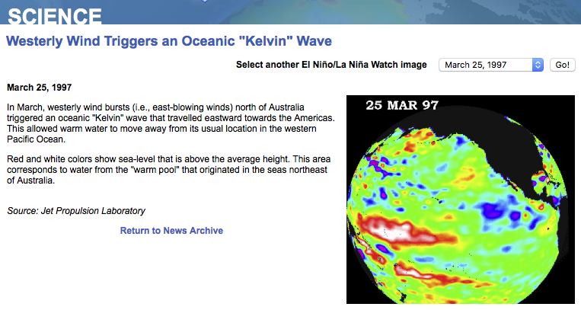
1997-1998 El Nino
NASA JPL

Slide 65
1997-1998 El Nino
WWB trigger
Kelvin wave
Build-up of warm water
NASA JPL: sealevel.jpl.nasa.gov

Slide 66


Westerly wind burst
Are there different types of WWB?
Harrison and Vecchi (1997) categorized WWBs by their geographic locations
Occurrence of extreme event
NE pattern

Slide 67


Westerly wind burst
Are there different types of WWB?
Harrison and Vecchi (1997) categorized WWBs by their geographic locations
Occurrence of extreme event
N pattern

Slide 68


Westerly wind burst
Are there different types of WWB?
Harrison and Vecchi (1997) categorized WWBs by their geographic locations
Occurrence of extreme event
C pattern

Slide 69
WWB are known to initiate the El Nino events. What atmospheric processes can cause WWBs?
  Madden Julian Oscillation (MJO) is the major fluctuation in tropical weather on weekly to monthly timescales.
Madden and Julian (1971)
Atmospheric process
Eastward propagating tropical wind/precipitation anomaly
30-60 days cycle
Affects monsoons, tropical cyclones, WWB and ENSO, mid-latitude weather over continental US
Image from NOAA

Slide 70

Influence from subtropics
Seasonal footprinting mechanism (Vimont 2003),
Looking for a pattern of sea level pressure (SLP) one year before El-Nino event
(top) SST associated with El-Nino.
(bottom) SLP associated with the following year’s El-Nino
When this SLP pattern occurs, there is an increased chance that an El-Nino event develops in the following year.

Slide 71

Influence from subtropics
Seasonal footprinting mechanism (Vimont 2003),

Slide 72

Influence from subtropics
Seasonal footprinting mechanism (Vimont 2003),
There is a winter-time SPL pattern associated with WWB event in the summer and with El-Nino in the following winter.
This summer-time WWB is in turn related to the summer-time SST pattern…
This is shown to be related to the Meridional Mode and the WES feedback (Chang et al 2007)

Slide 73
WES feedback and MM
Wind – Evaporation – SST (WES) feedback, Xie and Philander (1994)
  Thermodynamic coupling; exists in Atlantic and Pacific
  Weaker wind → Less evaporation → Warmer SST
  Stronger wind → More evaporation → Cooler SST

Slide 74

Influence from subtropics
Meridional Mode and ENSO (Chang et al 2007)
a. MM pattern of SST and winds
b. MM seasonal amplitude
d. Blue = spring-time MM index, Red = ENSO index

Slide 75
Summary
ENSO is a manifestation of the strong ocean-atmosphere coupling with impacts on global weather, biogeochemistry, fishery, agriculture, …
The ENSO cycle is irregular because of complex interplay between many processes, feedbacks and triggers.
An ENSO event lasts 12-18 months every 3-7 years.
ENSO is triggered by WWBs which in turn depends on atmospheric weather, MJO, and the subtropical MM.
PDO is an ENSO-like climate fluctuation on the timescale of 10s of years, influencing the global surface temperature

