Slide 1
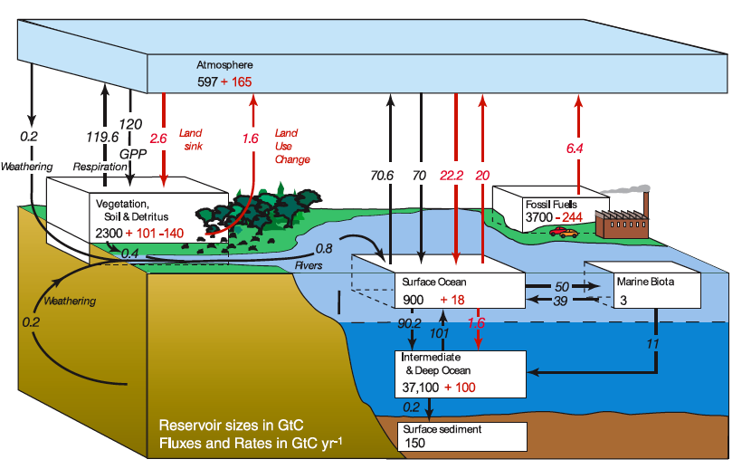
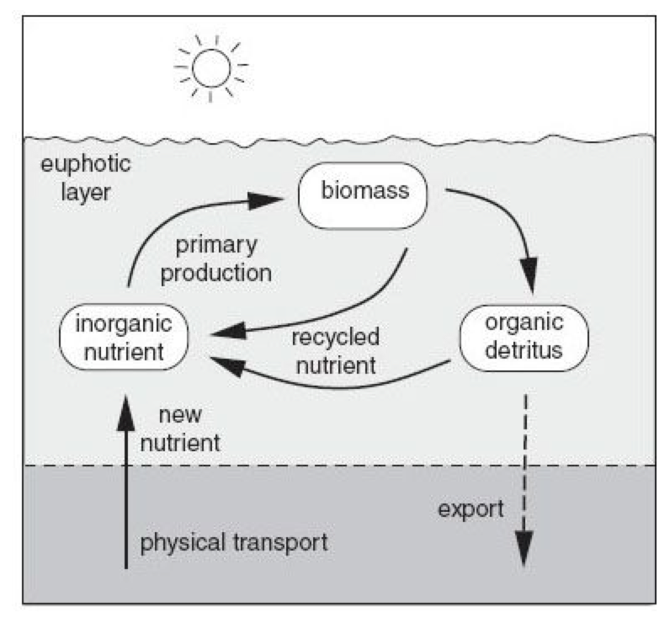
Week 12: Nutrient and carbon cycling
1 GtC (giga-tons C) = 1 PgC (peta-grams C) = 10¹⁵ gC
Figure credit: IPCC, N. Gruber
10-15PgC/yr: NCP ~ export of organic carbon from surface euphotic layer to the thermocline and deep waters

Slide 2
A simple nutrient cycle model
Ps
Ps: surface phosphate
Pd: deep phosphate
V_{M} = Vertical circulation
J = Export production
Pd
Downward organic flux (J) is balanced by the vertical transport at steady state: the balance regulates the vertical gradient

Slide 3
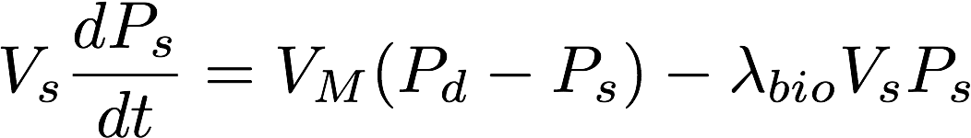
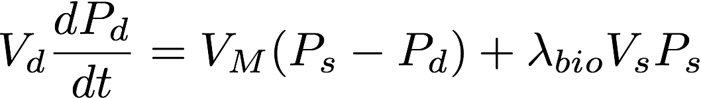
2-box nutrient cycle model
V_{S} : volume of the surface box (m³)
V_{d} : volume of the deep box (m³)
V_{M}: vertical circulation rate (m³/s)
P_{S}: surface P concentration (molP/m³)
P_{D}: deep P concentration (molP/m³)
λ_{bio}: biological P export rate (1/s)

Slide 4
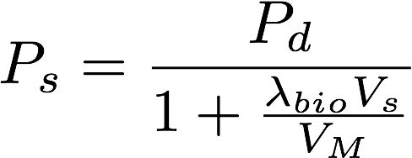
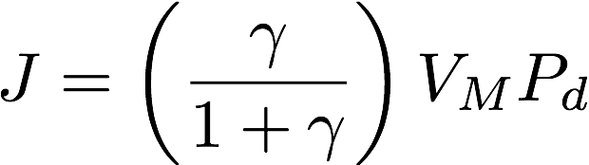
Steady state solutions
Conservation of nutrient
Solution for surface nutrient
Dimensionless number (γ) measuring relative strengths of biological P export and circulation supply.
Solution for export production
Notes:
Conversion: 10 PgC/yr = 16/(12*106) * 1e16 = 1.2e14 molN/yr

Slide 5
Some numbers…
Each year, human activity emits about 10PgC
  About half of it remains in the atmosphere
  Remaining half goes into the land and the ocean
Each year, marine photosynthesis fixes 50PgC of carbon dioxide into organic matter
  About 30% of it sinks to the thermocline/deep ocean
The oceans contain 90+% of carbon molecule in the atmos/land/ocean system
  38,000 PgC as dissolved inorganic carbon

Slide 6
Why the oceans contain such a large amount of carbon?
CO₂ is soluble and reacts with water
  DIC (dissolved inorganic carbon) or Total Carbon
  Why most of carbon molecules are in bicarbonate and carbonate ions?

Slide 7
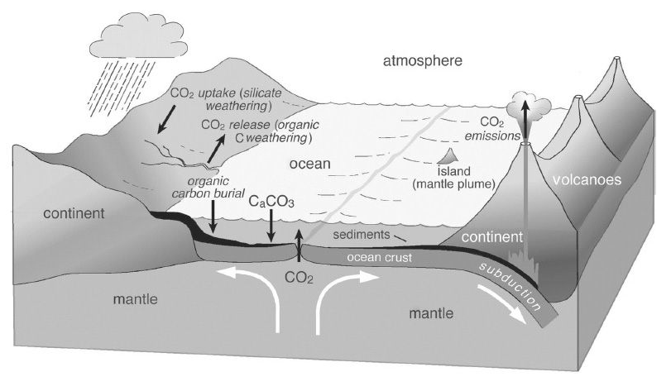
Geological carbon cycle
Ca²⁺, Na⁺, K⁺ …
HCO₃⁻, CO₃²⁻
Cycling of carbon between rocks, air and seawater
“Carbonate Buffer System”: positive and negative ions must balance each other → electron balance

Slide 8
Residence time of nutrients and carbon
MRT = (mean residence time) = (inventory) / (flux)
Inventory: X PgC
Flux in
Flux out
Fluxes: Y PgC/yr
MRT = (X, PgC)/(Y, PgC/yr) = X/Y, yr

Slide 9
Example: what is the MRT of carbon biomass in the marine/land biota?
Carbon inventory in marine biota = 3PgC
NPP ~ 50 PgC/yr
MRT = 3 / 50 = 0.06 yr
c.f. Carbon inventory in land biota = 2300 PgC
NPP ~ 50 PgC/yr
MRT = 2300 / 50 = 46 yr

Slide 10
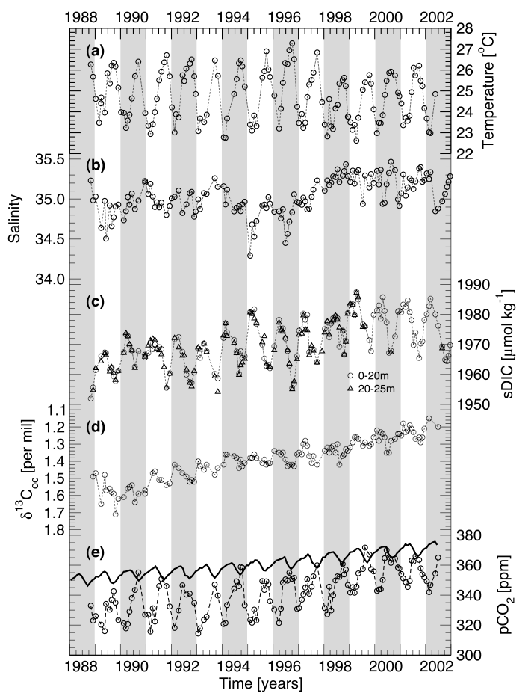
Observed seasonal cycle in Hawaii
Brix et al. (2004)
During the summer, low DIC coincides with high SST → Biological C uptake and export.
pCO2 is high during the summer (low solubility)
Long term increase in C and decrease in C-13 (Suess effect)

Slide 11
Solubility of gases in the seawater
CO₂ is a soluble gas
Solubility of CO2 = how many CO2 molecule can be dissolved in a unit mass of seawater at equilibrium
Note: Surface ocean is not always at equilibrium… sometimes under-saturated and super-saturated, depending on many factors including biological C uptake, heating/cooling, transport, etc.

Slide 12
Solubility: Henry’s law
CO₂ solubility (here, K₀) is a function of temperature and salinity (units: molC m⁻³ atm⁻¹)
Square bracket [] indicates concentration
Fugacity (fCO2) and partial pressure (pCO2) are almost equivalent (~1%) difference → activity vs concentration

Slide 13
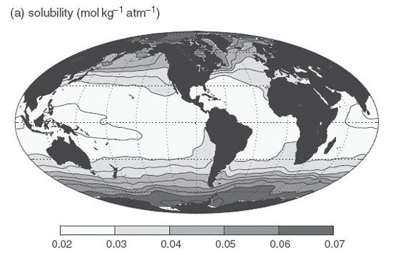
Mapping the solubility of CO₂

Slide 14
Air-sea exchange
Surface ocean exchanges gases with the overlying atmosphere: how does it happen?
Two types of gas exchange kinetics
  Diffusive gas exchange
  Bubble mediated gas exchange
The rate at which the gas molecule is exchanged at the air-sea interface depends on the types of physical processes responsible.

Slide 15

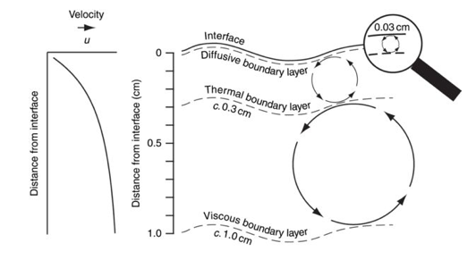
Diffusive gas exchange
Molecular diffusion at the diffusive boundary layer
  Enhanced by the turbulent mixing
G: gas transfer coefficient (m s⁻¹)
Note: diffusive flux is down-gradient between ocean and atmosphere.
The rate coefficient (G) depends on the near-surface turbulence

Slide 16


Controls on air-sea gas transfer rates
G: gas transfer coefficient (ms⁻¹)
  Turbulence in the surface ocean
  Depends on:
    Surface wind speed
    Schmidt number (Sc)
      Viscosity of the water
      Molecular diffusivity of gas in the water

Slide 17
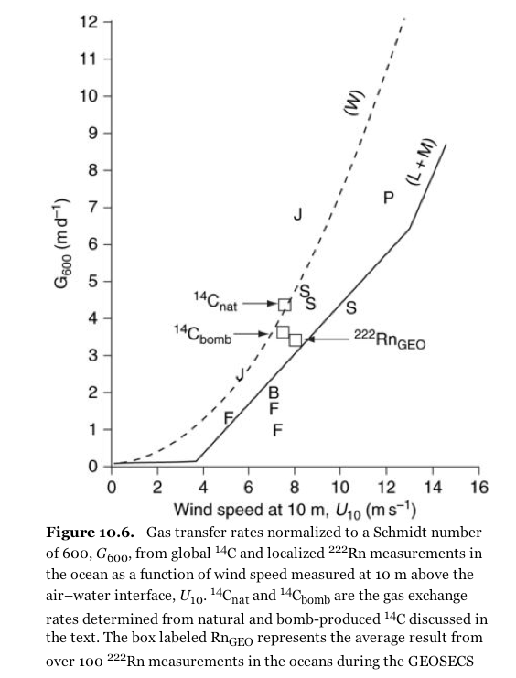
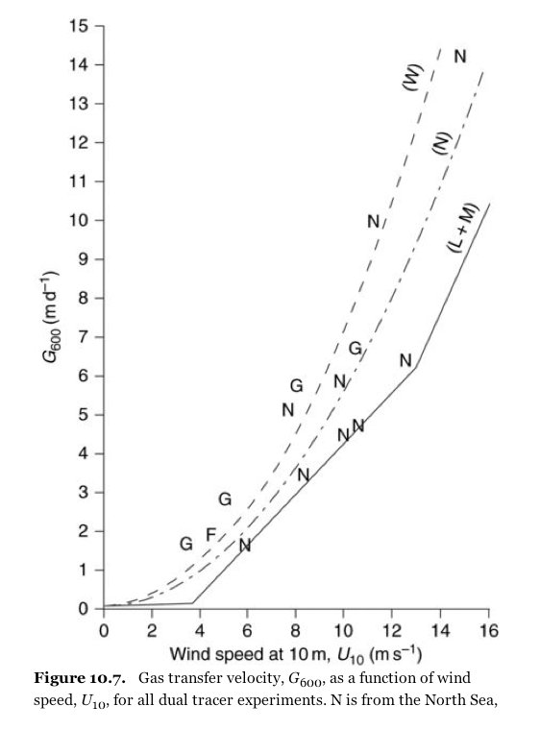
Wind dependence of G

Slide 18
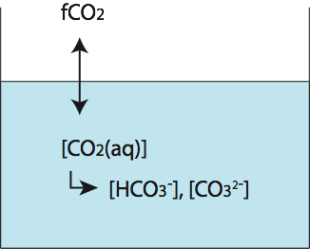
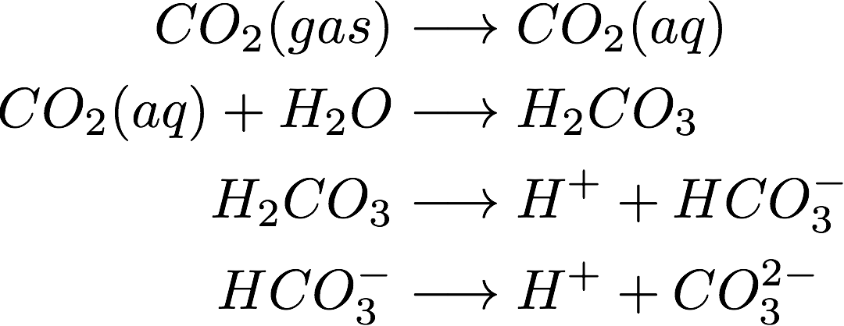
Carbonate chemistry
Formation of HCO3 and CO3 ions

Slide 19

Dissolved inorganic carbon
CO2 reacts with water to form bicarbonate and carbonate ions
In aquatic system, carbon inventory is expressed as the sum of inorganic C species
~1%
~90%
~10%

Slide 20
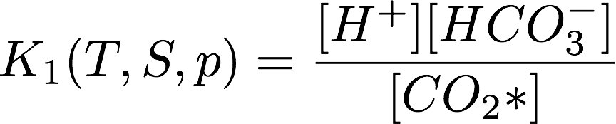

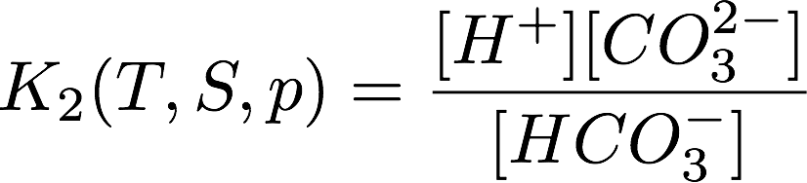
Local Chemical Equilibrium
These reactions reaches chemical equilibrium within a few minutes

Slide 21
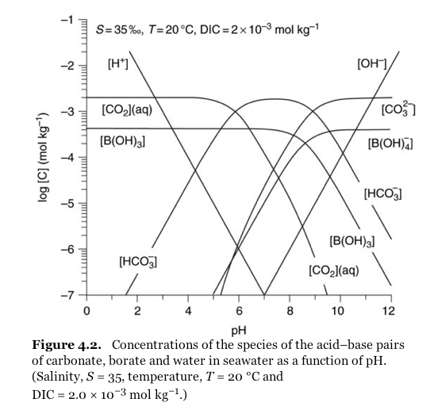
Partitioning of carbon molecule

Slide 22
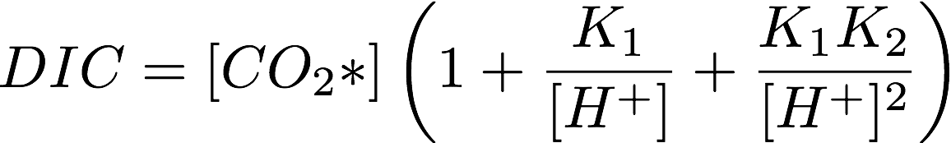
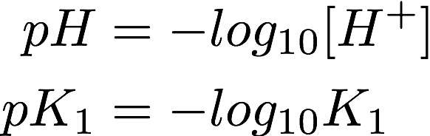

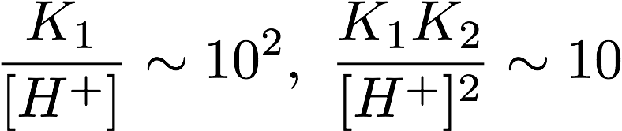
Partitioning of carbon molecule
At present climate,
pH = 8,

Slide 23
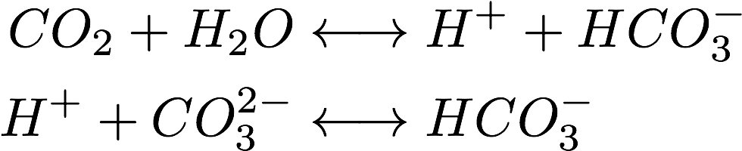
Carbonate buffer
Acid-neutralizing ability of the seawater
  Initially adding CO2 molecule increases [H⁺]
  Additional [H⁺] reacts with carbonate ion
    Bicarbonate increases twice the rate of initial CO2 addition
    The change in [H⁺] is suppressed as a net effect
Notes:
Ended here 11/6

Slide 24
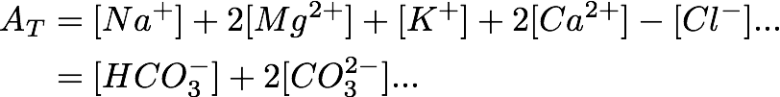
Alkalinity and pH of the seawater
Consider electric neutrality
  Cations (Na⁺, Mg²⁺, K⁺, Ca²⁺, ...)
  Anions (Cl⁻, HCO3⁻, CO3²⁻, ...)
  Group cations and anions into strong and weak ions

Slide 25
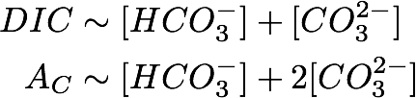
Carbonate alkalinity
Alkalinity (AT), carbonate alkalinity (AC) and DIC
  Carbonate alkalinity (AC: about 90% of AT) contains only bicarbonate and carbonate ions.

Slide 26
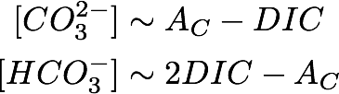


Useful approximations
Thus
Note: CO₂ addition will increase DIC but not alkalinity. HCO₃⁻ increases twice the rate of DIC at the expense of CO₃²⁻
And,

Slide 27
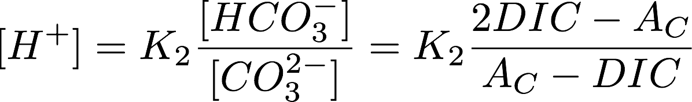
Control of pH
On average the pH of seawater is about 8.
  The pH is maintained by the balance between CO₂ and alkalinity level of the seawater.
  In a CO₂-rich ocean, the balance shifts to the right, i.e. ocean acidification.

Slide 28
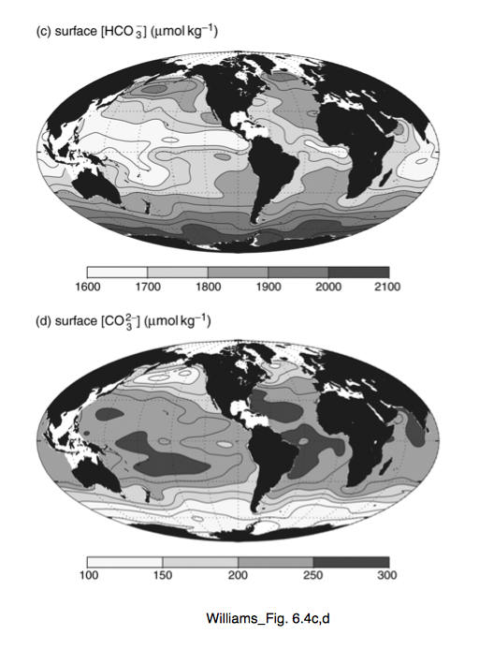
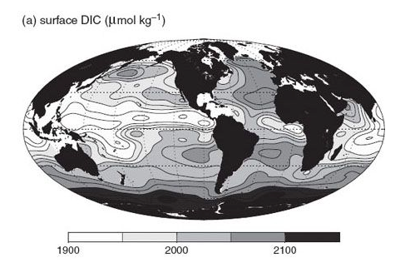
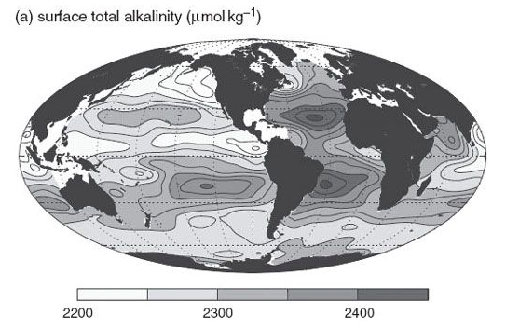
Spatial distributions
HCO₃⁻ ~ 2DIC-Alk
DIC
CO₃²⁻ ~ Alk-DIC
Alk

Slide 29
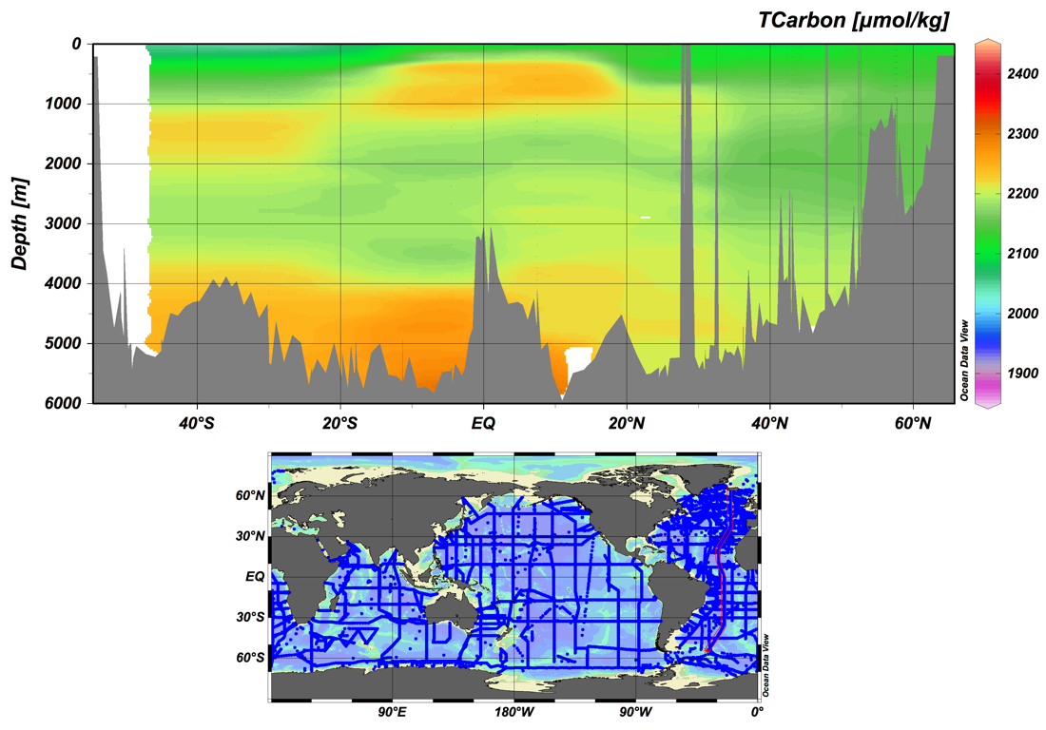
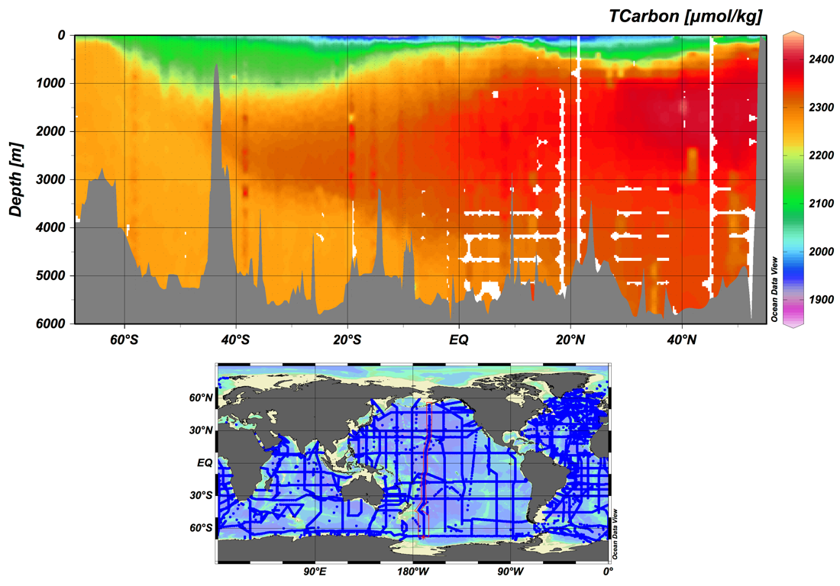
DIC in the oceans
Atlantic
Pacific
WOCE (1990s)

Slide 30
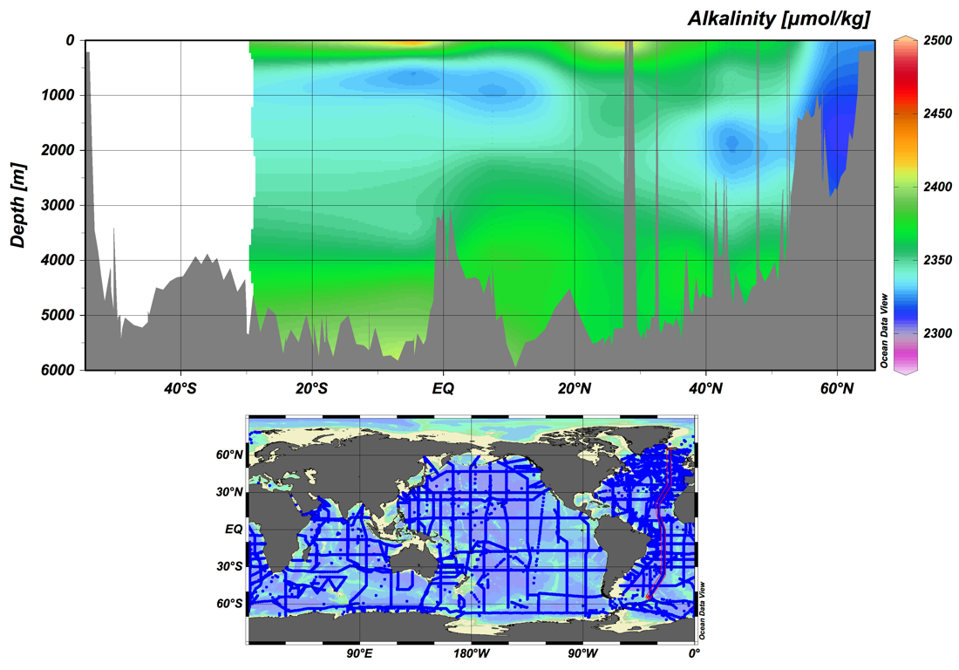
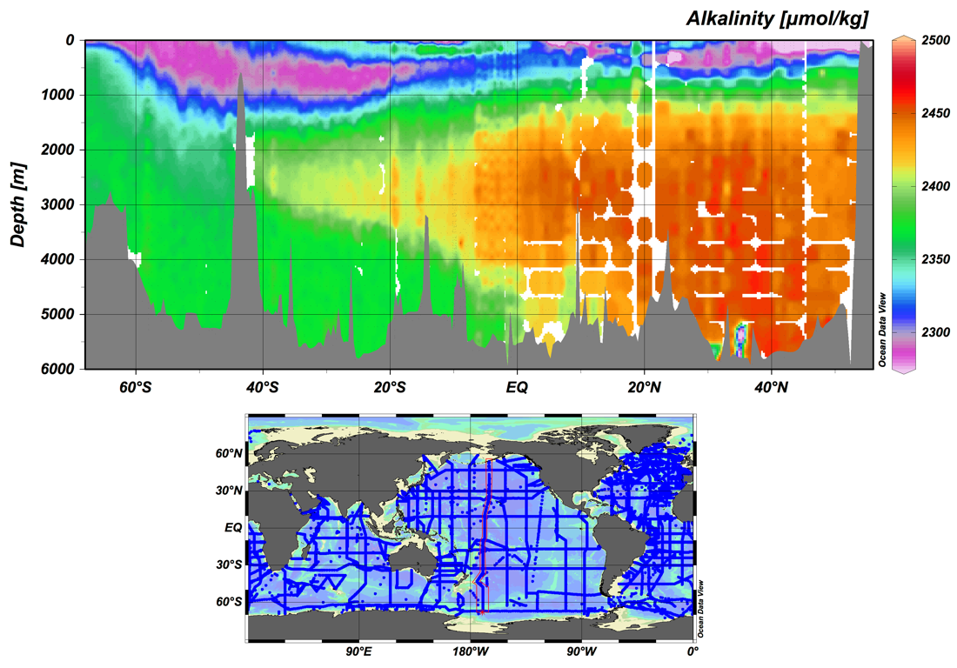
Alk in the oceans
Atlantic
Pacific
WOCE (1990s)
Notes:
ended here…

Slide 31
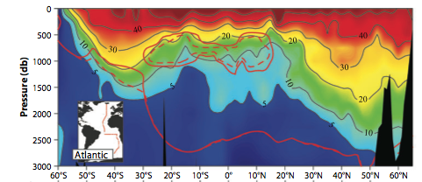
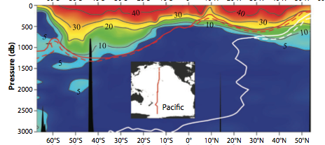

Anthropogenic CO2
So far, the oceans absorbed about 1/3 of CO2 emission
The best estimate for the last few decades that ocean absorbs CO₂ at the rate of about 2 PgC/year.
What regulates its spatial pattern?
Most of anthropogenic CO2 remains within the top 1,000m in the oceans. Why?

Slide 32
Ocean carbon uptake
Air-sea gas transfer
  Wind speed, solubility of CO₂
Chemical reaction driving the CO₂ uptake:
  Carbon uptake is chemically enhanced by this reaction. [CO₃²⁻] level controls its efficiency.

Slide 33
Spatial distributions
HCO₃⁻ ~ 2DIC-Alk
DIC
CO₃²⁻ ~ Alk-DIC
Alk

Slide 34
Is CO2 more soluble at high latitudes?
Yes – colder SST enhances the solubility of CO₂
Why then tropics/subtropics contain more anthropogenic CO₂ in the surface water?
  Subtropical water has higher alkalinity due to the excess evaporation → Enhanced buffering capacity (higher CO₃²⁻) → Subject to the same [CO₂] increase, subtropical water can absorb more carbon molecule than high latitudes

Slide 35
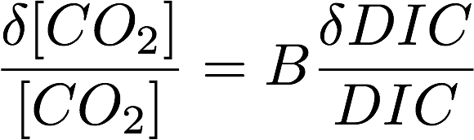
Revelle (Buffer) factor
Equilibrium carbonate chemistry
  Link between [CO₂] and DIC.
  B is called Revelle (buffer) factor
    B is about 10 in tropics/subtropics
    B is about 18 in polar ocean
    Anthropogenic CO₂ increase leads to different DIC response depending on the value of B
→ Spatial variation of both bicarbonate and carbonate ions increases B with latitude

Slide 36
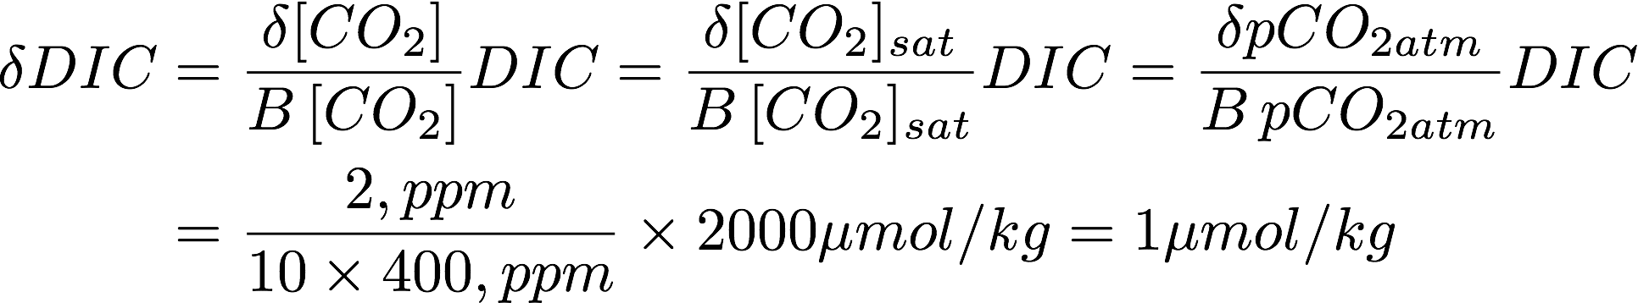
Some numbers
Yearly rate of atmospheric CO2 increase fluctuates year to year, but it’s magnitude is about 2ppm/year. Assuming saturation at the surface, can you predict the increase in the DIC of the surface water?
Use buffer factor,

Slide 37
Observed seasonal cycle in Hawaii
Long-term increase in oceanic DIC
Looking at the slope, the rate of increase is about 15 μmol/kg from 1988 to 2002
This is approximately about 1 μmol/kg per year!

Slide 38
More numbers
If the surface ocean DIC is increasing at the rate of about 1 μmol/kg per year for the surface mixed layer, what would be the yearly carbon uptake in PgC?
Assume average MLD of 100m and the area of the global surface ocean is about 3.5 x 10¹⁴ m², we get:
This is not enough to account for the ocean carbon uptake of 2 PgC/year.

Slide 39
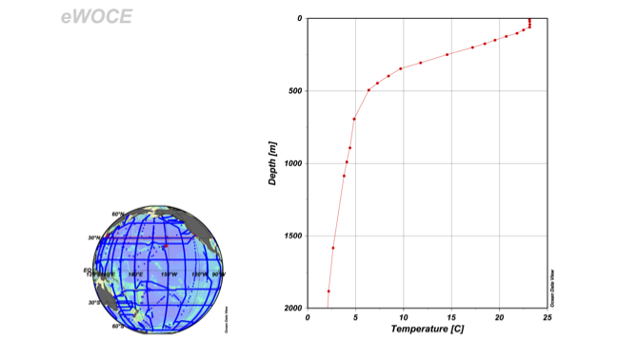
Circulation, timescale of ventilation and the carbon sequestration
Surface water is transported into the interior ocean
Vertical circulation replaces subsurface water (via the ocean currents and mixing)
Age of seawater ~ residence time of water
Mixed layer: ~1year
Thermocline: ~10years
Deep ocean: ~1,000 years

Slide 40
Water Age
How do we define the “age of water”?
  How long has it been since the water was in last contact with the surface?
  Age = 0 : surface water
  Age generally increases with depth
How can we measure it?

Slide 41

Observations of water age
Carbon-14 (¹⁴C, radiocarbon)
  Half life of 5,730 years
  Natural C-14 is useful for deep waters
  Bomb C-14 issues
Tritium-Helium tracer
  Half life of 12.43 years
  Most useful for thermocline waters
Transient tracers
  CFC-11, -12, -113, SF₆ are typically used
  Increasing trend in the atmosphere ➔ ocean
  Ocean concentration lags behind the atmosphere
  Most useful for thermocline waters

Slide 42
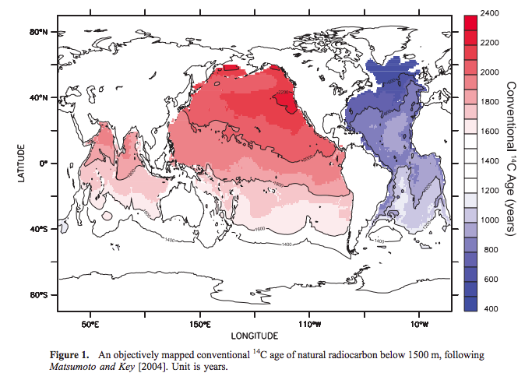
Observed C-14 age
Matsumoto et al., 2007, JGR-Ocean

Slide 43
Issues with C-14 age
The surface C-14 is not at equilibrium with the atmosphere
Air-sea exchange of carbon isotope is very slow: it takes about 10 years to equilibrate the surface mixed layer → large air-sea disequilibrium
This is called “surface reservoir age” indicating that the newly formed deep water has non-zero (positive) age.

Slide 44
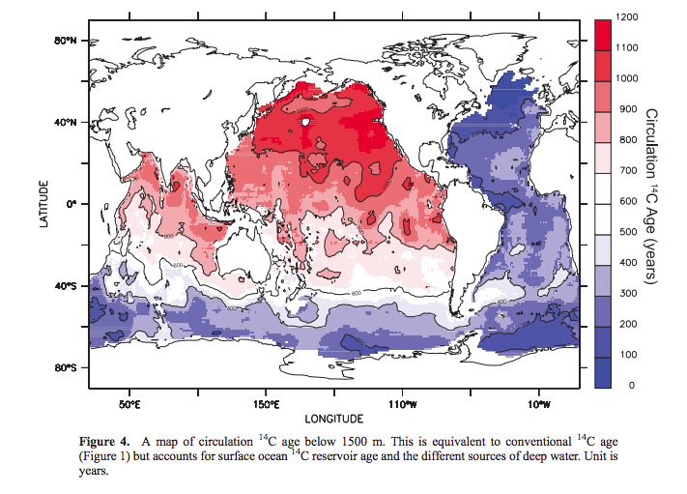
Corrected C-14 age

Slide 45
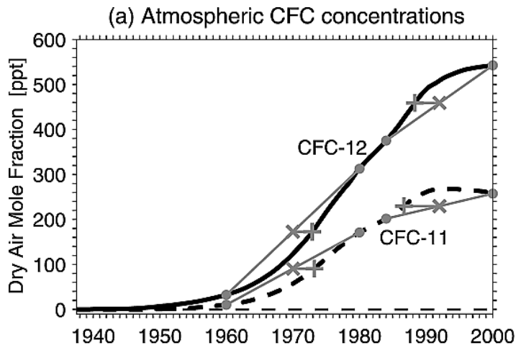
CFC-11, -12
Mecking et al., (2004)

Slide 46
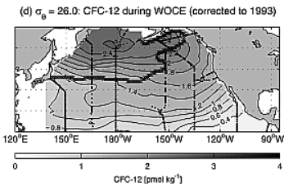
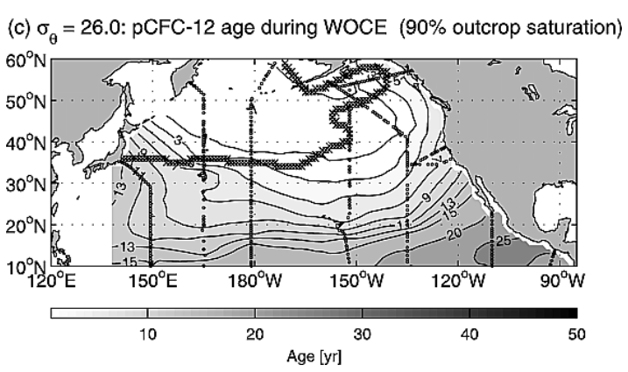
CFC-12 age in the thermocline
High CFC concentration means young age ➔ more recently ventilated waters
The age of waters in the upper ocean thermocline < 10 years in mid-latitudes.
The effect of mixing tends to reduce the concentration age

Slide 47

Ocean carbon uptake
As the ocean absorbs fossil fuel CO₂, what would happen to [HCO₃⁻] and [CO₃²⁻]?
  DIC increases but Alk remains the same.

Slide 48
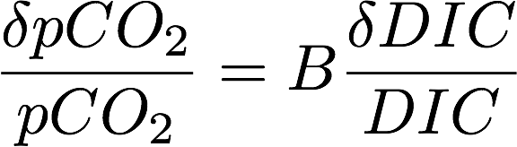
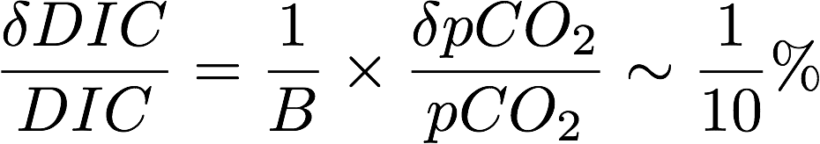
Ocean carbon uptake
If pCO₂ increases by 1%, what would be the DIC increase under constant Alk?
  Use the Buffer factor

Slide 49
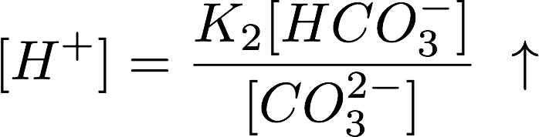
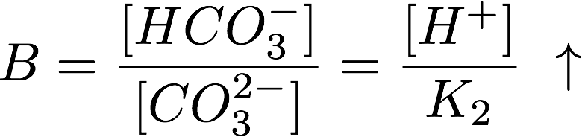
Ocean carbon uptake
As the ocean absorbs fossil fuel CO₂, what would happen to [H⁺] and Buffer factor?
  [HCO₃⁻] increases and [CO₃²⁻] decreases…

Slide 50

Marine CaCO₃ production
Calcifiers can biologically produce CaCO₃. (biomineralization)
Impacts on DIC and Alkalinity
  1 mol of CaCO₃ production consumes 2 mols of alkalinity and 1 mol of DIC
  Implication for [CO₃²⁻] and [HCO³⁻]?
  Implication for pH?

Slide 51
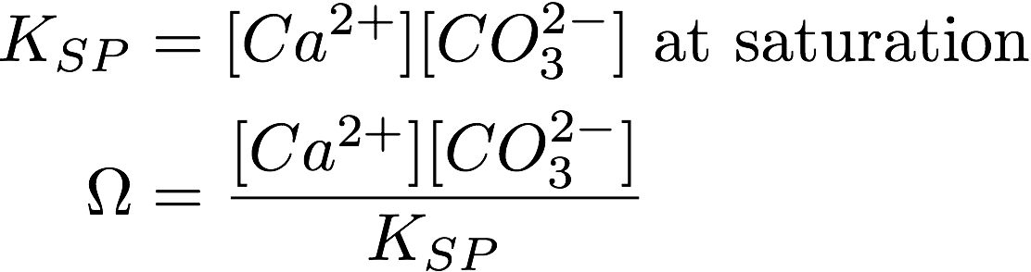
CaCO₃ dissolution
Their dissolution is controlled by its solubility (Ω).
If Ω is less than 1, it is undersaturated and the CaCO3 dissolves in the water.
If Ω is greater than 1, it is supersaturated.

Slide 52
CaCO₃ dissolution
Their dissolution is controlled by its solubility (Ω).
Biogenic CaCO₃ has two mineral forms; calcite and aragonite (K_{SP} is different between the two)
Aragonite is more unstable than calcite (larger Ksp)
K_{SP} increases with pressure, so naturally deep waters tend to be undersaturated → CaCO₃ dissolves in the deep water.

Slide 53
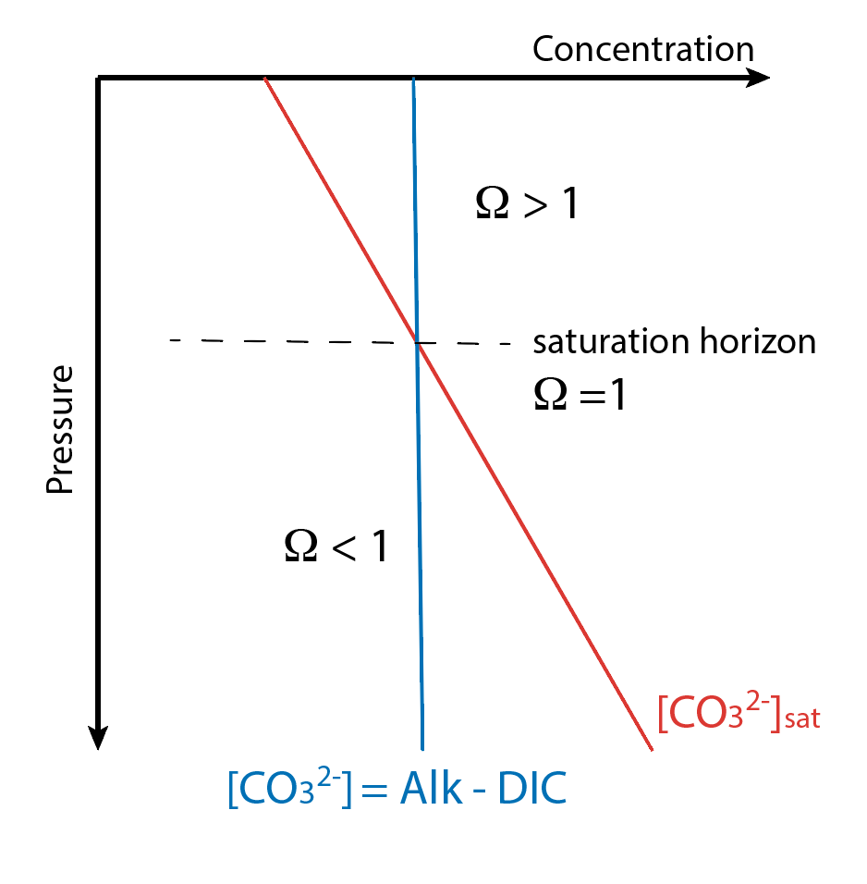
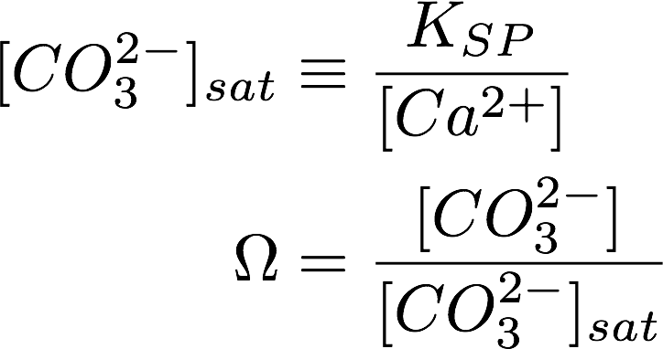
Dissolution profile
The depths of saturation horizon ~ approx 3km in the Atlantic and 1km in the Pacific.
It is shoaling approx. 1-2 m/yr

Slide 54
Calcium carbonate pump
Production of sinking CaCO3 particles at the surface
  It removes both DIC and Alk from the surface water, lowering surface [CO₃²⁻].
  The balance shifts to the left in the above equation → increasing CO₂ in the surface water
  Surface water has more [CO₂], leading to de-gassing of CO2 to the atmosphere.

Slide 55
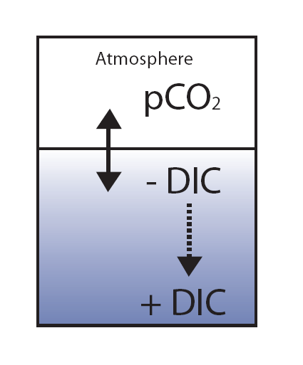
Carbon pumps
Volk and Hoffert (1985)
  Mechanisms that maintain vertical gradient of DIC in a steady state
Simple 1D view
  Organic pump driven by sinking organic particle
  Carbonate pump driven by sinking CaCO3 particles
  Solubility pump driven by thermal stratification

Slide 56
Solubility pump
Vertical temperature gradient
  Global mean SST is about 15ºC.
  Deep water is about 2ºC.
    Deep water contains higher DIC relative to the surface
  Considering the temperature dependence of solubility, the cooling of global ocean by 1ºC leads to a lowering of atmospheric CO₂ by 10 ppm at steady state.

Slide 57
Biological pump
Organic pump
  Increases thermocline/deep nutrients and carbon. Also consumes oxygen.
  Decreases atmospheric CO₂
Carbonate (CaCO₃) pump
  Increases thermocline/deep alkalinity and carbon.
  Decreases buffering capacity at the surface, therefore increases atmospheric CO₂

Slide 58
Steady state carbon cycle
Steady state d/dt → 0
Atmos + Ocean C inventory is constant.
For the 1-box atmos 2-box ocean model;
Global C mass balance
Air-sea exch and carbonate chemistry
Deep ocean C balance

Slide 59

Solubility pump
Solubility pump acts through K₀ in the carbonate chemistry
Look at a small perturbation
Global C mass balance
Air-sea exch and carbonate chemistry
Deep ocean C balance

Slide 60



K₀ decreases with T
With pCO2=280ppm, Ma=1.8 x 10²⁰ mol, and K₀=0.04 we get
about 9ppm per 1°C warming.

Slide 61
Biological pump
The 2nd term in the deep ocean DIC
Deep ocean P is essentially a constant, so Ps, is the only variable (i.e. preformed P).
Global C mass balance
Air-sea exch and carbonate chemistry
Deep ocean C balance

Slide 62
Biological pump
The 2nd term in the deep ocean DIC
Deep ocean P is essentially a constant, so Ps, is the only variable (i.e. preformed P).
Global C mass balance
Air-sea exch and carbonate chemistry
Deep ocean C balance

Slide 63

Biological pump
Ps, is measures the inefficiency of biological pump. Weaker productivity → higher surface P
With typical parameters, we get
about 130ppm per 1μM increase in Ps

Slide 64
Transient carbon cycle
Emission of fossil fuel CO₂ makes the carbon cycle off-balance.
Modern C cycle is no longer in steady state.
HW9 will be addressing what controls the rate of CO₂ uptake under increasing pCO₂^{atm}

