Slide 1
Part II: chemical oceanography
Processes: Physical, chemical and biological mechanisms that transfer elements within the ocean and across boundaries with atmosphere and land biosphere
Cycling: Interaction of processes that regulates the global distribution
Climate-relevant elements: CO₂, methane, oxygen, nutrients, trace metal, ...

Slide 2
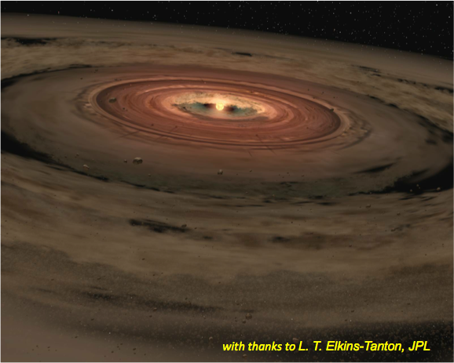
The origin
  13.7 billion years ago (Ga): The Big bang
  12.5 Ga: The Milky Way galaxy
  4.57 Ga: The Solar System

Slide 3
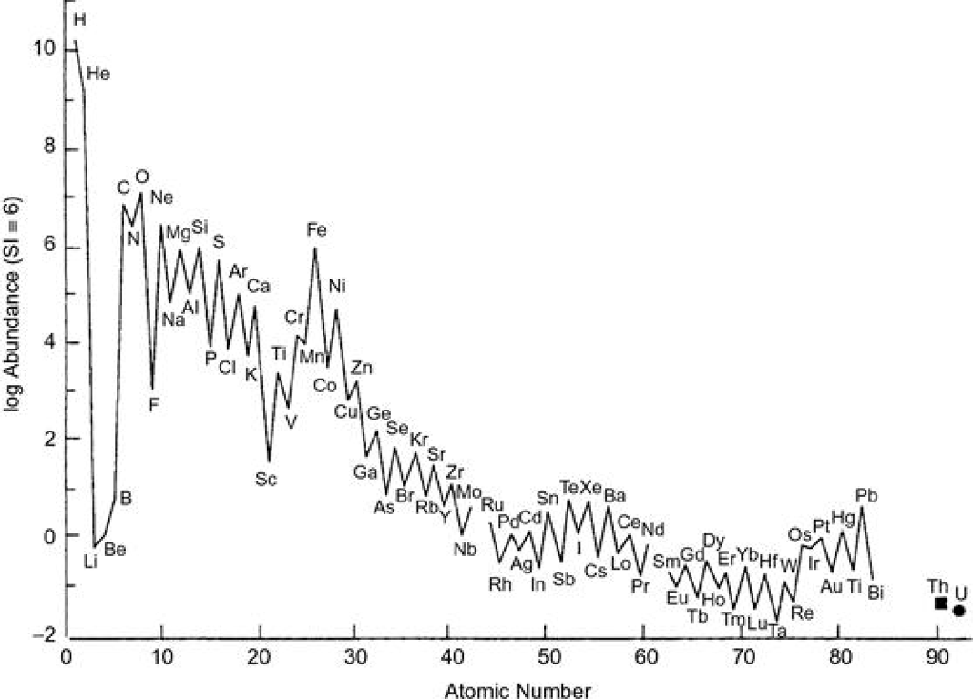
Cosmic abundance
Schlesinger Fig 2.1

Slide 4
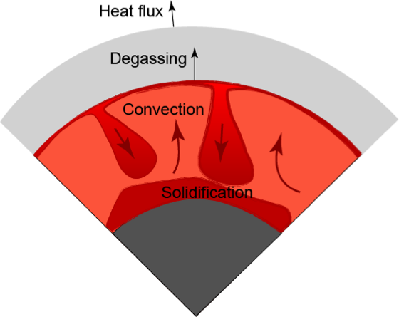
Cooling and solidification of the early Earth
Primitive meteorites
Degassing of H2O leads to the formation of the proto ocean

Slide 5
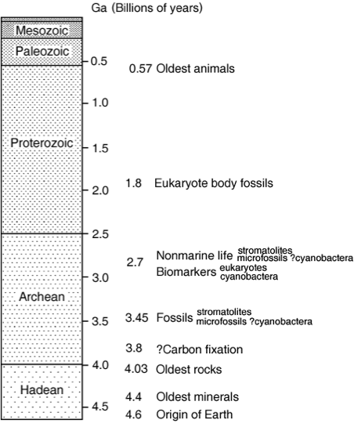
Early life
0.5 Ga: Cambrian explosion
2.5 Ga: Atmospheric oxygen starts to rise
3.4-3.8 Ga: Evidences of the earliest life

Slide 6
The Archean Earth
4 to 2.5 Ga
Very low atmospheric oxygen content
  No ozone layer
  UV radiation reaching the surface
    Early life was likely anaerobic and underwater
CO2 and CH4 rich atmosphere
  Super greenhouse effect
  Despite the faint young sun, the surface of the Earth was likely warmer than today

Slide 7
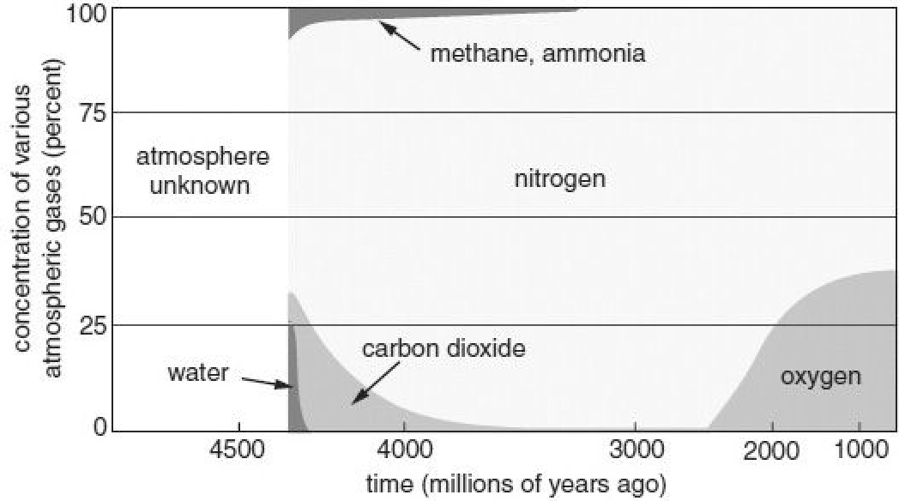
Early Atmosphere

Slide 8
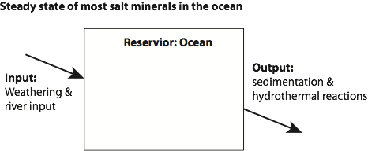
Geochemical balances
Mass balance
  Reservoir: ocean
  Steady-state: (input) = (output)

Slide 9

Inventory and flux
Inventory: total amount in the reservoir (mol, kg, ...)
Flux: rate of input or output (mol/s, kg/s, ...)
Mean Residence Time (MRT) = Inventory / Flux

Slide 10
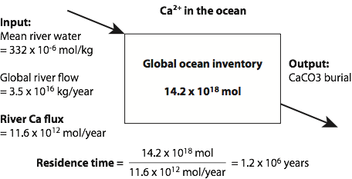
Some example

Slide 11
Mackenzie-Garrels mass balance
Mackenzie and Garrels (1966)
Steady state: (input) = (output)
Dissolved constituents in the global rivers and the oceans
Calculate mass balance
Obtain residence time for each element

Slide 12
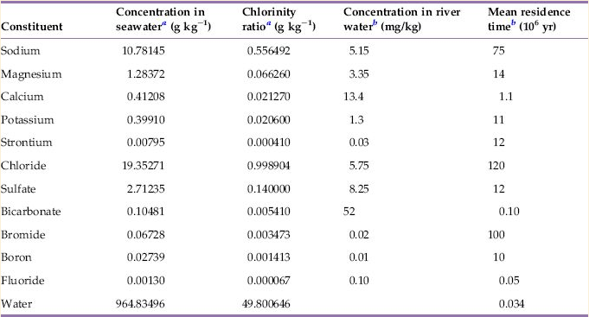
Residence time of dissolved constituents in the seawater
Schlesinger Table 9.1

Slide 13
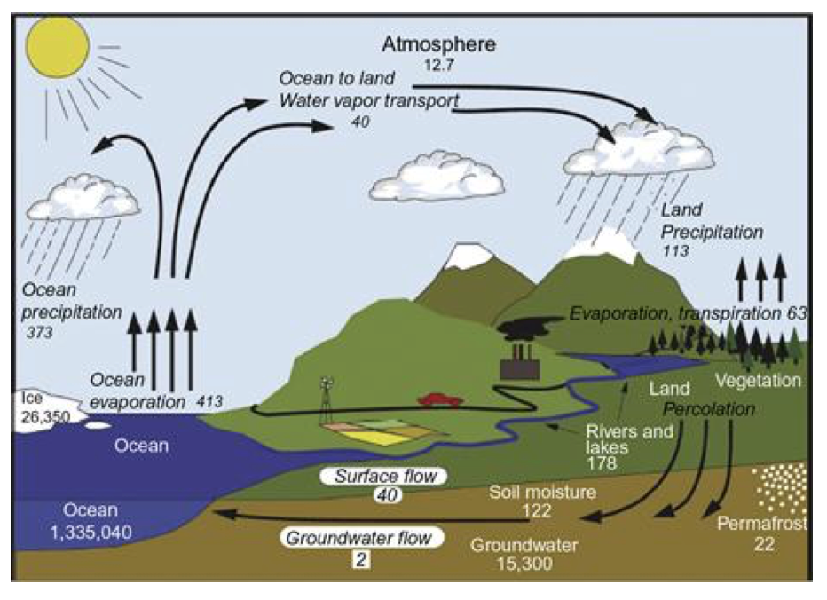
Water cycle : residence time of water molecule
in the ocean w.r.t. evaporation ~ 3.4 x 10³ year
Units in 10³km or 10³km/yr

Slide 14
Salinity
Main source of salt in the ocean is river input.
Why is ocean much saltier than the rivers?

Slide 15
Salinity
Main source of salt in the ocean is river input.
Why is ocean much saltier than the rivers?
Once salt enters the ocean, it remains there for a long period of time (MRT ~ millions of years), so it can accumulate to a higher concentration than the river water. It also explains why salinity is almost uniform (35 psu, or 3.5%wt)

Slide 16
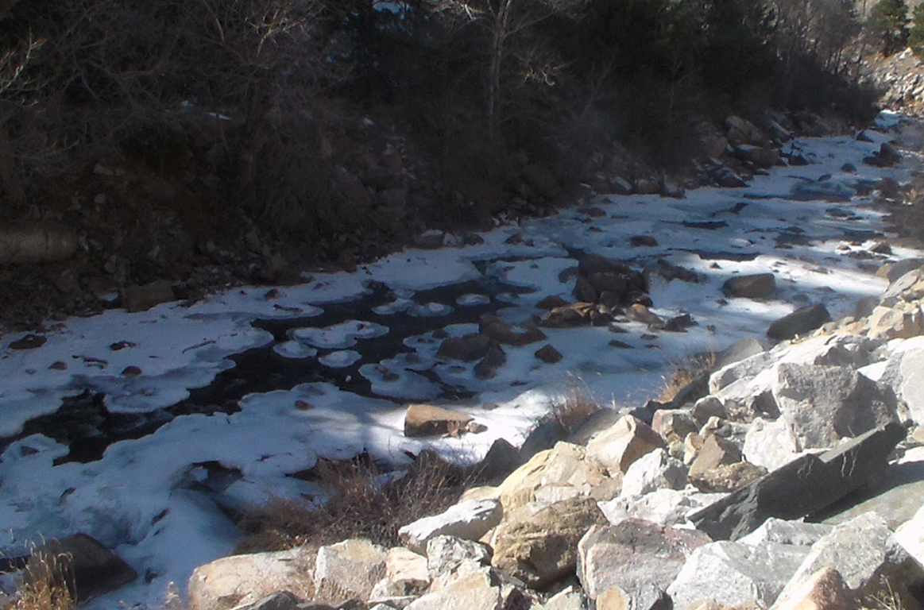

Weathering
Rocks and Atmosphere
  Breakdown of rocks
  Runoff to the ocean
  Source of minerals to the ocean
  Sedimentation
(Igneous rocks) + (CO₂ acid) = (sedimentary rocks) + (salty ocean)

Slide 17
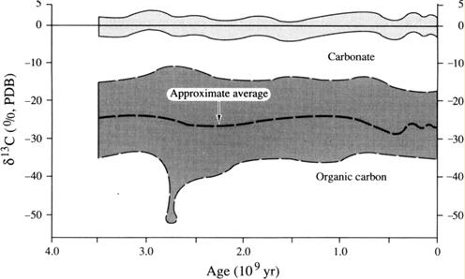
Photosynthesis
3.8 Ga: early evidence of photoautotrophs
  Fossilized organic matter depleted in ¹³C

Slide 18
Basic concepts and terms in metabolism
Anabolism = biosynthesis, production of organic matter. There are two types of anabolism. Autotrophy and heterotrophy based on the different sources of carbon.
  Autotrophy = biosynthesis based on inorganic matter (like CO₂)
  Heterotrophy = biosynthesis based on organic matter (like eating food)
    Production of organic matter requires energy. Depending on the energy source, we have further classification. (e.g.) Photoautotrophy, chemoautotrophy
Catabolism = consumption of organic matter. It destroys organic matter. For example, heterotrophs gaining energy from the organic matter would be chemoheterotrophy.

Slide 19
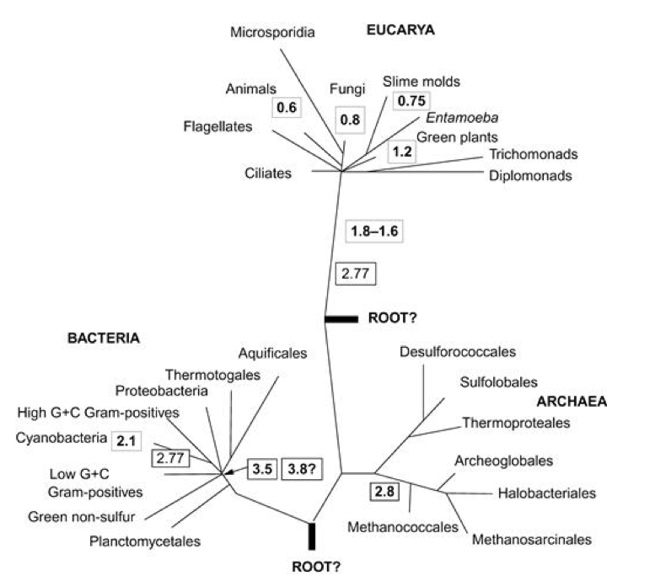
Basic concepts and terms
Three domains of life
  Archaea, single-cell microorganism, prokaryote (without cell nucleus) exists in various habitats, genetically distinct from bacteria.
  Bacteria, single-cell microorganism, prokaryote. Very diverse and widely distributed in many habitats.
Eukarya, contains membrane-contained cell nucleus, and there are single-cell (unicellular) and multi-cellular organisms

Slide 20
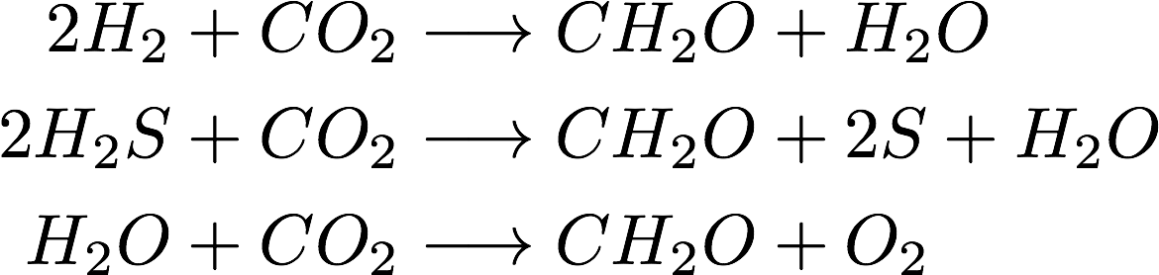
Early Photosynthetic reactions
Use sunlight as the energy source to reduce CO2 into organic molecules
The last reaction eventually become dominant due to the abundance of water and much higher energy yield of O₂, that fundamentally changed chemical environment in the oceans (and atmosphere).

Slide 21
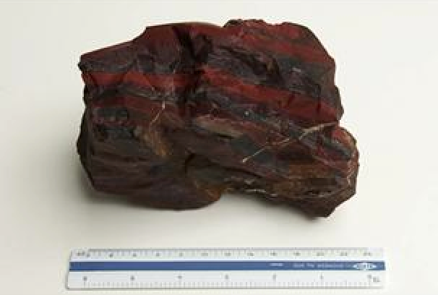
Oxygenation of the atmosphere
~2 Ga: atmospheric oxygen starts to increase
Banded iron formation
  O2-poor Archean ocean well dissolved Fe²⁺
  As O2 is produced and it reacts with Fe
  Fe²⁺ is oxidized to form iron oxide deposition
Schlesinger Fig 2.7
Banded iron formation
from South Africa

Slide 22
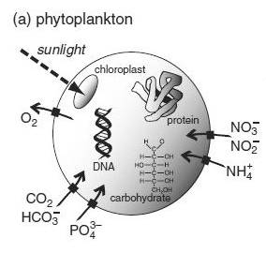

Photosynthesis
Microscopic plant, drifting in the surface ocean
Responsible for about 50% of photosynthesis on the Earth
Diverse in size, genetic information, and biogeochemical functions
Harvests light, absorbs CO₂ and nutrients to produce organic material

Slide 23
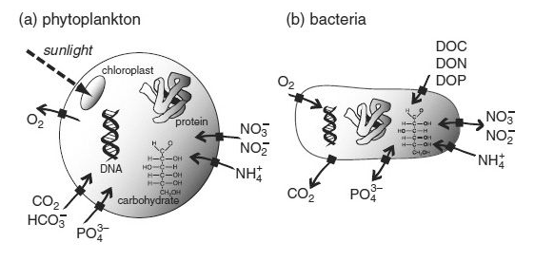

Elemental composition of microbes
% cell
54.5
25.5
16.1
4.0

Slide 24
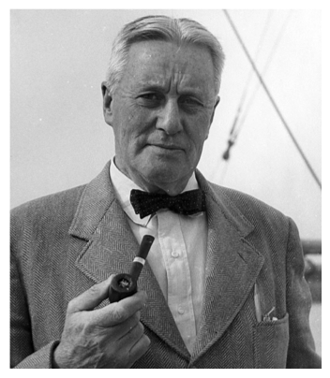
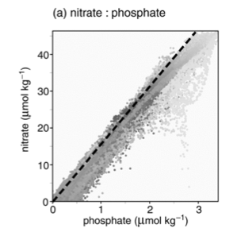
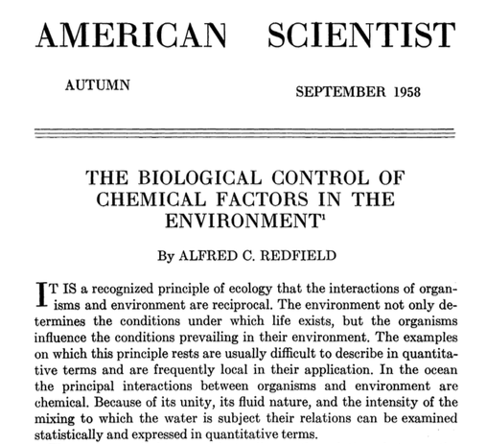
Redfield Ratio
Bulk Marine Organic matter P:N:C:O₂ = 1:16:106:-138
Same ratio in the seawater
Redfield, (1958)

Slide 25
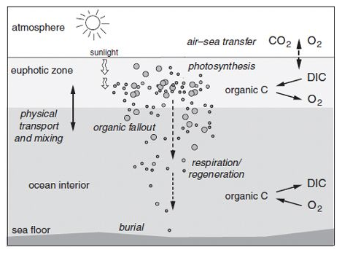
Photosynthesis
106 CO₂ + 16 NO₃ + H₂PO₄ +12 H₂O + light
→ C₁₀₆H₂₄₆O₁₁₀N₁₆P + 138 O₂

Slide 26
What regulates primary productivity?
106 CO₂ + 16 NO₃ + H₂PO₄ +12 H₂O + light
→ C₁₀₆H₂₄₆O₁₁₀N₁₆P + 138 O₂
H₂O (and CO₂) molecules are always available in the surface ocean
In modern ocean, marine photosynthesis generates about the same amount of O₂ as the land biosphere.
Nutrients (such as N and P) can be limiting photosynthesis
Light can be limiting photosynthesis

Slide 27
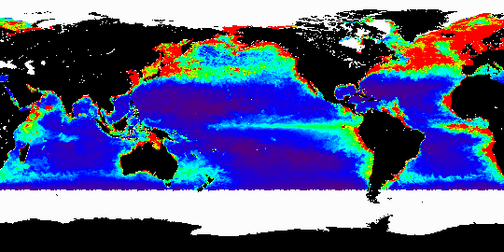
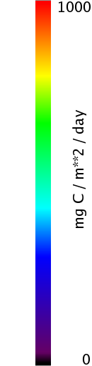
Pattern of global ocean productivity
SeaWiFS-based productivity estimates (Behrenfeld and Falkowski 1997)
June 2004
High productivity: high latitudes (summer hemisphere), tropics, coastal regions
Low productivity: subtropics, high latitudes (winter hemisphere)

Slide 28
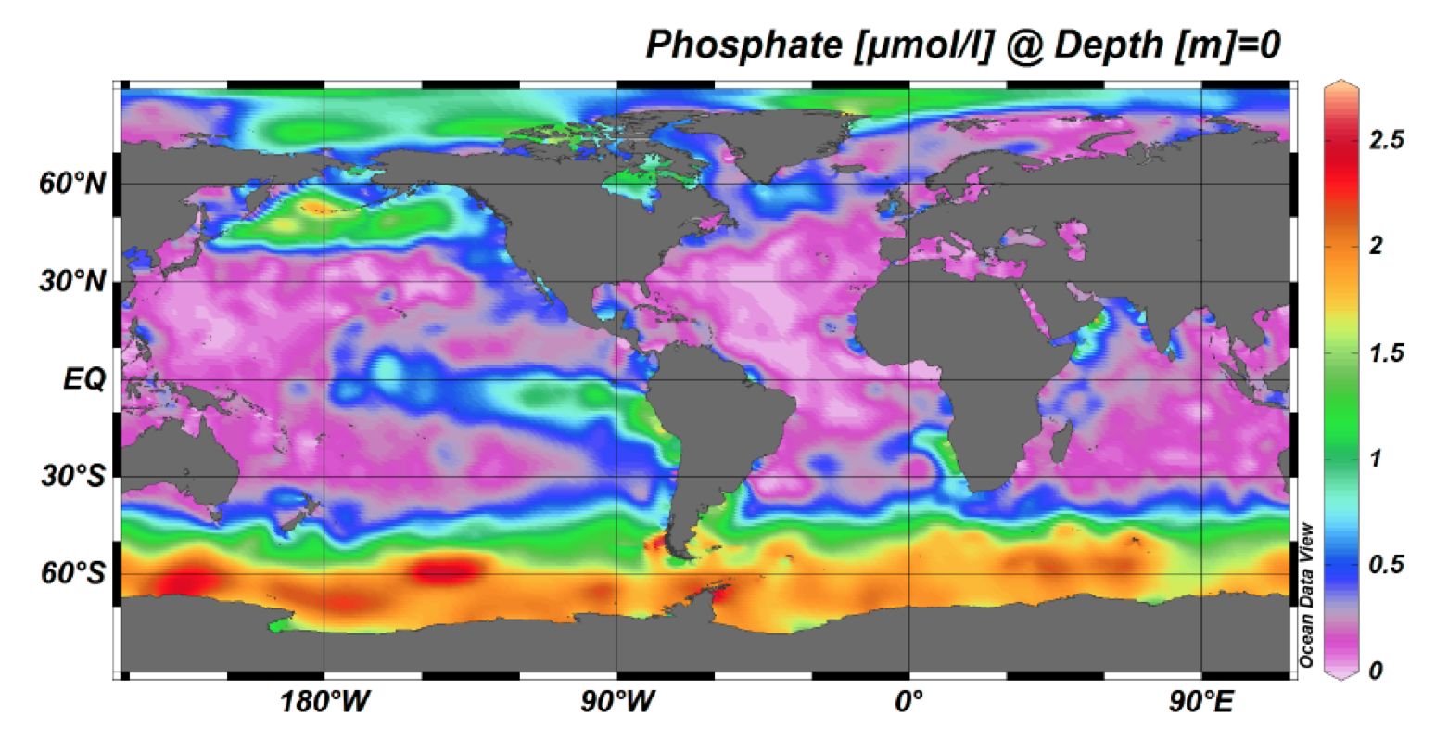
Surface nutrient distribution

Slide 29
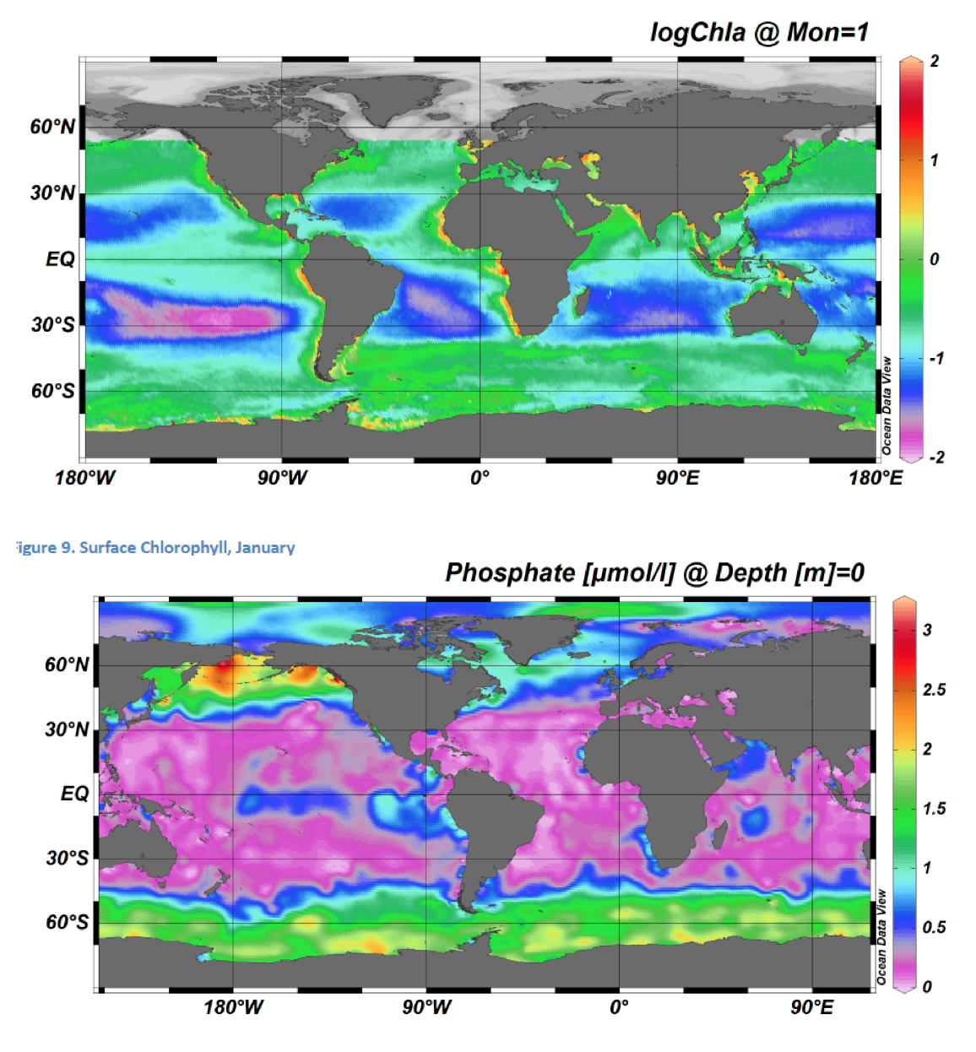

Slide 30
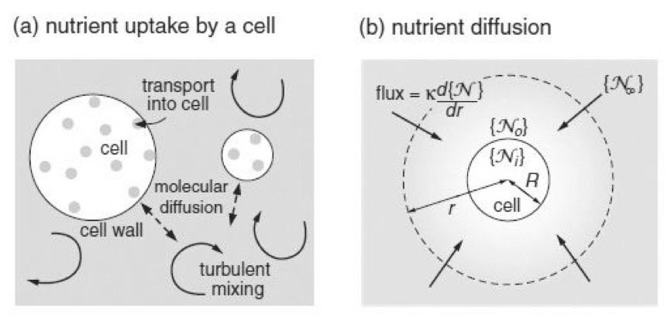
Nutrient uptake kinetics
Nutrient in the ambient water diffuses towards the plankton cell surface (rate limiting under low N condition)
Nutrient transporter takes in the nutrient across the membrane (rate limiting under high N condition)

Slide 31


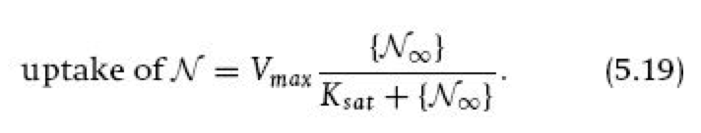
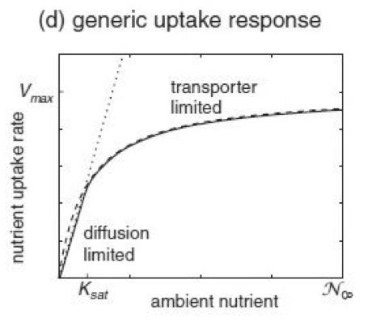
Two regimes of nutrient uptake
Low nutrient level → diffusion
High nutrient level → transporter enzyme kinetics

Slide 32
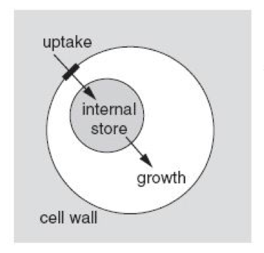
The role of cell size
Consider low N, thus diffusion-limited regime,
(per cell N uptake) is proportional to R, but
(per unit volume N uptake) is proportional to R⁻²
Smaller cell size is more advantageous in low N condition (because it has less biomass per surface area)
Larger plankton can store N internally and use it when needed: e.g. phytoplankton bloom

Slide 33
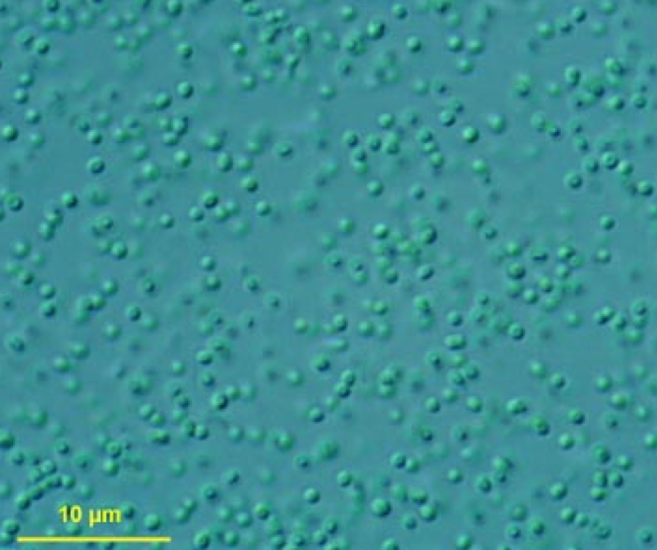
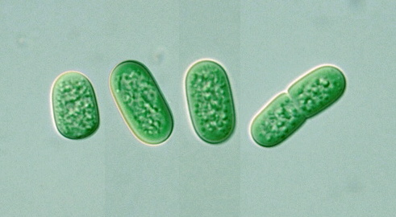
Pico-phytoplankton
Tiny (< 1μm) single-cell photosynthesizing bacteria
Prokaryotes
Take up nutrients efficiently at very low levels
Easily grazed and recycled
Prochlorococcus
Synechococcus

Slide 34
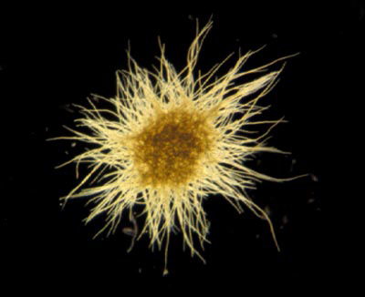
Diazotrophs
Nitrogen fixing bacteria
Can utilize N₂ as a nitrogen source
Trichodesmium

Slide 35
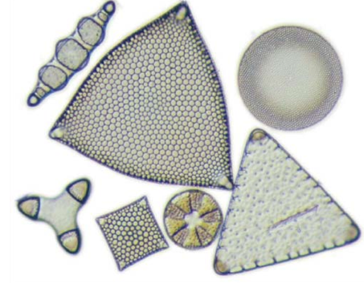
Diatom
Large (2 to 200 μm) photosynthetic eukaryotes
Can grow quickly and form blooms
Silica-based shells (frustles) → Sinkers
Abundant in upwelling regions (e.g. equator, southern ocean)

Slide 36
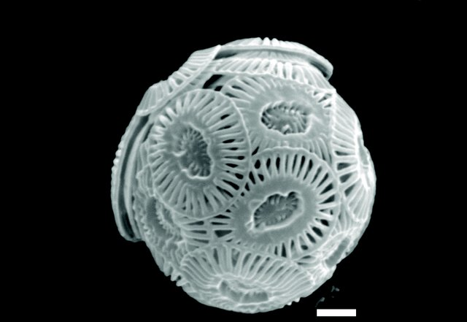
Coccolithophorids
Calcium carbonate shells
CaCO₃ cycling
Sinkers

Slide 37
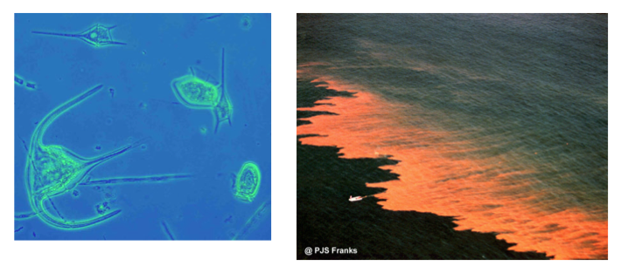
Flagellates
Motile
Mixotroph
Can grow rapidly and bloom → HABs

Slide 38
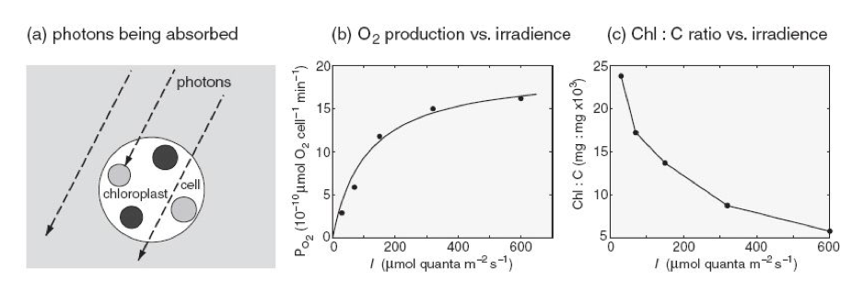
Light
Phytoplankton has chlorophyll pigment, light harvesting mechanism
  Under low light condition, phytoplankton increase chlorophyll to capture more photons
  Under high light condition, phytoplankton reduce chlorophyll

Slide 39
Variation of light with depth
Seawater is an excellent absorber of light
  How deep can the solar radiation reach?
  Depends on the particle concentration in the seawater
  Light intensity has an exponential decay with depth
  Red light (longer wavelength) is more readily absorbed into the seawater
  Blue light penetrates deeper and scattered by water molecule
  For typical open ocean condition, Z_{λ} is about 20m for blue light, and is only a few meters for red light
  The clearest water, N depleted water from the subtropical open ocean, has a deep dark blue color, almost black

Slide 40
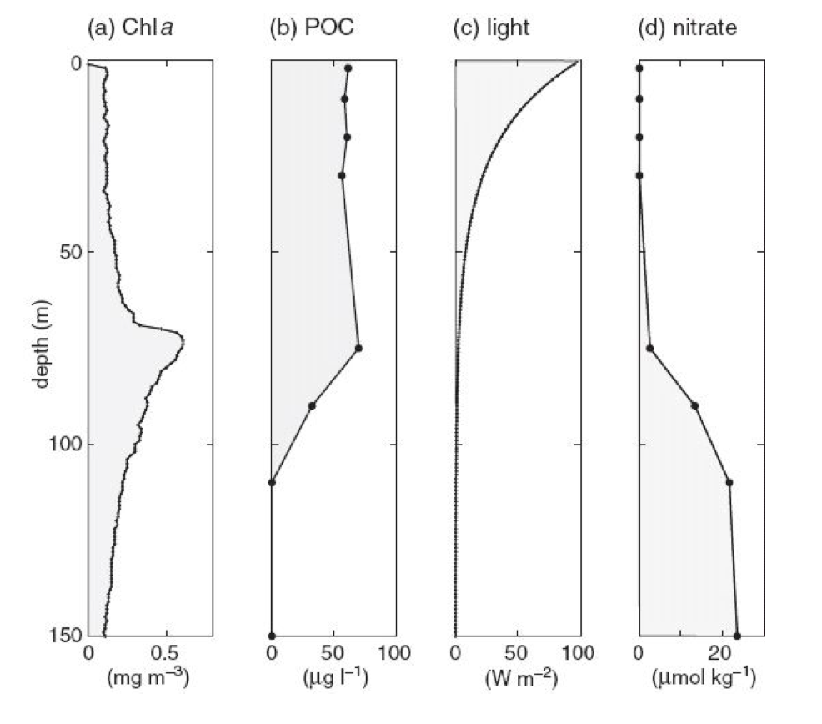
A typical vertical profiles
Chla = Chlorophyll-a, common pigment
POC = Particulate Organic Carbon ~ biomass + detritus in particle form

Slide 41
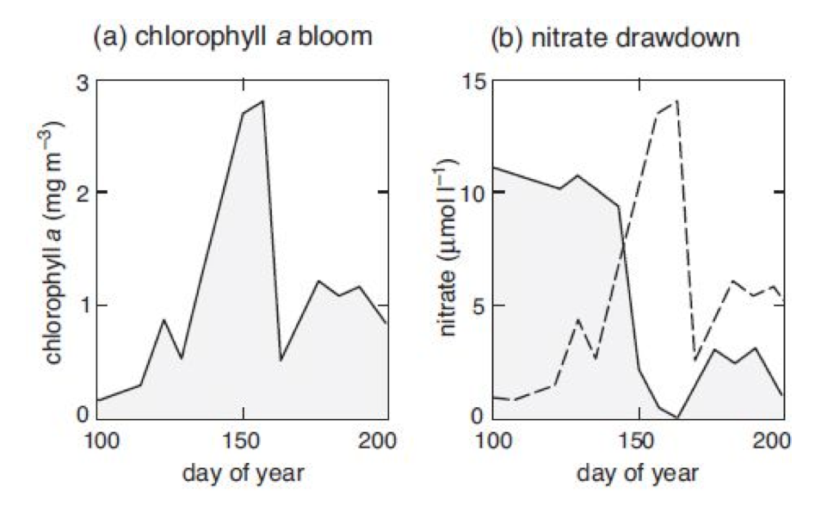
Seasonal cycle of photosynthesis
North Atlantic bloom

Slide 42
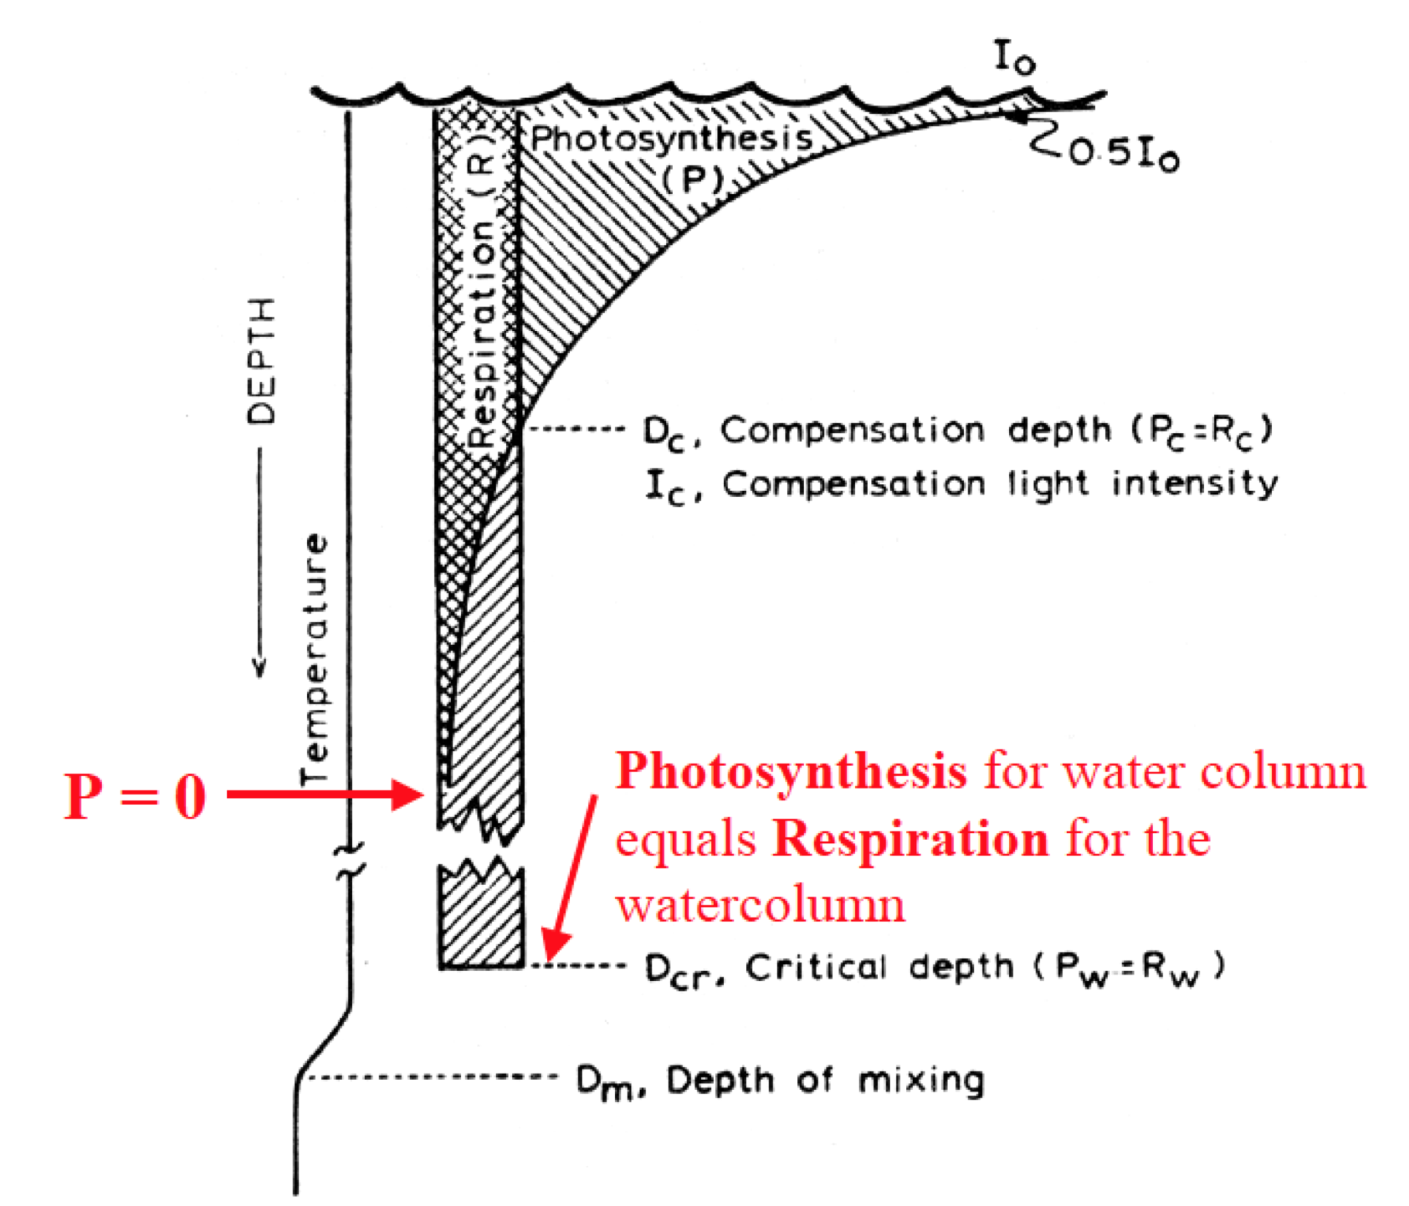
Sverdrup Hypothesis: A theory for spring bloom
Plankton is vertically transported through the depth of the mixed layer
If MLD < critical depth, the vertically integrated photosynthesis exceeds respiration in the mixed layer.

Slide 43

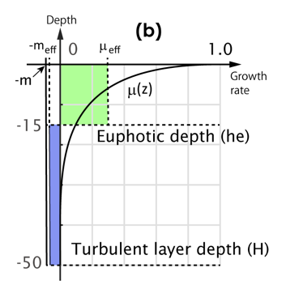

Critical depth theory (Sverdrup theory)
Simple 2 layer model
Assume there is a strong turbulence so that phytoplankton is well mixed down to the mixed layer depth (h)
Light is only available above the euphotic depth (he).
Mortality (m) is constant throughout the mixed layer.
Then we have the critical depth (hc)
Mixed layer depth (h)
Kida and Ito (2017)

Slide 44
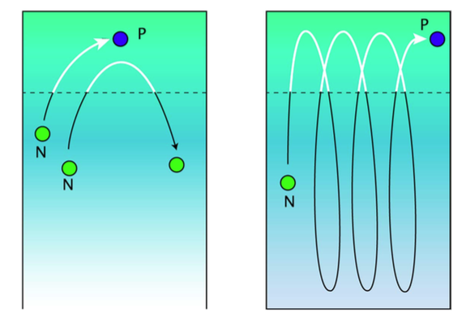
Critical turbulence theory
Observational data often show phytoplankton bloom before the mixed layer shoals.
Can phytoplankton bloom occur with a deep mixed layer?
Weak mixing
Strong mixing
Euphotic
layer
If the mixed layer turbulence weakens, it is possible for some water parcel to remain in the euphotic layer long enough to trigger a bloom
Mixed
layer
Kida and Ito (2017)

Slide 45
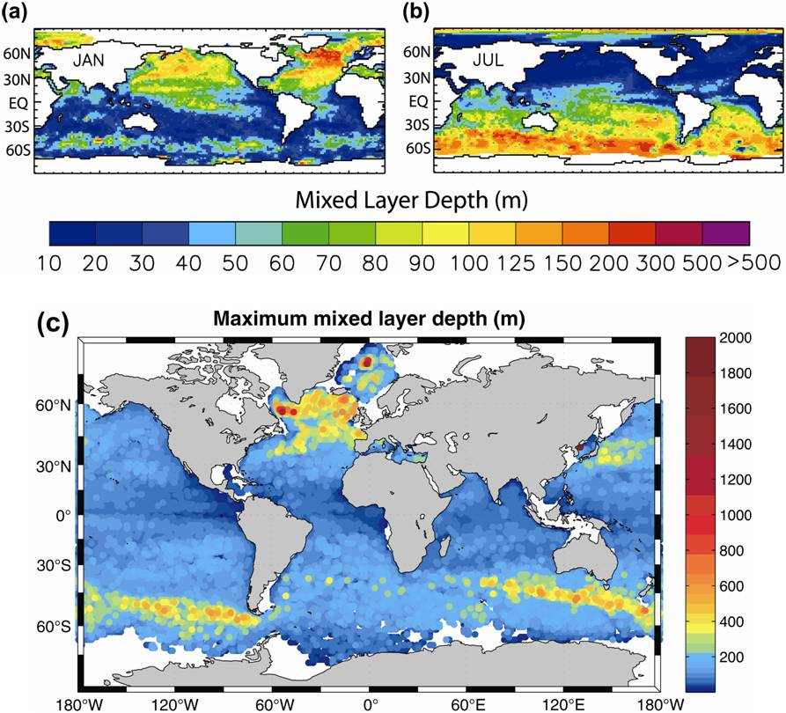
Seasonality of the surface mixed layer
NH winter
NH summer
Notes:
Ended here

Slide 46
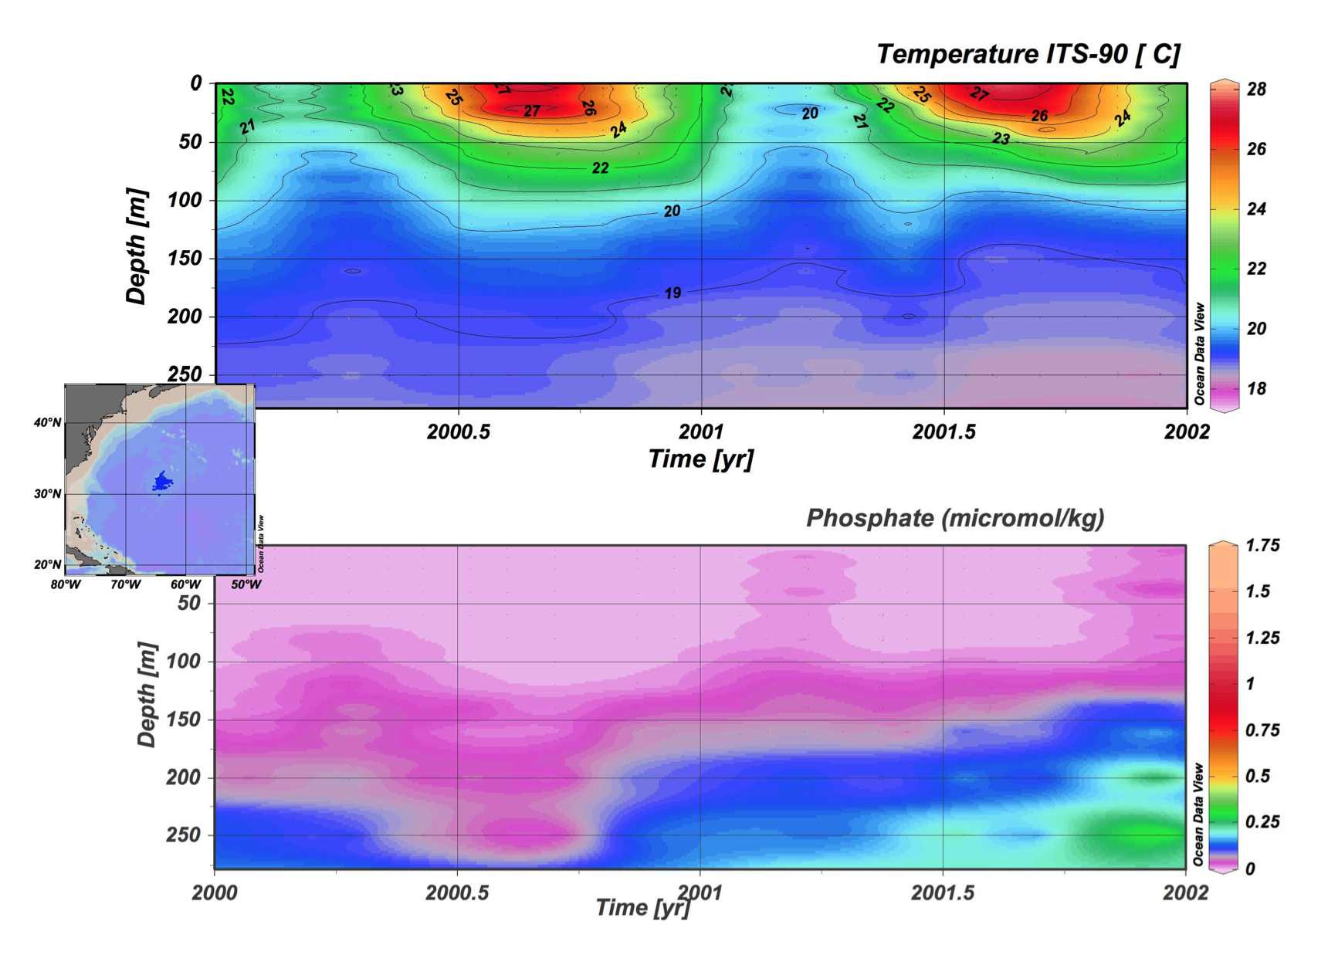

Slide 47
Seasonal progression
Nutrient limitation
Light limitation

Slide 48
Large scale distribution of nutrients
Vertical gradient
  Surface water is generally depleted with nutrients (uptake)
  Deep water is enriched in nutrients (remineralization/respiration)
Horizontal gradient
  Relatively new deep water (e.g. NADW) contains less nutrient
  Relatively old deep water (e.g. NPDW) contains high nutrient

Slide 49
Subpolar productivity
Strong seasonality
  Spring/summer blooms
Light limited
  Upper ocean stratification regulates productivity
    Spring/summer shoaling of the mixed layer
    Wind-induced mixing (prefers weak wind)

Slide 50
Subtropical productivity
Relatively weak seasonality
Macro-nutrient (N,P) limited
  Upwelling supply of nutrient regulates productivity
    Winter-time deepening of mixed layer
    Wind-induced mixing (tropical storm, episodic wind events etc)
    Ocean eddies induce episodic upwelling events

Slide 51
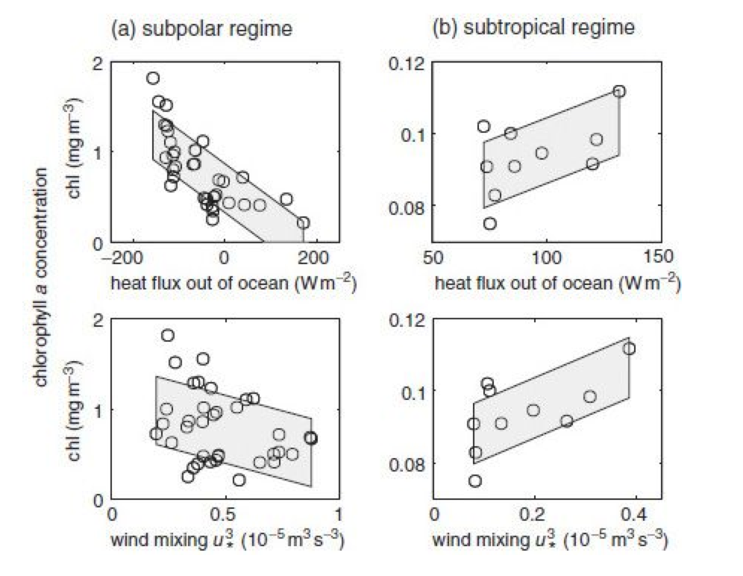
Subtropical vs subpolar productivity

Slide 52
GPP, NPP and NCP
GPP (Gross Primary Production)
  Total amount of photosynthesis
NPP (Net Primary Production) = GPP – Ra
  Ra is the autotrophic respiration
  Subtract plant respiration
NCP (Net Community Productin) = NPP – Rh
  Rh is the heterotrophic respiration
  This is the total amount of biological C fixation

Slide 53
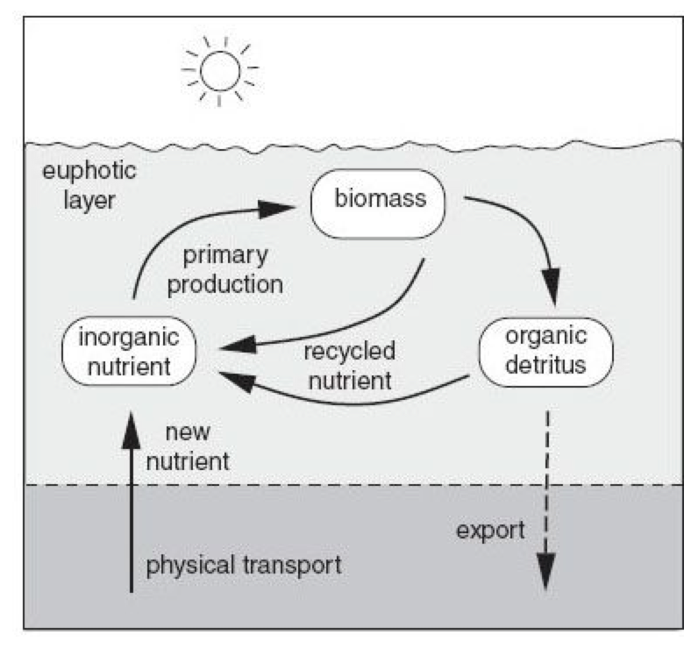
GPP, NPP and NCP
NPP
Upwelling of nutrient
NCP ~ biological C fixation

Slide 54
Observing ocean productivity
Ship-based, in-situ measurements
  Carbon-14 (¹⁴C) incubation
  Nutrient mass balance
  Oxygen mass balance
Satellite ocean color data
Marine particles

Slide 55
Ship-based, in-situ measurement of biological productivity
C-14 incubation experiment
  Steeman-Nielsen (1952)
  Most of C atom has the atomic mass of 12
  C-14 is radioactive → a marker to track the flow of C
  Add radiocarbon to the bottle containing water sample
  During photosynthesis, carbon is assimilated into the organic matter

Slide 56
Ship-based, in-situ measurement of biological productivity
Is C-14 measuring gross or net primary productivity?
  Strong photosynthesis during day
  Weak photosynthesis / respiration at night → 12 hour incubation under light → 12 hour incubation in dark
  Total 24 hours (light+dark) C-14 incubation ~ NPP per day
  Remember NPP = GPP – Ra
  Ra (autotrophic respiration = phytoplankton respiration)

Slide 57
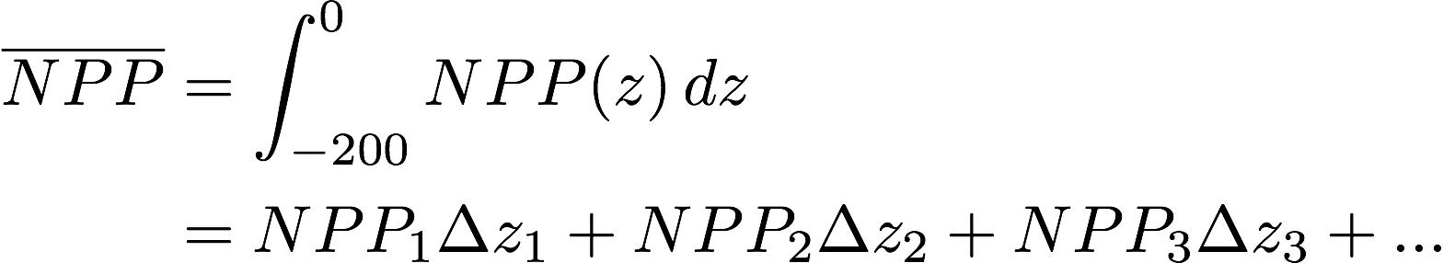
HW: calculating NPP
NPP (mgC/m³) can be measured at each standard depths (5m, 25m, 45m, 75m, 100m, 125m, 150m, 175m).
We want to know the vertically integrated NPP per unit area for the water column (gC/m²/day).

Slide 58
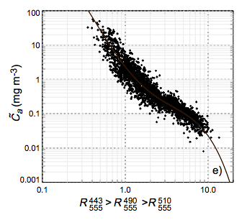

Measuring chlorophyll from space
Remote sensing reflectance (λ) = the ratio between reflected and incident solar radiation (normalized for solar angle, sun-earth distance, and atmospheric absorption)
SeaWiFS sensors (412, 443, 490, 510, 555, 670, 765, 865nm wave lengths)
  Standard algorithm for SeaWiFS is chl_oc4
O’Reilly et al., (2000)

Slide 59
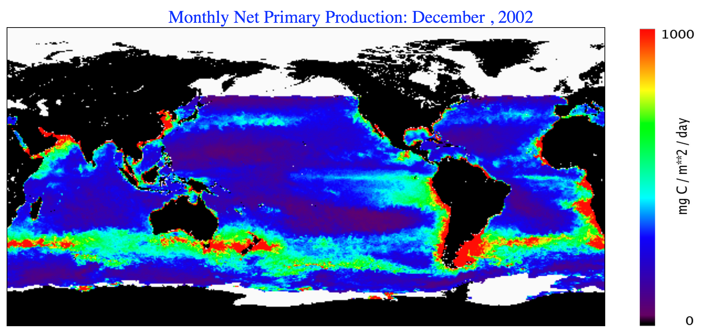
From chlorophyll to NPP
Chlorophyll-based satellite estimate (Behrenfeld and Falkowski 1997)
  Photosynthsis = function of chlorophyll, available light and SST
  Chl → a proxy for biomass
  SST → a factor controlling the growth rate

Slide 60
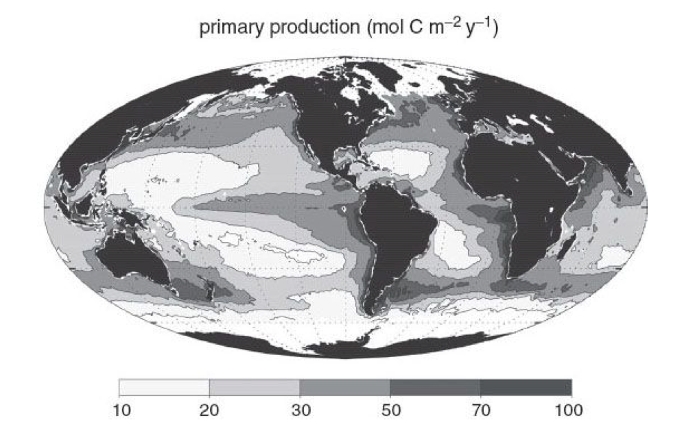
Global, satellite based map of NPP

Slide 61
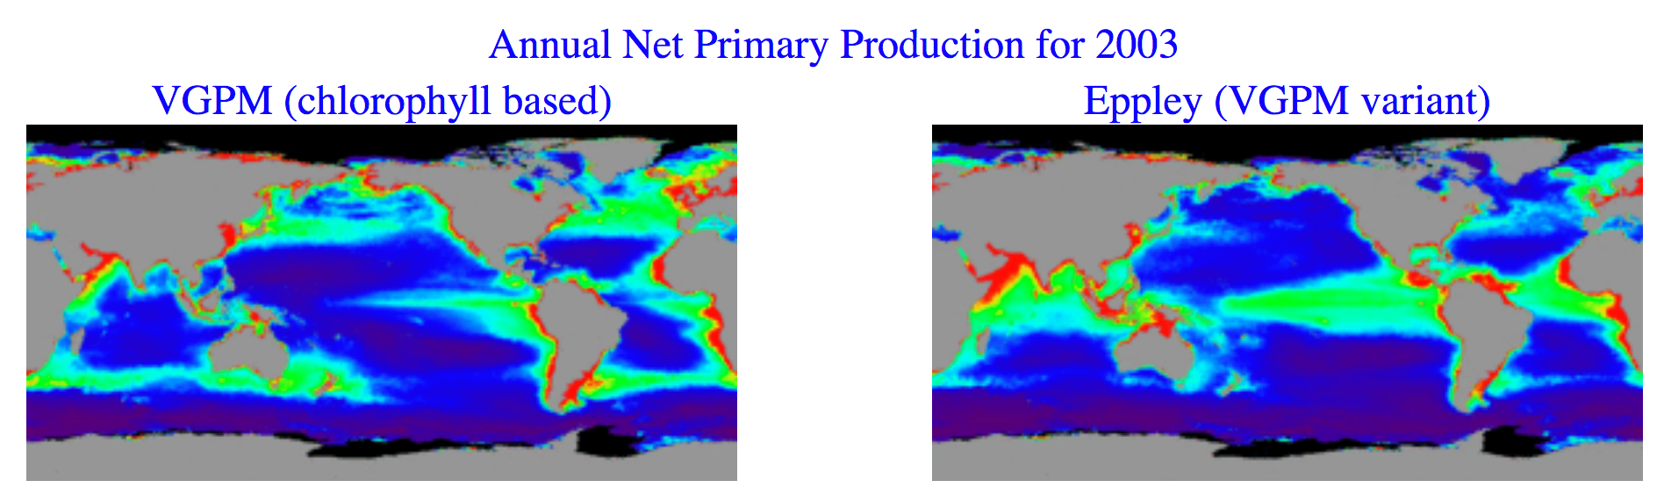
Issues with satellite-based productivity
Many models exist relating chlorophyll and NPP
  Note: satellite productivity is NOT observation!
  These models are calibrated fit to observed NPP (i.e. C-14 incubation data)
  Regional adaptations are often necessary
OSU Ocean Productivity products

Slide 62
Nitrogen mass balance
Different forms of nitrogen available for phytoplankton
  Urea and ammonium (NH₄) are produced by the decomposition of organic matter. They are readily available for uptake, therefore strongly depleted
  Nitrate (NO₃) is often depleted in the surface, but enriched at depths
Recycled N supply = Urea and NH₄
Upwelling “new” N supply ~ NO₃

Slide 63
“New” and “Recycled” production
Nitrogen source
  Recycled production uses Urea and NH₄ supplied by the decomposition of organic matter within the surface mixed layer
  New production uses NO₃ supplied by the entrainment or upwelling from thermocline
  Considering the vertical N mass balance, New production is approximately equal to Export production and NCP

Slide 64
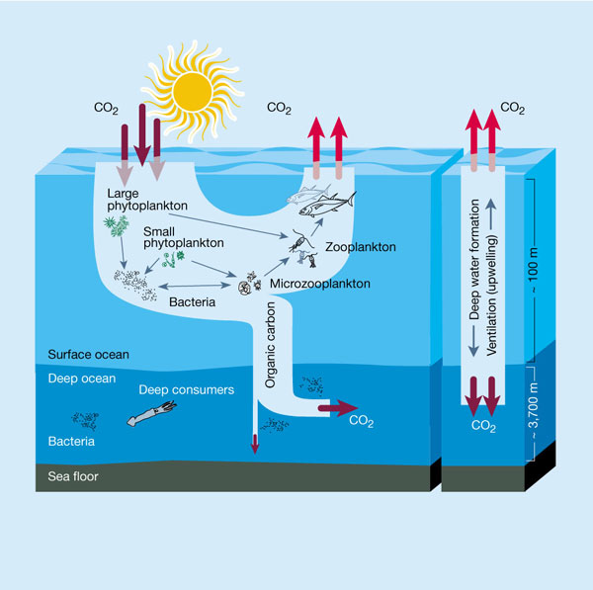
Nutrient and carbon cycling
Chisholm (2000)
Global marine NPP ~ 50 PgC/year
Global average e Ratio ~ 0.3
Export production ~ 50 x 0.3 = 15 PgC/year
Recycled production ~ 50 – 15 = 35 PgC/year

Slide 65
Vertical profile of sinking particles
Composition of sinking particle
(Sinking particle) = (Organic matter) + (mineral particles)
Globally, about 6% of sinking C out of euphotic layer is CaCO₃ (the rest is organic C).
Also globally, the ratio of Si:CaCO₃ is about 2:1 (Sarmiento et al., 2002)
Attenuation of sinking particle
Approximately only 5% of particle remains at 1000m depth
“Martin curve”

Slide 66

Measuring marine particles by sediment traps
Sediment trap
= Rain gauge like instrument that captures falling particles in the water

Slide 67

Sinking organic matter
Burd and Jackson (2009)
Larger particle sinks faster
Aggregation: physical and biological processes that transfers material to a larger particles.
Fragmentation: physical and biological processes that breaks apart particles into smaller sizes.
e Ratio measures the fraction of NPP that is exported across the base of euphotic zone

Slide 68

Particle size spectrum
Jackson et al., (1997)
Burd and Jackson (2009)
The abundance of particle as a function of size (diameter)
There are much more smaller particle than larger ones. Observations show power law relationship.

Slide 69

Respiration at depth
As measured by O₂ in dark bottles of water samples at depth

Slide 70
Large scale distribution of nutrients
Vertical gradient
  Surface water is generally depleted with nutrients (uptake)
  Deep water is enriched in nutrients (remineralization/respiration)
Horizontal gradient
  Relatively new deep water (e.g. NADW) contains less nutrient
  Relatively old deep water (e.g. NPDW) contains high nutrient

Slide 71

Nitrate
NADW
NPDW
Phosphate
NADW
NPDW

Slide 72

Contrasting different nutrient cycling

Slide 73
Redfield ratio
When organic matter decomposes in the deep water, it releases inorganic nutrient and carbon dioxide to the deep water.

Slide 74

N*: decoupling between N and P
N* = NO₃ – 16*PO₄ + const.
Sarmiento and Gruber 2006

Slide 75
N*: decoupling between N and P
N* > 0 : net N input (N-fix > denitrif)
N* < 0 : net N output (N-fix < denitrif)
Sarmiento and Gruber 2006

Slide 76
Pattern of global ocean productivity
SeaWiFS-based productivity estimates (Behrenfeld and Falkowski 1997)
June 2004
High productivity: high latitudes (summer hemisphere), tropics, coastal regions
Low productivity: subtropics, high latitudes (winter hemisphere)
Compare North Atlantic and North Pacific.

Slide 77
Micro-nutrient
Phytoplankton also needs trace elements such as iron as necessary nutrients
  Sources/sinks of iron in the oceans are not fully understood
  Iron can be released from mineral dust depositing in the surface ocean
  Other sources include continental shelf sediment and hydrothermal sources
  Iron in oxygenated seawater forms Fe-oxides and sink out from the water column (Precipitation)
  Iron is also particle-reactive, and is absorbed into particles that sink out (Scavenging)
  Dissolved iron concentration is very low (a factor of 1,000 smaller than phosphorus) in the seawater

Slide 78


Fe limitation of marine productivity
Dust deposition to the surface ocean
Surface nitrate concentration highlighting the High-Nutrient-Low-Chlorophyll regions.
(cross) Sites of meso-scale Fe addition experiments
Boyd et al., (2007)

Slide 79

Nutrients in the mineral dust
Mineralogical composition
  Clay (illite, kaolinite)
  Carbonates (calcite, dolomite)
  Phosphates (apatite)
  Fe oxides (hematite, goethite)
What is bioavailable is the water-soluble fraction
(Fe input into the surface water)
= (1) mass of dust deposition
x (2) fraction of total Fe in the dust
x (3) soluble fraction of Fe
TEM images of marine aerosols
Buseck et al., (1999)

Slide 80

Soluble Fe fraction
Mechanisms for mobilization of Fe are not well known
Observed soluble Fe fraction → 0.001% to 90%
In order to satisfy the Fe demand of marine phytoplankton, we need about 0.5% to 2% solubility
Total Fe (yellow)
Soluble Fe (green)

Slide 81


Fe chemistry in the seawater
What happens to the mineral Fe after its deposition over the surface ocean?
  Hydrolysis reactions
  Scavenging onto particles
  Binding with organic ligands
  Photochemical reactions
Boyd and Ellwood (2010) Nat. Geosci.

Slide 82


Large-scale distribution of Fe
Fe
O₂

