Slide 1
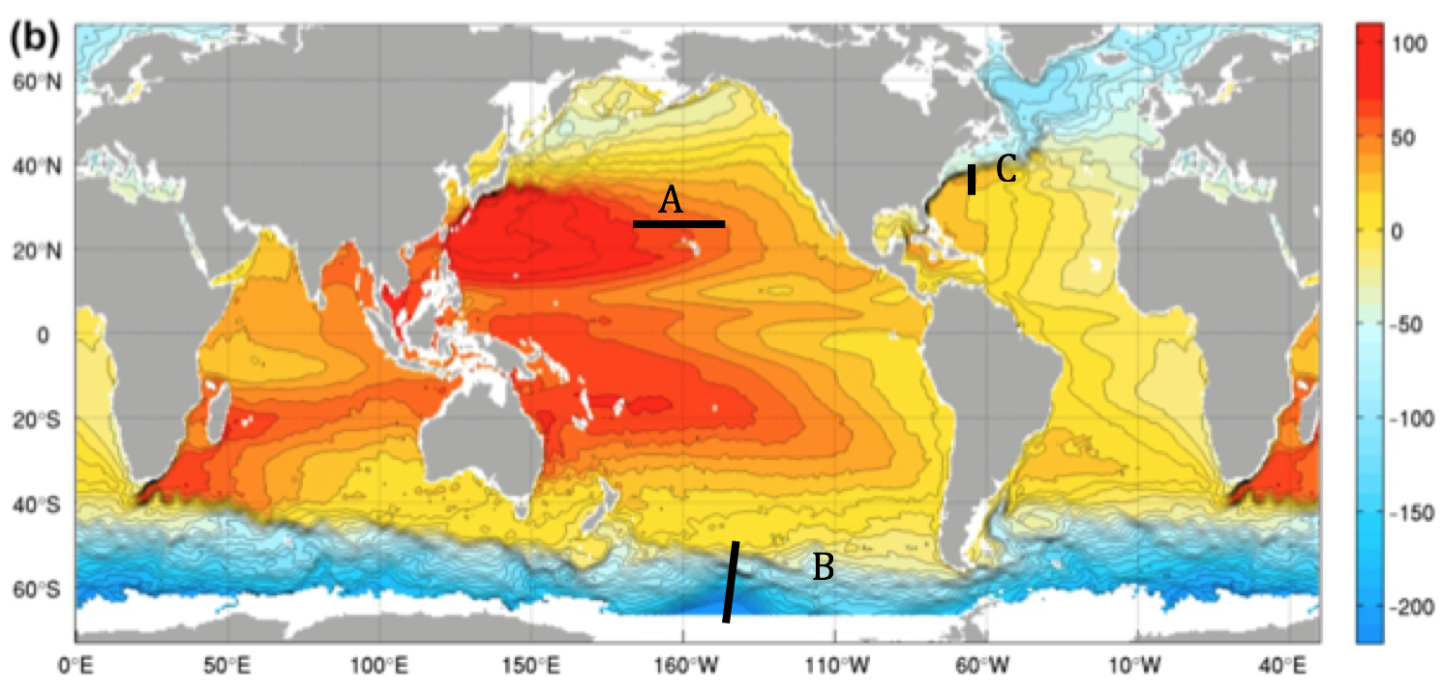
Red = PGF
Blue = Coriolis
Black dash = Geostrophic flow

Slide 2
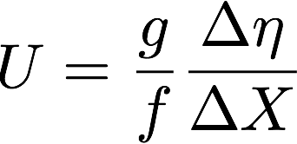
Geostrophic calculation using SSH
Calculate SSH gradient
Calculate Coriolis parameter,
A: Δη = 0.2 (m), ΔX = 3 x 10⁶ (m), f = 0.7 x 10⁻⁴ (s⁻¹), and U = 0.9 x 10⁻² (m/s).
B: Δη = 2 (m), ΔX = 1.5 x 10⁶ (m), f = 1.3 x 10⁻⁴ (s⁻¹), and U = 10 x 10⁻² (m/s).
C: Δη = 1 (m), ΔX = 0.7 x 10⁶ (m), f = 1 x 10⁻⁴ (s⁻¹), and U = 14 x 10⁻² (m/s).

Slide 3
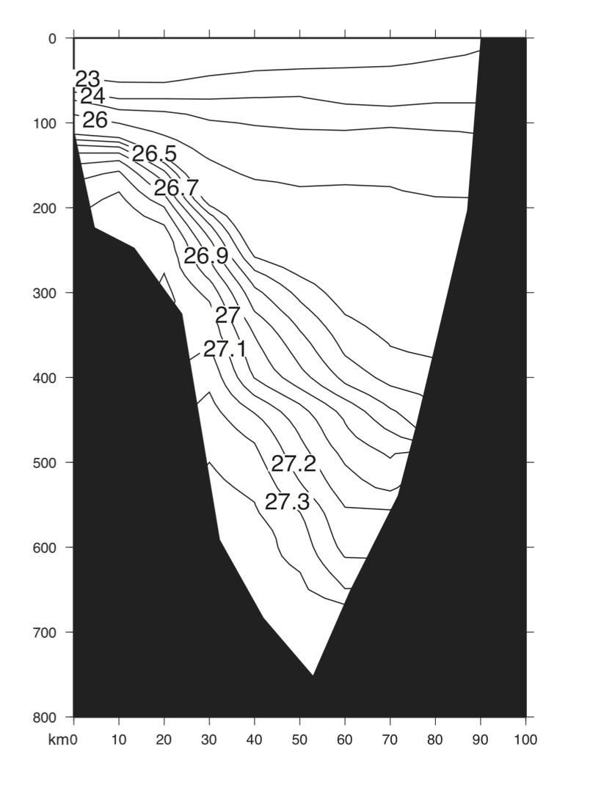
Florida (west)
The Bahamas (east)

Slide 4
H
L
Florida (west)
The Bahamas (east)
More dense
Less dense

Slide 5
H
L
Florida (west)
The Bahamas (east)
PGF
Coriolis
More dense
Less dense

Slide 6
H
L
Florida (west)
The Bahamas (east)
PGF
Coriolis
More dense
Less dense

