Slide 1
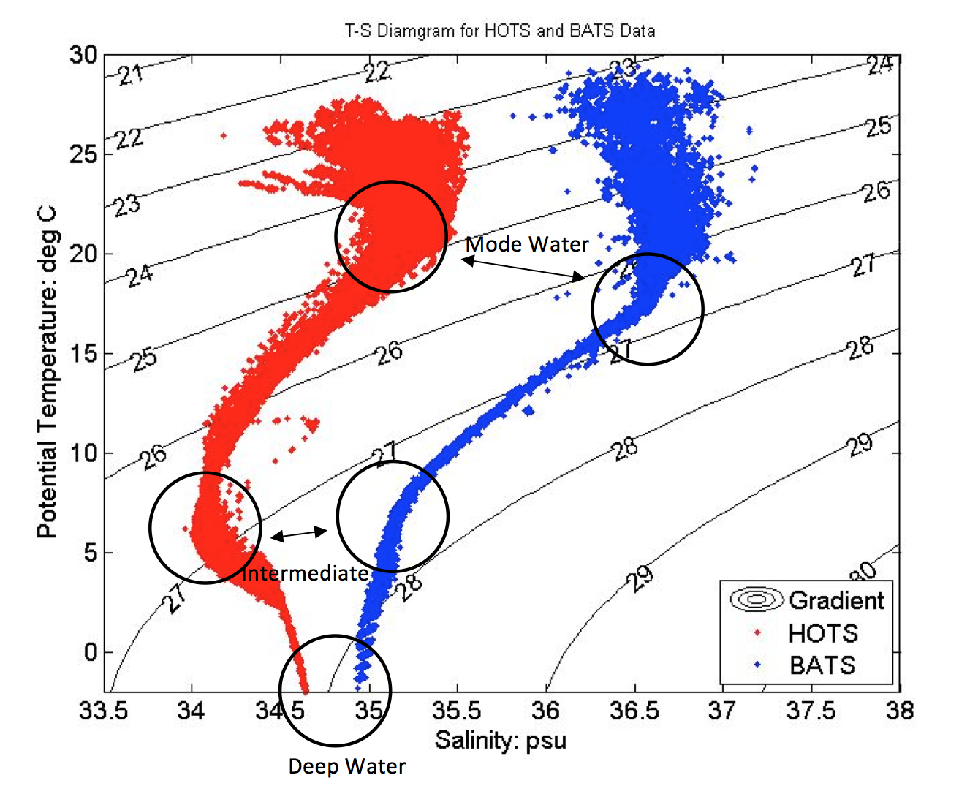
HW #2
Grading guidelines
T-S diagram has salinity as X-axis, temperature as Y-axis
Axes should be labeled.
Density contours should include contour label to indicate its value.
Plot should include HOT (BATS is optional since HW1 and it is not required).

Slide 2
Mode water
Mode = most frequently observed value
In BATS data, the mode of temperature sample is 18 degree C = Mode Water

